Slide 1
PRAGMA – 9
V.S.S.Sastry
School of Physics
University of Hyderabad
22nd October, 2005

Slide 2
Parallel Algorithms for Markov Chain
Monte Carlo Sampling Methods in Statistical Physics

Slide 3
Outline of the Presentation
Monte Carlo Sampling in Statistical Physics
Generalization to Parallel Algorithms
Non-Boltzmann Sampling: Relative Merits
Issues of Parallelization: Domain Decomposition

Slide 4
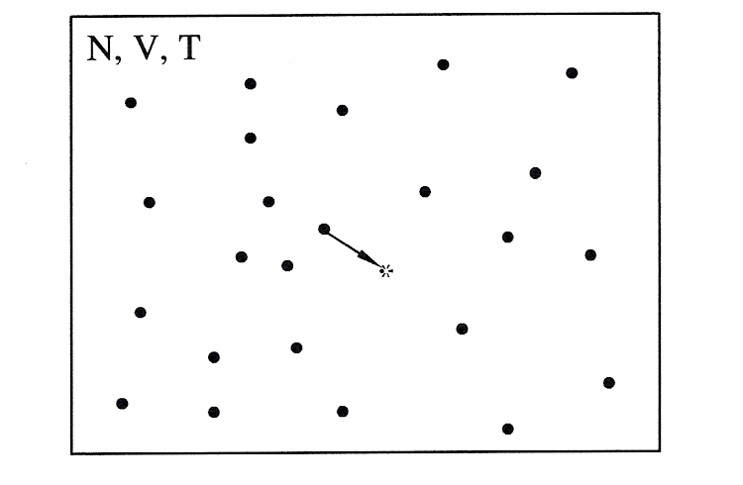
Microstate in a canonical ensemble

Slide 5
Measuring process in macro-systems
Macroscopic measuring processes take finite time.
During this process the system goes through a succession of a very large number of microstates.
Any measured property is, hence, its time average of over the trajectory in the appropriate state variable space (phase space for physicists).
In thermal equilibrium, this time average is equal to (under the so-called ergodic conditions) an equivalent average over a suitably constructed (Boltzmann) ensemble of systems.
Monte Carlo simulations are concerned with estimating averages of different physical properties over such equilibrium ensembles.

Slide 6
Central Issue in Monte Carlo Application
Curiously, a system in thermal equilibrium (fixed temperature, Boltzmann ensemble) moves overwhelmingly only in a limited volume of phase space.
Averages of variables computed based on simple Monte Carlo integration methods, on the other hand, span the entire phase space. This is very cumbersome and prohibitively expensive.
Importance sampling techniques focus on guiding Monte Carlo steps so as to limit them only in the preponderant region of phase space (region of importance). This improves significantly the efficiency of making the estimates.

Slide 7
Use of Metropolis algorithm
Metropolis algorithm makes the system hop from one microstate to another (random walk in phase space), but with a preference to stay in the region of importance.
It is based on conservation laws of the probability flow in phase space (microscopic detailed balance).
Observable features are extracted by averaging them over microstates collected in the regions of importance.

Slide 8

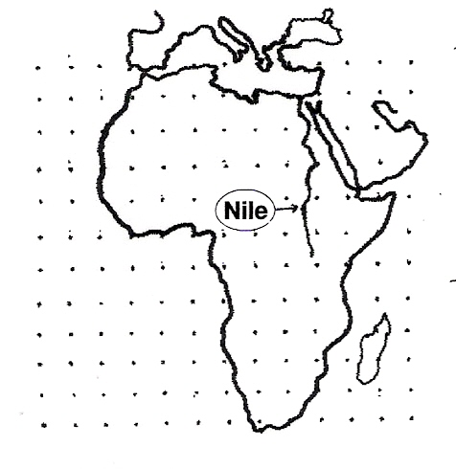
Illustration of importance sampling
(Courtesy : Lecture Notes on
Computational Soft Matter by D. Frenkel, 2004)

Slide 9
Need for Parallel Simulations
Two factors make the single-processor (serial) computations even with Metropolis algorithm tedious:
  Need to work with bigger systems for reliable results.
  Necessity for large number of MC steps needed for valid averages.
Solution:
  Make simultaneous, but statistically independent, parallel random walks within the importance region.
  Combine the data for final averaging.
The algorithm for parallelizing the above scheme is conceptually simple (referred to as embarrassingly simple by professionals!). It requires parallel streams of pseudo-random numbers which are statistically independent.

Slide 10
Case for a non-Boltzmann ensemble
Canonical ensemble is the Boltzmann ensemble. Here, the microscopic states are distributed according to the Boltzmann law: P(E) α exp[-E/k_{B}T] (at a fixed temperature).
Monte Carlo simulations requiring a high degree of temperature resolution necessitate repetitive canonical simulations at very many temperatures. This is a very tedious effort.
The solution lies in collecting all the possible microscopic configurations, (say, uniformly distributed with energy), as an ensemble Ж which is naturally non-Boltzmann in nature.
Any Boltzmann ensemble, corresponding to a chosen fixed temperature, can then be extracted from Ж, by a suitable mathematical process, called reweighting technique.

Slide 11
Non-Boltzmann Ensemble: A Superior Technique
Unique Features:
A computationally efficient strategy.
High resolution data of relevant variables result.
Even quasi-ergodic systems can be dealt with.
Important fall-out on computational strategy:
Independent parallel random walks over the phase space are not suitable.
Whatever parallelizing scheme is adopted, the evolution of the system can not break the Markov chain, and will have to be wholly within a single random walk.

Slide 12
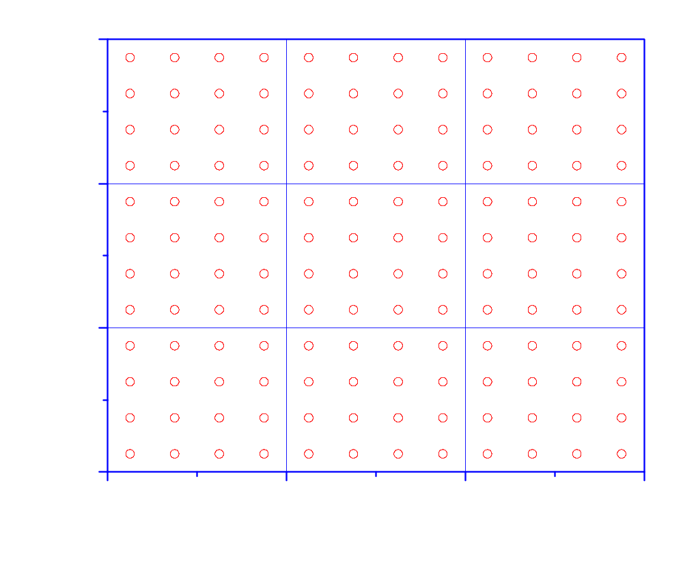
Domain decomposition in physical space
[ Figure demonstrates a Lattice-model ]

Slide 13
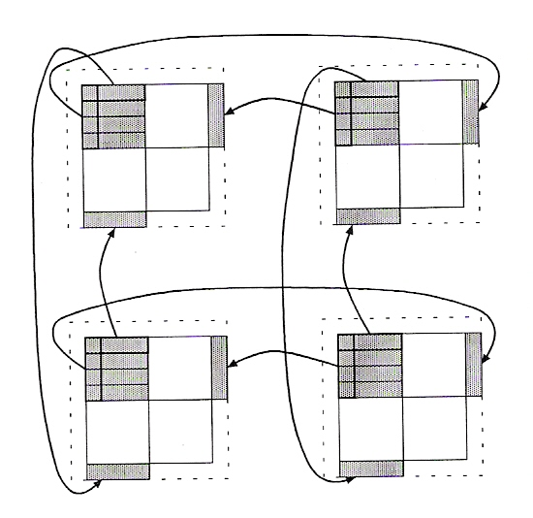

Slide 14
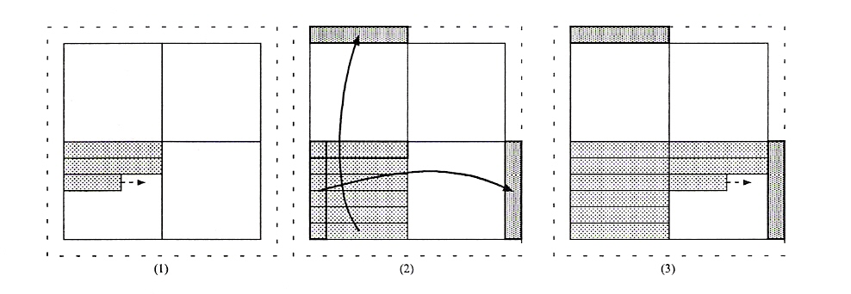

Slide 15
Application of Domain Decomposition Scheme
(Canonical Ensemble : Zannoni et. al., 2003)
Simulation of a phase transition in a liquid crystal:
  [NVT] ensemble with T as the control parameter
  Large system (128x128 lattice) with domain decomposition scheme
  Maximum number of processors employed: 96
  Model Hamiltonian : Prototype lattice model due to Lebwohl-Lasher
Objective:
  Demonstration of the domain decomposition scheme with unbroken Markov chain during a single random walk (on a lattice), while parallelizing the code.
  Examination of the scalability with different processors.

Slide 16
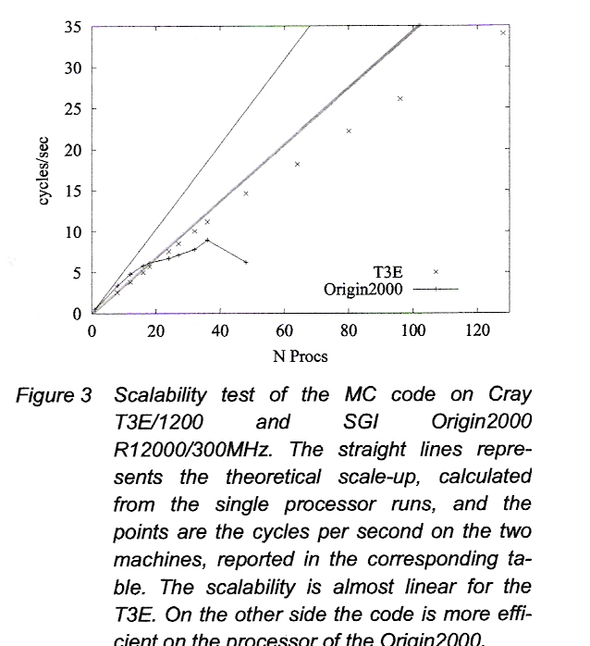

Slide 17
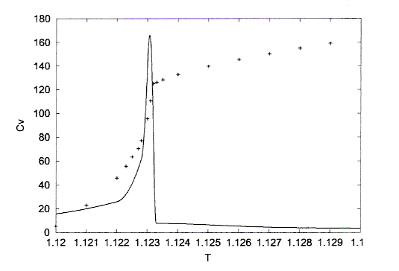
Dependence of physical parameters with temperature
[ 2-d liquid crystal: 128x128 ; I-N transition ]
(Zannoni et. al., 2001)

Slide 18
New Applications of Parallel Algorithms
Based on Domain Decomposition
Implementation of non-Boltzmann ensemble methods on large systems with continuous degrees of freedom (complex fluids).
Estimation of density states in multi-parameter space, so as to facilitate construction of complex phase diagrams.
Extension to off-lattice models which permit displacement of parts of the sub-system across the domain boundaries.

Slide 19
        Team Members
        D. Jayasri
        G. Saipreethi
        T. Niranjan
        Arun Agarwal
        V.S.S. Sastry

Slide 20
Thank you for your kind attention!

