Slide 1
PRAGMA9 – Demo
Bioinformatics applications inside Gfarm using meta-scheduler (CSF) and local schedulers (LSF/SGE/etc)
Dr. Xiaohui Wei, JLU, China
Dr. Wilfred W. Li, UCSD, USA
Dr. Osamu Tatebe, AIST, Japan

Slide 2
Motivations
To integrate CSF4, local job schedulers with Gfarm
  To provide a grid test bed for data-intensive applications, like iGap etc.
To support a GT4 and GT2 mixed Grid Env
  The WSRF based GT4 is released in April, 2005
  GT2 is still popular, most clusters in SDSC are using GT2 and SGE 5.3
To integrate CSF4 with different local job schedulers – LSF, SGE, PBS, Condor etc
  CSF4 is a WSRF based meta-scheduler
  Different sites use different local schedulers, LSF/SGE/PBS etc

Slide 3
Community Scheduler Framework 4.0 – CSF4
What is CSF
  Full name: Community Scheduler Framework
  CSF is a meta-scheduler working at grid level
  The first version of CSF, CSF3, was developed based on GT3-OGSI, contributed by Platform (a CA software company/LSF)
  CSF4 is the GT4-WSRF compliant version of CSF, which is a contribution component of GT4
  CSF is an open source project and can be accessed at http://sourceforge.net (the cvs mainline code is csf4)
  The development team of CSF4 is from Jilin University

Slide 4
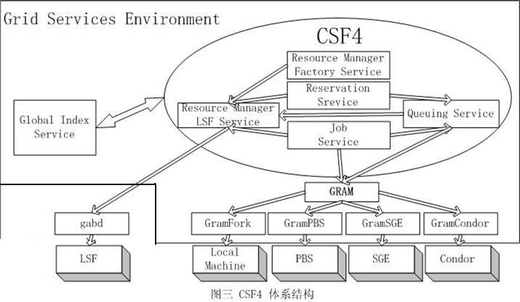
CSF4 – Architecture

Slide 5
Meta-scheduler vs Local Resource Manger
Meta-scheduler
  In a Grid-computing environment, there is a common requirement for users to query, negotiate access and manage resources existing within different administrative domains at Grid level. The meta-scheduler is designed to perform such global wide policies.
Local scheduler
  Typically local Resource Management software (RM) like LSF, PBS, and Sun Grid Engine is responsible for load balancing and resource sharing polices within a local administrative domain.

Slide 6
The Grid Test Bed Overview
Remote cluster on rocks-52
Pre-WS-GRAM
GT2: Gatekeeper
CSF4
SGE5.3
Fork
Local cluster on rocks-110
WS-GRAM
GT4: WSRF
gabd
Pre-WS-GRAM
GT2: Gatekeeper
Remote cluster on rocks-110
Rocks-110.sdsc.edu
Rocks-32.sdsc.edu
SGE6
Fork
LSF6
LSF
SGE5.3
Fork
Local cluster on rocks-110
Remote cluster on rocks-32/rocks-52

Slide 7
Demo Environment Setup
Set up GT4/CSF4 at rocks-110(frontend)
Set up SGE6.0u4 at rocks-110 cluster and SGE6.0 adapter for GT4 – developed by adapter developed by London e-Science Centre (http://www.gridwisetech.com/content/view/11/14/lang,en/)
Set up GT2 at rocks-32 cluster
Set up SGE5.3 at rocks-32 cluster and SGE adapter for GT2
Set up Gfarm1.2 on both rocks-32 and rocks-110 clusters
Set up LSF6.0 on both rocks-32 and rocks-110 clusters

Slide 8
To Support Full Delegation for GT2 Gatekeeper
Java CoG Kit supports full delegation
  The class org.globus.gram.GramJob
  is provided to represent a simple gram job
  This class supports full delegation.
Let CSF4 use Java CoG Kit instead of Gatekeeper client library to contact with GT2 Gatekeeper service

Slide 9
CSF4 configuration examples
Configuration for CSF Resource Manager
(resourcemanager-config.xml)
<cluster>
<name> gatekeeper32 </name>
<type> GRAM </type>
<host> rocks-32.sdsc.edu/jobmanager-fork </host>
<port> 2119</port>
<version>2.4</version>
</cluster>
<cluster>
<name> sge32 </name>
<type> GRAM </type>
<host> rocks-32.sdsc.edu/jobmanager-sge </host>
<port> 2119</port>
<version>2.4</version>
</cluster>

Slide 10
CSF4 configuration examples(cont.)
<cluster>
<name> sge52 </name>
<type> GRAM </type>
<host> rocks-52.sdsc.edu/jobmanager-sge </host>
<port> 2119</port>
<version>2.4</version>
</cluster>
<cluster>
<name> demo_lsf_cluster1 </name>
<type> LSF </type>
<host> rocks-32.sdsc.edu </host>
<port> 1966</port>
<version>6.0</version>
</cluster>

Slide 11
Demos
Demo 1 – Query available clusters to CSF
Demo 2 – Run a Gfarm job access gfarm file system in remote SGE5.3

Slide 12
CSF4 – Demo1
Demo1
Get all cluster information available
$ csf-job-RmInfo

Slide 13
CSF4 – Demo2(PRAGMA)
Run a Gfarm job in remote SGE5.3 (rocks-52)
$ csf-job-create –rsl test_gfarm.rsl –name job6
$ csf-job-start job6 –Rh https://198.202.88.110:8443/wsrf/services/metascheduler/ResourceManagerFactoryService –c sge52
$ gfls wublast.out
$ cat /gfarm/zding/wublast.out

Slide 14
CSF4 – Demo2+
Run a Gfarm job in remote SGE5.3 (rocks-32)
$ csf-job-create –rsl test_gfarm.rsl –name job5
$ csf-job-start job5 –Rh https://198.202.88.110:8443/wsrf/services/metascheduler/ResourceManagerFactoryService –c sge32
$ gfls wublast.out
$ cat /gfarm/zding/wublast.out
[zding@rocks-32 zding]$ cat test.out | grep "At:"
  At: rocks-34.sdsc.edu
  At: rocks-36.sdsc.edu
  At: rocks-34.sdsc.edu

