Slide 1
Flexible, robust, and efficient multiscale QM/MD simulation using GridRPC and MPI
Yoshio Tanaka, Hiroshi Takemiya
(National Institute of AIST, Japan)
Shuji Ogata
(Nagoya Institute of Technology, Japan)

Slide 2
Outline
Target simulation
  Atomic Force Microscope Tip Induced Anodic Oxidation
  Multiscale hybrid QM/Classic Simulation
  Behavior and requirements
Implementation
  GridRPC + MPI
  Strategy for the long run
Ongoing experiments
  environments
  live status and demonstration
Summary and future work

Slide 3
Target simulation
- Atomic Force Microscope Tip Induced Anodic Oxidation -

Slide 4
Mechanical and Chemical Reactions with Scanning Probe Microscopy
larger
pressure
smaller
pressure
AFM nano-rubbing
Atomic-scale
friction of MEMS
AFM anodic
oxidation
-
e
adsorption
water
polymer film
on substrate
-
e
aggregation
of molecules
“furrows” (うね)
H-saturated Si
local oxides (SiO₂)
e.g., locally oriented
liquid crystal
(光導波路)
e.g., stick-slip process
e.g., lithography

Slide 5
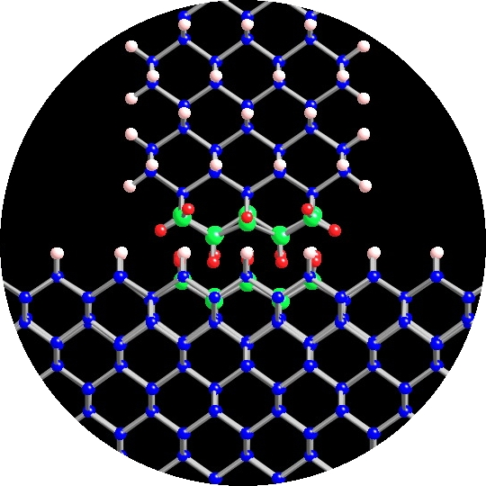
Relations between external strain, microscopic structure, and oxidation
Nanoscale-Tip
under strain
Oxidation at the contact region
1. Atomic-scale
commensuration of
tip and substrate
H-saturated
Si(100)
2. Direction of motion
motion
3. Tip pressure
4. Inserted molecules (humidity)
5. Electron transfer

Slide 6
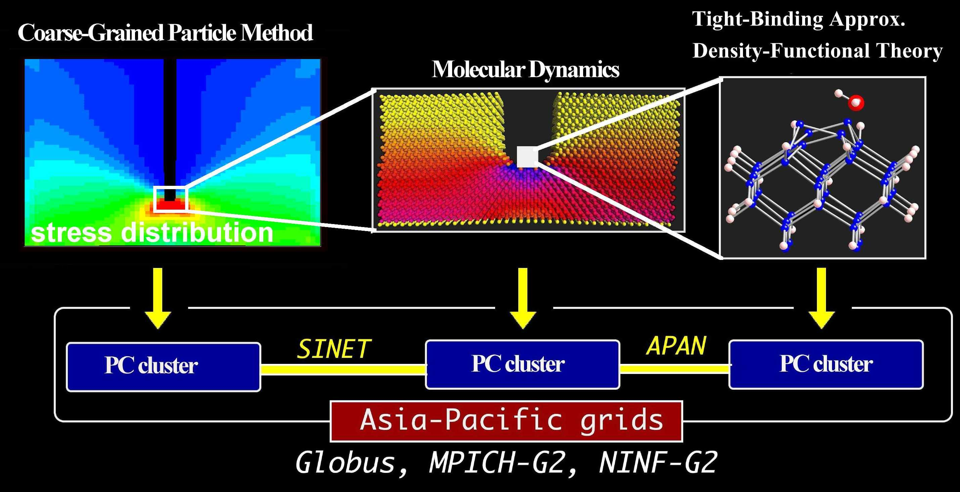
Hybrid QM(DFT)-CL(MD) Simulation Scheme
Hybrid Coarse-Grained-Particles/MD simulation scheme
Hybrid QM(DFT)-CL(MD) simulation scheme
seamless coupling with the buffered-cluster method
adaptive choice of QM-region
Financial supports: ACT-JST (year 2001-2004), JST-CREST(2005-present)

Slide 7
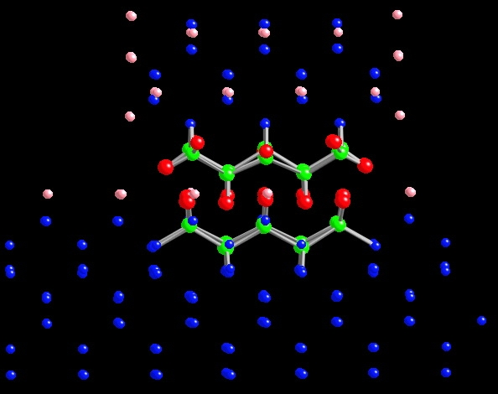
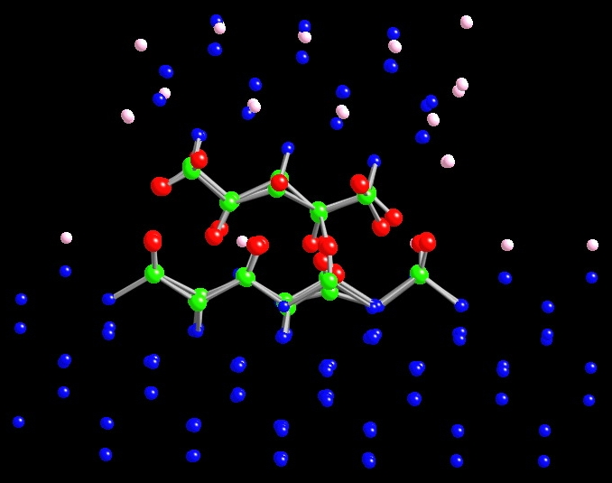
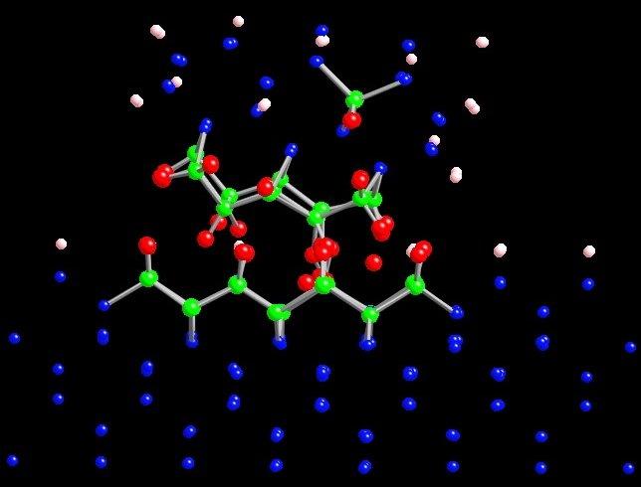
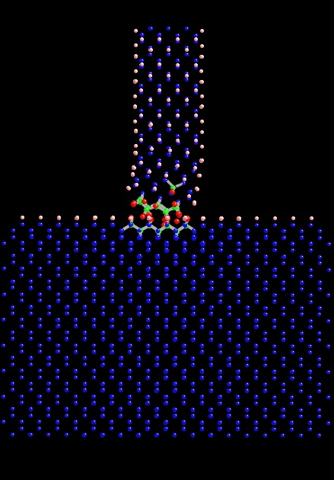
Hybrid QM-CL Simulation Run: Slide direction ⊥ Si-Si dimers
15fs
300fs
QM-Si
CL-Si
QM-H
CL-H
Expansion of
QM region
v=0.009 Å/fs
525fs
525fs
fix
Zoom
out
view
40Å
Detachment of
saturation-H atoms
Formation of
Si-Si bonds between tip and substrate
Detached QM-H atom

Slide 8
Requirements by the simulation
Flexibility
  Adaptive expansion of QM region
    Number of atoms in a QM region may increase or decrease
    Number of QM regions may increase or decrease
Robustness
  Need to continue more than few weeks, few months
  Simulation should be capable of fault recovery
Efficiency
  Compute-intensive QM simulation runs on hundreds of cpus
  Each (independent) QM simulation runs on a different cluster
15fs
300fs
525fs

Slide 9
Implementation
- GridRPC + MPI -
- Strategy for long run -

Slide 10
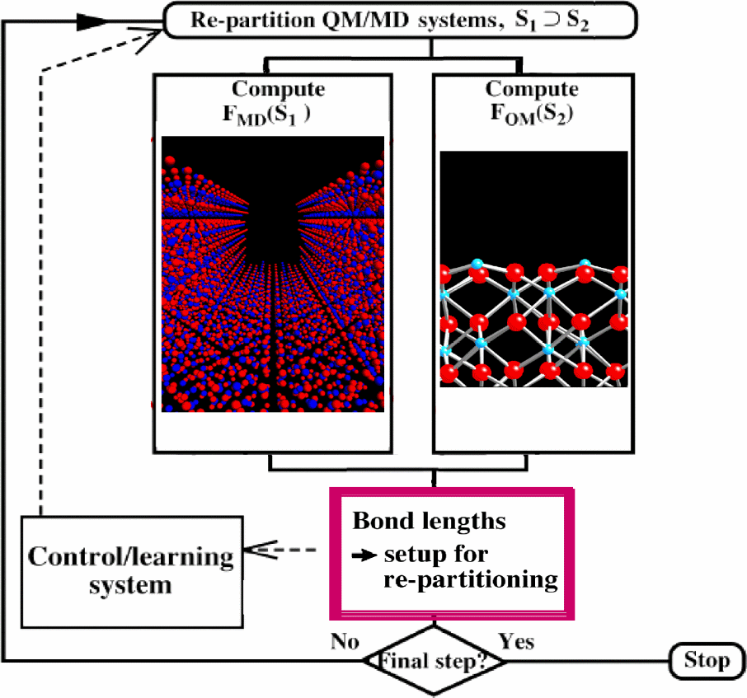
Algorithm and Implementation
Algorithm
Implementation
initial set-up
Calculate MD forces of
QM+MD regions
Data of QM atoms
Calculate QM force
of the QM region
Calculate QM force
of the QM region
Calculate MD forces of QM region
Calculate QM force
of the QM region
MD part
QM forces
QM part
Update atomic positions
and velocities
MPI_MD_WORLD
GridRPC
MPI_QM_WORLD

Slide 11
Does the implementation give solutions for the requirements?
Flexibility
  GridRPC enables dynamic join/leave of QM servers.
  GridRPC enables dynamic expansion of a QM server.
Robustness
  GridRPC detects errors and application can implement a recovery code by itself.
Efficiency
  GridRPC can easily handle multiple clusters.
  Local MPI provides high performance on a cluster by fine grain parallelism.

Slide 12
Strategy for long run
Impossible to run the simulation for few months on fixed clusters.
QM simulation will migrate to the other cluster either by intentionally or unintentionally.
  intentional migration
    Exceeds the maximum runtime for the cluster
    Reservation period has expired
  unintentional migration
    Any error/fault is detected
The next cluster will be selected by either reservation or simple selection algorithm.
  Selection algorithm considers
    number of available cpus
    number of requested cpus
    records of past utilization
Simulation reads a host information file in every time step.
  A cluster can join to/leave from the experiment on-the-fly.

Slide 13
Examples of hosts information
<HOST>
NAME SDSC
ID 2
ADDR rocks-52.sdsc.edu
FROM 2005/4/18/12/30/30
TO 2006/9/18/12/30/30
MAX_AVAIL 86400
CPU_MAX 32
CPU_INIT 32
</HOST>
<HOST>
NAME F32-2
ID 9
ADDR fsvc001.asc.hpcc.jp
FROM 2005/10/7/9/0/0
TO 2006/10/11/12/0/0
MAX_AVAIL 172800
CPU_MAX 128
CPU_INIT 64
</HOST>

Slide 14
Ongoing experiment
- Experimental environments -
- Live status and demonstration -

Slide 15
Experimental Environments (as of Oct. 19)
 | Cluster | Site | Used #CPU | Physical #CPU
1 | F32-2 | AIST | 128 | 136 (2 x 68)
2 | F32-3 | AIST | 128 | 264 (2 x 132)
3 | P32 | AIST | 128 | 256 (2 x 128)
4 | M64 | AIST | 64 | 256 (4 x 64)
5 | ISTBS | U. Tokyo | 128 | 340 (2 x 170)
6 | POOL | Tokushima U. | 32 | 47 (1 x 47)
7 | ALAB | TITECH | 32 | 60 (2 x 30)
8 | Rocks-52 | SDSC | 16 | 120 (4 x 30)
9 | AMATA | KU | 8 | 8 (1 x 12)
10 | ASE | NCHC | 8 | 8 (2 x 8)
11 | UME | AIST | 8 | 8 (2 x 14)
12 | TGC | NCSA | 8 | 8 (4 x 12)
Used #CPU is decided based on
  memory size, busyness, and stability for launching MPI processes

Slide 16
Summary and future work
GridRPC + MPI implements flexible, robust, and high performance Grid applications.
  flexible – allow dynamic resource allocation / migration
  robust – detect errors and recover from faults
  efficient – manage hundreds to thousands of CPUs.
Will have a joint experiment with TeraGrid
  SIMOX (Separation by Implantation of Oxygen) simulation run for more than 1 week on 5 x 128 cpu clusters which are reserved in advance.
Research issues
  Load balancing between QM simulations
  More clever scheduling algorithm
  …

