Slide 1
Australian Partnership for
Advanced Computing
“providing advanced computing, information and
grid infrastructure for eResearch”
Partners:
Australian Centre for Advanced Computing and Communications (ac3) in New South Wales
CSIRO
Queensland Parallel Supercomputing Foundation (QPSF)
iVEC – the Hub of Advanced Computing in Western Australia
South Australian Partnership for Advanced Computing (SAPAC)
The Australian National University (ANU) ACT
The University of Tasmania (TPAC)
Victorian Partnership for Advanced Computing (VPAC)

Slide 2
Australian Partnership for
Advanced Computing
“providing advanced computing, information and
grid infrastructure for eResearch”
APAC 1 (…2000 – 2003…)
  National Facility
  Education, Outreach, Training
APAC 2 (…2004 – 2006…)
  National Facility
  Grid
  Education, Outreach, Training
APAC 3 (…2007 – 2011…)
  National Grid
  National Facility
  Training

Slide 3
APAC’s National Infrastructure Role
Advanced Computing Infrastructure
  peak computing system (‘capability’ computing)
Information Infrastructure
  management of community-based data collections
  large-scale, distributed, nationally significant (reference) data
Grid Infrastructure
  seamless access to the national computing and information infrastructure
    access to federated computing and information systems
  advanced collaborative services for research groups
    collaborative visualisation
    computational steering
    tele-presence
    virtual organisation support
  support Australian participation in international research programs
    eg, astronomy, high-energy physics, earth systems, geosciences

Slide 4
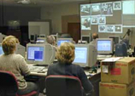
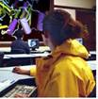
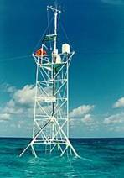
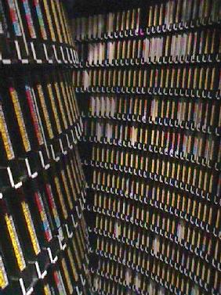
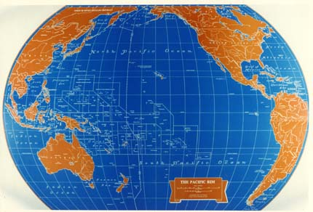
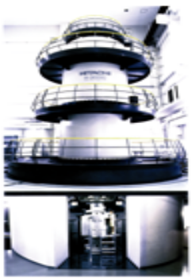
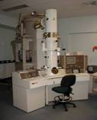
APAC National Grid Services
Research Teams
Data Centres
portals and workflow
distributed computation
federated data access
remote visualisation
collaboration services
Sensor
Networks
Other Grids:
Institutional
National
International
Instruments

Slide 5
APAC National Grid - Status
Systems coverage
  Grid users can access ALL systems in APAC Partnership
  About 4000 processors and 100’s of Terabytes of disk
  More than 3PB of disk cached HSM systems
Institutional and regional coverage
  Resources and team members are supported in all capital cities (+Townsville!)
  Requests for service are spreading to multiple sites in some regions (leading to the need for an affiliate model):
    Clayton in addition to the city in Victoria
    UWA in addition to ARRC in W.A.
    ANSTO and Newcastle in addition to ac3 in NSW
    JCU and UQ as part of QPSF in Queensland

Slide 6
APAC National Grid - Status
Nearing operational status
  some applications close to ‘production’ mode
  not all core services are fully operational everywhere
Undertaking a re-organisation
  Moving out of independent development projects
  Moving towards three layers: user support, middleware deployment team and grid operations centre
Focus on production status of services
  Eg. CA and myproxy at production status, VOMRS soon
  Not all site gateway servers support all services
  Most services/protocols are in stable state on some sites

Slide 7

Starting Point: Projects
Grid Infrastructure
  Computing Infrastructure
    Globus middleware
    certificate authority
    system monitoring and management (grid operation centre)
  Information Infrastructure
    resource broker (SRB)
    metadata management support (Intellectual Property control)
    resource discovery
  User Interfaces and Visualisation Infrastructure
    portals to application software
    workflow engines
    visualisation tools
Grid Applications
  Astronomy
  High-Energy Physics
  Bioinformatics
  Computational Chemistry
  Geosciences
  Earth Systems Science

Slide 8
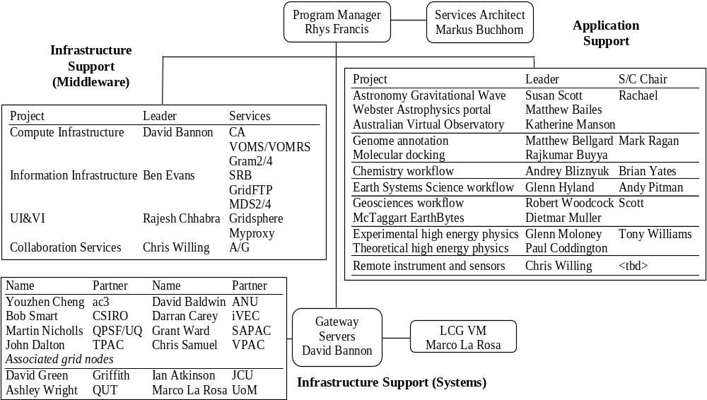
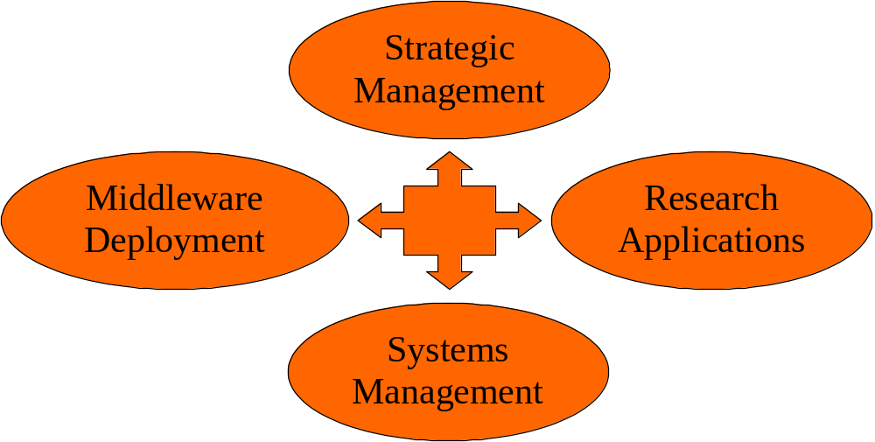
Organisation Chart

Slide 9
Examples of Grid Applications
Earth System Sciences (ESS) – example of community based data access
Geosciences – example of research focussed data access and compute scheduling
High Energy Physics – example of middleware interoperation, data and compute
Basic APAC Grid model
Services available to support applications

Slide 10


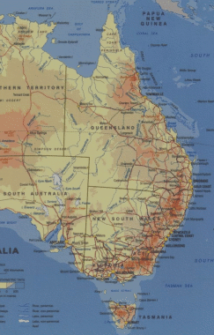
ESS – OPeNDAP Services
APAC NF (Canberra)
International IPCC model results
TPAC 1/8 degree ocean simulations
AC3 Facility (Sydney)
Land surface datasets
Met Bureau Research Centre (Melbourne)
Near real-time LAPS analyses products
Sea- and sub-surface temperature products
CSIRO HPSC (Melbourne)
IPCC CSIRO Mk3 model results
CSIRO Marine Research (Hobart)
Ocean colour products & climatologies
Satellite altimetry data
Sea-surface temperature product
TPAC & ACE CRC (Hobart)
NCEP2, WOCE3 Global, Antarctic AWS, Climate modelling
Sea-ice simulations

Slide 11
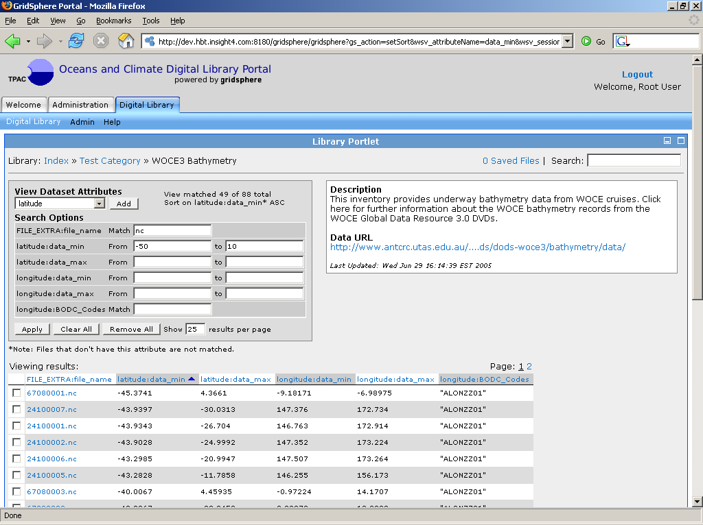

Slide 12
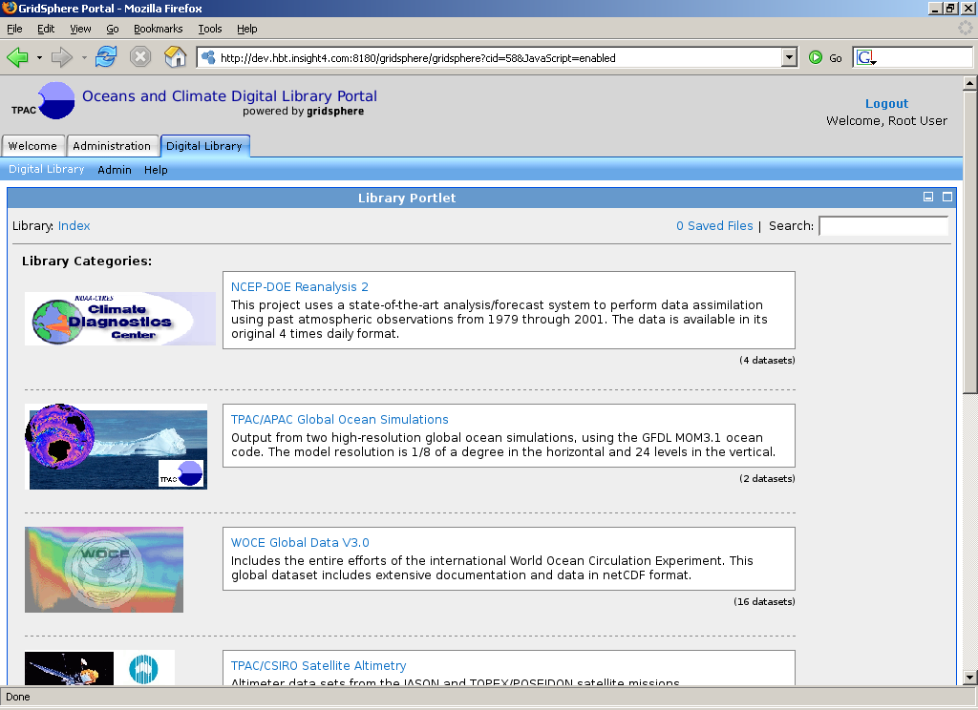
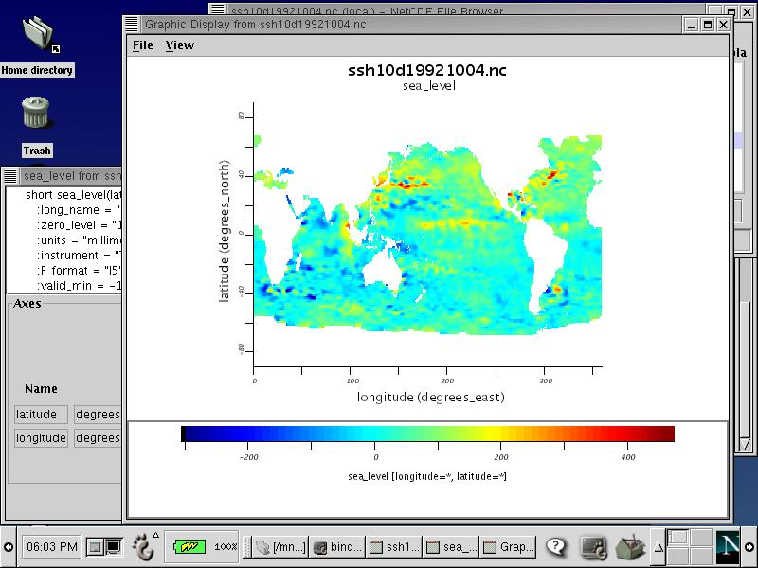
ESS – Workflow Vision
Status
Discovery
Visualisation
Analysis Toolkit
Crawler
Job/Data Management
OPeNDAP
APAC NF
VPAC
AC3
SAPAC
IVEC
Digital Library

Slide 13
ESS – Good News Developments
Australian Bureau of Meteorology keeps its data in MARS
The BoM has decided to build an OPenDAP interface to its MARS storage system
OPeNDAP developers are working with the BoM and APAC Grid to support GSI authentication
We hope to have all available data published into the grid environment

Slide 14
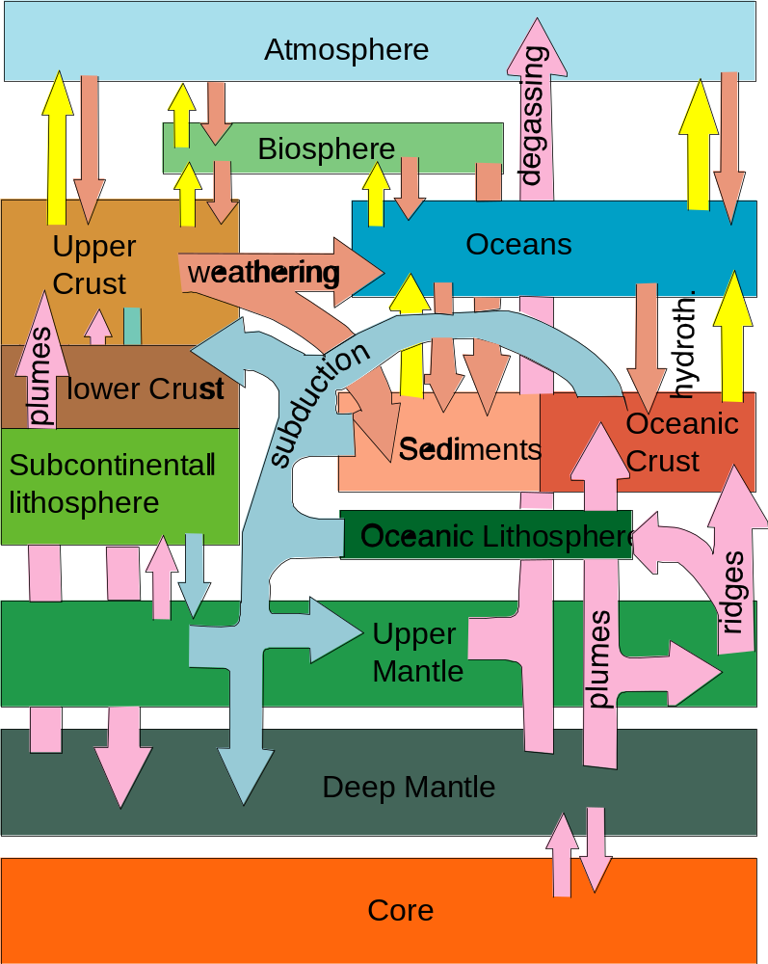
APAC Grid Geoscience
Conceptual models
Databases
Modeling codes
Mesh generators
Visualization packages
People
High Performance Computers
Mass Storage Facilities

Slide 15
Workflows and services
iVEC & HPSC
Sites (SRB)
Status: iVEC site
User
Login
Edit Problem Description
Run Simulation
Job Monitor
Archive Search
Local Repository
Data Management Service
Results Archive
Resource Registry
AAA
Job Management Service
Service Registry
Geology W.A
Rock Prop. W.A
EarthBytes Service
Rock Prop. N.S.W
Snark Service
HPC Repository
Geology S.A
Notes:
LOGIN
Allows user to gain access to the system
User interface to AAA service
Provide functionality to supply username, password & credentials to gain access to system
INTERFACES :
Sends – username, password & credentials
Receives – grid-proxy
STATUS:
Current: Gridsphere portal coupled tightly to myproxy-server, GSI
Next Level: Gridsphere portal accessing AAA service (myproxy-based/GSI) through defined interface
Future: Custom UI accessing AAA service, simplify interfaces
Technical Requirements:
- web server to host gridsphere portlet (IVEC)
- myproxy installed and externally accessible (IVEC?)
- GT(2-4) using pre-ws security installed on APAC node (IVEC?)
LINKS:
- https://www.seegrid.csiro.au/twiki/bin/view/Compsrvices/AuthorisationAuthenticationAccounting
- http://grid.ncsa.uiuc.edu/myproxy/
- http://shibboleth.internet2.edu/shibboleth-documents.html
AAA Service
service that provides authorisation, authentication and auditing for grid users
manages users credentials and grid-proxies
manages user authorisation (permissions)
INTERFACES
Sends: success/failure & grid-proxy to Login portlet
Receives: user credentials and requests for authorisation
STATUS:
Current: GSI using Myproxy-server, tightly coupled to a gridsphere portal (Login portlet)
Future: decoupled AAA service, defined interface, based on shibboleth, SAML, WS-Security??
Technical Requirements:
- myproxy installed and externally accessible
- GT(2-4) using pre-ws security
LINKS:
- https://www.seegrid.csiro.au/twiki/bin/view/Compsrvices/AuthorisationAuthenticationAccounting
- http://grid.ncsa.uiuc.edu/myproxy/
- http://shibboleth.internet2.edu/shibboleth-documents.html
Docs:
- devwed1015_rouault.pdf – brief intro to SAML
- saml-2.0-os.zip – full spec
EDIT PDC
REGISTRYS
A repository is required to store the information about process/service/repository registered in the registry
There will not be just one registry for the Grid, there maybe multiple which will require federating
INTERFACES:
Sends: responses to registry queries (info about resources, services, data & results archives etc)
Receives: queries from user portals and other services
STATUS:
Current: java Registry Service implementation (ebXMLrr), CLRC metadata model mapped to ebRim
Future - ebXML registry server, various metadata models mapped to ebRim, direct access to SRB repositories
Technical Requirements:
- ebXMLrr server installed with repository
- ebXMLrr access Globus, resource metadata repositories and SRB
LINKS:
- https://www.seegrid.csiro.au/twiki/bin/view/Compsrvices/ServiceRegistry
- http://ebxmlrr.sourceforge.net/3.0/index.html
DATABASES
Set of Databases for Geosciences with common interface – Geology, rock properties etc
INTERFACE:
Sends: responses to (spatial) queries from Edit PDC Workflow portal, datasets
Receives: (spatial) queries from Edit PDC portal
STATUS:
Current: Databases are present and use WFS common interfaces and Geoserver open source WFS implementation with SEE Grid extensions , Community defined XML based interchange language (XMML), Demonstrator for Geochemistry implemented and National Roadshow underway need to define common interfaces, Industry take up underway, … going very well.
Future: Registries, more observational databases
Technical Requirements:
- installation of databases on the APAC grid
- APAC grid AAA for Databases
- develop interface for databases so that they “publish” data in same format
Links:
DATA MANAGEMENT SERVICE
Provide facility to search for datasets based on specified metadata
INTERFACES:
Sends: responses to Archive Search queries (metadata about datasets)
Receives: queries from user Archive Search portal
STATUS:
Current: Java Registry Service implementation (ebXMLrr), CLRC metadata model mapped to ebRim
Future - ebXML registry server, various metadata models mapped to ebRim, direct access to SRB repositories
Technical Requirements:
- ebXMLrr server installed with repository
- ebXMLrr access to SRB
LINKS:
- https://www.seegrid.csiro.au/twiki/bin/view/Compsrvices/ServiceRegistry
- http://ebxmlrr.sourceforge.net/3.0/index.html
RESULTS ARCHIVE/ARCHIVE SEARCH
Storage service to archive datasets and results
INTERFACES:
Sends: datasets
Receives: requests and submission of datasets
STATUS:
Current: SRB
FUTURE: Web service interface to query SRB and Registry
AND………………………..
Allows user to search and publish datasets to a repository with accompanying metadata
User and programs able to upload/download datasets
Query registry of archives/results/datasets
INTERFACES:
sends – queries (search), submit metadata
receives – query results, submission confirmation
STATUS:
Current – java client to Registry Service (ebXML), CLRC metadata model mapped to ebRim, ebxmlrr Registry Service and database
Future - gridsphere client to ebXML registry server, Profiles for standard Registers and interfaces ( various metadata models mapped to ebRim)
Technical Requirements:
- web server to host ebXML client gridsphere portlet
- Data management portal/service (ebXML server)
- HPC and metadata Repositories
- FUTURE, ability to use portal to use the retrieved url (SRB url) and download associated dataset directly
LINKS:
- https://www.seegrid.csiro.au/twiki/bin/view/Compsrvices/DataResults
- https://www.seegrid.csiro.au/twiki/bin/view/Compsrvices/DataResultsDesign
- https://www.seegrid.csiro.au/twiki/bin/view/Compsrvices/RyansIntroToEbXML
COMPARING ebXML to other standards – UDDI, MDS, CLRC etc…..
- https://www.seegrid.csiro.au/twiki/pub/Compsrvices/RyansIntroToEbXML/technology_feature_matrix.htm
See documents:
- ebusinessxmlregistry.pdf – good overview of what ebxml is – conceptual
- regrep-rs-3.0-cd-01.pdf – web services specification for ebXML reg
- regrep-rim-3.0-cd-01.pdf – registry information model for ebXML reg
- registryv3.ppt – another good overview of what ebXML is
- ebRimspec3.gif – pretty picture – how the RIM works!

Slide 16
Good News Developments
Project achieved common portal access to Australian exploration data during 2005
A ‘production’ status SRB federation is operating across the continent providing sharing for ‘model’ data
Job submission using web services interface to Globus Toolkit 4 in operation at iVEC node
Job submission to multiple ‘east’ coast grid sites undergoing testing as we speak
Expect to be our first application making use of the VOMRS authorisation services (May)

Slide 17
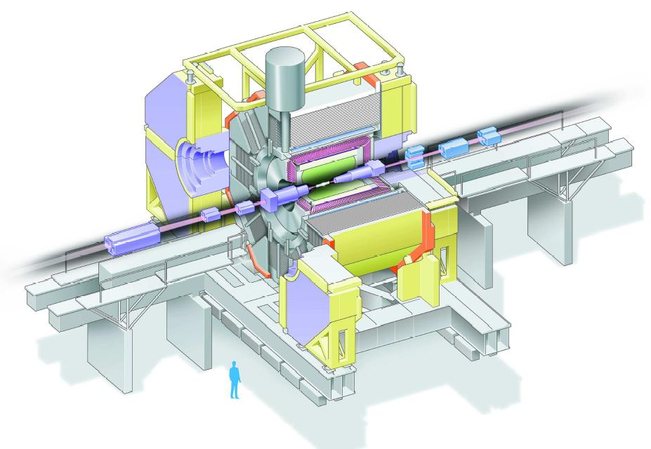
Belle Experiment

Slide 18
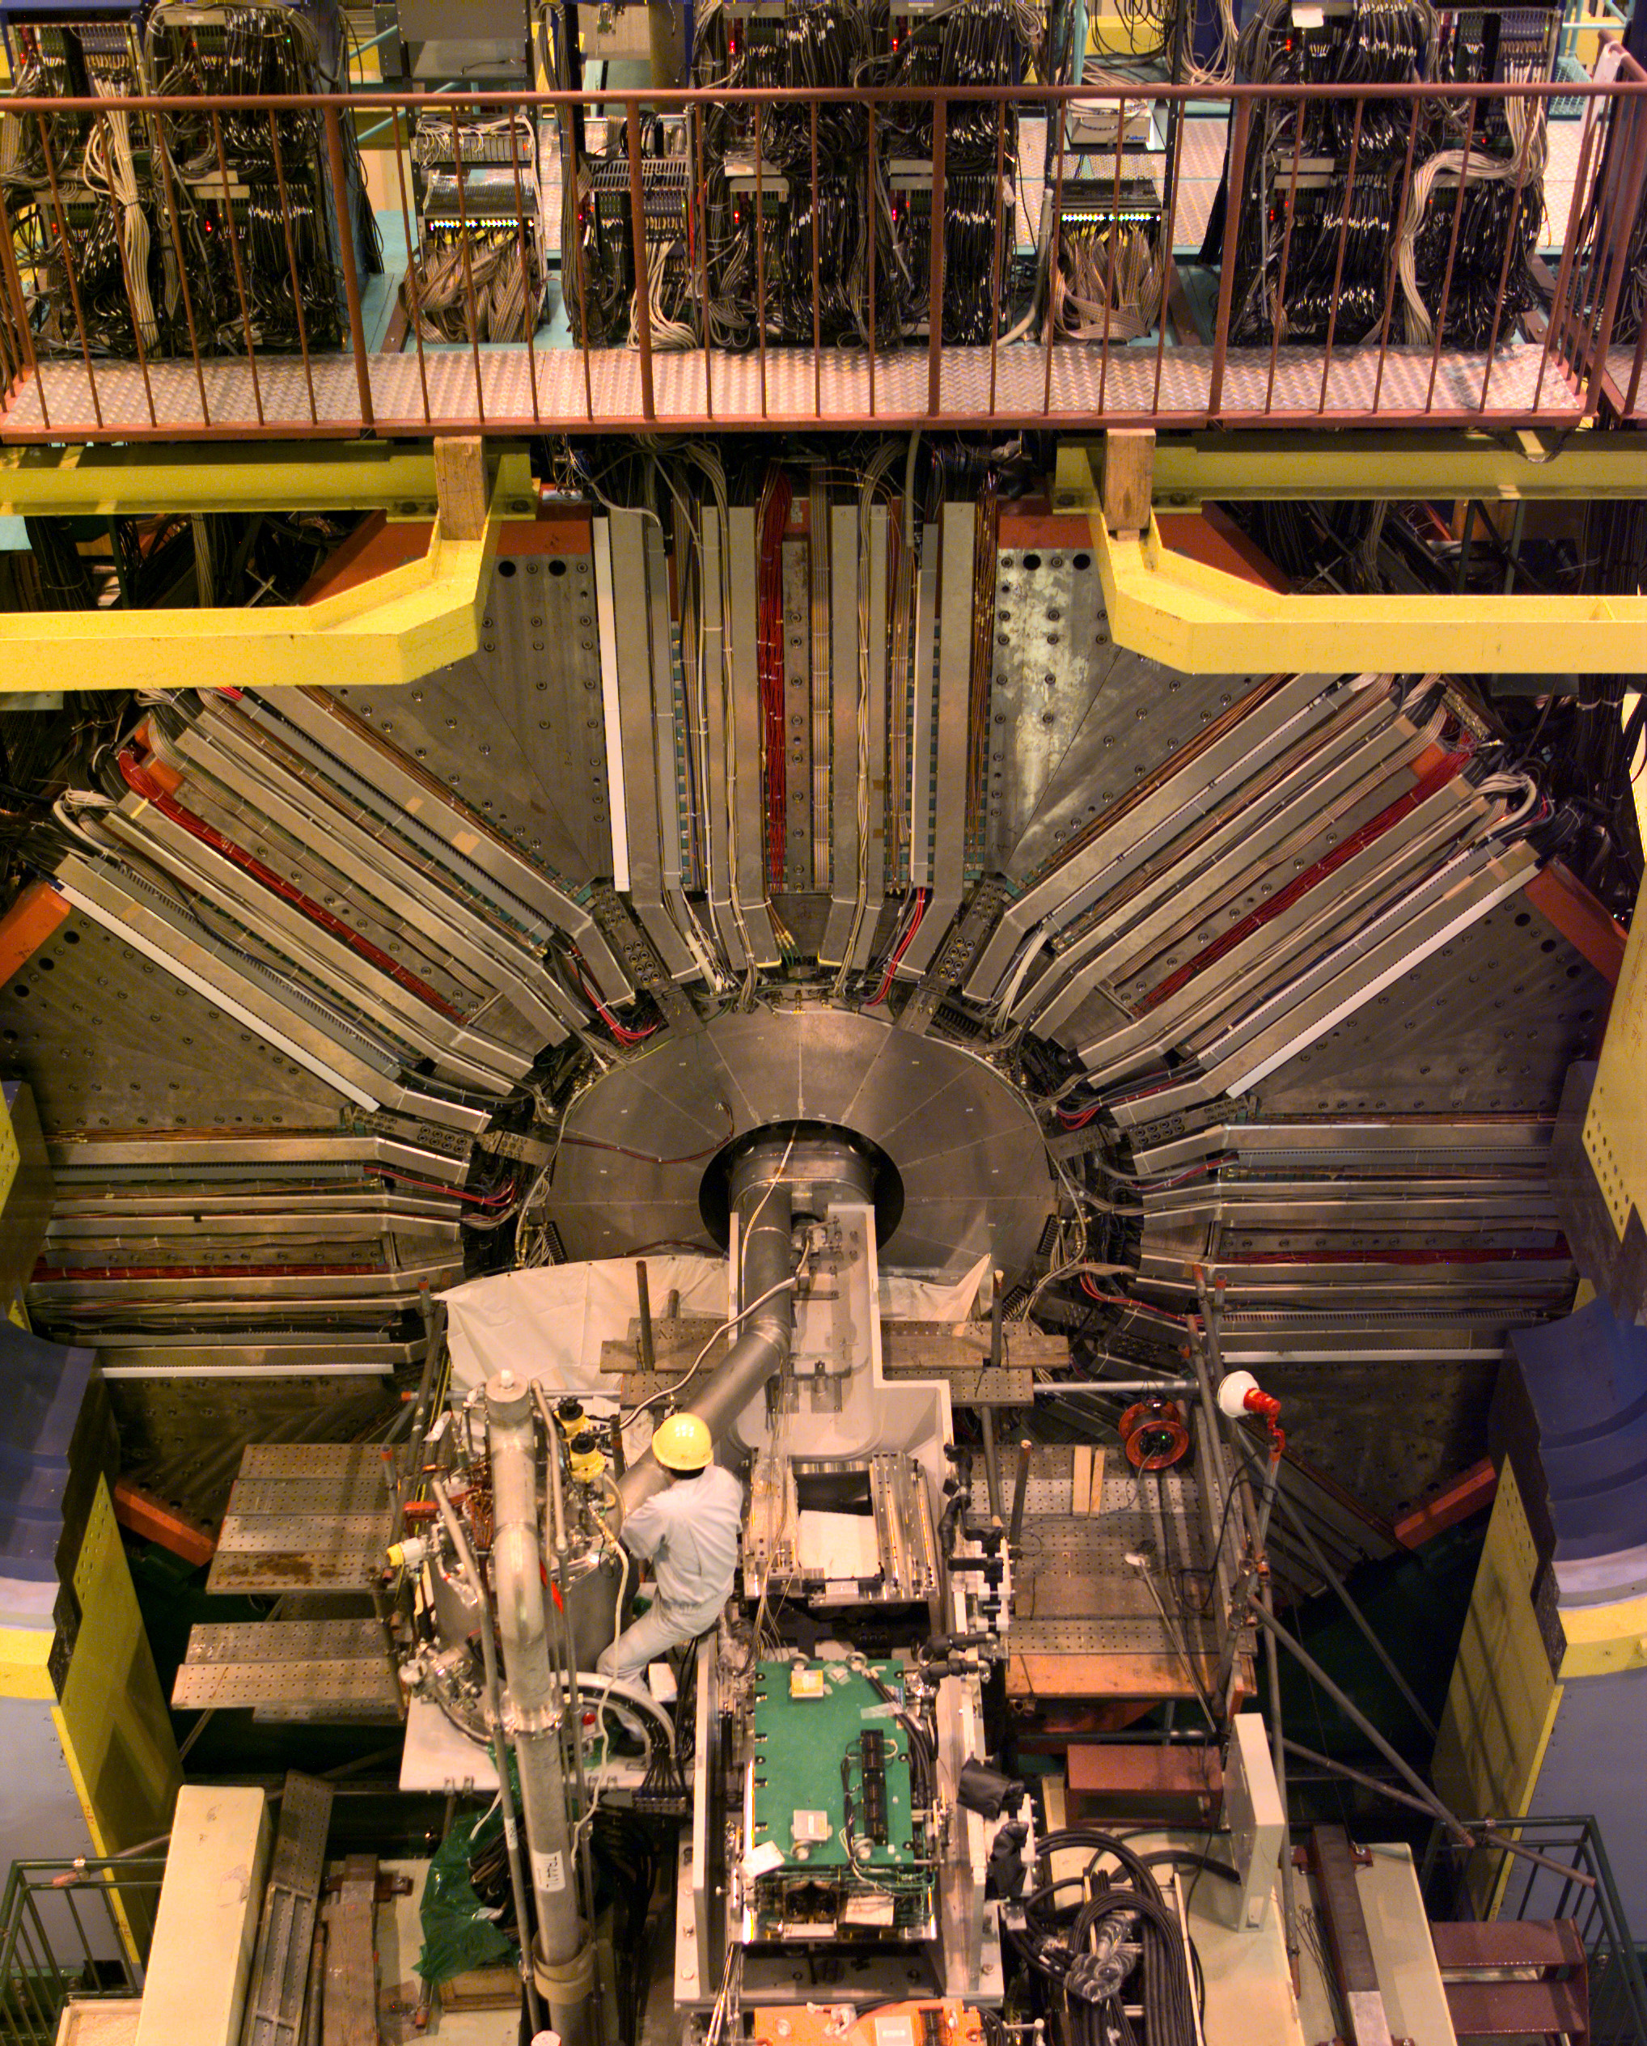
Belle Experiment
K.E.K. B-factory detector (Tsukuba, Japan)
  Matter/Anti-matter investigations
  45 Institutions, 400 users worldwide
On-line data from experiments
Locally simulated collisions or events
  used to predict what we’ll see (features of data)
  essential to support design of systems
  essential for analysis
2 million lines of code

Slide 19
Belle simulations
Computationally intensive
  simulate beam particle collisions, interactions, decays
  all components and materials : 10x10x20 m to 100 µm
  tracking and energy deposition through all components
  all electronics effects (signal shapes, thresholds, noise, cross-talk)
  data acquisition system (DAQ)
Need 3 times as many simulations as real events to reduce statistical fluctuations

Slide 20
Belle status
Apparatus at KEK in Japan, research done world wide
Data shared using an SRB federation: KEK, ANU, VPAC, Korea, Taiwan, Krakow, Beijing
Previous job flow based on scripts
Project has now deployed LCG middleware for job management at University of Melbourne
APAC National Grid deployment provides job execution (at 3 sites) and SRB data management (at 2 sites) with data flow using international SRB federation
Good example of inter-grid middleware interoperation

Slide 21
Our most important design decision
Installing Gateway Servers at all grid sites, using VM technology to support multiple grid stacks
Cluster
Cluster
Datastore
Gateway Server
High bandwidth, dedicated private networking between grid sites
V-LAN
Gateway Server
Gateways will support, GT2, GT4, LCG/EGEE, Data grid (SRB etc), Production Portals, development portals, experimental grid stacks
Datastore
Cluster
Cluster

Slide 22
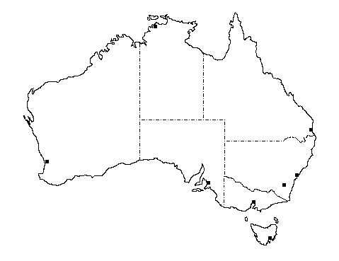
National Grid Infrastructure
Portal Tools:
GridSphere
Workflow Tools:
Kepler?
a virtual
system of
computing, data storage and visualisation
facilities
QPSF
(JCU)
Security:
APAC CA
MyProxy
VOMRS
APAC
National Facility
QPSF
IVEC
ac3
Systems:
Gateways
Partners’ Facilities
ANU
SAPAC
VPAC
CSIRO
TPAC
Network:
GrangeNet
APAC VPN (AARNet)

Slide 23
APAC National Grid
Computing Grid Infrastructure
Resource Discovery:
APAC Software Registry
MDS
INCA?
QPSF
(JCU)
Job Submission:
Command Line
Portals
Job Monitoring:
Scope
MonaLisa?
APAC
National Facility
QPSF
IVEC
ac3
Job Management:
Globus, PBS
Nimrod
LCG
SAPAC
ANU
VPAC
CSIRO
Computing Systems:
Peak
Mid-range
Special
TPAC

Slide 24
APAC National Grid
Data Management Infrastructure
Data Access:
OGSA-DAI
Web services
OPenDAP et al
QPSF
(JCU)
Data Management:
Globus
SRB
SRM
APAC
National Facility
QPSF
IVEC
Data Transfer:
RFT
GridFTP
Global File System
ac3
SAPAC
ANU
VPAC
CSIRO
Mass Data Storage Systems:
Tape – based (silos)
Disc-based
TPAC

Slide 25
APAC National Grid
Collaboration Support Infrastructure
Visualisation Services:
Prism and VisServer
Visualisation Software
QPSF
(JCU)
Collaboration Tools:
AG Whiteboard
APAC
National Facility
QPSF
ac3
IVEC
SAPAC
ANU
Facilities:
Access Grids
Virtual Reality Systems
VPAC
CSIRO
TPAC

Slide 26
Providing Advanced Computing
and Grid Infrastructure
for eResearch
Thankyou !
Dr Rhys Francis
APAC Grid Program Manager
www.apac.edu.au

