Slide 1
PRAGMA 10: CICESE’s Application for Membership
Raúl Hazas-Izquierdo
Telematics Director, CICESE
Grid Coordinator, CUDI

Slide 2
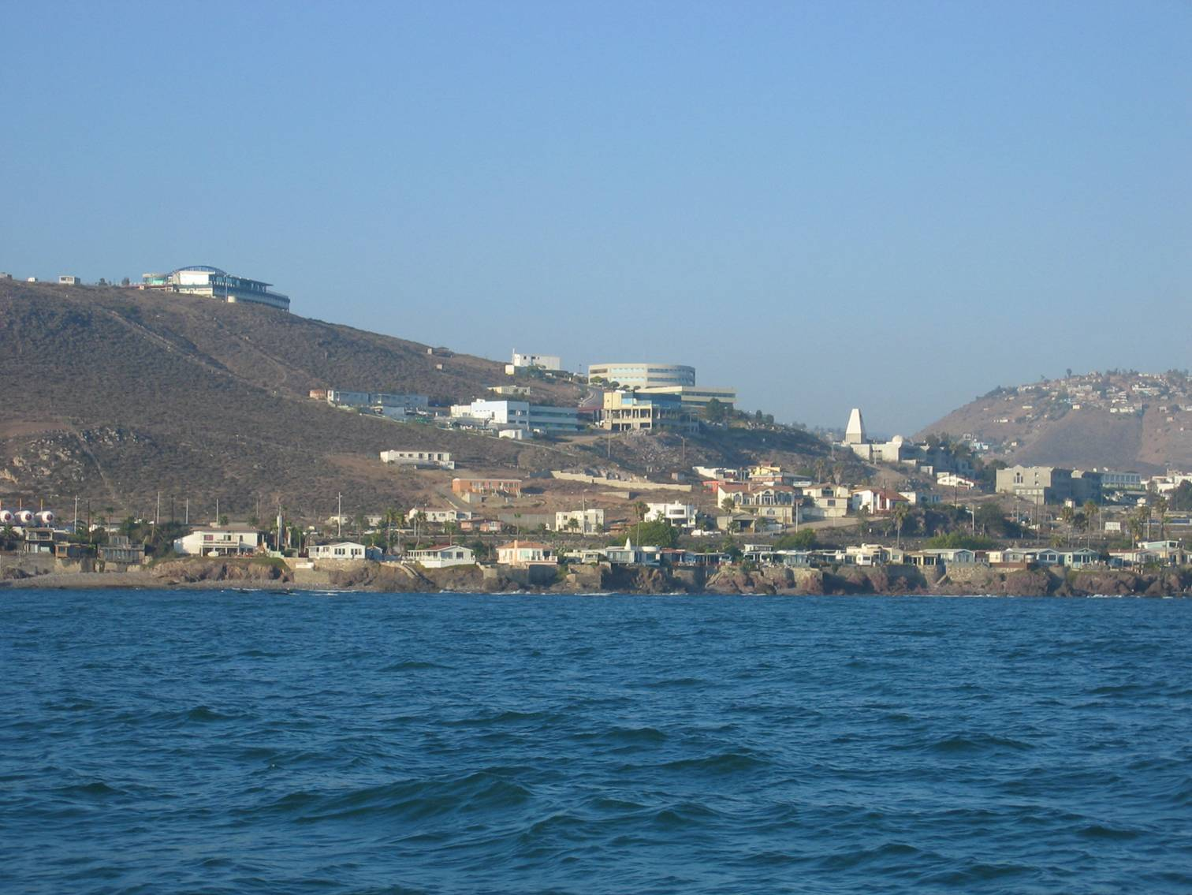
What is CICESE?
CICESE is a research and masters and PhD degree-granting institution established in 1973
It does research on:
Oceanography
Earth sciences
Biotechnology
Optics-Electronics-Computer Science

Slide 3
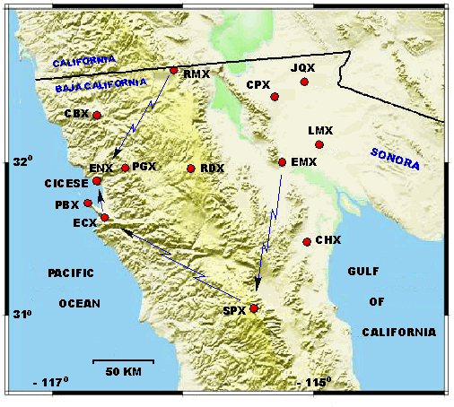
Earth sciences
Telemetry network for the northwest of Mexico, specifically for the Baja California Peninsula region.
Linked to CICESE either by microwave or Internet 2 connectivity

Slide 4
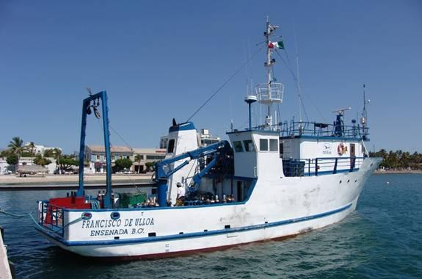
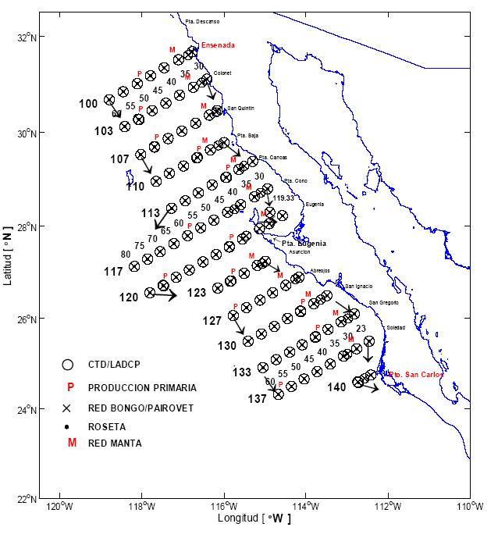
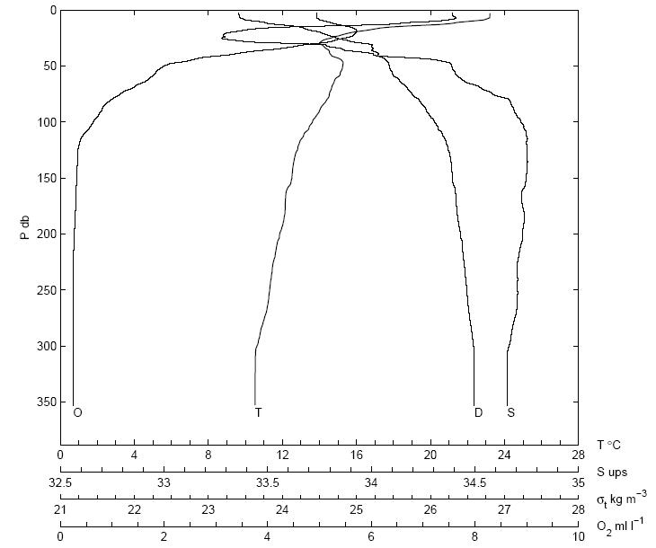
Oceanographic research
Leading research group on oceanography in Mexico
Fully-equipped 84 ft research vessel
Scientific cruises along the Pacific and Gulf of California
Joint cruises with SIO and UNAM on different bodies of water

Slide 5
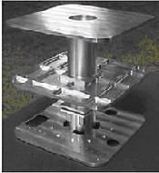
Electronics and Telecommunications
Participant of a multi-institutional project, the SATEX micro satellite project,
  Consisting of a series of micro satellites
  To mobilize human resources in space technology
  Develop test beds.
culminating in the launch of SATEX-1

Slide 6

Federating computing resources and expertise
CONACYT-CUDI applications initiative grant (Oct. 2003)
Co-organizer of the Mexican Academic Grid (GRAMA)

Slide 7
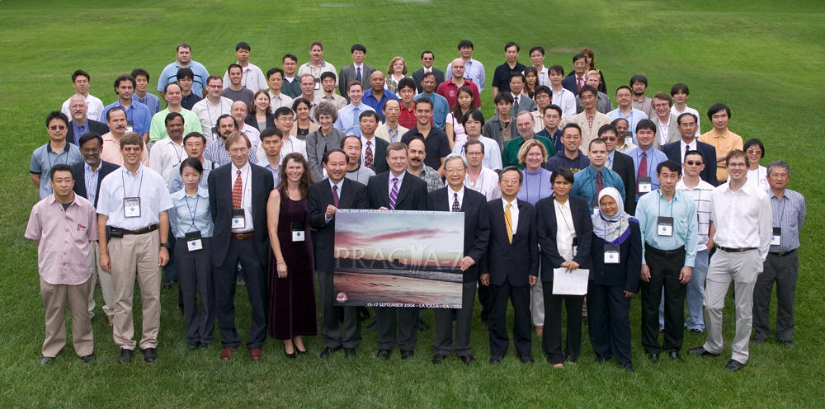
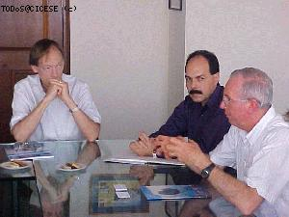
CICESE’s participation in PRAGMA
Invited as an observer to PRAGMA 7 meeting in San Diego
Planned collaboration
  Stressing geographical proximity to SDSC (~70 miles)
  30 + years of successful collaborations with UC system, UCSD in particular

Slide 8
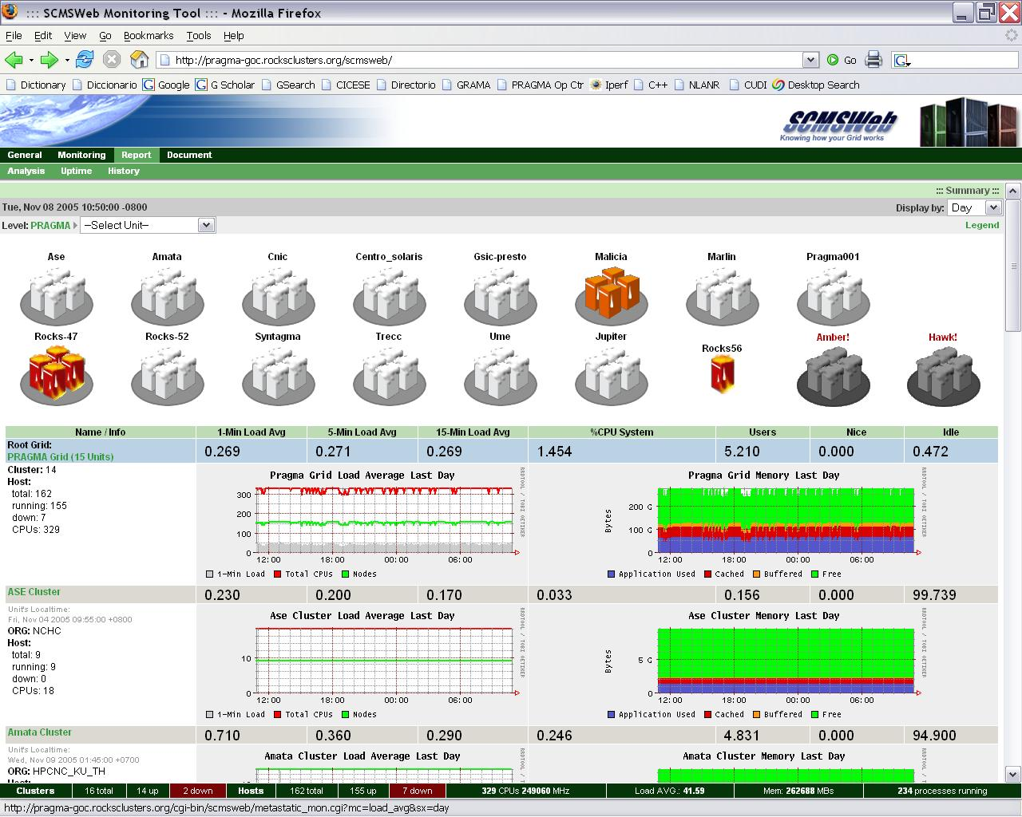
CICESE’s involvement
Highly motivated technical group
Benefits from a varied expertise
Willing to collaborate
Worked with Dr. Putchong Uthayopas’ HPC group at Kasetsart University, Thailand, in porting SCMSWeb to Solaris OS

Slide 9
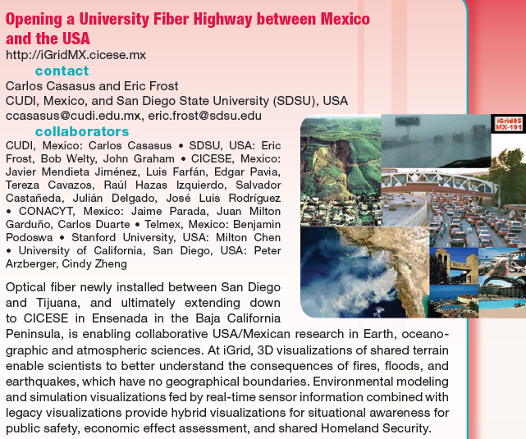
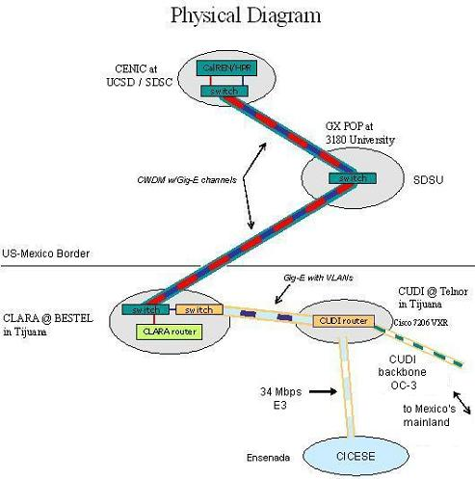
CICESE at iGrid2005
Demo with a bi-national motivation
Collaboration among CONACYT, CUDI and associated Mexican universities, and CENIC, CalIT2 and their affiliates
A computing-intensive parallel application (MM5)

Slide 10
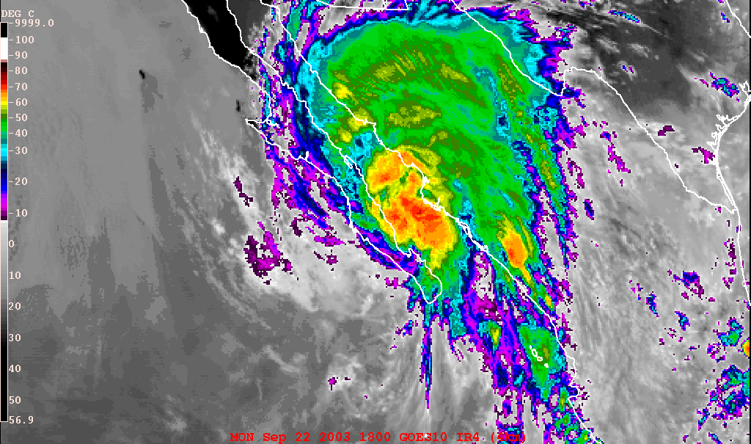
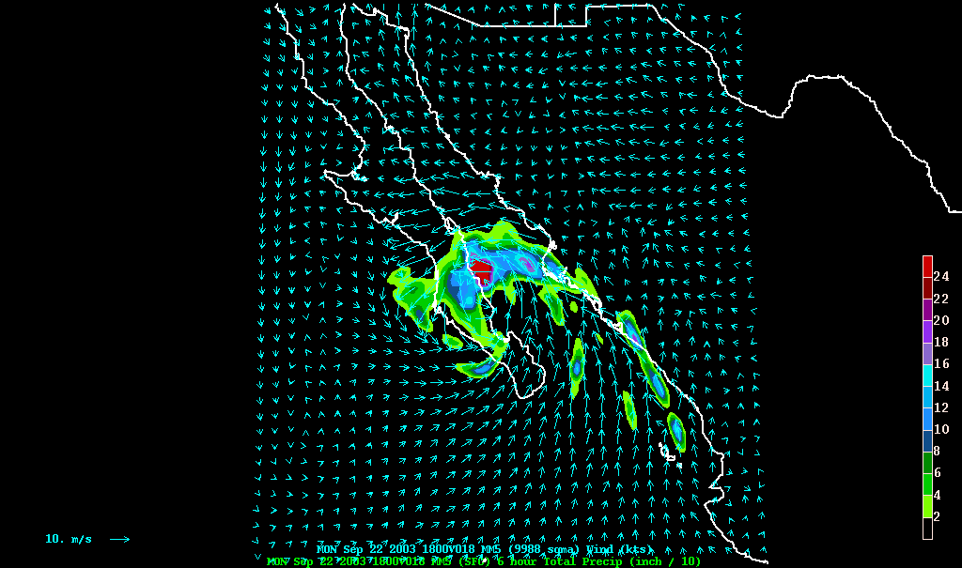
Results
Differences among diverse computer architectures, compilers and operating systems, required a good deal of collaboration in order to successfully port MM5 to a grid environment
Greater resolution achieved, may yield better forecasting

Slide 11
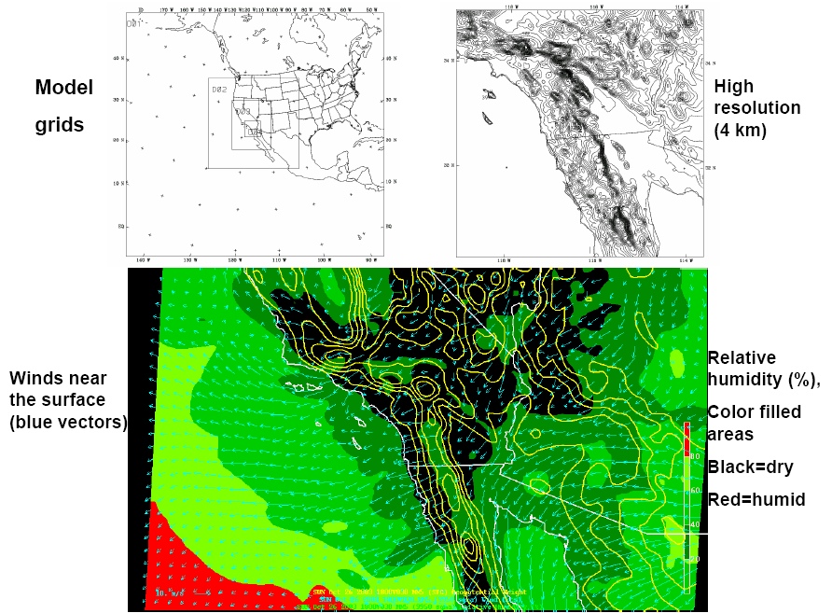

Slide 12
Present and Future
Attracting domain scientists (e-science drivers) to grid activities
Working with KISTI in using MPICH+GX for MM5 application
Continue working with Resources working group
Abide by PRAGMA’s Operating Principles and Procedures
Involve in advancing PRAGMA’s mission

