Slide 1
Common Instrument Middleware Architecture and
Federation of Instrument Resources for
X-ray Crystallography
Rick McMullen
Indiana University

Slide 2
CIMA Project Goals
Integrate instruments and sensors (real-time data sources) into a grid computing environment via Web Services interfaces
Abstract instrument capabilities and functions to reduce data acquisition and analysis applications’ dependence on specialized knowledge about particular instruments
Move production of metadata as close to instruments as possible and facilitate the automatic production of metadata
Develop a standard, reusable methodology for “grid enabling” instruments
Notes:
Web Services interfaces can be wrapped in WS-RF to provide these as Grid Services
Also, to do these while Collaborating with scientists in academia and industry in a broad range of disciplines who either develop instruments or whose work depends on the details of using them.

Slide 3
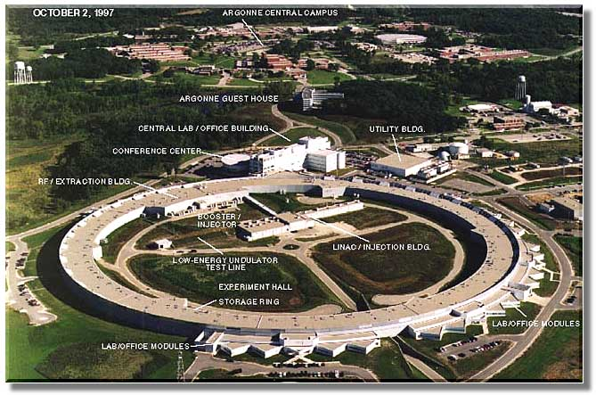
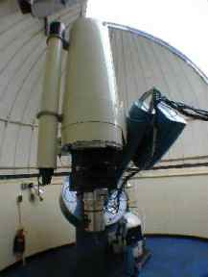
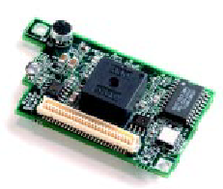
CIMA Reference Implementation Applications
Synchrotron X-Ray crystallography
  Argonne APS ChemMatCARS &
  DND-CAT
  CrystalGrid (global network of crystallography centers)
Robotic telescopes
  MMSF robotic optical observatory
Sensor networks
  Ecological observation
  Berkeley MOTE sensor package

Slide 4
CIMA Components
Service implementation for accessing the instrument’s functionality and metrics
  Plug-in modules - interface to hardware
  Channel service - provides a network interface via
  Web Services->WS-RF Grid Service
Functions (location, authentication, authorization, scheduling)
Schemata for representing instrument functionality
A small, high performance Web Services stack (Java and C++) including Proteus support for multiprotocol, multimodal transport.
Notes:
Service implementation for accessing the instrument’s functionality and metrics using industry standard service implementation methodology (Web Services)
Plug-in modules - interface to hardware
Channel service - provides a network interface via Web Services->WS-RF Grid Service
Functions to register with a directory service, authenticate users, provide access control to instrument controls and data, and co-schedule the instrument into a Grid computing and storage context
Supported directory services: UDDI; looking at GT4 MDS
Schemata for representing instrument functionality in WSDL and OWL-DL with instances (RDF) built into the instrument; Model for representing instrument function, metrics, and calibration
A small, high performance Web Services stack (Java and C++) including Proteus support for multiprotocol, multimodal transport.

Slide 5
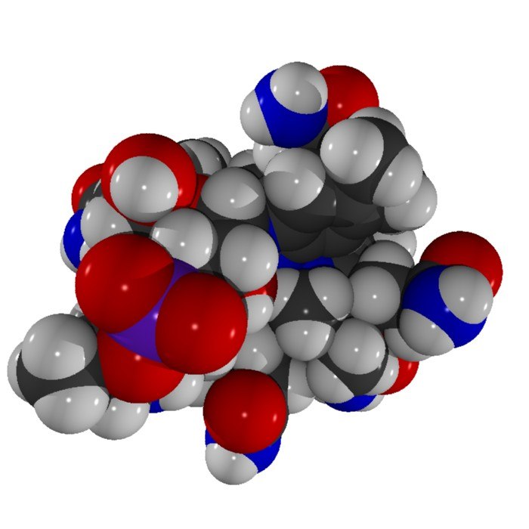
X-ray Diffraction Crystallography
X-ray diffraction crystallography is an important technique for determining the 3-D structure of both large and small molecules
Critical in life sciences, chemistry, materials science and nano-technology
Data from diffractometers are streamed using CIMA protocol to a data management system
Data for one experiment consist of 12 or more streams (~7 types); each lab has a slightly different set of observables
Current and previous data streams
are accessible through a portal
using custom portlets
Many labs and their equipment
and users need to be supported
  Four currently active (APS, IU, IU bio, Purdue
  More joining (UMinn, AU, UK; APS remote users)

Slide 6
Portal for X-ray Crystallography
Data acquisition
Collaboration and problem solving
Data management
Data reduction and structure solution
Publication and data sharing

Slide 7
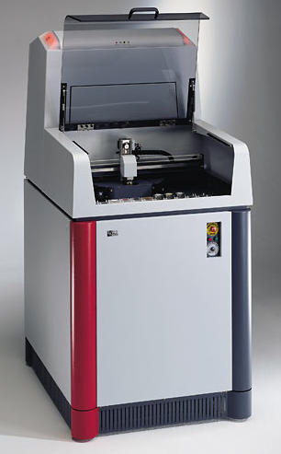
Advanced Photon Source at Argonne National Lab, Chicago, USA
Bruker AXS
Diversity in instruments for X-ray diffraction crystallography

Slide 8
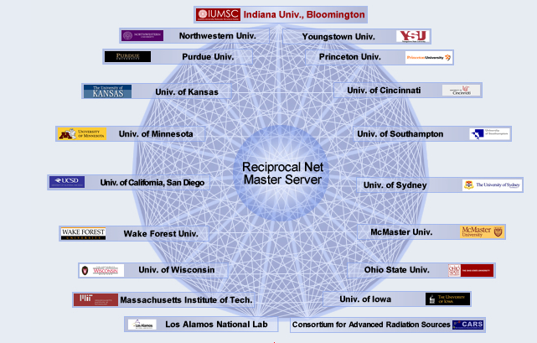
ReciprocalNet and CIMA Sites
James Cook University

Slide 9
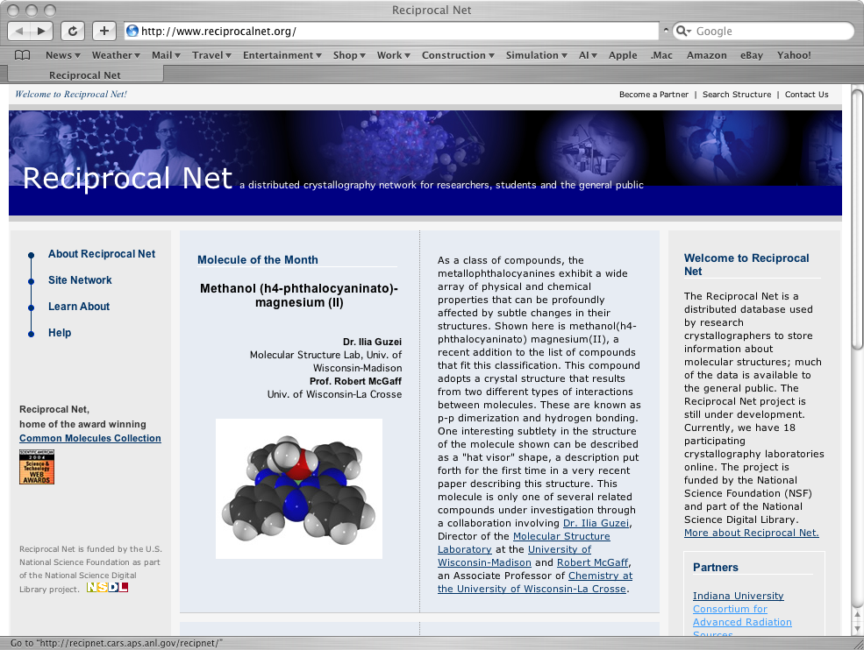

Slide 10
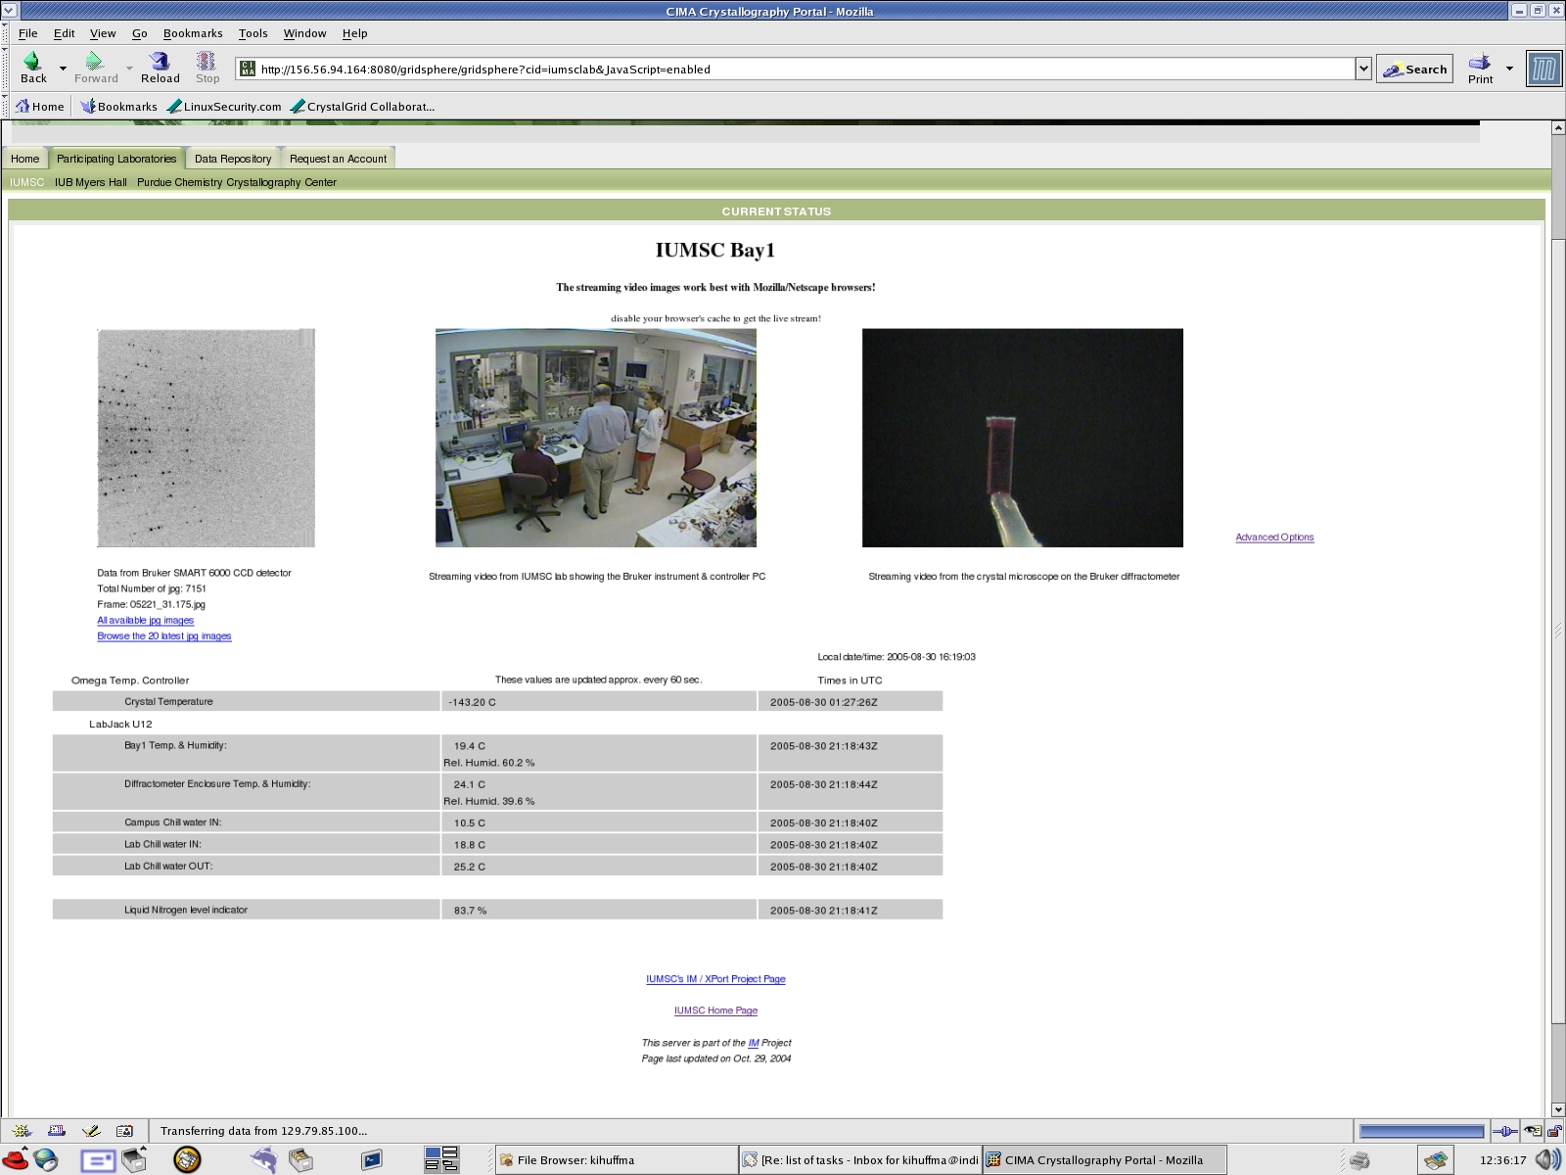
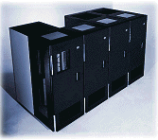
Lab 1
Lab 2
Lab 3
Instrument 2
Instrument 1
Instrument 1
CIMA proxy 2
Instrument 1
CIMA proxy 1
CIMA proxy 1
CIMA proxy 1
Instrument 2
CIMA proxy 2
Data Manager
Data Manager
Grid compute and
storage resources
GridSphere Portal Server
OGCE
“Grid”
portlets
and
Workflow
manager

Slide 11
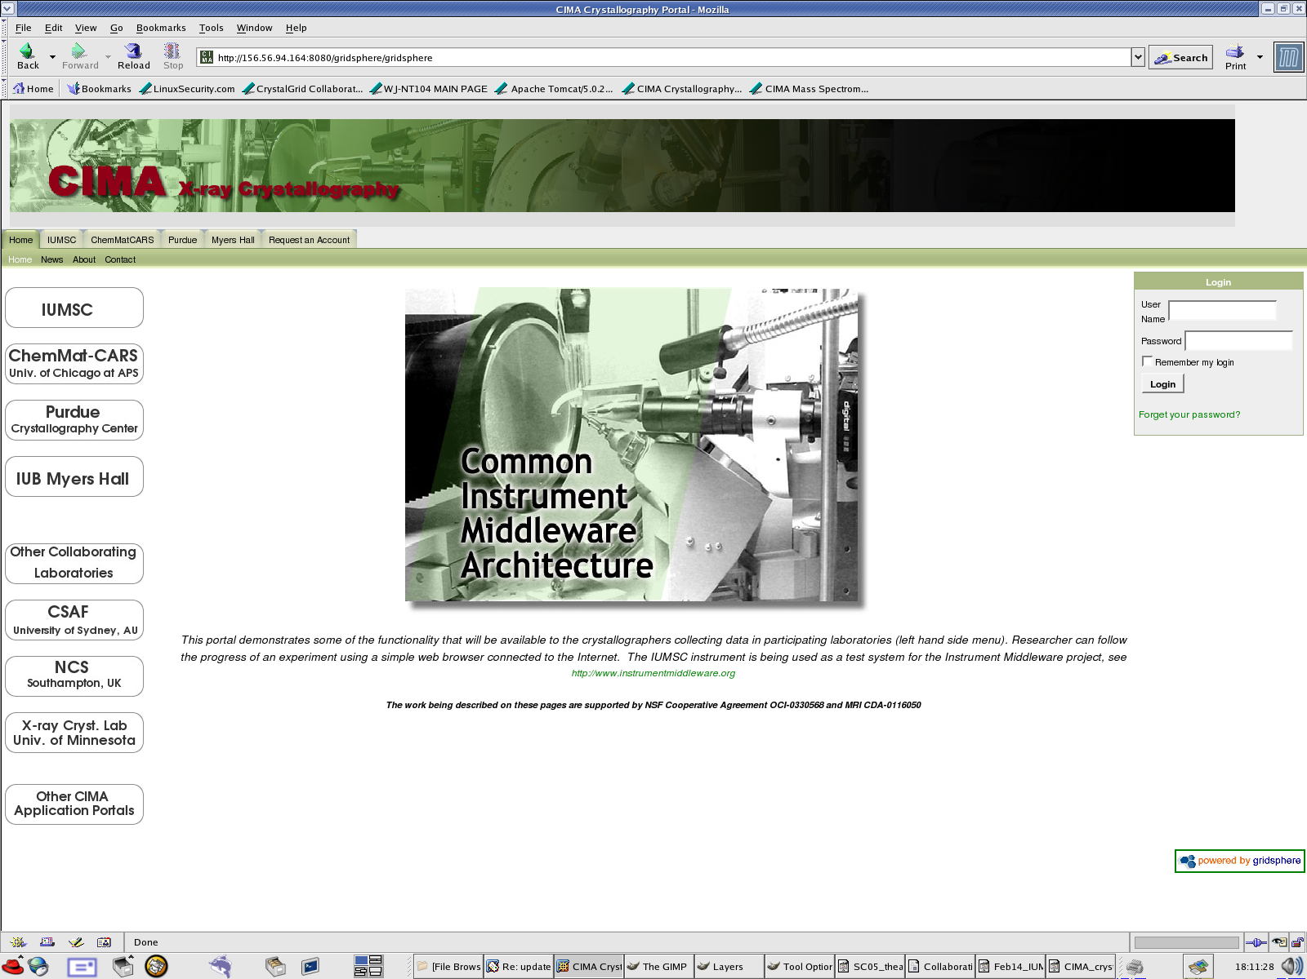
Notes:
Kia

Slide 12
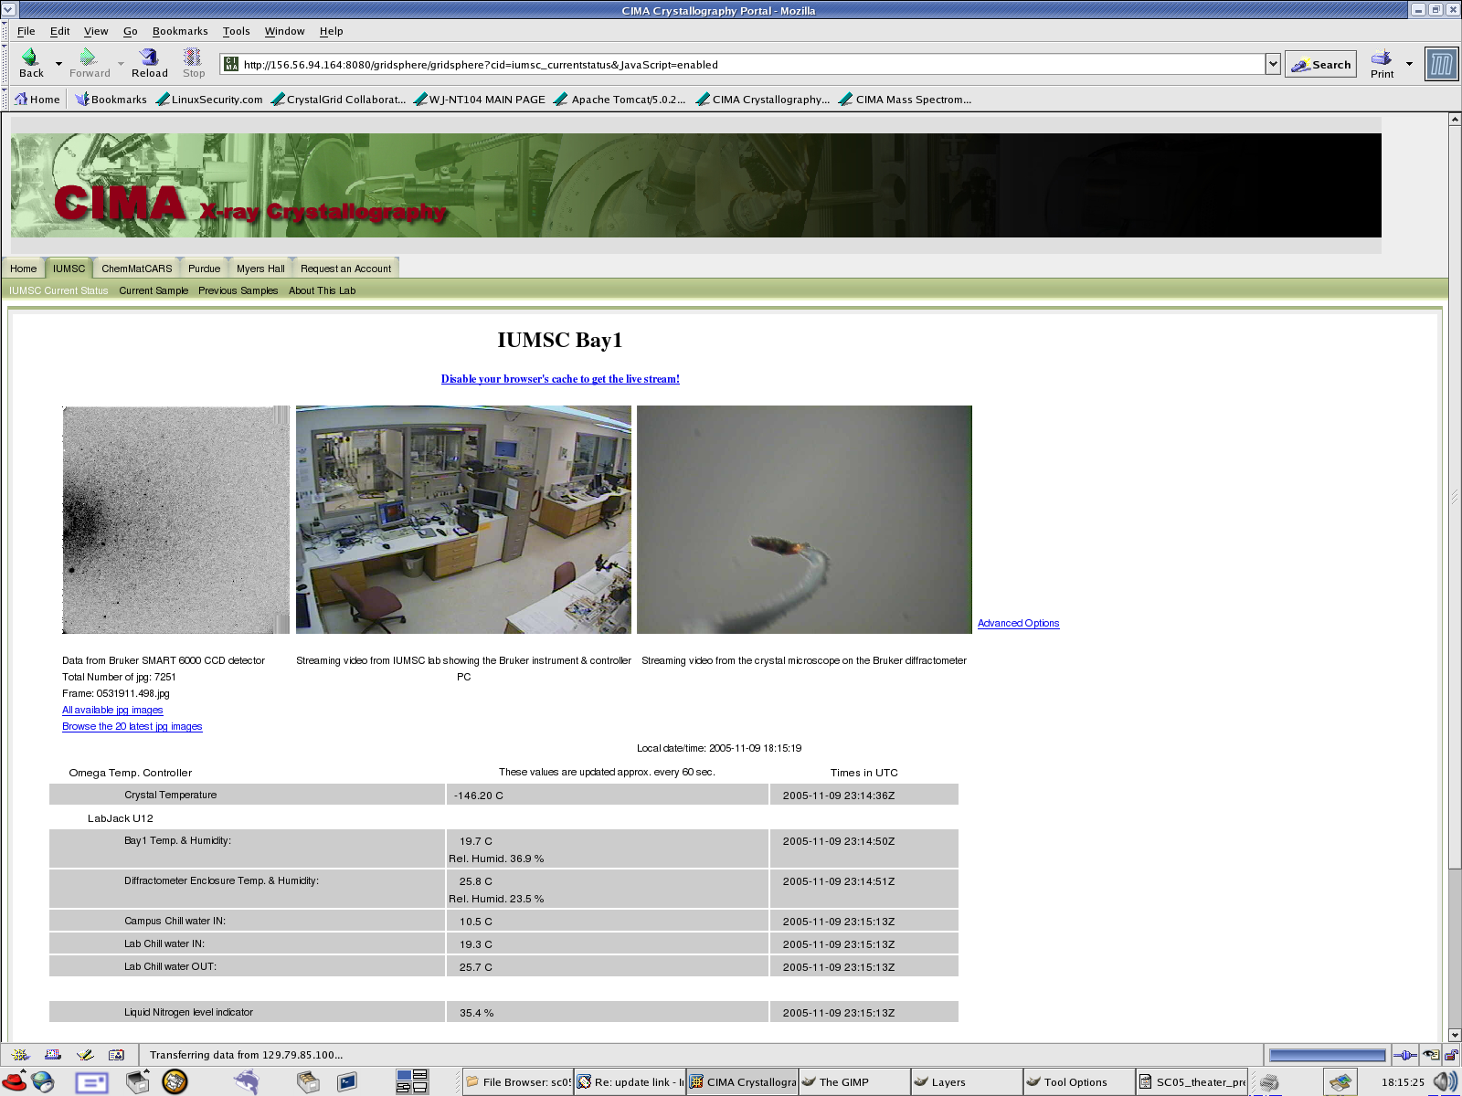

Slide 13
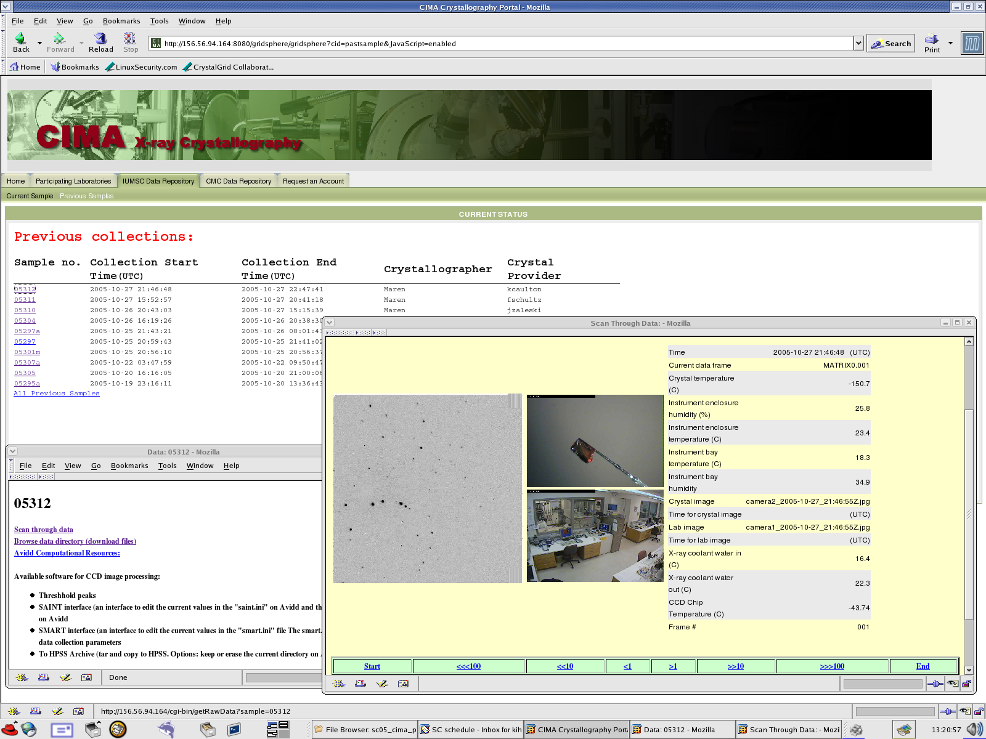

Slide 14
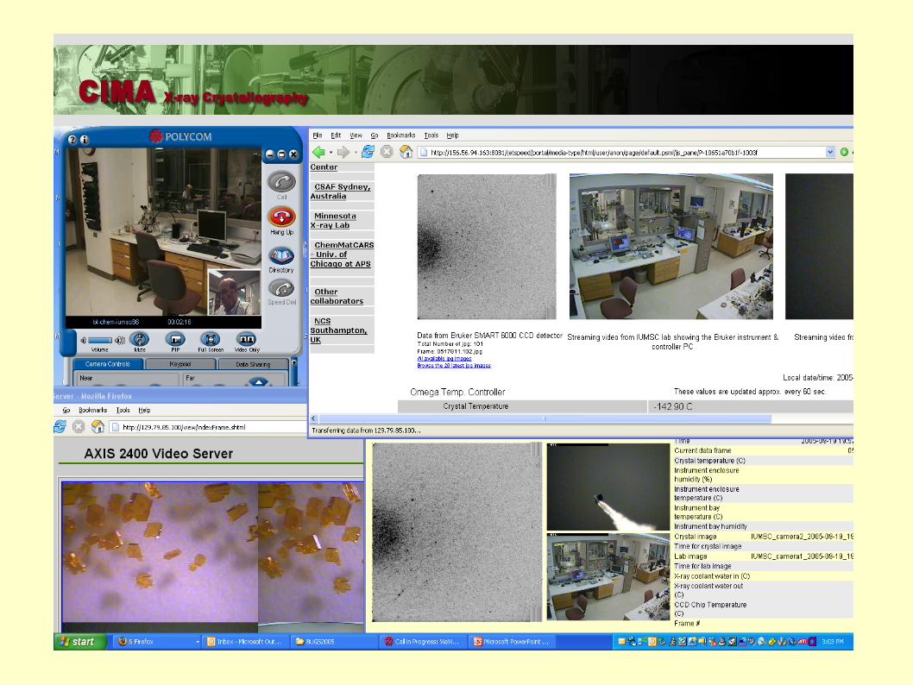

Slide 15
Using CIMA to create a federation of X-ray diffraction labs
For users
  Tele-presence - work with local lab staff
  Remote monitoring of experiments and environmental conditions - First look at data; How good is my sample?, are things OK there?
For labs
  Lab services aggregation and sharing - extends local capabilities
  Data sharing
  Community codes for analysis, visualization
Linkage to publishing and archival mechanisms
  Meshes with ReciprocalNet for publishing and distribution of structures
  Data can be archived in one or more storage systems
Current and planned participants in federation includes labs in Indiana (IU, Purdue), University of Minnesota, Argonne National Labs, UK and Australia

Slide 16
Using CIMA to create a federation of X-ray diffraction labs
For users
  Tele-presence - work with local lab staff
  Remote monitoring of experiments and environmental conditions - First look at data; How good is my sample?, are things OK there?
For labs
  Lab services aggregation and sharing - extends local capabilities
  Data sharing
  Community codes for analysis, visualization
Linkage to publishing and archival mechanisms
  Meshes with ReciprocalNet for publishing and distribution of structures
  Data can be archived in one or more storage systems
Current and planned participants in federation includes labs in Indiana (IU, Purdue), University of Minnesota, Argonne National Labs, UK and Australia

