Slide 1


Flexible IO Services in the Kepler Grid Workflow System
David Abramson
Jagan Kommineni
Ilkay Altintas
www.csse.monash.edu.au/~davida/griddles

Slide 2
KEPLER Core Capabilities
Capturing & designing scientific workflows
  Making existing (Grid) WFs reusable
  Composition of services to perform a scientific WF
Executing scientific workflows
  Distributed and/or local computation
    Range of invocation techniques
      Local, Web Services, Globus GRAM
  Various models for computational semantics and scheduling
  SDF and PN: Most common for scientific workflows

Slide 3
Kepler Directors
Orchestrate Workflow
Synchronous Data Flow
  Consumer actors not started until producer completes
  Files copied from producer to consumer.
Process Networks
  All actors execute concurrently
  Communication through
    TCP/IP Sockets
    Dedicated IO
IO modes produce different performance results.
Actors need to be coded to support specific IO modes

Slide 4
GriddLeS
Legacy applications
  Invoked using a range of techniques
  Need to be shielded from IO details in Grid
    Local files
    Remote files
    Replicated files
    Producer-consumer pipes
Don’t want to lock in IO model when application is written (or even Grid Enabled)
Choice of IO model should be
  Dynamic
  Late bound

Slide 5
Flexible IO in GriddLeS
Late bound decision
Local
File
read()
write()
seek()
Remote
File
close()
open()
FileMultiplexer
Cache
SRB
Remote
Application
Process
Legacy Application
Replica
Replica
Replica
Replica

Slide 6
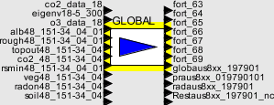
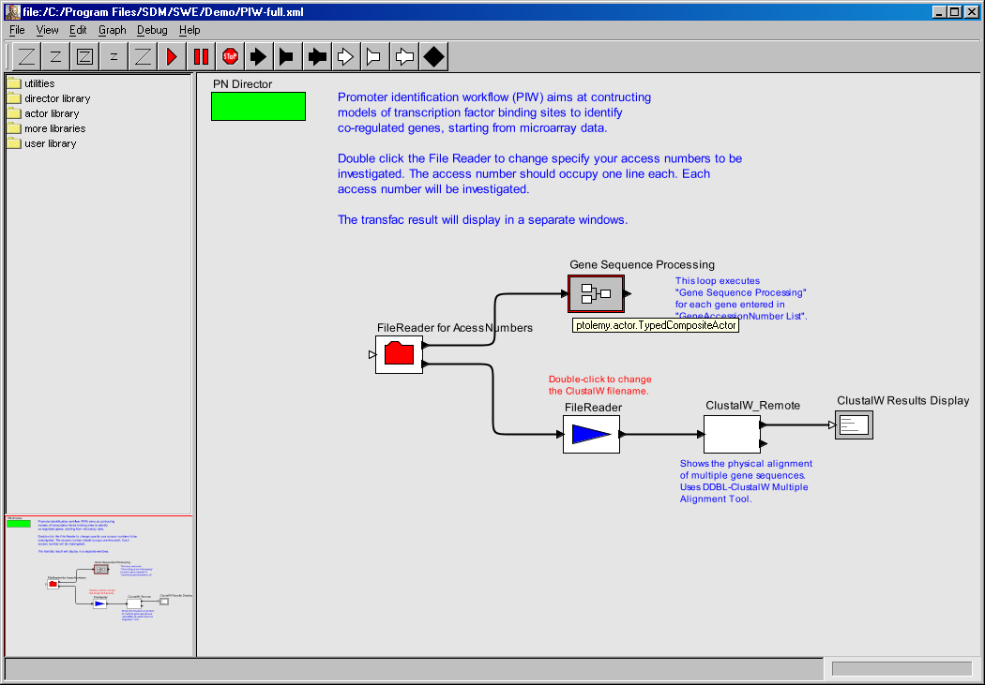
Integrating Kepler & GriddLeS
Invoke (Globus, WS, ssh)
Application
Read,
Write,
etc
Make
Actor
Grid FTP
Server
Remote File
Client
Local File
System
Local File
Client
Grid Buffer
Server
Grid Buffer
Client
GriddLeS Name
Server (GNS)
GNS
Client
SRB
Client
File Multiplexer

Slide 7
Demo

Slide 8
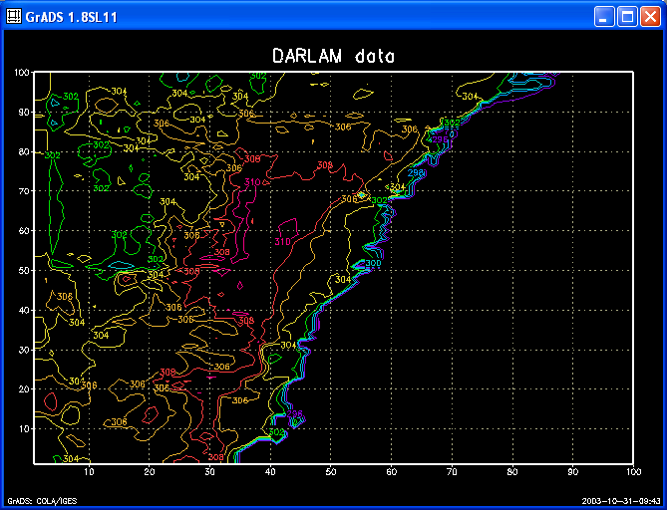
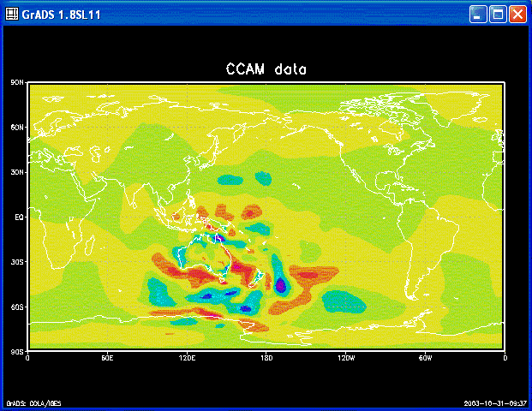
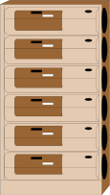
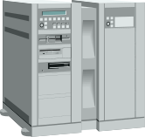
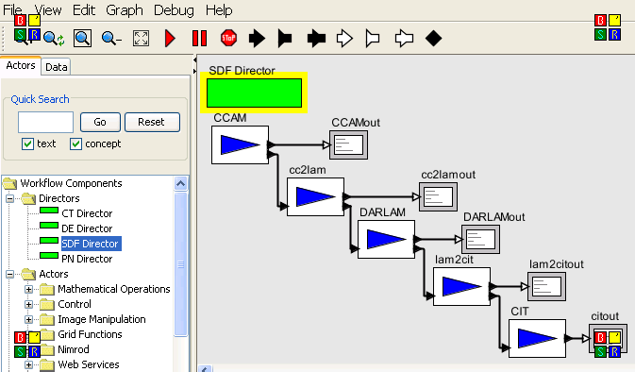
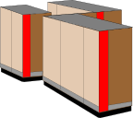
Distributed Atmospheric Sciences
Regional Weather Data
Temperature, Pressure, etc
Global Climate Data
Temperature, Pressure, etc
CCAM
CCAM
CCAM
Kepler
All models provided by CSIRO Division of Atmospheric Research

Slide 9
Demo

Slide 10
Acknowledgements
CSIRO Division of Atmospheric Sciences
  John McGregor,
  Jack Katzfey and
  Martin Dix
Funding & Support
  Australian Research Council (ARC)
  Australian Government (DCITA, DEST)
  Hewlett Packard
  US National Science Foundation
  US Department of Energy

