Slide 1
NECTEC Status Report
Mr. Supakit Prueksaaroon
RDC, National Electronics and Computer Technology Center
National Science and Technology Development Agency
Ministry of Science and Technology
112 Thailand Science Park, Phahon Yothin Rd., Klong 1,
Klong Luang, Pathumthani 12120, Thailand
E-mail: supakit.prueksaaroon@nectec.or.th
Notes:
Good Afternoon everybody. My name is Supakit Prueksaaroon representing NECTEC. Today I would like to give you an update on the progress of my organization.

Slide 2

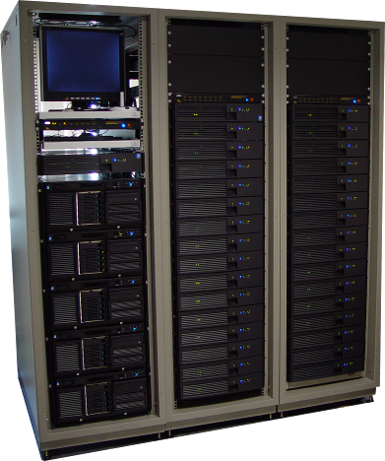
NECTEC Current Resources
33 Nodes Cluster
  1.4 GHz Dual Itanium2
  Total Memory 128GB
  Storage 3.2TB
ROCKS 3.3.0
HPL Bechmark ~200 GFLOPS
Lustre 1.2.6 (Operated)
Gfarm 1.2.9 (now Testing)
Notes:
Last year, we installed the high performance computing cluster to assist research in Thailand. Our system consists of 33 nodes of dual Itanium 2 cluster and is based on ROCKS 3.3.0. The HPL score of this cluster is around 200 GFLOPS. For the storage system, we installed and tested the Lustre and Gfarm file systems on this cluster. Our clustre uses the Lustre for the operated file system. For the Gfarm we plan to add our grid testbed node.

Slide 3
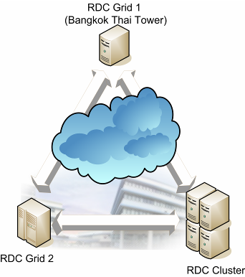
GT4 Testbed
Local testbed
  4 Sites Testbed
    2 clusters, 2 workstations
  Based on GT4
  Testing functions
    Submit Jobs through WSRF standard
    Scheduler test
      SGE, PBS
    MPICH-G2
      Fluid flow simulation
    Gfarm file system
Testing with Thailand National Grid Project.
Planing to join with PRAGMA GT4 testbed
Notes:
For the Grid infrastructure and Testbed we started setting up the infrastructure and machines for testing the Grid in our organization. The system based on GT4 has 4 testing functions. These functions are submitting jobs using the WSRF standard, testing Scheduler compatibility for both SGE and PBS, testing some MPI-G2 jobs on GT4 environments and using the Gfarm for the Grid file system. Last week we joined the Thailand National Grid project to test our system. After this seminar we plan to join the PRAGMA GT4 testbed.

Slide 4
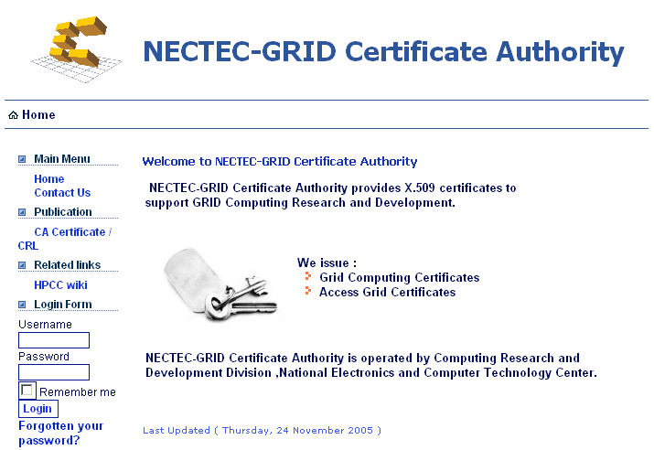

APGRID PMA
Member start on Nov. 2005
Experimental Level
  Web based
Current Status
  Writing CP/CPS
  Procurement Equipment
Production Level in June 2006
Notes:
Nectec has been a member of the APGRID PMA since Nov. 2005 .Currently we are at experimental level. Our system has been developed to handle user accounts, applications and record certificate issuing and downloading. There are still a few things that we still need to define. For example, the user information to be collected, the process of verifying the user profile and the management of official documents. We are planning to upgrade to Production level in June. We have now started to draft CP/CPS and bought some equipments for this

Slide 5
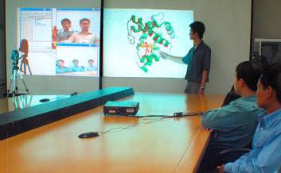
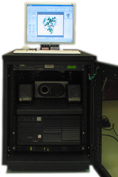
AccessGrid
Equipment
  Venue Server
  Bridge Server
  Full-room Client node
Functional
  Domestic Conference Broadcasting
Notes:
For the AccessGrid, We have set up the AccessGrid facility and started using it to broadcast local conferences in Thailand.

Slide 6
Thank You
Question?
Notes:
Thank you very much any questions?

