Slide 1
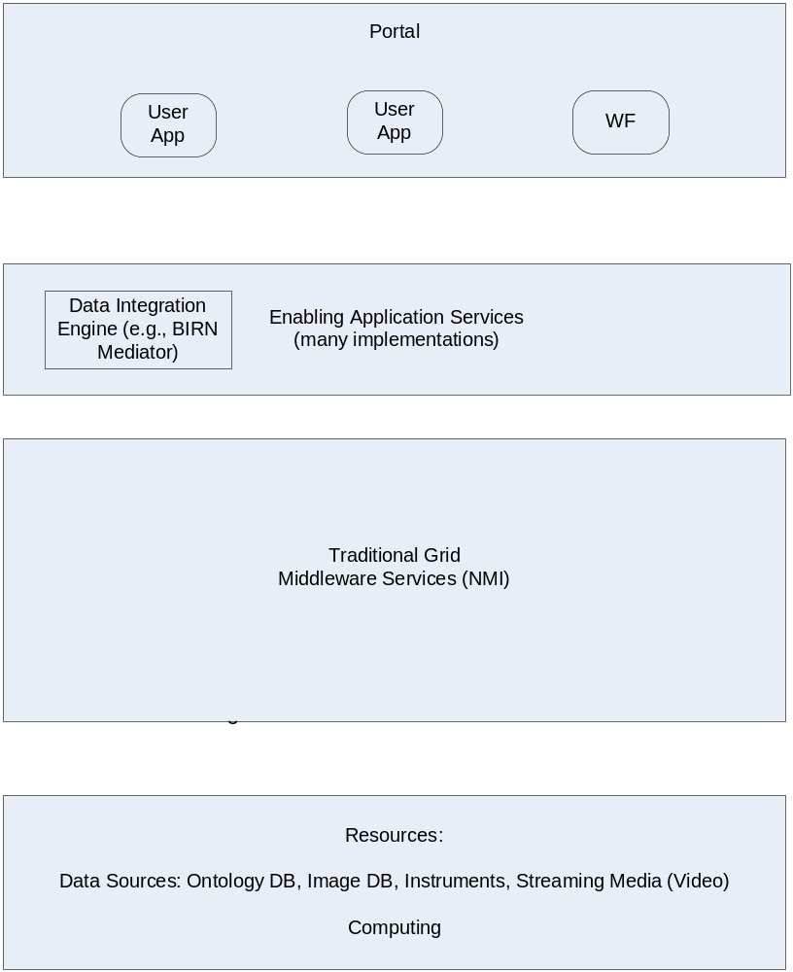
Generalized Architecture

Slide 2
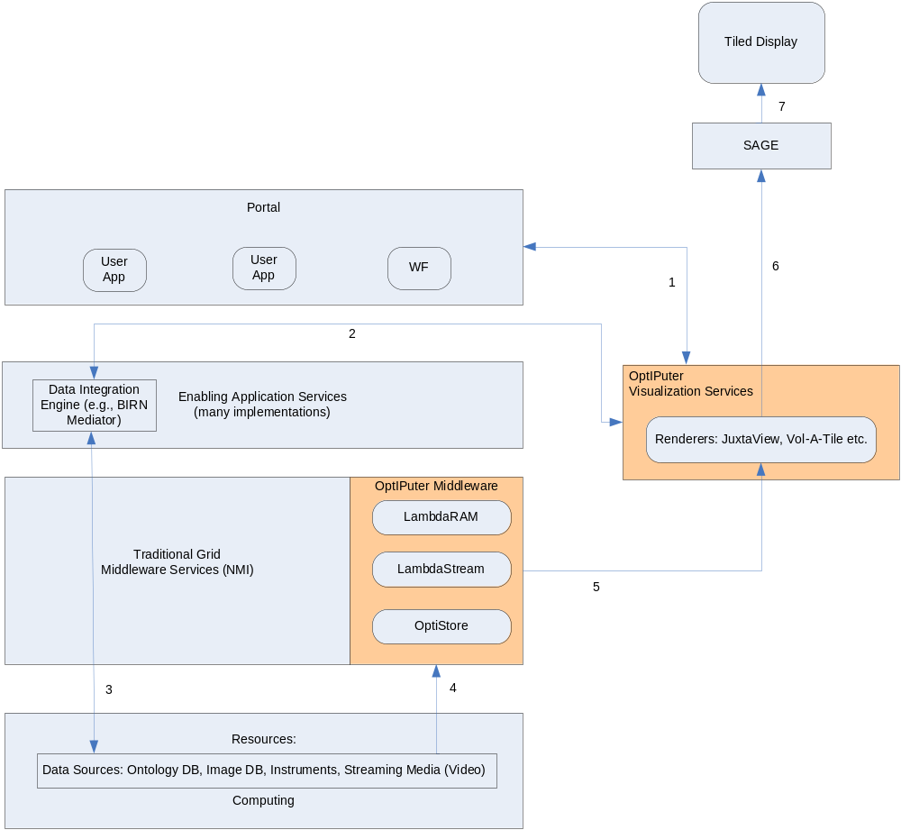
Generalized Architecture w/ TDW Integration

