Slide 1


Grid Portals in Australia
Raj Chhabra
QPSF Grid Manager (QUT)
Project Leader for UI & VI Projects (APAC)

Slide 2
Grid Portals
APAC Grid Program
Infrastructure projects & Application Projects
Grid Portal Services (one of infrastructure proj)
  JSR168 based Portals
    GridSphere Portal Container
  Common set of portlets, applets + gridportlets + whatever we can find in the world.

Slide 3
Application Projects
Astronomy
  Theory Portal
  ZeusMP Portal (hydrodynamic simulation)
BioInformatics
  NAMD Portal
  ‘Dock’ based Molecular Docking Portal
  MrBayes & Paup based Portal
Chemistry
  Amber applet (to be used in portal and as a stand alone app)
  Gaussian Portal
Earth System Science
  Digital Library Portal (OpenDAP based)
GeoSciences
  Seismic Simulator
  eScript Portal (a python based stand alone application used by many GeoScientists in Aus)

Slide 4
Other Grid Portals..
Engineering
  Abacus Portal
NeuroScience
  Neuroimaging Portal( Howard Florey Institute for Neuroscience, Melbourne)
JSR168 based SRB Portal (JCU, Townsville)
Engagements began
  Nuclear Science (ANSTO, Sydney)
  Atmospheric Science (UNSW, Sydney)

Slide 5
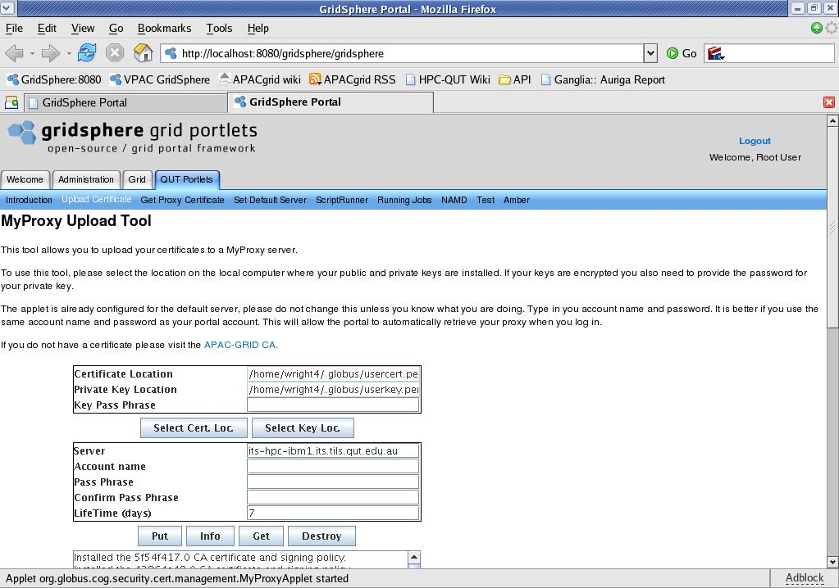
Generic Portlets -QUT

Slide 6
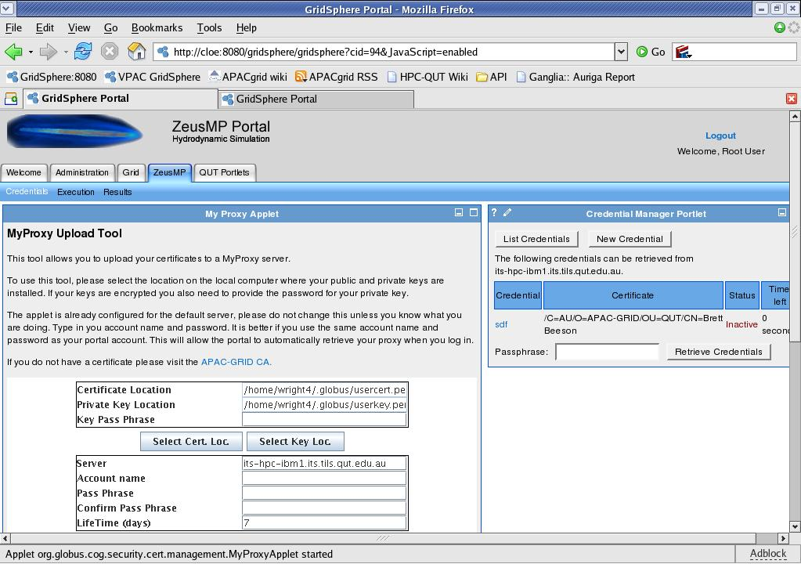
ZeusMP Portal

Slide 7
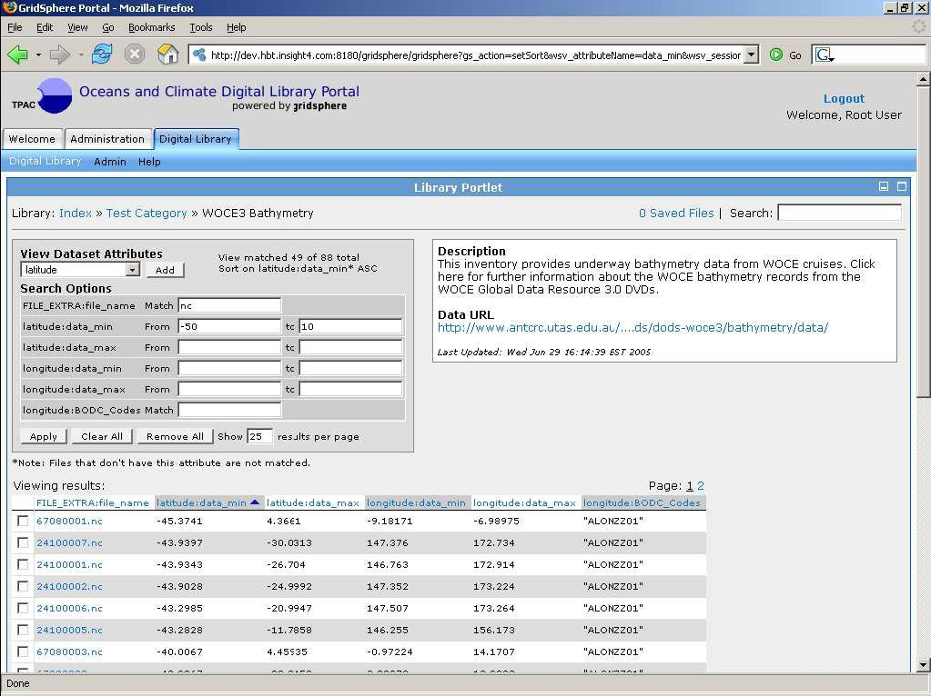
Earth System Science Portal

Slide 8
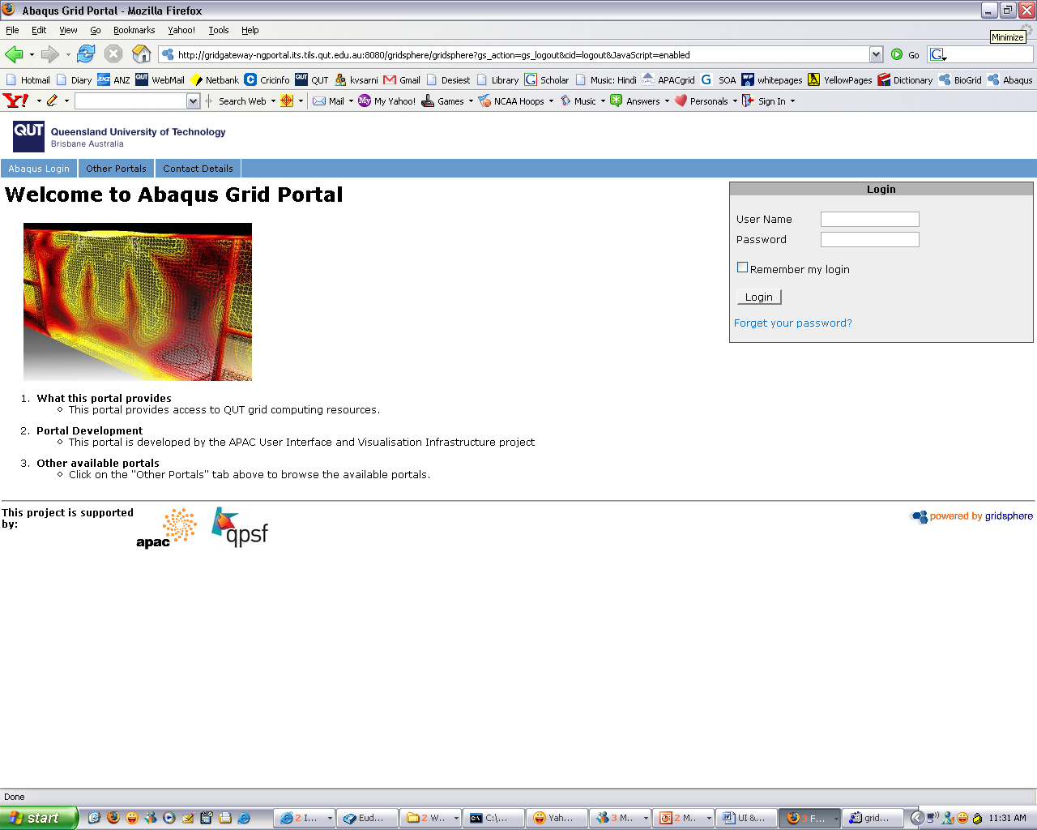
Abaqus Portal

Slide 9
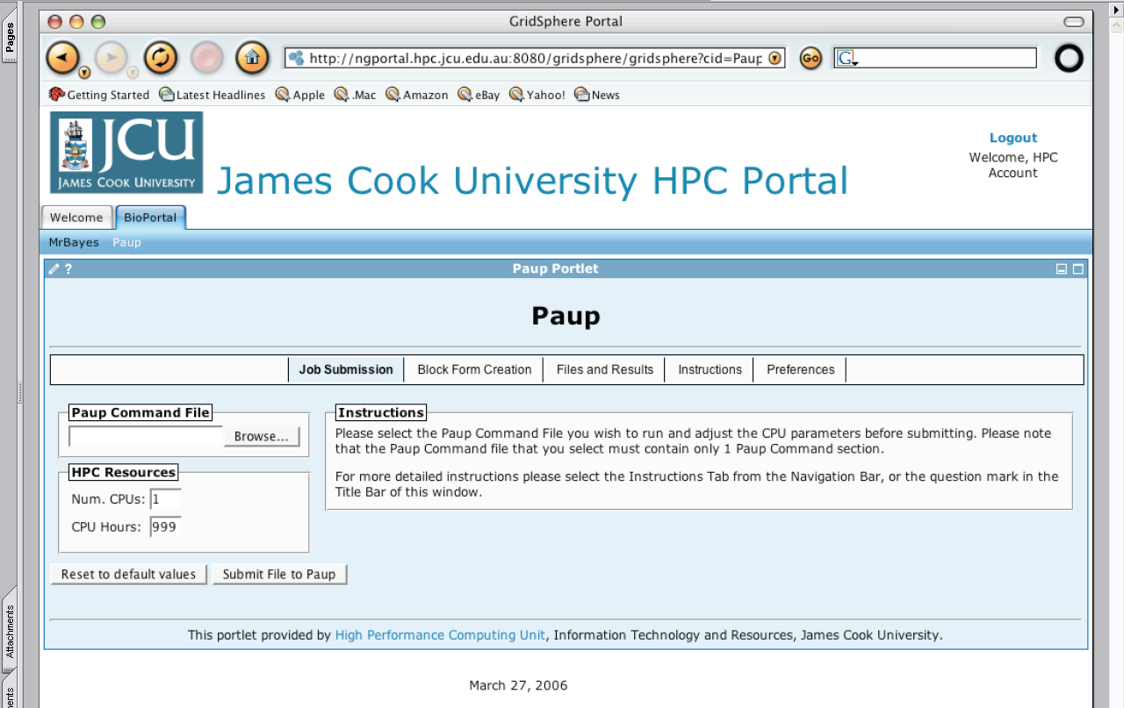
BioPortal (Paup)

Slide 10
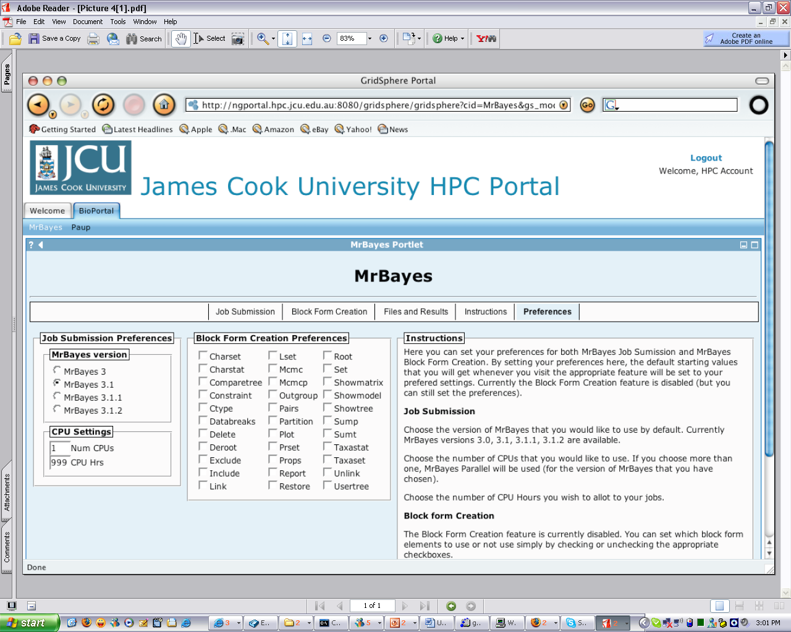
BioPortal (MrBayes)

Slide 11
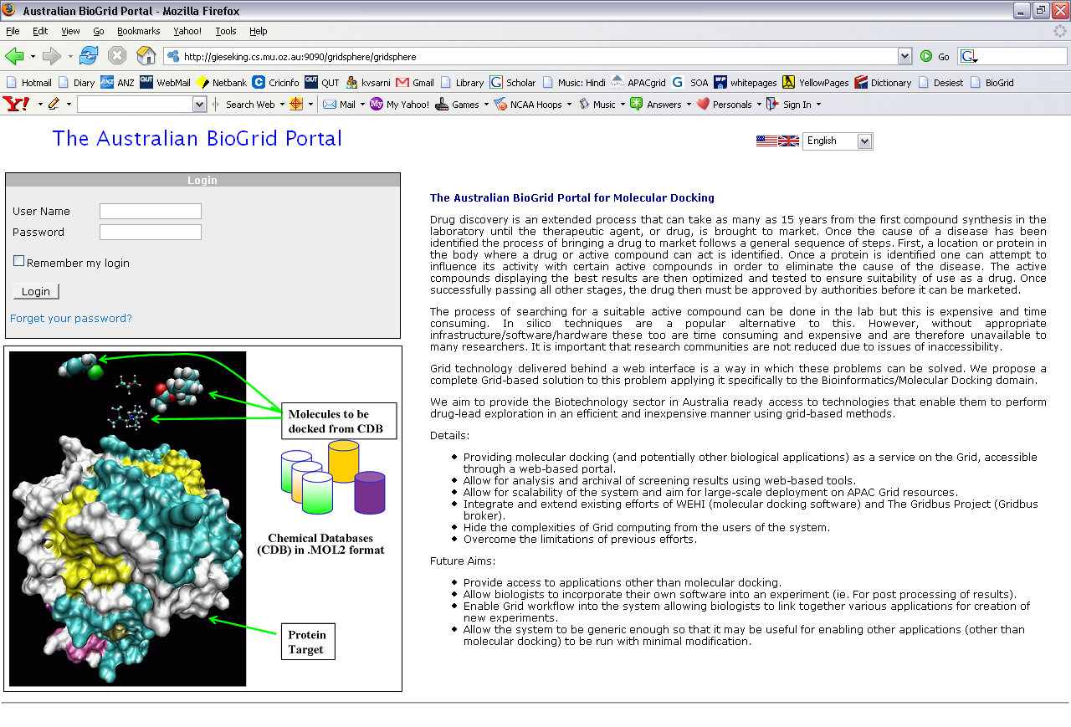

Slide 12
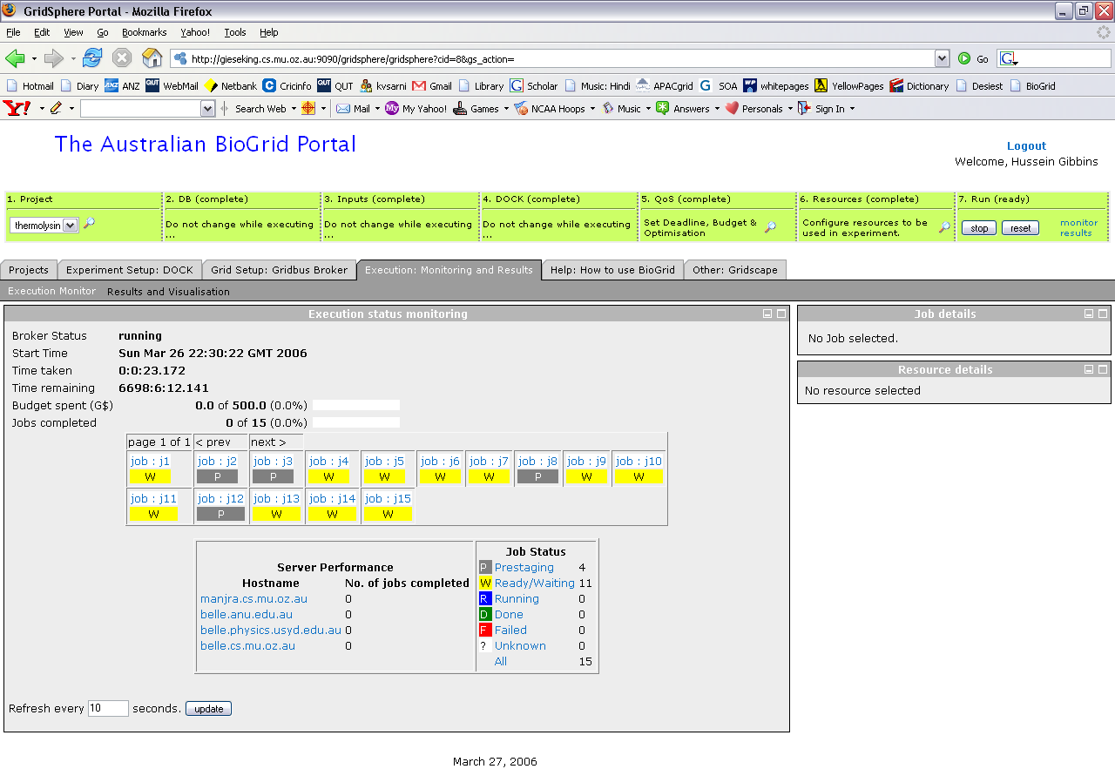

Slide 13
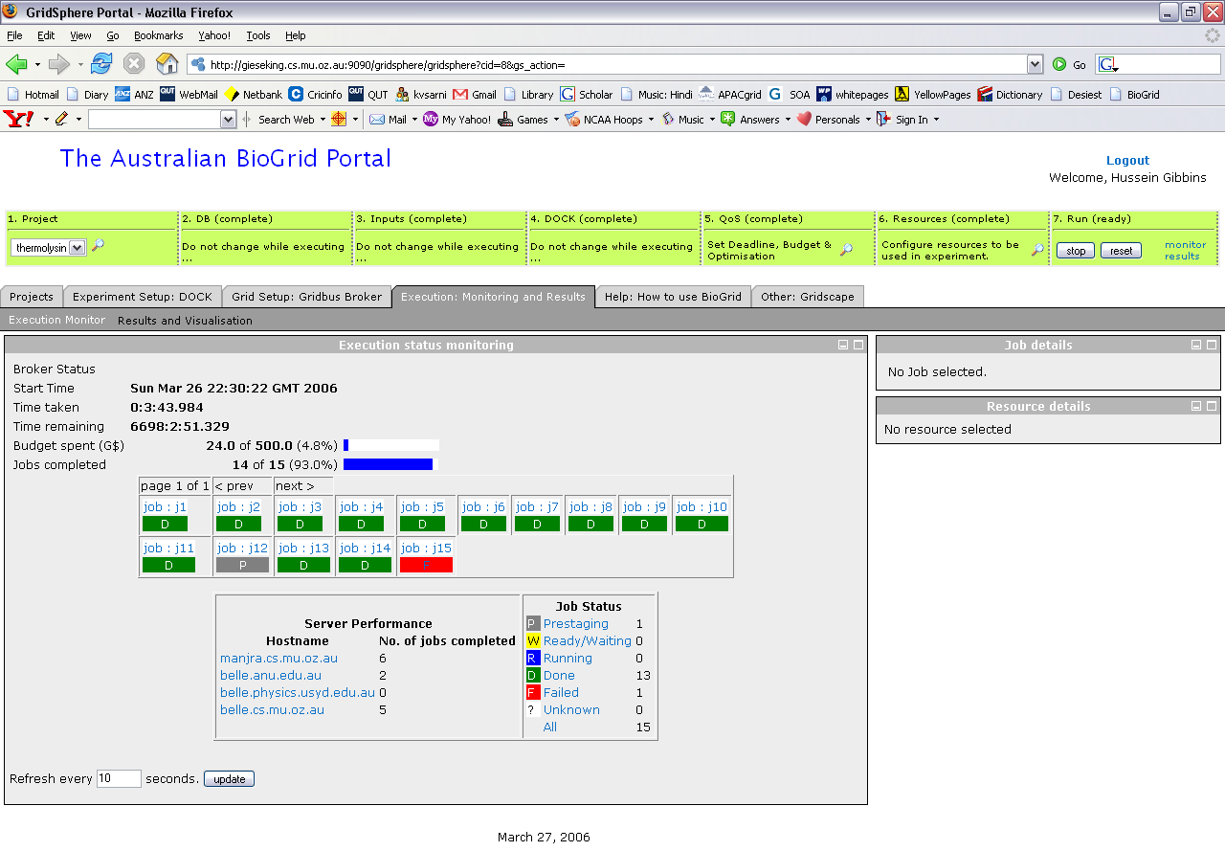

Slide 14
Demo now…
Demonstration of “Australian BioGrid Portal”
  Developed by Uni of Melbourne
    Hussein Gibbins, Rajkumar Buyya et. El.
Demonstration of “Abaqus Portal”
  Developed by QUT
    Matthew Watts, Ashley Wright

