Slide 1
Resources WG Update
PRAGMA 10

Slide 2


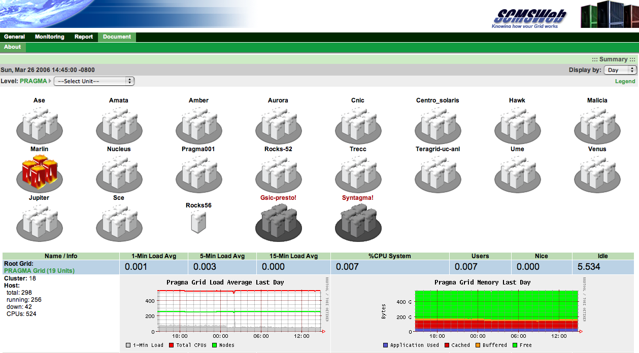
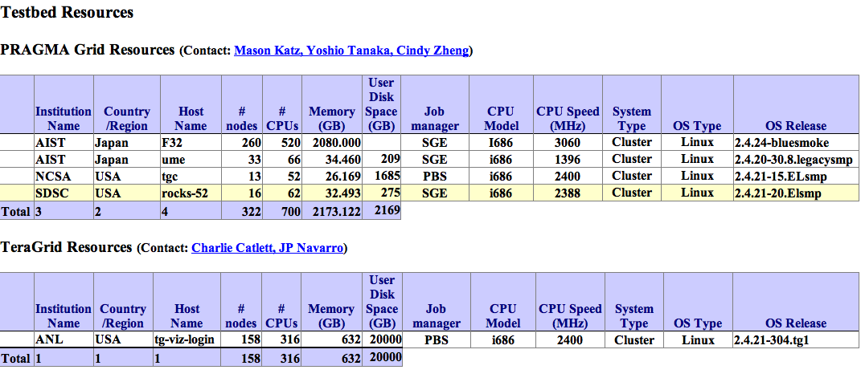
Interoperability
PRAGMA <-> TG (ANL)
Moving onto EGEE
GGF GIN group
Trust Enabled by APGrid PMA

Slide 3
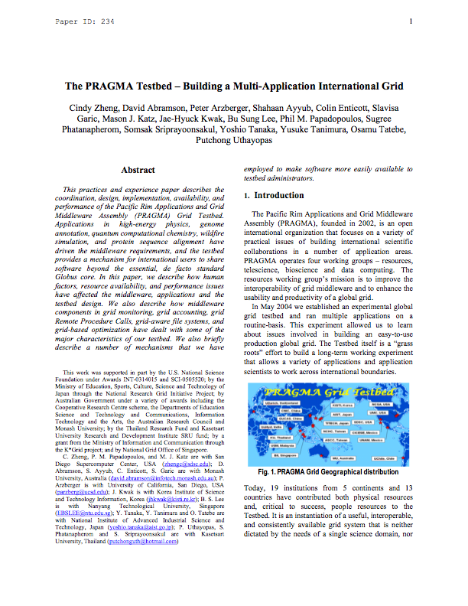
CCGrid ‘06 Paper

Slide 4

Sage
Tile-Display Walls
Created by EVL (UIC)
Joint EVL-UCSD effort
  Integration into Rocks
  CalIT / OptIPuter users
  Software released for others
    CNIC
    Osaka
    AIST
    KISTI
    Others…

Slide 5
Breakout Session Agenda
Today (90 min)
Routine Use Experiments (20 min)
CA (10 min)
Migration to GT4 (15 min)
PlanetLab (20 min)
Sage / Viz Clusters (5 min)
Tomorrow (60 min)
Paired with Data WG
Time for Open Discussion

Slide 6
Unofficial Trip
Wed (all day)
  8:00am - 5:20pm
  $139 (AUS)
Making reservations today
See me or Teri by 1:00pm today if you would like to attend
This is similar to the trip happening on Fri.

Slide 7
Highlights of Breakout Session
SCMSWeb
  Moving to GLUE schema
  Long term development (6-12 mo)
Gfarm
  Next routine use app will be installed in Gfarm
  Gfarm is becoming a universal requirement
  “Community Software Area” from TG?
GT4 Usage Statistics
  Non-issue, we all know
PRAGMA CA
  Expected operational by next meeting

