Slide 1
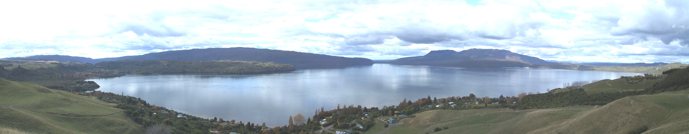
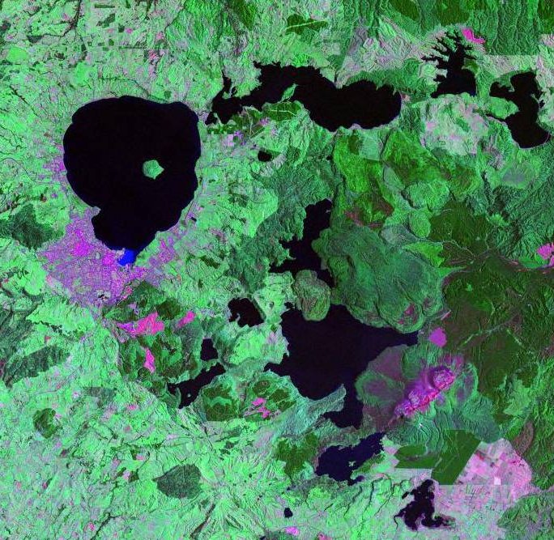
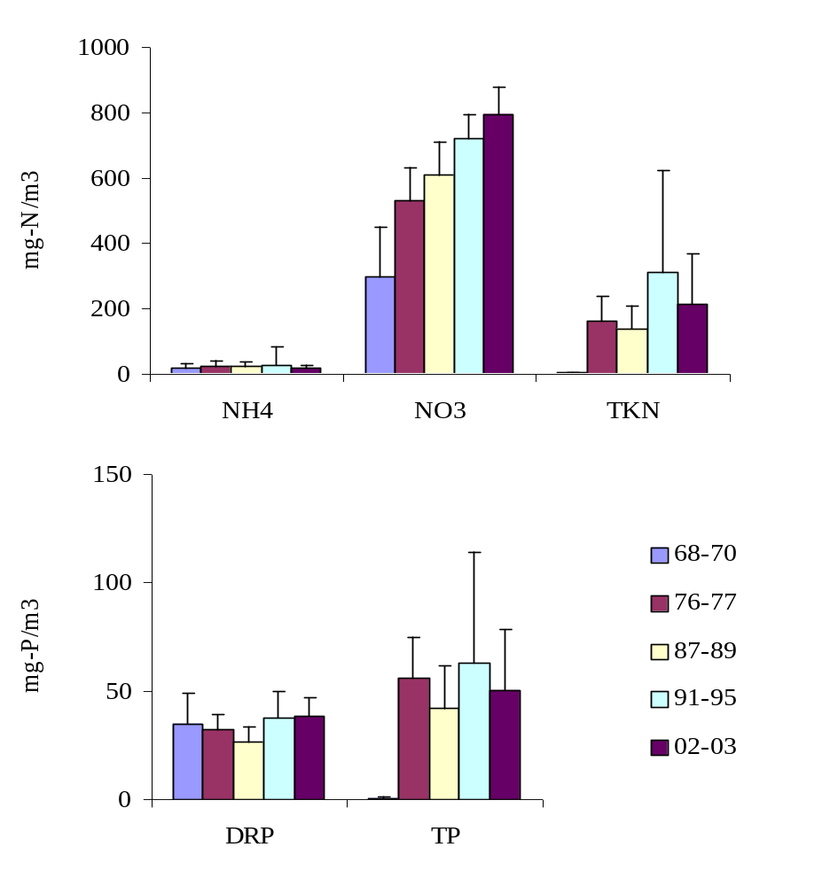

The New Zealand connection: Rotorua lakes
Location
Stream nitrate levels
N
David Hamilton and Chris McBride
University of Waikato, New Zealand

Slide 2
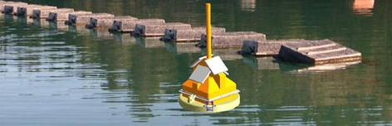
Sensors – Lake stations
Light meters
Thermistor string - Apprise Technologies “TempLine”
Dissolved oxygen - Zebra-tech “d-opto” optical sensors
Fluorometer – Seapoint chlorophyll fluorometer
pH and chloride – INW “TempHion T3” sensors
Irradiance – Appogee QSO quantum sensors
Datalogger – iQuest “DS-4483” logger
DO
~1.5 m
chl a
pH/chloride/temp
Thermistor string (11 sensors)
redox/nitrate/temp
pH/chloride/temp
DO
~ 20m

Slide 3
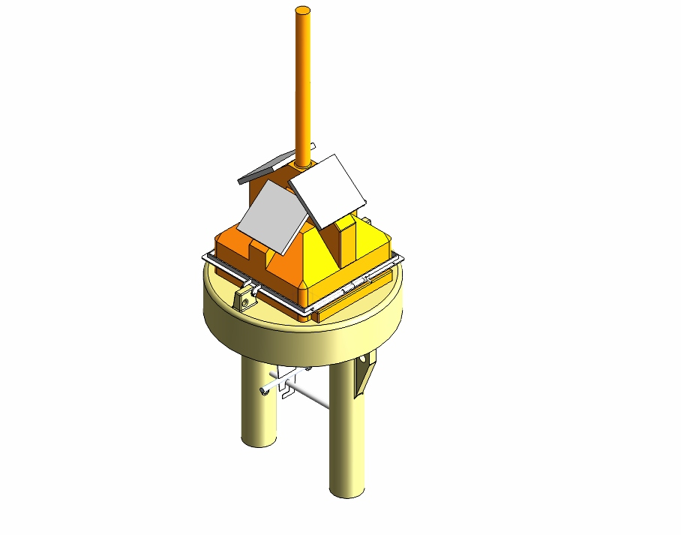
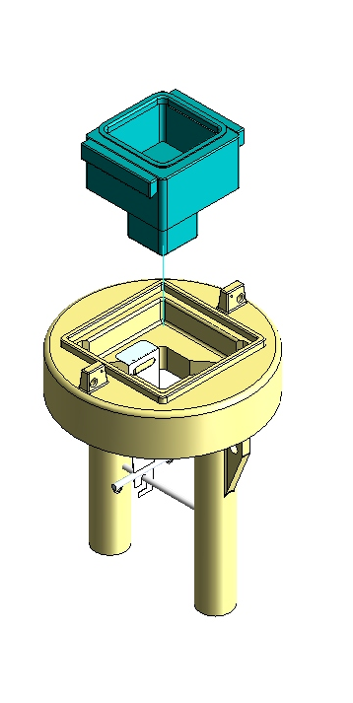
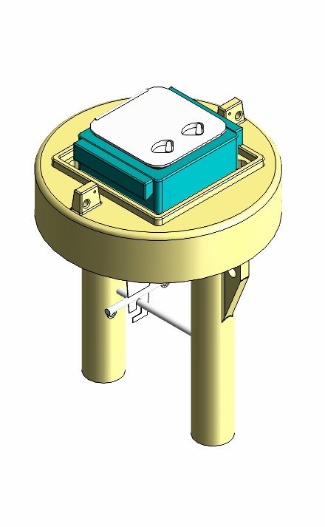
Buoy design

Slide 4
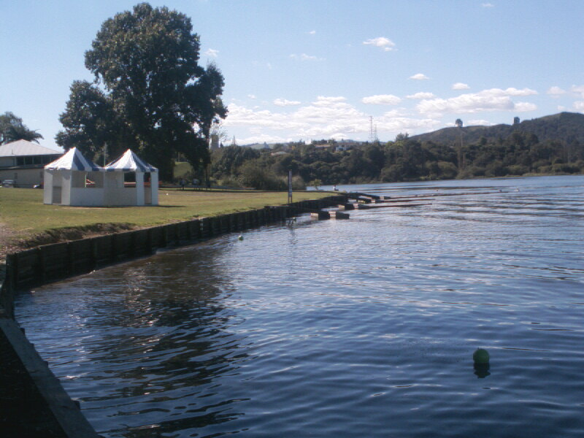
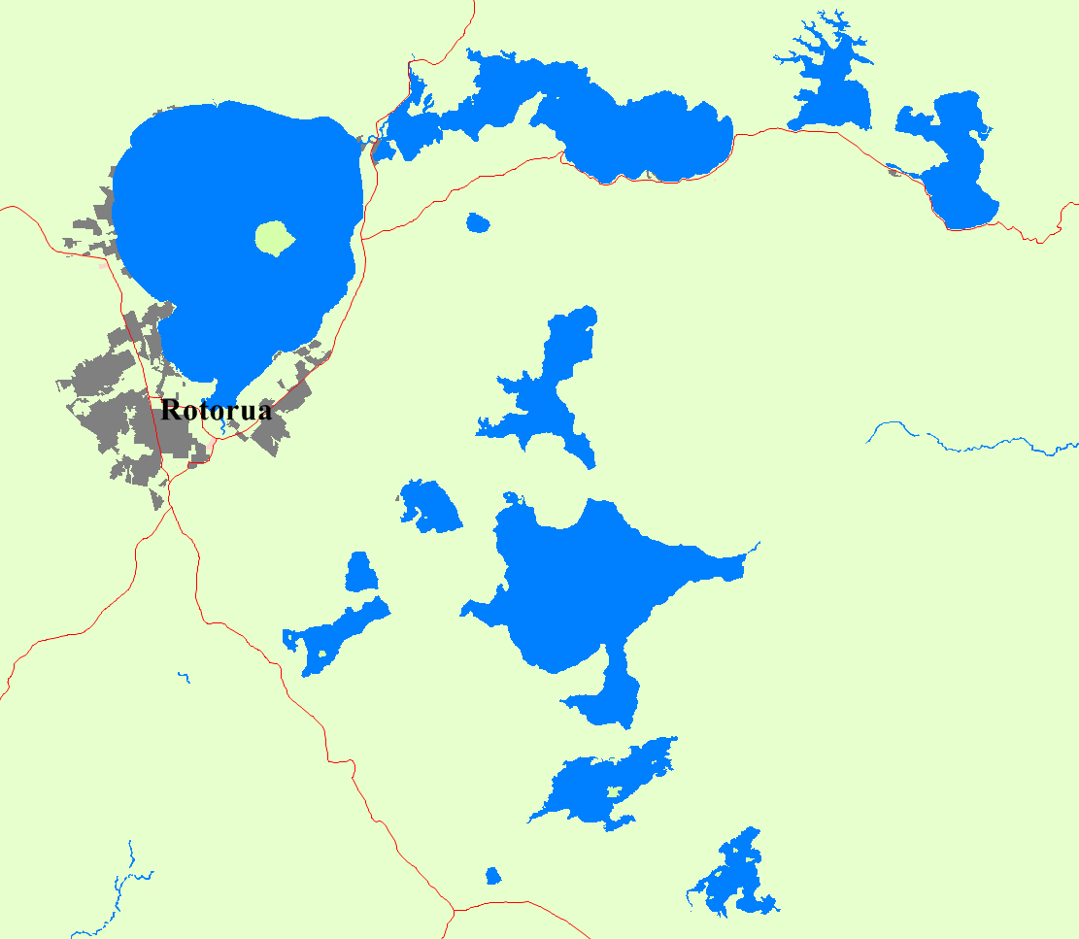


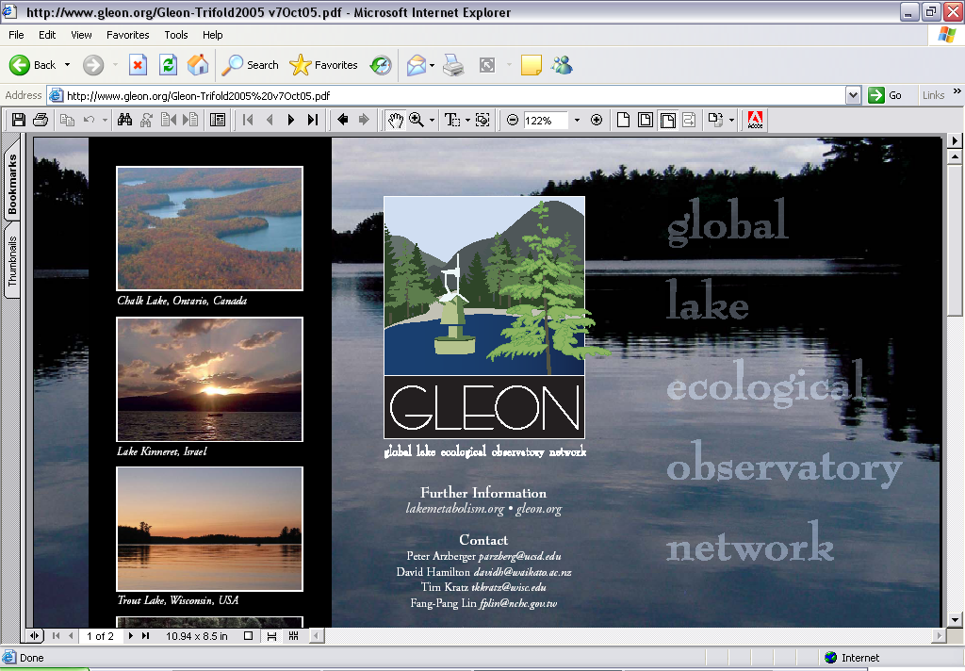

Rotorua Lakes remote sensor network
L. Rotoiti:
Crater
L. Rotorua
L. Rotoiti:
Narrows
L. Tarawera
Tarawera:
Weather station
Select a lake or weather station from the
map above to view summary graphs/data
OR
Choose your own sensors/lakes/date ranges to make graphs or download data.

Slide 5
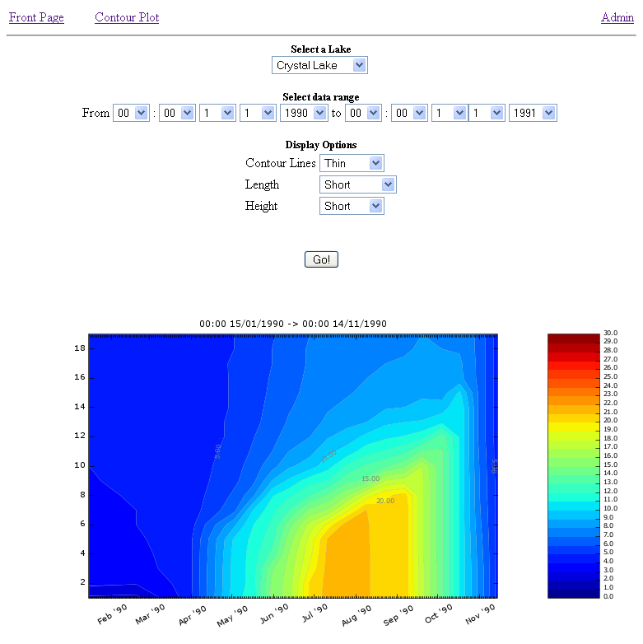
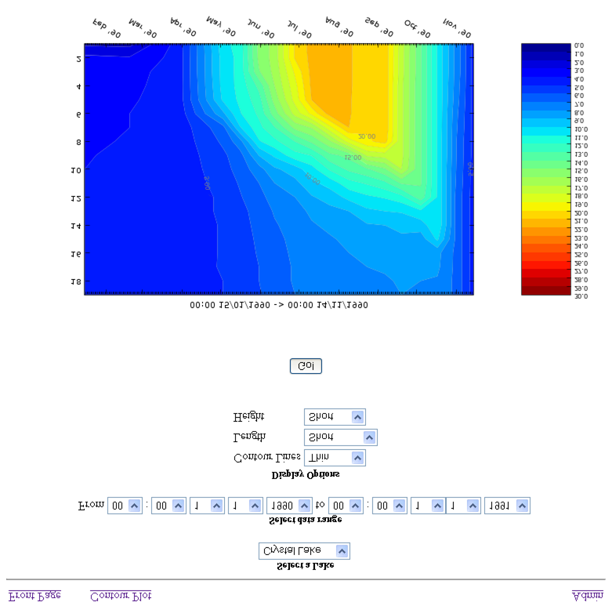
Web interface - Lake Rotorua
Values logged at:
14:15:00
Sensor | Value | Last logged | Graph last: | Graph last: | Graph last:
DO [%sat]- surface | 9.00 | 14:15:00 |  | 1 week | 6 months
DO [%sat] - bottom | 5.00 | 14:15:00 | 24 h | 1 week | 6 months
Chlorophyll a [ug L⁻¹] | 10.00 | 14:15:00 | 24 h | 1 week | 6 months
pH - surface | 7.00 | 14:15:00 | 24 h | 1 week | 6 months
pH - bottom | 7.00 | 14:15:00 | 24 h | 1 week | 6 months
Cl⁻ [ppm]- surface | 0.00 | 14:15:00 | 24 h | 1 week | 6 months
Cl⁻ [ppm] - bottom | 0.00 | 14:15:00 | 24 h | 1 week | 6 months
ORP - bottom | 0.00 | 14:15:00 | 24 h | 1 week | 6 months
NO₃⁻ [ppm] - bottom | 0.00 | 14:15:00 | 24 h | 1 week | 6 months
24 h
0 m
21.4 °C
2 m
21.4 °C
4 m
21.4 °C
6 m
21.4 °C
8 m
21.4 °C
10 m
21.4 °C
Last: 2 weeks 2 months 1year
30
0
12 m
21.4 °C
5
25
14 m
21.4 °C
Temperature [ºC]
Depth [m]
20
16 m
21.4 °C
10
15
15
18 m
21.4 °C
20 m
21.4 °C
20
10
TempLine
thermistor
string
Sep
Dec
Mar
Jun
Homepage

Slide 6
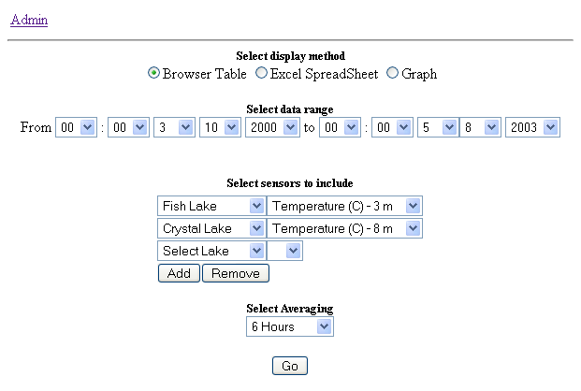
Web interface - Lake Rotorua

Slide 7
Web interface - Lake Rotorua

