Slide 1
Tele-science & Ecogrid
Working Group
Shinji Shimojo
Fang-Pang Lin

Slide 2
Participants
Kenneth Chiu
Jim DeRoest
Rick McMullen
Haiyan Au
George Mclaughlin
Kazunori Nozaki
Seiichi Kato
Hsiu-Mei Chou
Fang-Pang Lin
Steven Peltier
Shinji Shimojo
Ian Atkinson
Susumu Date
And more…

Slide 3
Tele-Science
We have seen various projects
  successfully completed & on-going
    Fang-Pang ECOGRID, NEESgrid
      Fujikawa OMNIDirectional Camera
    Steven Peltier Tele-science Portal for tomography
      Nozaki TDW as an infrastructure
    Rick CIMA (Common Instrument Middleware Architecture)
    Ian Organising sensors
    Heon NeedsGrid
    Jim HDTV streaming
    Heiyan An E-science: avian flu research
What next ?
Our group is growing and there will be a need for shared infrastructure of tele-science

Slide 4
PRAGMA blessed Stack ?
Rather than doing Top-down,
Let’s go Bottom-up
Let’s first identify all the needed components and find out what have been used.

Slide 5
Components needed
Authentication
Portal
Scheduler
Meta-scheduler
Workflow system
Control Protocol
Data storage
Data Movement/Data Conversion
Video/audio/data streaming (live/replay)
HTDV streaming
Capture/Store
Chatting
Video conferencing
Visualization
Maybe a lot more……

Slide 6
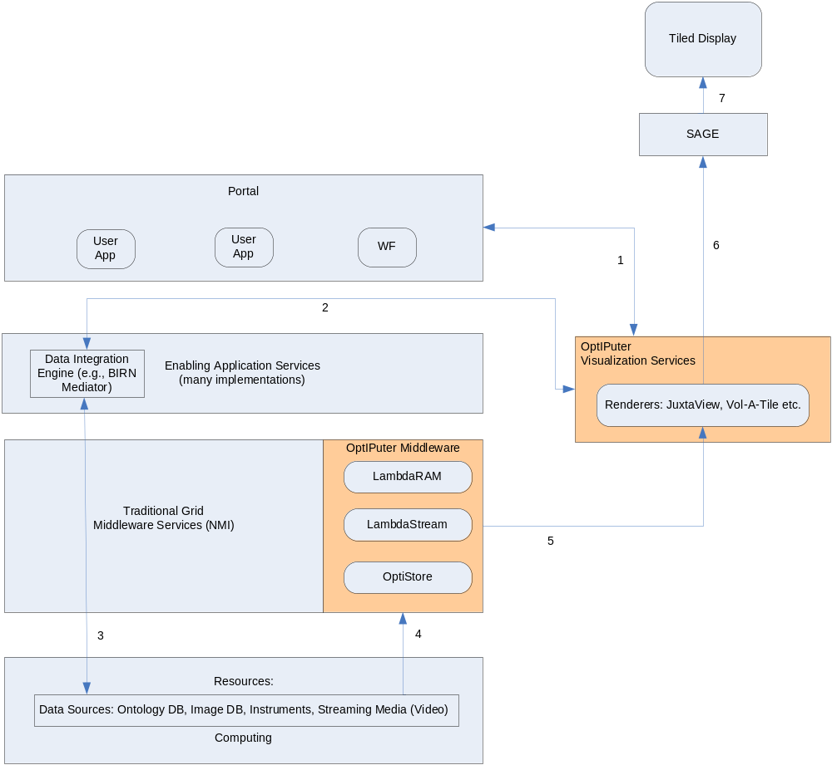
Generalized Architecture w/ TDW Integration
Steven Peltier

Slide 7
For each project,
Find out what software have been used…
GT3, GT4, myproxy,
Access Grid, , , ,
Gridsphere
Make a complete report !
use e-mail and Blog

Slide 8
Our Future
Set up Mailing list and Blog (Thanks Ken!)
Briefly describe your tele-science infrastructure on Blog
We will gradually come up with common architecture and infrastructure for telescience with help of other WG (especially Resource)
We are going to apply to HPC Analytic Challenge
  Competition is a driver to synthesize our effort !!

