Slide 1
Telepresence system with omni-directional cameras
Kazutoshi Fujikawa
Nara Institute of Science and Technology
fujikawa@itc.naist.jp

Slide 2
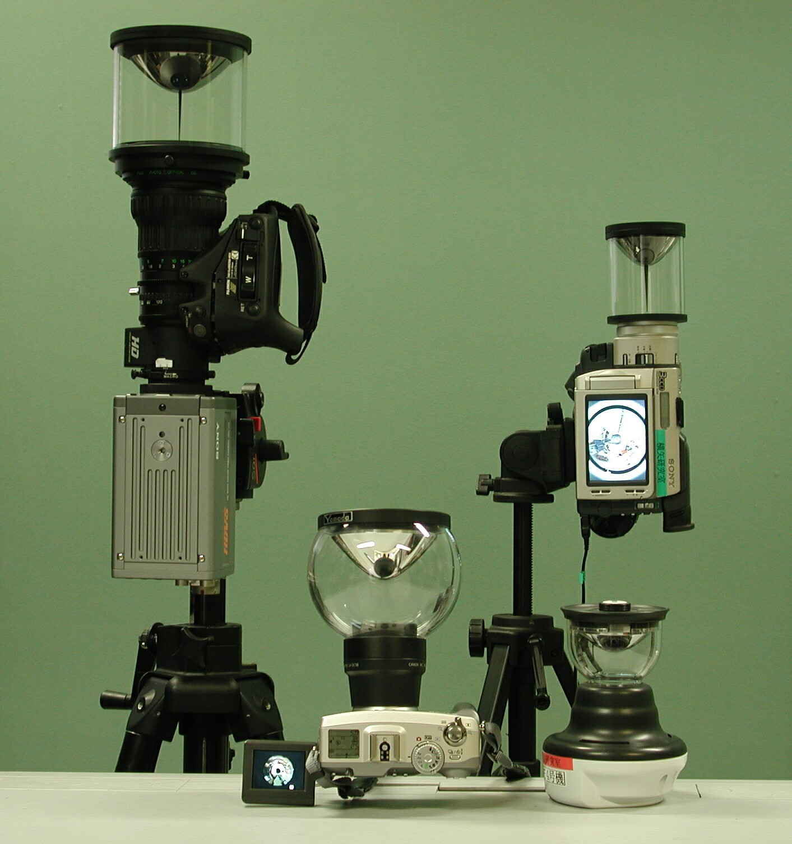
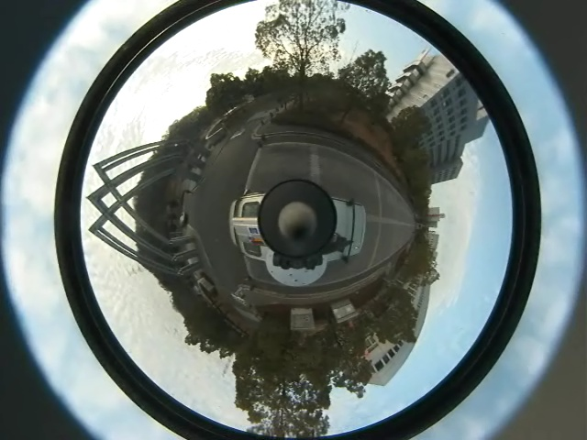
Omni-directional cameras and their image
Omni-directional
cameras
Acquired image

Slide 3
Location Independent image
Can be generated from images of three omni-directional cameras.
Actual camera
Virtual camera

Slide 4
Live demonstration
You can see a guy is walking in the demo room (probably).
Frame rate is about 1fps.
  It depends on the image quality.
  Currently we use uncompressed TIFF format.
I hope the demo works well!!

Slide 5
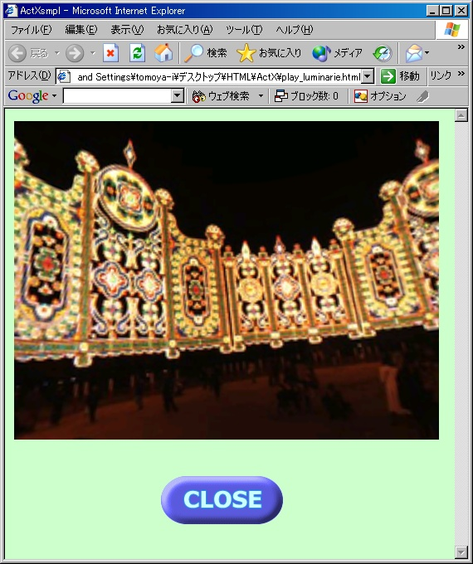

Demo environment
Four omni-directional cameras.
  System selects three cameras by user’s location.
Virtual images are created on cluster system in Nara Institute of Science and Technology.
Townsville
Nara
Actual camera
Viewer
Virtual camera
User terminal
Image streaming module
Image calculation module
Computational resource

