Slide 1
Telescience Update
Shinji Shimojo
Fang-Pang Lin

Slide 2
Discussions
1. Environment:
a. Common Test Platform:
b. Common Architecture
i. Middleware <led by Tomas Molina>
ii. Viz Wall (TDW) <Framework from Jason Leigh>
2. Applications:
a. General Targets: <Need Shinji’s guidance>
i. On demand real-time streaming.
ii. Distributed measurement
iii. Scalable, adaptive, reusable…
b. Applications: Bio-medical, Earthquake, Flood Control,
Meteorological, Agricultural, Ecological, Oceanographic
    c. Other requirements:
i. For general users <requirement proposed by Joe>
d. Tech Targets:
Test limit of sensor streaming data.
How far we can get for grid services
Real time video streaming
<Andrew Chien (Optiputer, UCSD)>

Slide 3
3. Possible joint Tests (real work & live demo)
a. SC 2005
      Telescience using Viz Wall: KBSI, KISTI, Osaka, UCSD, NCHC
      Coral Reef Ecosystem video streaming (Ecogrid): NCHC, UCSD, Nara, Osaka, KISTI
b. PRAGMA 10 -- Prepare Challenge proposal (by Mar 2006)
      Telescience using Viz Wall!
      Real time sensor data from: (multiple projects for real science) GLEON lakes (Trout lakes, YYL … etc), CREON reefs (GBR, KT…etc)
      Agriculture--
a. SC 2006
      Attend Grand Challenge for real time Sensor data! (need cross workgroup collaboration)
b. Others:
i. NEES collaboration.
ii. Agriculture.
4. Longer Term Planning <Raja, Tomas>
a. PRAGMA real time datagrid with PRAGMA PR-POP (ref. Roadnet POP or BIRN RACK)
b. A PRAGMA blessed software stack on the common hardware platform. (effective, but cheap)
c. Global Applications as drivers <Fang-Pang>

Slide 4
Update
Live demo of Omnidirectional Camera on SC05 (also in this breakout)
2 tiled display is about to be installed in Osaka U.
New applications come up.
Ecogrid update

Slide 5
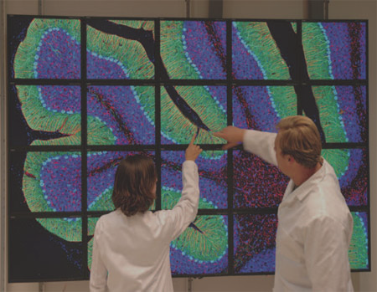
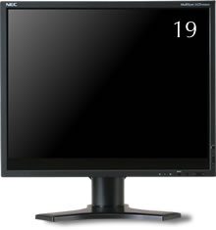
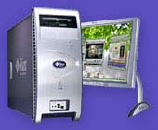
Sensor Wall (Viz Wall)
2 set of 4x5 tiled display will soon be installed on Osaka Univ. campuses.
  Hard ware
    NEC 19 inch LCD1990SXi (20 + 1)
      Resolution 1280 x 1024
    Sun Java Workstation W2100z (10+1)
      AMD Opteron 2.6GHz x 2
      8GB Main memory
      HDD 140GB+
  Software
    ROCKS vizRoll
    SAGE (Scalable Adaptive Graphics Environment)
    LDViz (M.Nakagawa, 2005)

Slide 6
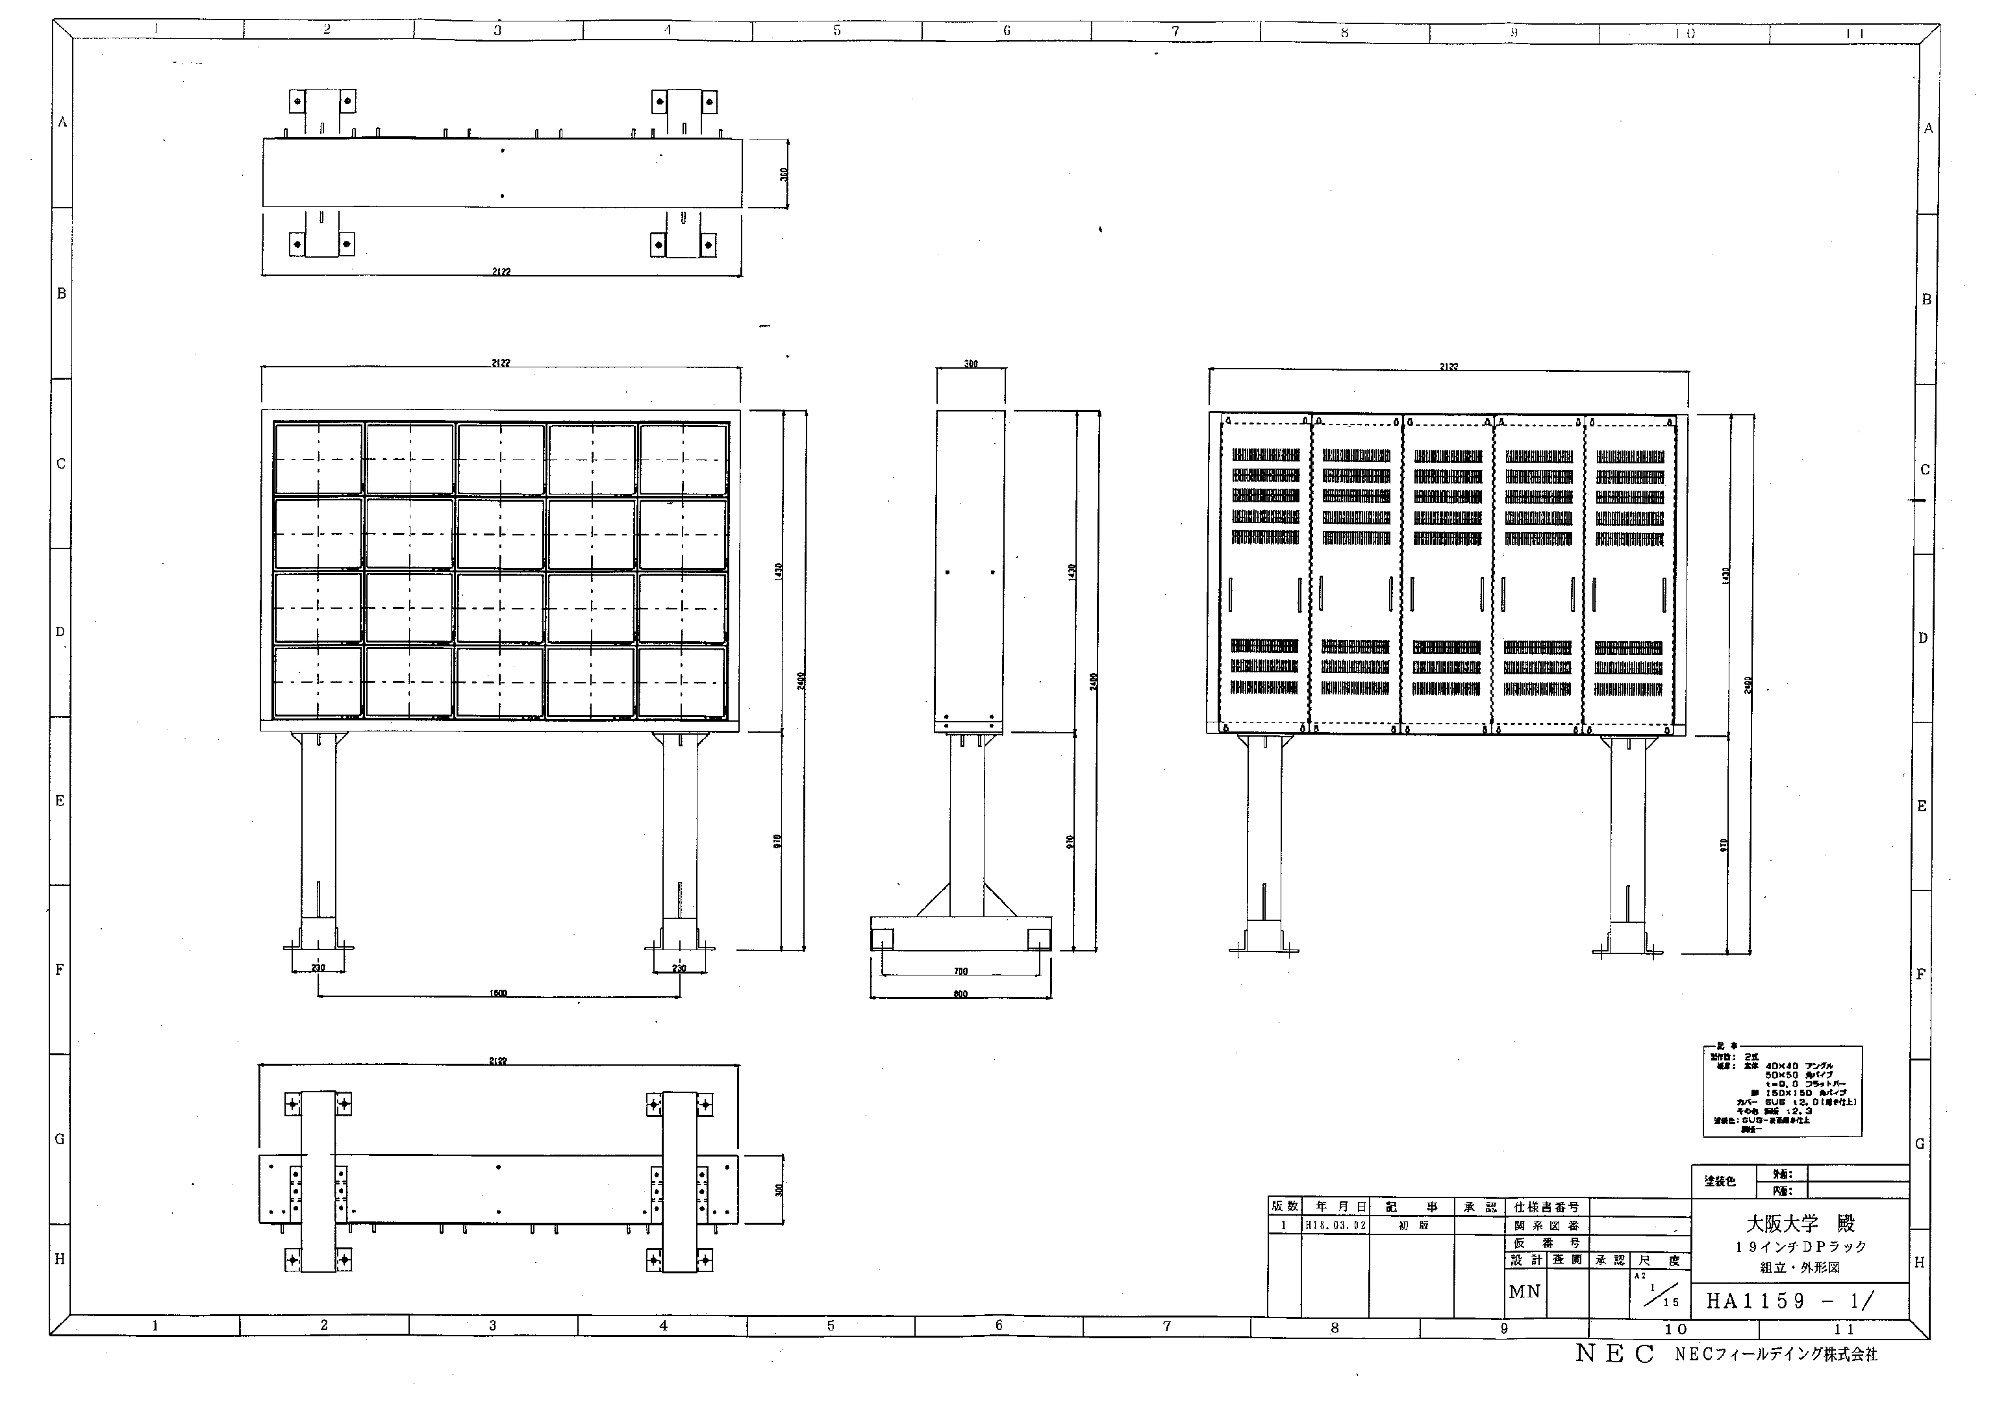
Tiled Display at Osaka U.

Slide 7


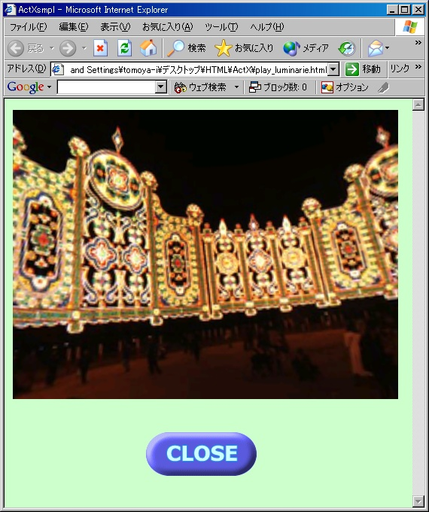


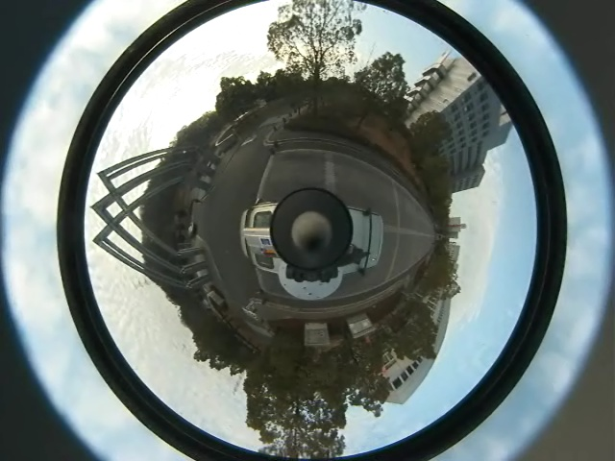
Demo environment
Four omni-directional cameras.
  System selects three cameras by user’s location.
Virtual images are created on cluster system in Nara Institute of Science and Technology.
Townsville
Nara
Actual camera
Viewer
Virtual camera
User terminal
Image streaming module
Image calculation module
Computational resource

Slide 8
Live demonstration
You can see a guy is walking in the demo room (probably).
Frame rate is about 1fps.
  It depends on the image quality.
  Currently we use uncompressed TIFF format.
I hope the demo works well!!

Slide 9


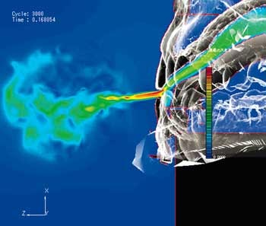
10Gbps data transfer
Hardware
CT
TDP
site
10G
router
HITACHI
JGNII network
JGN2 Cluster
10Gbps
(LR)
G-rx-csi
TDP
site
10G
router
iSCSI
10Gbps(ER)
CFD computation
Ct6509
Node #1
Node #1
Node #2
Node #2
Node #3
Node #0
10Gbps(LR)
Hp
Provurve
Node #3
Ct3460
10Gbps
1Gbps
Node #22
Node #23
Node #22
SAGE
Node #24
Node #23
Node #24
Tiled Display
Volume data (53Mbyte)
1.27Gbyte
Notes:
Confidential
そこで、このスライドのようなシステムを構築中だ。
それぞれのノードに蓄積された５３Mのデータを一挙に可視化ノードに１対１で転送する。
そこで、１０Gbpsの帯域を確保すれば、クラスタのスイッチのアップリンクさえ１０Gであれば、非常に高速な可視化環境が、遠隔であっても、実現できることになり、同時に、タイルドディスプレイの最高性能を発揮することも可能である。
同時に、ネットワークの最高性能も使用することとなる。

Slide 10



Application
Computational Grid
SSL
Medicertified
hybrid wind tunnel
Web portal GW server
Knowledge service
MPI
Volume
Display
Integrated
interface
PIV
Metadata schema service
VPN
OAI-PMH
Dublin Core
SOAP
RA server
ICD-10
DataGrid
Job control
HTTP/SOAP
Metadata service
SOAP
Terminology service
RDF
SOAP
Semantic control server
HTTP/SOAP
UMLS
SNOMED-CT
BPEL4WS
SPQRQL
Service
Invocation
GSI
Metadata catalog server
HTTP/SOAP
Wrapper
Annotation
SOAP
SRB
admin
Visualization Grid
QoS bandwidth Assurance
Volume
service
Image Analysis
service
GSI
QoS reservation service
Volume
rendering
SRB servers
DiffServe AF
Segmentation
Notes:
Confidential
先のスライドで得られる結果は、医療、発音、流体音響学的にも世界に例を見ない成果が期待できる。
これらの情報をユーザに提供するためには、このスライドのようなセマンティックWeb上でのシステム構築が必要であると、考え、現在構築中である。また、この成果は、５月のIEEE/ACM CBMSで公開予定。

Slide 11
Ecogrid & New Efforts
Townsville, Mar, 2006
Lake Metabolism & Coral Reef Study
  CLEON/CREON meetings
    2nd Meeting will be held in Townsville with highlight on Great Barrier Reef (GBF) Monitoring.
    3rd Meeting will be held in Taiwan before SC2006.
  CLEON field visit to Rotorua lakes & Kaori Reserve, New Zealand
  CREON field visit to GBR (this week)
  Virtual Museum of Marine Science and Aquarium
    Collaborate with NMMBA Combining Education and Research for Marine Science.
    HDV streaming & Virtual Reality
    IPv6-enable Giga bit network
    Lightpath study, e.g. UCLP.
Agricultural Applications
  MetBroker: An Intelligent Data Broker for Virtual Integration of Heterogeneous Distributed Meteorological Databases

Slide 12
Ecogrid & New Efforts
Extension to GeoGrid integrated with Research in Ecology, Meteorology, Remote Sensing, Hazard Mitigation.
  Data Provision will be from Nat’l Space Program. (aist)
  Consolidation of General Environmental Research within NCHC.
  Collaborate with Water Resource Agency, and possible extension to National Fire Agency (more than 1000 video camero monitoring) in TW.
Collaborate with PRIME and PRIUS
tdw

Slide 13
Issues
Tiled Display wall software integrataion
Remote Sensor applications
Integrated architecture for telescience

