Slide 1


COMPLAINTS TO RESOURCE GROUP
Habibah A Wahab, Suhaini Ahmad, Nur Hanani Che Mat
School of Pharmaceutical Sciences,
Unversiti Sains Malaysia

Slide 2
MIGRATING AMBER to GRID
SYSTEM REQUIREMENT
  Software:
  Globus 2.x, 3.x or 4.x
  Fortran 90 compiler
  Hardware:
  ~50GB of disk space
  Linux on 32bit Intel machine

Slide 3
HOW WE BEGAN…
Contact Cindy for testing resources.
Allocated Resources:
      USM – hawk.usm.my
      USM – aurora.cs.usm.my
      ROCK- 52 – rock-52.sdsc.edu
      ASCC – pragma001.grid.sinica.edu.tw
      IOIT-HCM – venus.ioit-hcm.ac.vn
      UNAM – malicia.super.unam.mx
  Thank You, Cindy!

Slide 4
HOW WE BEGAN…
Contact Cindy for testing resources.
Allocated Resources:
      USM – hawk.usm.my
      USM – aurora.cs.usm.my
      ROCK- 52 – rock-52.sdsc.edu
      ASCC – pragma001.grid.sinica.edu.tw
      IOIT-HCM – venus.ioit-hcm.ac.vn
      UNAM – malicia.super.unam.mx
  Thank You, Cindy!
Contacting the system administrators are fine, but is there any system that we could just submit our job without worrying about where they will be executed ?

Slide 5
WHAT WE ENCOUNTERED….
Hardware:
  Heterogeneous architecture between clusters
Globus Authentication:
  Requires users account in all clusters
  Globus’s user certificate setup on each cluster
  The cert need to be signed by institution CA admin.
  User have to know all clusters in PRAGMA (host address and total of nodes on each site).
  Certain port cannot be accessed.
    e.g: gsiftp port – for file transfer

Slide 6
WHAT WE ENCOUNTERED….
Hardware:
  Heterogeneous architecture between clusters
Globus Authentication:
  Requires users account in all clusters
  Globus’s user certificate setup on each cluster
  The cert need to be signed by institution CA admin.
  User have to know all clusters in PRAGMA (host address and total of nodes on each site).
  Certain port cannot be accessed.
    e.g: gsiftp port – for file transfer
This is okay, a lot of work but we wish this process could be simpler…..

Slide 7
more encounters….
MPICH/MPI
  No standard parallel software on the grid
  e.g: MPICH (ASCC, UNAM, hawk, IOIT-HCM, aurora), LAM (rocks-52)
  User need to know whether mpich/lam is configured by ssh/rsh
rsh or ssh?
  setting up rsh/ssh without password between execution nodes.
  non-standardized usage of rsh/ssh on the grid. Some clusters are using rsh and others are using ssh.
  e.g :
      rsh – IOIT-HCM
      ssh – hawk, aurora, ASCC, UNAM, rocks-52

Slide 8
more encounters….
MPICH/MPI
  No standard parallel software on the grid
  e.g: MPICH (ASCC, UNAM, hawk, IOIT-HCM, aurora), LAM (rocks-52)
  User need to know whether mpich/lam is configured by ssh/rsh
rsh or ssh?
  setting up rsh/ssh without password between execution nodes.
  non-standardized usage of rsh/ssh on the grid. Some clusters are using rsh and others are using ssh.
  e.g :
      rsh – IOIT-HCM
      ssh – hawk, aurora, ASCC, UNAM, rocks-52
How we wish there is a standard parallel software and rsh/ssh running on all the clusters in pragma testbed….

Slide 9
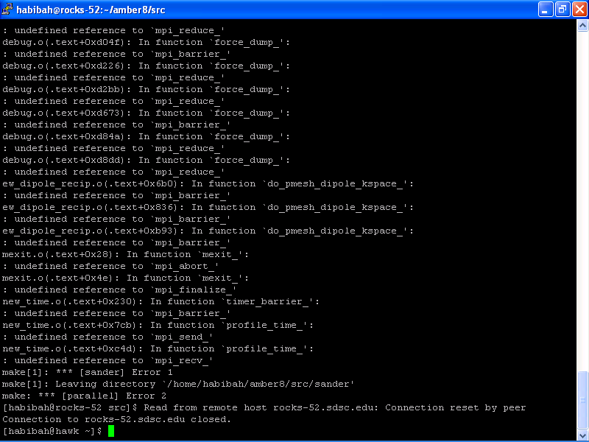
still more …..
Compiling parallel AMBER
  Unable to compiled with mpich/lam in the cluster.
  Can compile amber-mpich in rocks-52, BUT…
      1. CANNOT BE EXECUTED USING GLOBUS (Figure 1)
      2. CAN BE EXECUTED USING GLOBUS, but run on one node only

Slide 10
But there is hope for us….
executable file can be copied between clusters with similar architecture and mpich configuration.
  executables copied from HAWK to UNAM, aurora, IOIT-HCM (mpich-configured with rsh)
  executables copied from rocks-52 to ASCC (mpich-configured with ssh )
Wilfred said that Gfarm can overcome this problem… Is it true Tatebe-san?

Slide 11
Testing AMBER with Globus
Testing execution on each cluster, using globus from hawk to all sites.
Testing gsiftp for sending and receiving files using from hawk-other cluster.
Network Condition
  Globus submission depends on the network condition.
  Globus submission may fail, yet, the user will not know…
Cluster reliability
  unexpected cluster problem. System may down or cannot be access due many factors.
Or… globus was just not working.
Notes:
Globus submission depends on the network condition. Unstable network may cause the job submission to stop or unable to transfer the input/output files.
user does not know whether the job got submitted or not.

Slide 12
Testing AMBER with Globus
Cindy, Sue gave up. Instead of working on 6 clusters you allocated to us:
      USM – aurora.cs.usm.my
      ROCK- 52 – rock-52.sdsc.edu
      ASCC – pragma001.grid.sinica.edu.tw
      IOIT-HCM – venus.ioit-hcm.ac.vn
      UNAM – malicia.super.unam.mx,
      She just work with 4 clusters:
  Aurora – 300K
  ASCC – 373K, 500K
  IOIT-HCM – 400K
  UNAM – 473K
      I think you know why…..
Testing execution on each cluster, using globus from hawk to all sites.
Testing gsiftp for sending and receiving files using from hawk-other cluster.
Network Condition
  Globus submission depends on the network condition.
  Globus submission may fail, yet, the user will not know…
Cluster reliability
  unexpected cluster problem. System may down or cannot be access due many factors.
Or… globus was just not working.
Notes:
Globus submission depends on the network condition. Unstable network may cause the job submission to stop or unable to transfer the input/output files.
user does not know whether the job got submitted or not.

Slide 13
Web Interface?
  Too many commands to remember & things to do to run AMBER on the grid
  Web is more user-friendly.
  But, it employs dynamic programming to process user’s command to run on the grid
  But, must understand the application (amber) work flow and input files.
  With this user can simply run and concentrate on the simulation.

Slide 14
AMBER Work Flow
User
Grid Middleware
Simulator Engine
Structure
Coordinates
Force Field &
Topology
Creator
Minimiser/
MD
simulator
Trajectory
Analyser
PDB, XYZ,
Internal
Coord.
Prmtop, prmcrd
Mdin
Md.Out
En.out
Trj.files
Junk in, Junk out!

Slide 15

ASCC
Gsiftp inputs & results
Globus-submit jobs
IOIT-HCM
Gsiftp inputs & results
Upload files/submit jobs
Globus-submit jobs
Download & view results
Hawk
Gsiftp inputs & results
User interface
Globus-submit jobs
Globus-submit jobs
Gsiftp inputs & results
Rocks-52
Aurora

Slide 16
TESTING…..
Thermo-effects of Methionine Aminopeptidase:
Molecular Dynamics Studies
http://hawk.usm.my/AMEXg

Slide 17
Globus-job-submit….
submitted 5 jobs(5 different temperatures of the same system) to 4 different clusters.
Each job will occupy any empty cluster.
List of clusters and jobs:
  Aurora – 300K
  ASCC – 373K, 500K
  IOIT-HCM – 400K
  UNAM – 473K
Simulation time: 20ps

Slide 18
Benchmarking
AMEXg Benchmark:
Submit 4 different temperatures for the same system to 4 different clusters.
List of clusters and jobs:
  Aurora – 300K [Running on 16 nodes]
  ASCC – 373K [Running on 4 nodes]
  IOIT-HCM – 400K [Running on 8 nodes]
  UNAM – 473K [Running on 8 nodes ]
Simulation time: 20ps

Slide 19
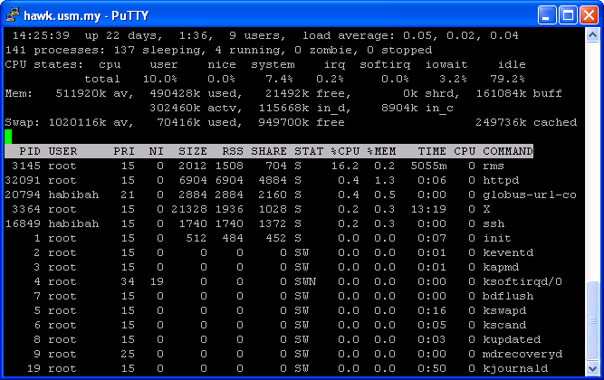
Checking……
Transferring input files from hawk to other clusters

Slide 20
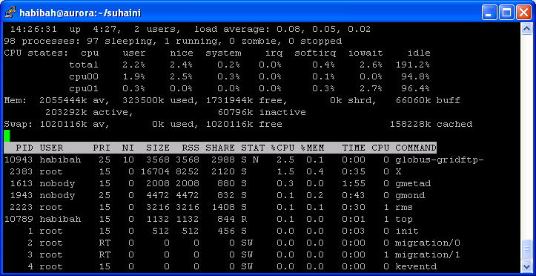

Checking……
Aurora cluster
Receiving files
from hawk
Job submitted
from hawk

Slide 21
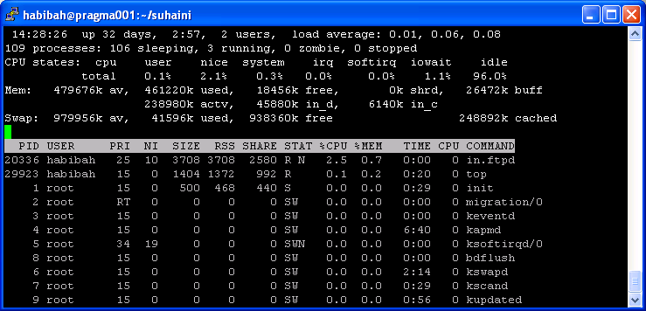
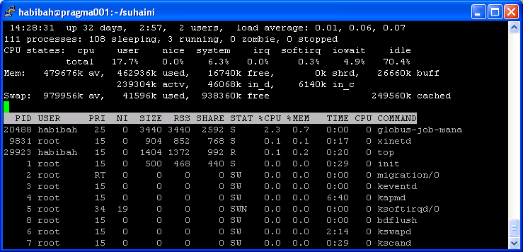
Checking……
ASCC cluster
Receiving files
from hawk
Job submitted
from hawk

Slide 22
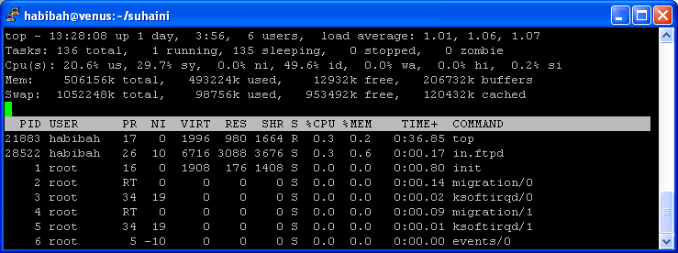
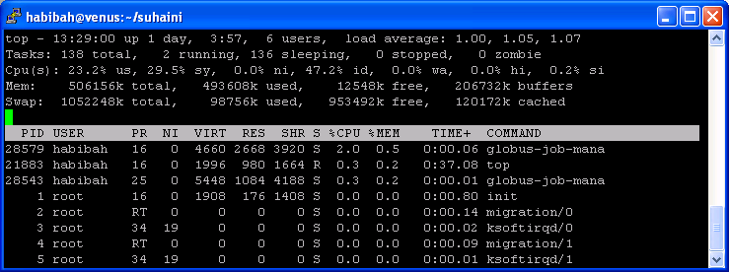
Checking……
IOIT-HCM cluster
Receiving files
from hawk
Job submitted
from hawk

Slide 23
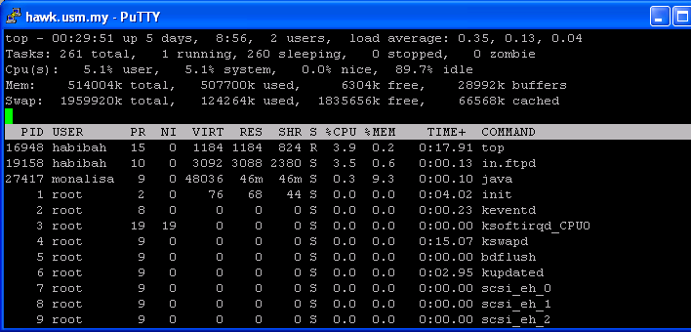
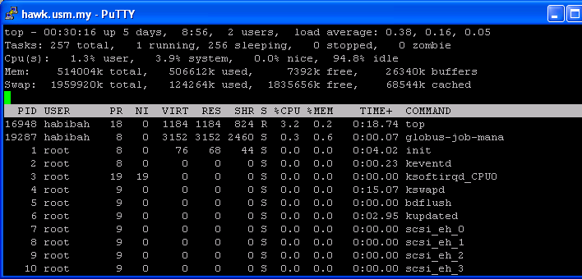
Checking……
UNAM cluster
Receiving files
from hawk
Job submitted
from hawk

Slide 24
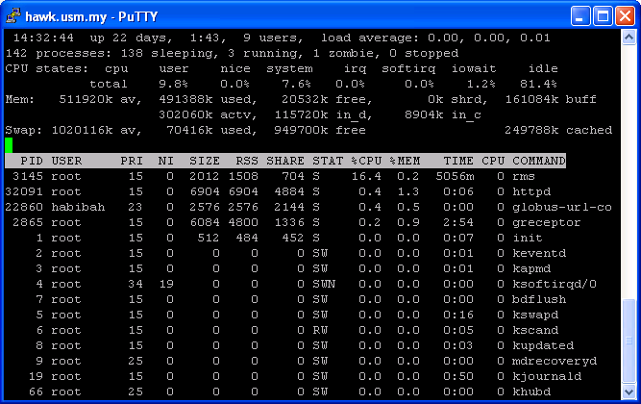
Checking……
Transferring/copying output files from clusters to hawk
Receiving files
from hawk

Slide 25
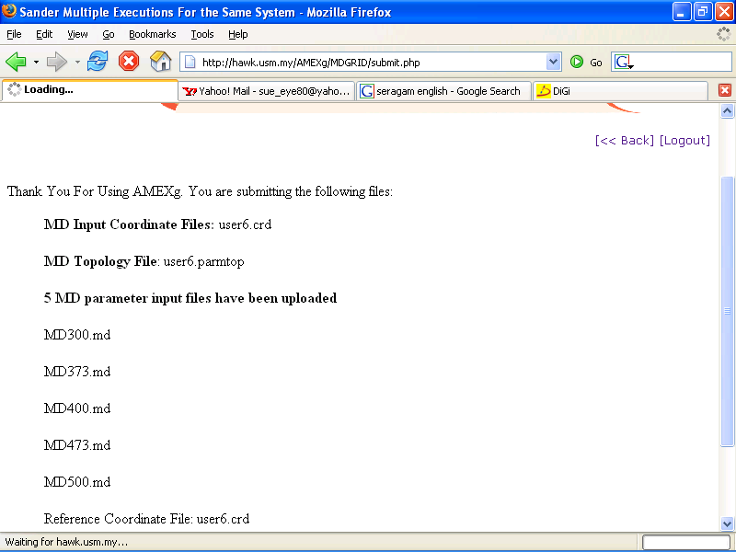
Interface displayed after uploading input files using AMEXg

Slide 26
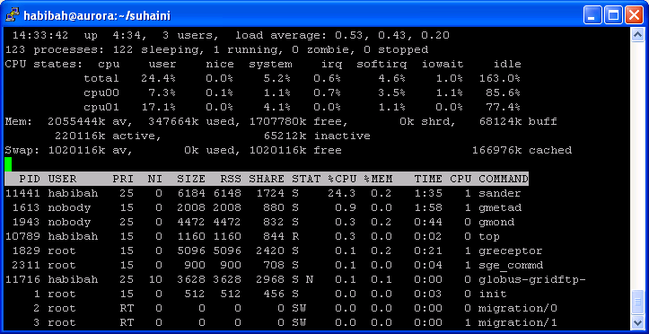
Transferring output files to hawk
Aurora cluster

Slide 27
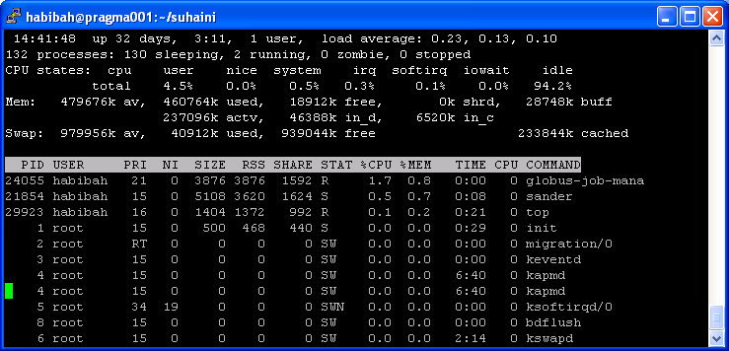
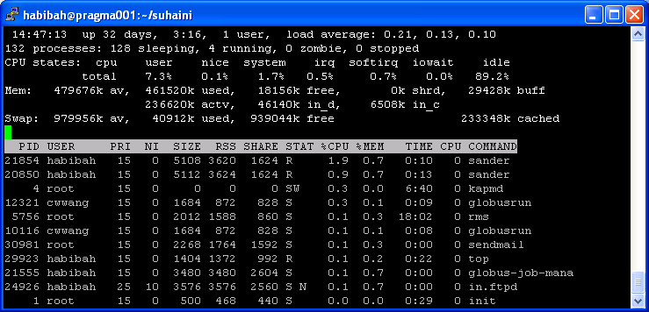
Transferring output files to hawk (cont.)
ASCC
cluster

Slide 28
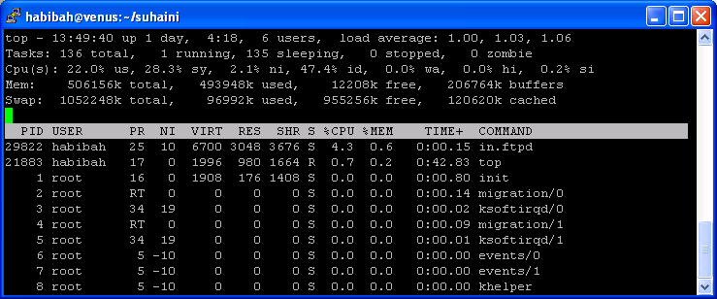
Transferring output files to hawk (cont.)
IOIT-HCM cluster

Slide 29
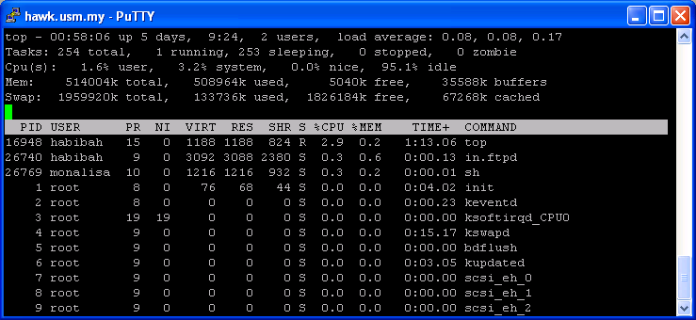
Transferring output files to hawk (cont.)
UNAM cluster

Slide 30
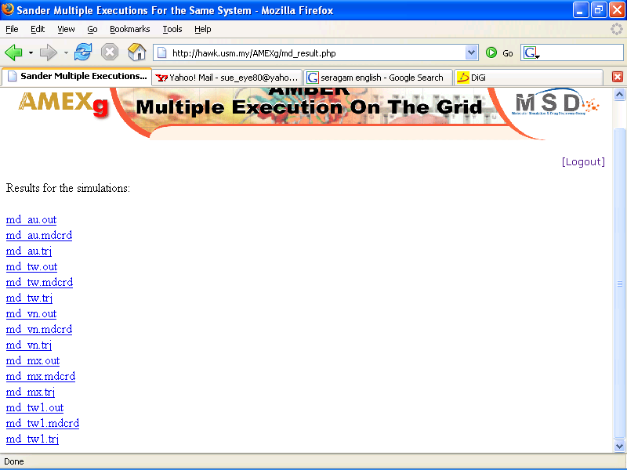
Result for MD simulation
List of output files

Slide 31
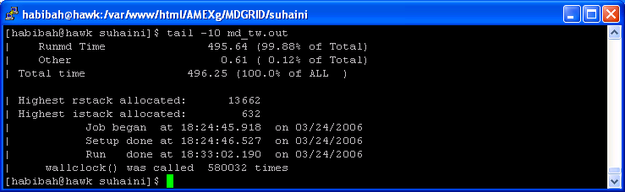
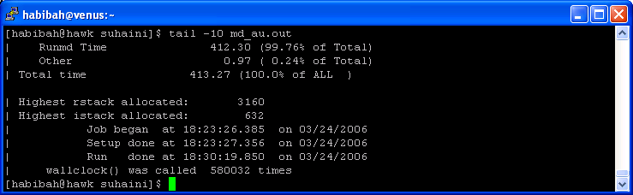


Benchmarking
ASCC – 373K
Aurora – 300K
UNAM – 473K
IOIT-HCM – 400K

Slide 32
Benchmarking
This is far from perfect…. We are working with GridSphere with Chan Huah Yong. But we are extremely happy that we can run our applications on the grid. If it is okay, we would like to run the applications from time to time on the testbed…. But soon, we need to think about the licencing issue, because AMBER is not free….
ASCC – 373K
Aurora – 300K
UNAM – 473K
IOIT-HCM – 400K

Slide 33

Sipadan Island, Sabah, Malaysia
Thank you!

