Slide 1

Care Asthma via Mobile Phone
(CAMP)
Shu-Hui (Bonita) Hung
NCHC Taiwan
2006/10/15

Slide 2

CAMP- Subject
Patient and physician User Friendly
  Peak Flow Rate (PFR) data twice daily
  Daily activities data (questionnaires)
Provides for long-term asthma care service without location/time limitations
Personalized weather condition updates and preventative measure suggestion messages
Real-time monitoring so physician can proactively help patient avoid asthma attack

Slide 3
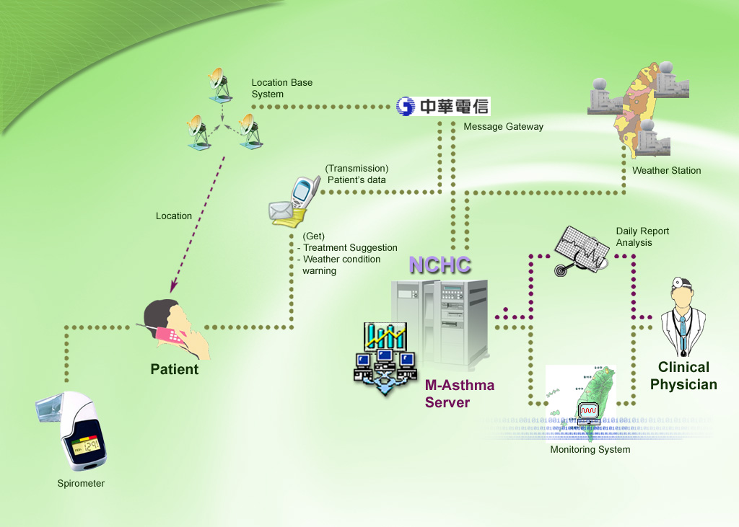
CAMP --- Flowchart

Slide 4
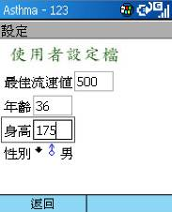
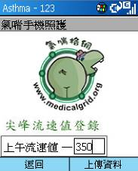
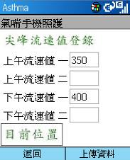
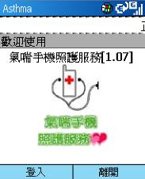

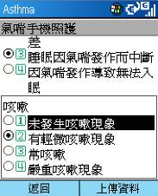
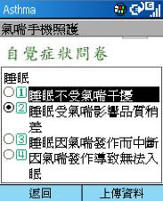
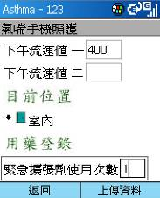

CAMP – Patient User Guide I
Log In Process
User setup
Input
View
Start
Questionnaires Answer
Coughing?
Sleeping?
In door?
Submit

Slide 5
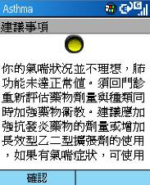
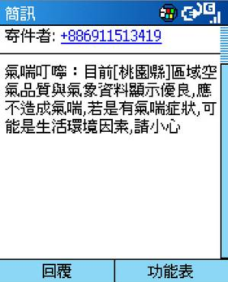
CAMP – Patient User Guide II
Asthma system Suggestion & Weather Caution Messenger
Asthma Condition?
Patient’s current location

Slide 6
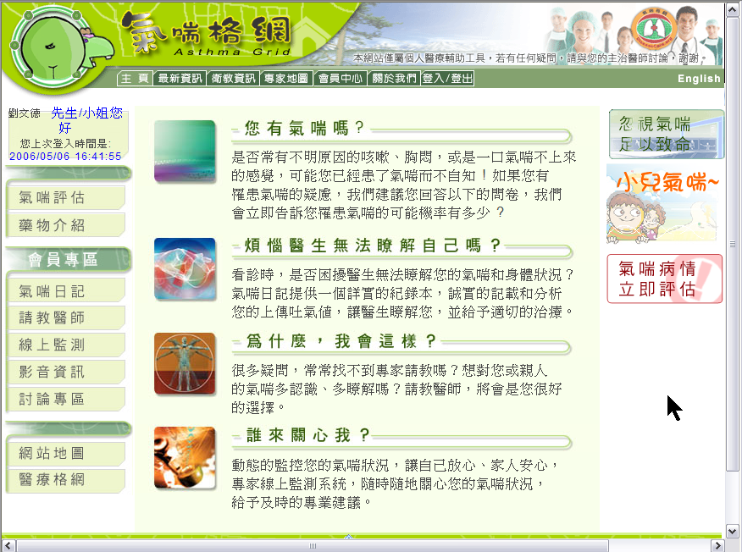
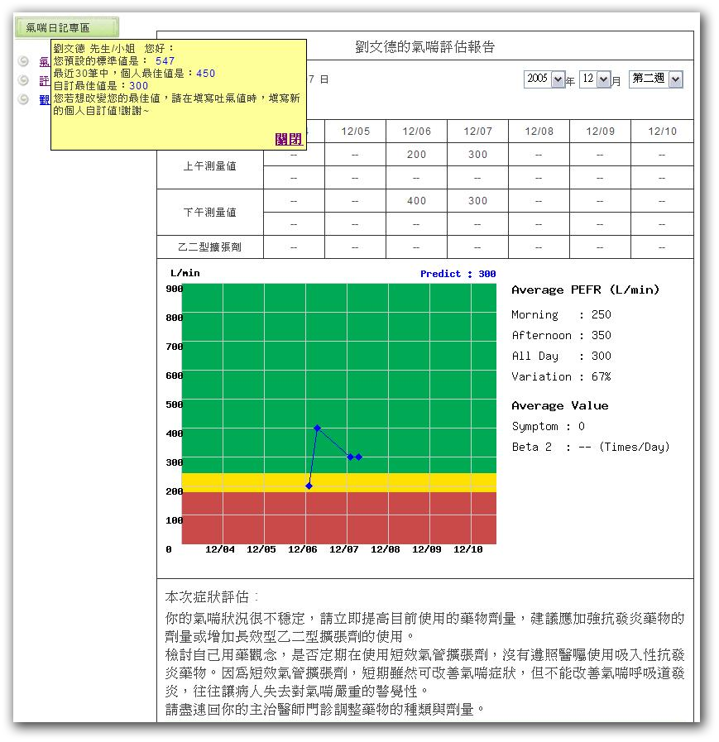
CAMP- Web Function
Patients & doctor login

Slide 7
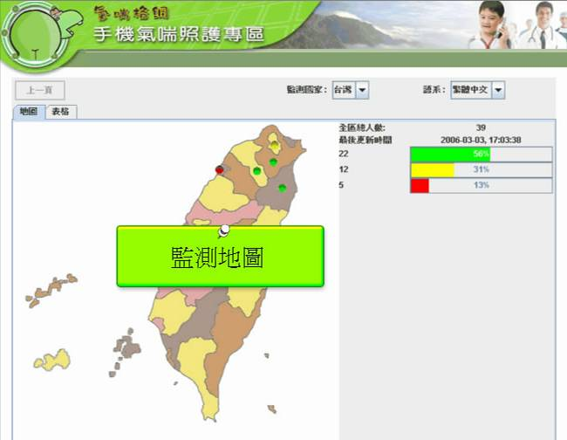
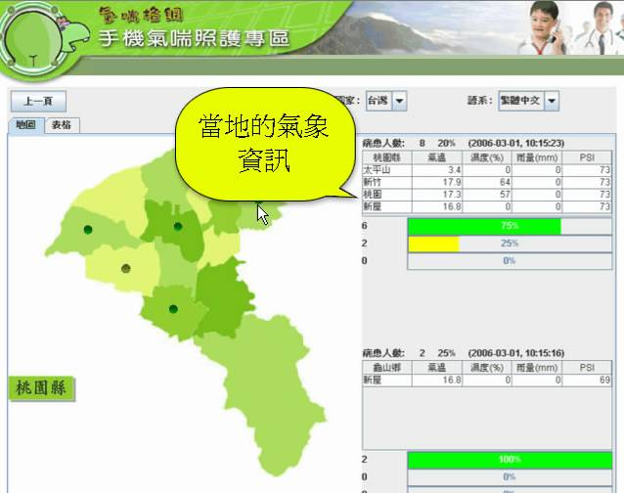
CAMP – Physician User Guide
Monitoring Map:
Patients & Weather

Slide 8
Listen to What CAMP Users Have to Say~
Video Play (5Mins)

Slide 9
~Thank you for your attention~
CAMP Website: http://www.medicalgrid.org
email: bonitahung@nchc.org.tw

