Slide 1

Progress Since PRAGMA 10
Resources Group
Pacific Rim Application and Grid Middleware Assembly
http://www.pragma-grid.net
http://goc.pragma-grid.net

Slide 2
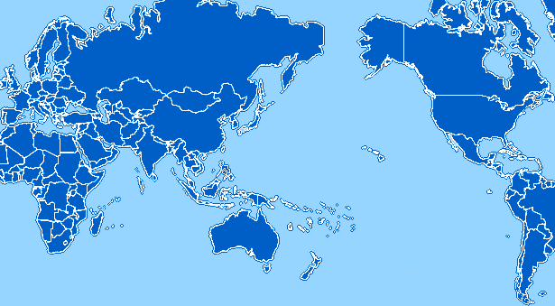
PRAGMA Grid Testbed
JLU
China
UZurich
Switzerland
BU
USA
CNIC
GUCAS
China
KISTI
Korea
SDSC
USA
AIST
OSAKAU
TITECH
Japan
NCSA
USA
KU
NECTEC
Thailand
UMC
USA
ASCC
NCHC
Taiwan
CICESE
Mexico
UoHyd
India
IOIT-HCM
Vietnam
UNAM
Mexico
MIMOS
USM
Malaysia
QUT
Australia
BII
IHPC
NGO
Singapore
UChile
Chile
MU
Australia
30 Clusters from 27 institutions in 14 countries

Slide 3
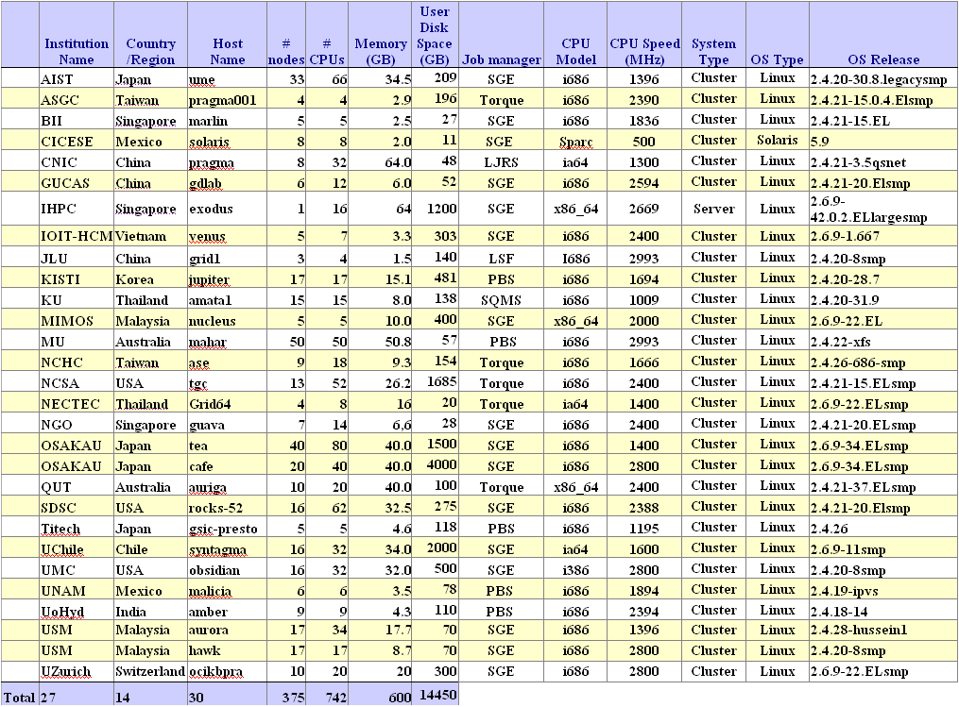
PRAGMA Grid Resources

Slide 4
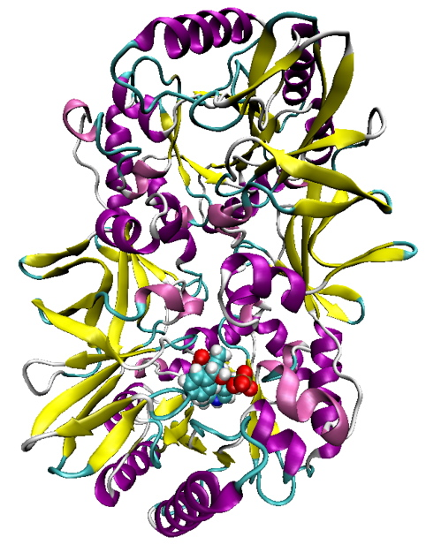
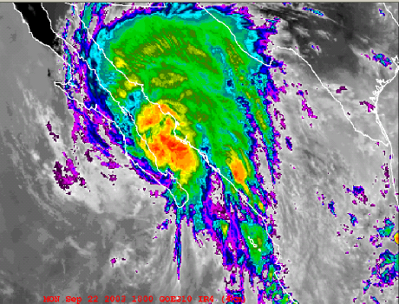
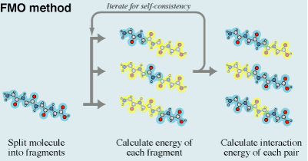
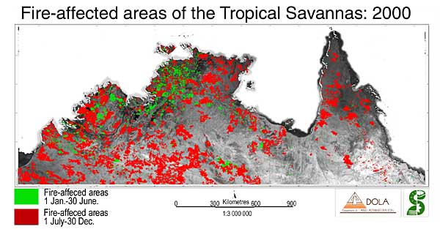
Applications http://goc.pragma-grid.net
Achieved long run and scientific results
  Savannah/Nimrod, MU, Australia
  FMO/Ninf-G, AIST, Japan
Successful run
  MM5/Mpich-Gx, CICESE/KISTI, Mexico/KISTI
11 applications continue run in testbed
  Savannah: climate model, MU, Australia
  MM5: climate model, CICESE, Mexico
  QM-MD, FMO: quantum-mechanics, AIST, Japan
  iGAP: genomics, UCSD, USA
  HPM: genomics, IOIT-HCM, Vietnam
  mpiBlast: genomics, ASCC, Taiwan
  Gamess-APBS: organic chemistry, UZurich, Switzerland
  Siesta: molecular simulation, UZurich, Switzerland
  Amber: molecular simulation, USM, Malaysia

Slide 5


Grid Security
IGTF (OGF) http://www.gridpma.org/
  APGrid PMA, http://www.apgridpma.org/
    5 site-CAs are IGTF accredited
      AIST, ASGC, CNIC, KISTI, NCSA
PRAGMA CA
  Naregi-CA, https://www.naregi.org/ca/
    APGrid, UChile, …
  Experimental CA in use for users/hosts
  Working on production CA under APGRID PMA
GAMA and Naregi-CA integration
  GAMA, http://grid-devel.sdsc.edu/gridsphere/gridsphere?cid=gama
  User private key issue

Slide 6


Grid Application Middleware
Ninf-G (AIST, Japan)
  3 applications (TDDFT, QMMD, FMO)
  Uchile working on a bioinformatic application
  Achieved long runs (1 week ~ 50 days)
  Improved fault-tolerance (papers)
  Simplified deployment procedures
  Speed-up development cycles
Nimrod/G (Monash University, Australia)
  3 applications (Savanah, Gamess, Siesta)
  Achieved long runs (90 different scenarios of 6 weeks each
  Improved fault-tolerance
  Enhanced scheduling augorithms
Mpich-Gx (KISTI, Korea)
  2 applications (MM5 and WRF, CICESE)
  Use private ip nodes for grid computing
  Improved fault tolerance
  Demonstrate performance

Slide 7

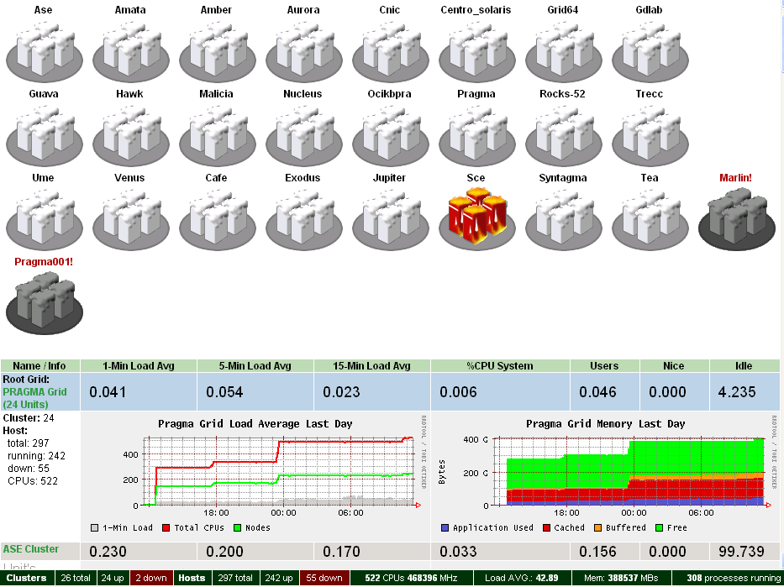
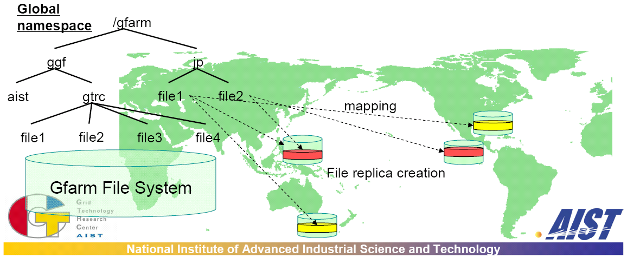
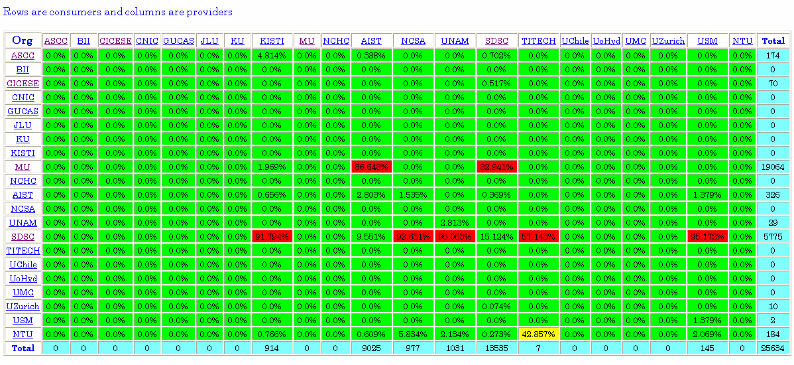
Infrastructure Middleware
Gfarm (AIST, Japan)
  First phase Gfarmfs-FUSE deployment
    AIST, SDSC, Tsukuba, NCHC
  Applications: iGAP (SDSC), GriddLeS (MU), …
SCMSWeb (KU, Thailand)
  Deployed to 26 sites
  Many new features, enhancements
MOGAS (NTU, Singapore)
  Deployed to 17 sites
  Will continue and setup server on goc
AMPlet (Waikato University, New Zealand)
  Deployed to 4 sites
  Will continue

Slide 8
Meta-schedulers
Community Scheduler Framework (CSF) – JLU, China
  Support GT2,4, GRAM or WS, SGE/PBS/LSF
  Tested with iGAP, next in testbed
  New release 4.0.3
  Resource info (now conf file, future MDS)
  Schedule algorithm (now round-robin, future dynamic)
Multi-Resource Scheduling (MRS) – IHPC, Singapore
  Dynamic estimation (statistics, simulations, algorisms)
  Predict, schedule, backfill
Dynamic co-allocation
  Grid Unified Remote (GUR) - SDSC, USA
  SGE extention - AIST, Japan
Advance Reservation-based Grid Co-allocation System – AIST, Japan
CSF

Slide 9
Application Services
Bioportal (QUT/SDSC/PRIUS)
Computational Grid Portal (NCHC)
CSF portal (JLU/SDSC)
CSE-online (UUtah)
  Tested Gamess with 3 sites: SDSC, NCSA, AIST
  Next – more sites, Amber, Sander

Slide 10
Sharing With Grid Communities
CCGrid 2006
  3 out of 4 keynotes were given by PRAGMA members
    Phil Papadopoulos (SDSC)
    Satoshi Sekiguchi (AIST)
    Jysoo Lee (KISTI)
  Paper presented by PRAGMA members
    Cindy Zheng, David Abramson, Peter Arzberger, Shahaan Ayyub, Colin Enticott, Slavisa Garic, Mason J. Katz, Jae-Hyuck Kwak, Bu Sung Lee, Phil M. Papadopoulos, Sugree Phatanapherom, Somsak Sriprayoonsakul, Yoshio Tanaka, Yusuke Tanimura, Osamu Tatebe, Putchong Uthayopas, "The PRAGMA Testbed - Building a Multi-Application International Grid," ccgrid , p. 57, 2006.
    David Abramson, Amanda Lynch, Hiroshi Takemiya, Yusuke Tanimura, Susumu Date, Haruki Nakamura, Karpjoo Jeong, Suntae Hwang, Ji Zhu, Zhong-hua Lu, Celine Amoreira, Kim Baldridge, Hurng-Chun Lee, Chi-Wei Wang, Horng-Liang Shih, Tomas Molina, Wilfred W. Li, Peter W. Arzberger, "Deploying Scientific Applications to the PRAGMA Grid Testbed: Strategies and Lessons," ccgrid , pp. 241-248, 2006.
    Bu-Sung Lee, Ming Tang, Junwei Zhang, Ong Yew Soon, Cindy Zheng, Peter Arzberger, David Abramson, "Analysis of Jobs in a Multi-Organizational Grid Test-bed," ccgrid , p. 59, 2006.
    Weicheng Huang, Chien-Lin Huang, Chien-Heng Wu, "The Development of a Computational Grid Portal," ccgrid , p. 56, 2006.
Other publications
  Arzberger, P., Papadopoulos, P. "PRAGMA: Example of Grass-Roots Grid Promoting Collaborative e-Science Teams," CTWatch Quarterly, Volume 2, Number 1, February 2006.

Slide 11

PRAGMA/GEON Collaboration
GEON workshop (Beijing, July 2006)
  PRAGMA: Satoshi Sekiguchi, Kai Nan, Cindy Zheng
  GEON: Chaitan B., Mian Liu, Huai Zhang, …
  Sharing data, software know-how and computing resources
  Run geoscience application (co-allocation issue)
    Near term – run on cluster, but pull and use distributed data
    Future – needs meta-scheduler can do reservation
Actions
  GUCAS completed a compute cluster setup
    geon roll installed
    Is a member of PRAGMA testbed
  CNIC working with GEON team on setting up a data node
    Will be a part of PRAGMA testbed
    Will share data with GEON data nodes

Slide 12
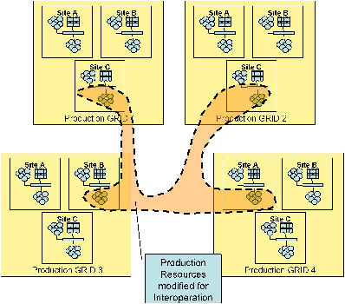
Grid Interoperation Now (GIN) http://forge.gridforum.org/sf/wiki/do/viewPage/projects.gin/wiki/GinOps
GIN testbed (started Feb. 2006)
  PRAGMA, TeraGrid, EGEE, OSG, NorduGrid
Applications
  TDDFT/Ninf-G
    Lead: Yoshio Tanaka, Yusuke Tanimura (AIST, Japan)
    Deployed and run
      PRAGMA - AIST, NCSA, SDSC
      TeraGrid – ANL
      OSG – UCSD
      NordiGrid
    Working on deployment to EGEE
  Savanah Study (data intensive)
    Lead: Colin Enticott (MU, Australia)
    In preparation

Slide 13
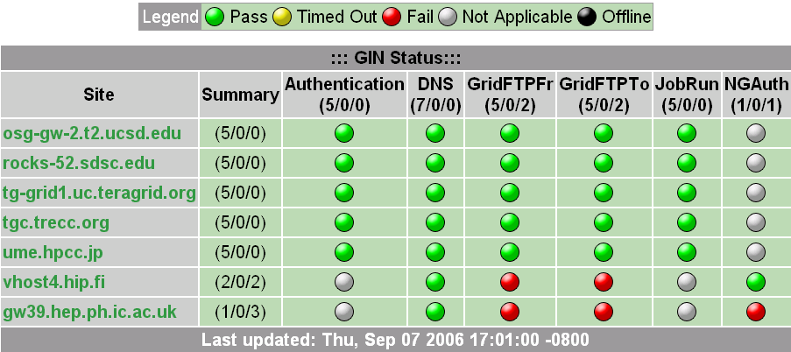
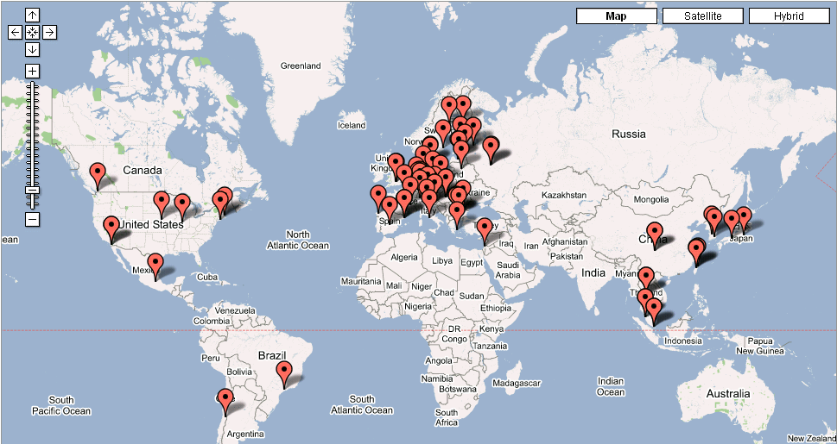
Grid Interoperation Now (GIN) [2] http://forge.gridforum.org/sf/wiki/do/viewPage/projects.gin/wiki/GinOps
Somsak Sriprayoonsakul, Sugree Phatanapherom, (KU, ThaiGrid)
Infrastructure testing matrix
  Test 7 clusters from 5 grids
    http://goc.pragma-grid.net/cgi-bin/scmsweb/probe.cgi
  New version to handle various grid service configurations/tests
GIN map
  implemented a XML-> LDIF translator for GIN map
    http://maps.google.com/maps?q=http://lfield.home.cern.ch/lfield/gin.kml
Cross-grid monitoring
  Common schema
    http://wiki.pragma-grid.net/index.php?title=GIN_%28Grid_Inter-operation_Now%29_Monitoring

Slide 14

























Thank You

