Slide 1
Experiences of Grid Enabled MPI Implementation named MPICH-GX with
Atmospheric Applications
Oh-kyoung Kwon, KISTI
Salvador Castañeda, CICESE
PRAGMA 11

Slide 2
Contents
Motivation
KISTI’s Proposal
  MPICH-GX
Experiments
Next things to do

Slide 3
Atmospheric Applications
MM5
    A weather model designed to simulate or predict atmospheric circulation.
WRF
    A next-generation numerical weather prediction system designed to serve both operational forecasting and atmospheric research needs.

Slide 4
The Problems
Global simulations require a great amount of resources and processing power
  Gigabytes of hard disk space for distributed databases
  Gigabytes of RAM
  Terascale computation

Slide 5
The Problems (cont'd)
Running on a Grid presents the following problems:
    Standard MPI implementations require that all compute nodes are visible to each other, making it necessary to have them on public IP addresses
      Public IP addresses for assigning to all compute nodes aren't always readily available
      There are security issues when exposing all compute nodes with public IP addresses

Slide 6
KISTI's Proposal
To solve the problem between public and private IP addresses, KISTI have developed MPICH-GX

Slide 7
MPICH-GX
MPICH-GX is a patch of MPICH-G2 to extend functionality required in the Grid.
MPICH-GX provides following functions.
  Private IP Support
  Fault Tolerant Support
Currently, MPICH-GX can run with GT3.x → In this year, we might move to GT4.

Slide 8

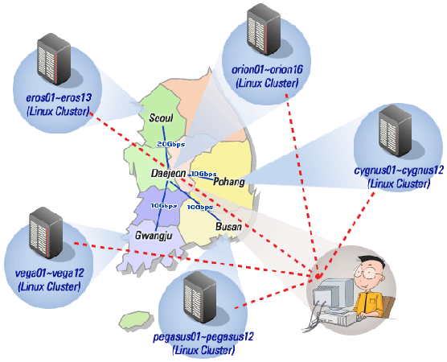

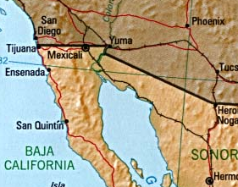
The Testbed
eolo
pluto
* The job on each cluster is scheduled through OpenPBS.

Slide 9
Experiments
12 nodes on single cluster (orion cluster): 17.55min
12 nodes on cross-site
  6 nodes on orion + 6 nodes on eros, where all nodes have public IP: 21min
  6 nodes on orion + 6 nodes on eros, where the nodes on orion have private
  IP and the nodes on eros have public IP: 24min
16 nodes on cross-site
  8 nodes on orion + 8 nodes on eros, where all nodes have public IP: 18min
  8 nodes on orion + 8 nodes on eros, where the nodes on orion have private
  IP and the nodes on eros have public IP: 20min

Slide 10
Next things to do
Test with larger input data
Study on minimum requirements of network bandwidth for MPI jobs in Grid environments
Working with MPICH-G4 and GT4 GRAM
Extension to include PRAGMA testbed

