Slide 1
SCMSWeb: Now and Then
Putchong Uthayopas
putchong_ut@thaigrid.or.th
Sugree Phatanapherom
sugree_ph@thaigrid.or.th

Slide 2
New Features
GLUE Schema
  ComputingElement
Geo-location
  Google Earth (KML)
  Google Maps
  Programmatic Interface
Flexible Probe
Bidirectional bandwidth meter

Slide 3
GLUE Schema
XML Schema
  PRAGMA
LDAP Schema
  PRAGMA
Useful information
  Hierarchical sites/clusters
  Lat/long per site
  Resource information via ComputingElement

Slide 4
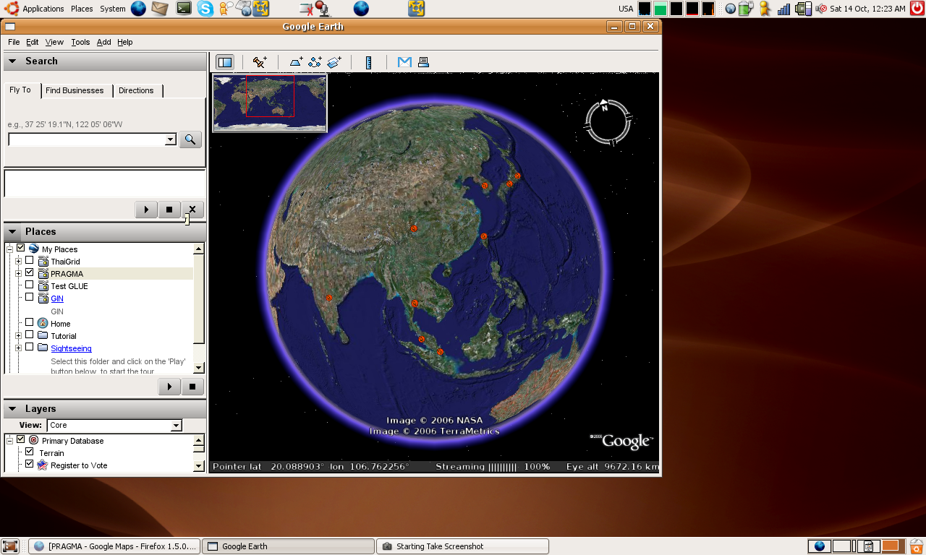
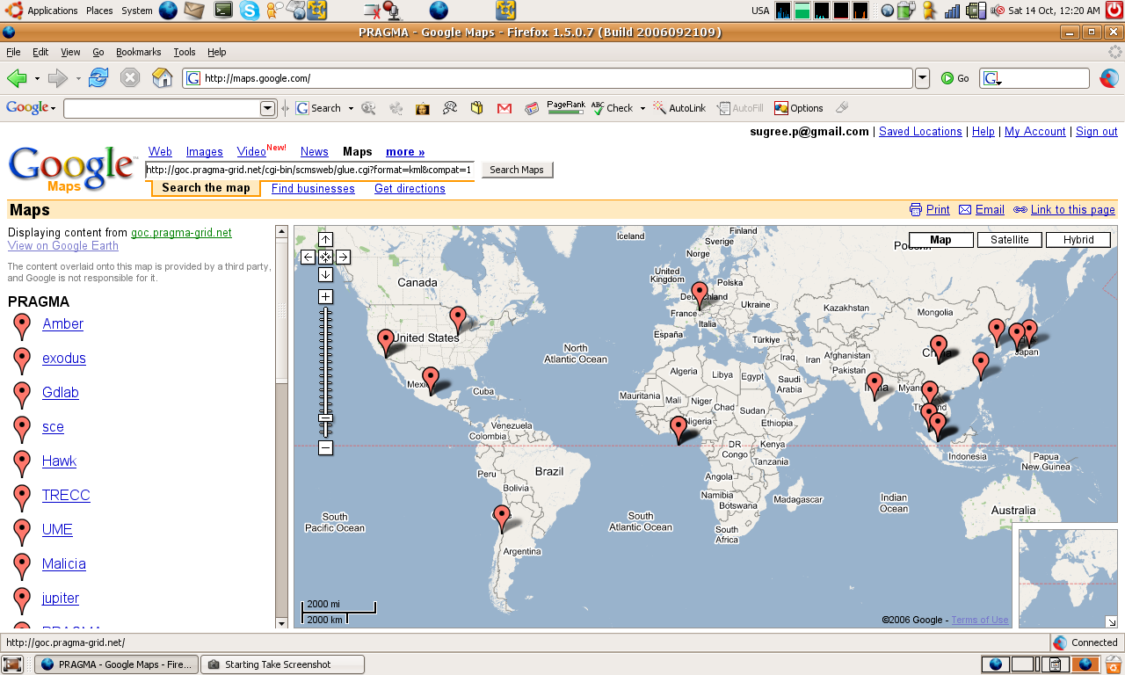
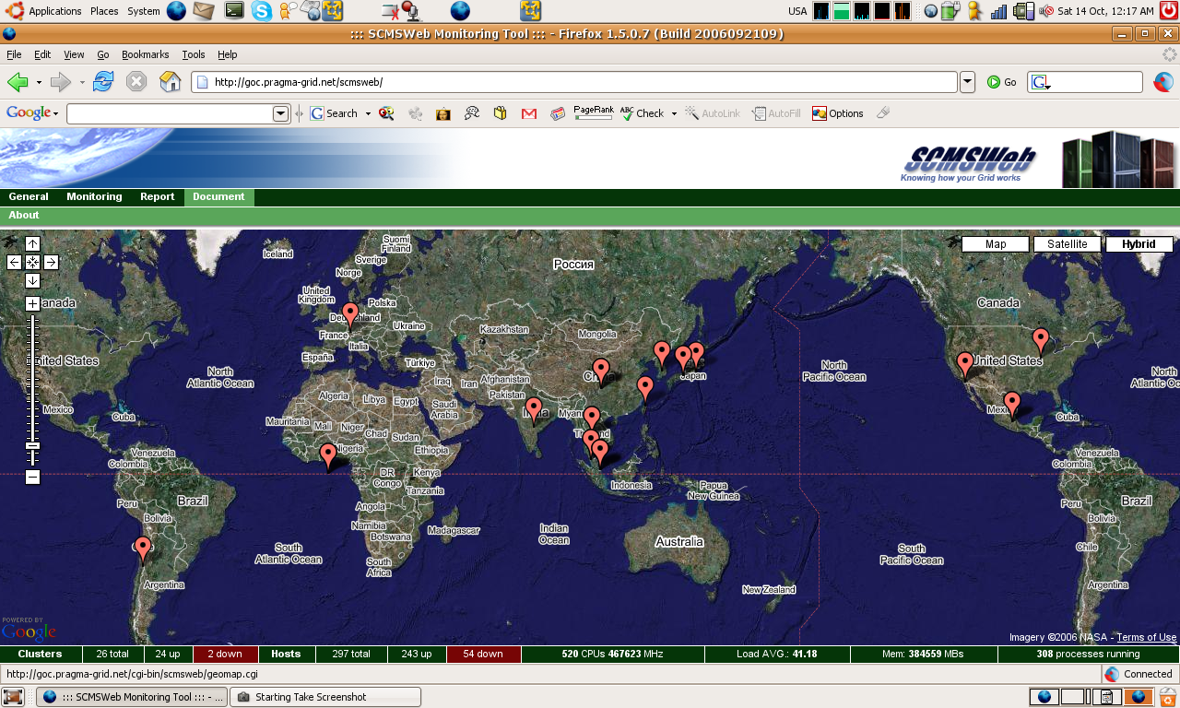
Geo-location
Google Earth
  KML
  Gzipped KML
Google Maps
  KML
  Gzipped KML
AJAX
  KMLJSON (http://json.org/)

Slide 5
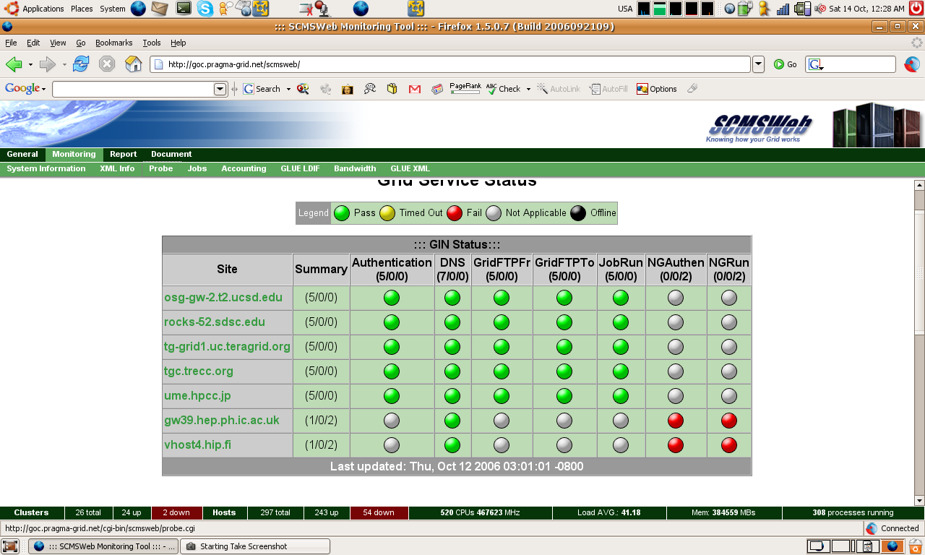
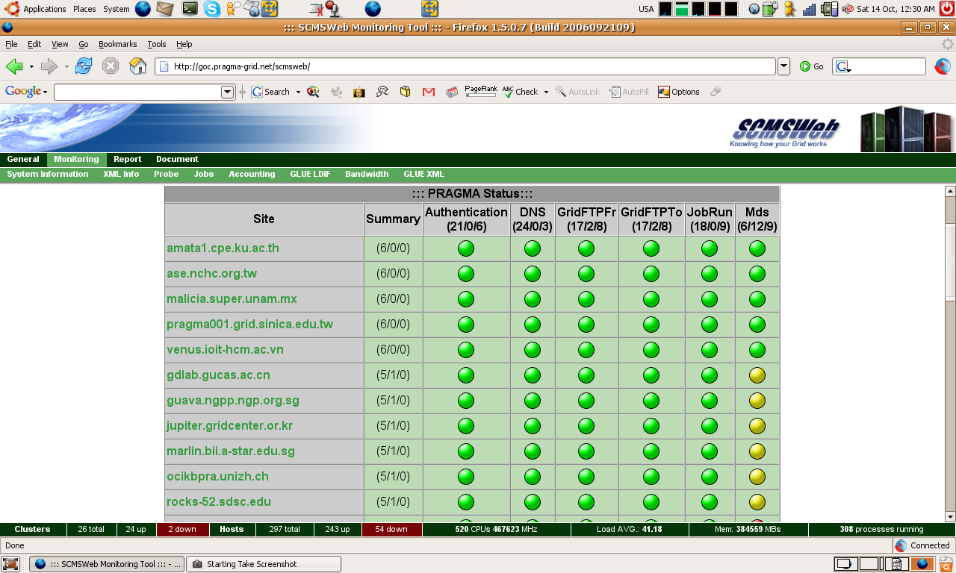
New Probe
Centralized configuration
Flexible
  Enable/disable probe per site
  Different targets for different probes
All-to-all probe
Automatic collection

Slide 6
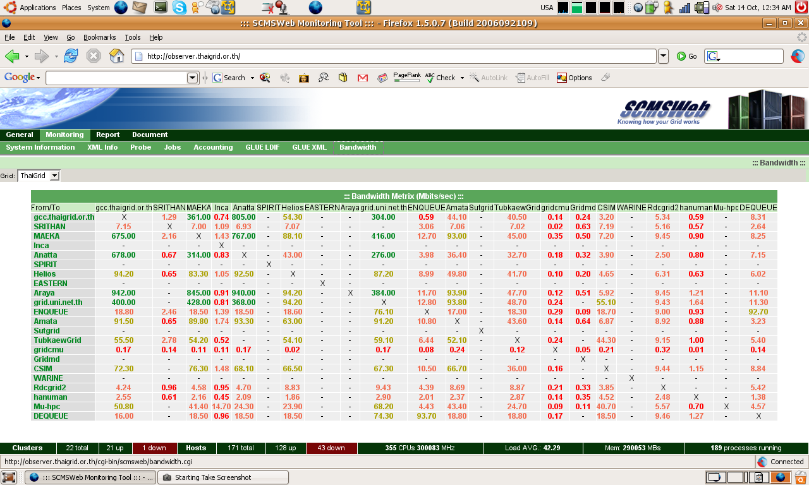
Bidirectional bandwidth meter
Run on top of probe and Iperf

Slide 7
Programmatic Interaction
Geo-location
  JSON
Resources
  queue_mon
http://goc.pragma-grid.net/cgi-bin/scmsweb/queue_mon.cgi
{hostname}/<jobmanager>@<queue>:<totalprocs>:<freeprocs>
nucleus.mygridusbio.net.my/jobmanager-sge@all.q:1:1
ocikbpra.unizh.ch/jobmanager-sge@all.q:2:2
rocks-52.sdsc.edu/jobmanager-sge@all.q:2:1
rocks-52.sdsc.edu/jobmanager-sge@-:0:0
syntagma.dim.uchile.cl@all.q:2:0
syntagma.dim.uchile.cl@-:0:0
venus/jobmanager-sge@vs02.q:1:0
venus/jobmanager-sge@vs04.q:1:1
venus/jobmanager-sge@vs01.q:1:0
venus/jobmanager-sge@vs03.q:1:1
exodus.ihpc.a-star.edu.sg@all.q:16:16
jupiter.gridcenter.or.kr/jobmanager-pbs@gridq:0:0

Slide 8
Demonstration
http://goc.pragma-grid.net/scmsweb/
http://observer.thaigrid.or.th/

Slide 9
In Progress
Gfarm probe
GLUE Schema
  StorageElement
  Probe
Bandwidth history
Network Weather Map
Access control
CMS Integration

Slide 10
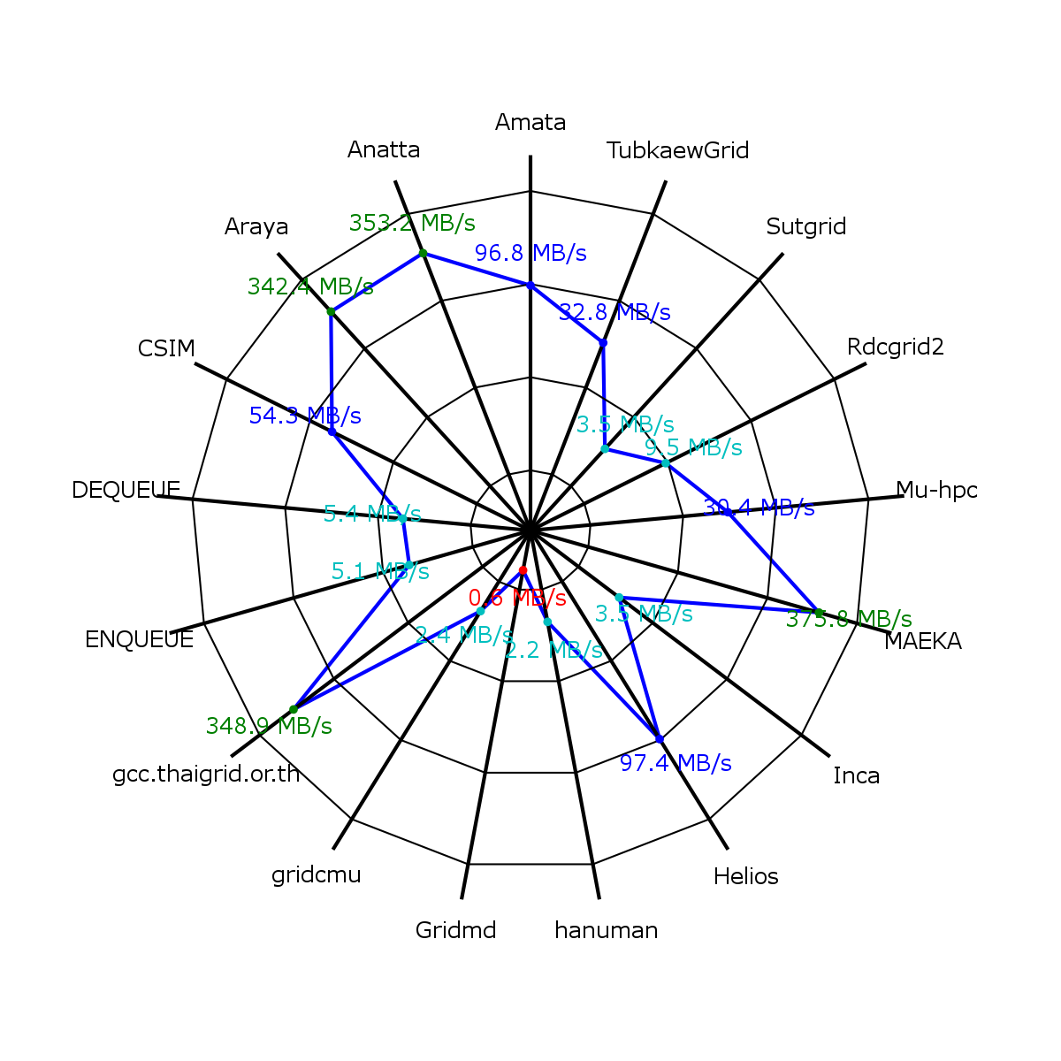
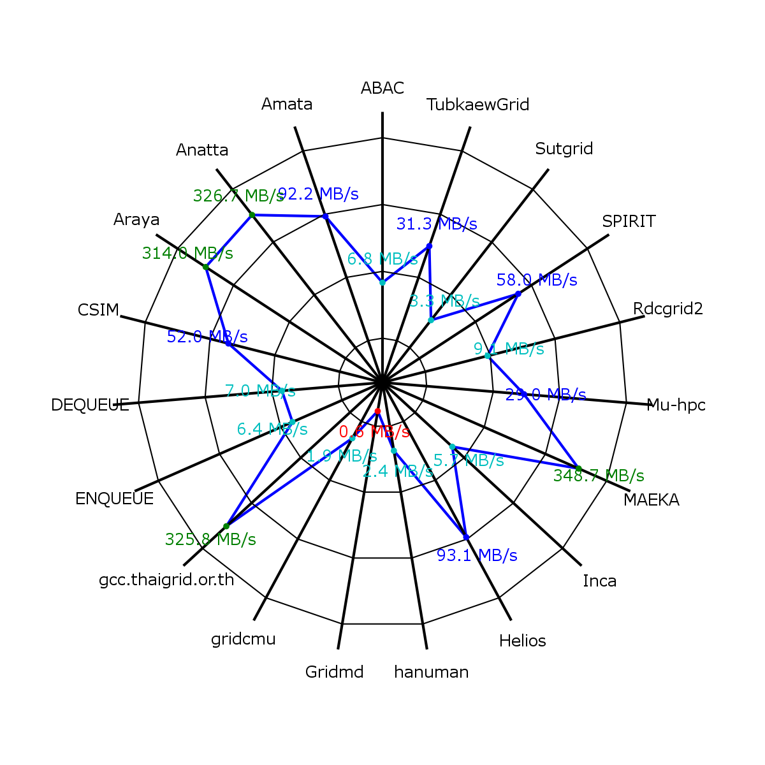
Bandwidth
2006/10/15
2006/10/16

Slide 11
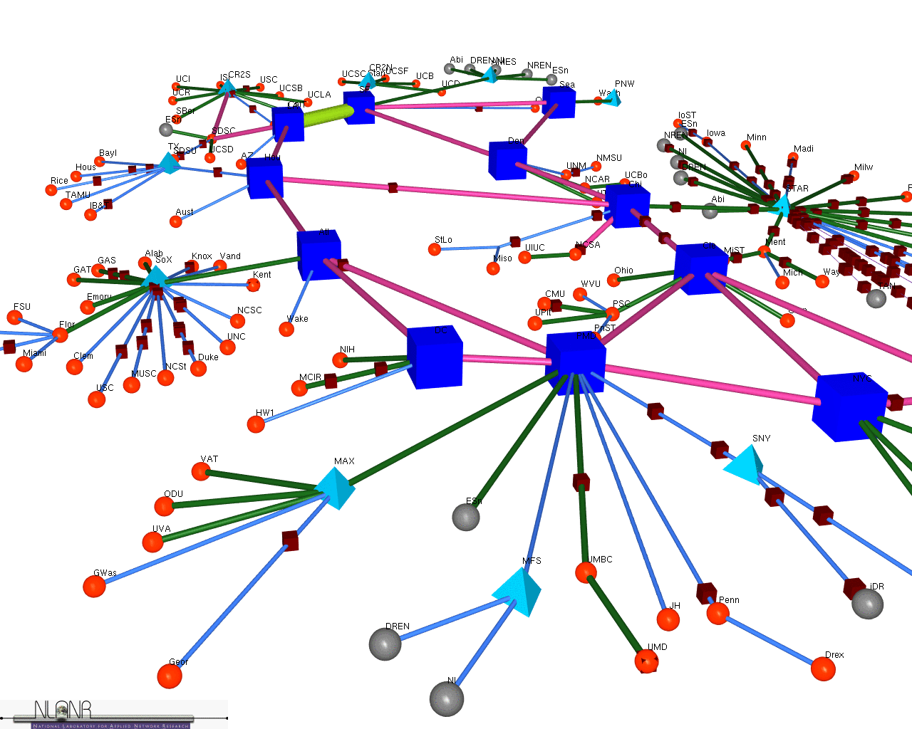
On Plan
AMPlet Integration
3D Visualization
  Gfarm?

Slide 12
Thank You

Slide 13
References
http://glueschema.forge.cnaf.infn.it/Mapping/XMLSchema
http://glueschema.forge.cnaf.infn.it/Mapping/LDAP

