Slide 1
Advance Reservation-based Grid Co-allocation System
Atsuko Takefusa, Hidemoto Nakada,
Tomohiro Kudoh, Yoshio Tanaka,
Satoshi Sekiguchi
National Institute of Advance Industrial Science and Technology (AIST)

Slide 2
Issues of Grid Co-allocation for HPC Parallel Applications
Coordination with existing queuing schedulers
  Each cluster should be shared between local and global users effectively
Advance reservation
  HPC parallel application jobs have to start simultaneously over the Grid
  Users cannot estimate what time their jobs start on each cluster managed by queuing schedulers
  Allocates resources w/o manual operation
Two phased commit protocol
  Guarantees safe distributed transaction
Secure and general interface
  Hides resource/scheduler heterogeneity

Slide 3
Overview
GridARS (Grid Advance Reservation-based Scheduling framework)
  Achieves AR-based co-allocation of distributed resources (e.g. computers and bandwidth) managed by various existing schedulers using PluS
  Provides GridARS-WSRF and -Coscheduler
    GridARS-WSRF provides WFRF I/F modules for RM
    Supports GSI and two-phased commit protocol for safe
    distributed transactions
PluS
  Plug-in reServation Manager for TORQUE and SGE
  Supports 2-Phase Commit
Live Demo
  Perform QM/MD simulation developed using GridMPI over reserved resources, using PluS and GridARS

Slide 4

GridARS Co-allocation System
5
?
Grid Application
5
SiteB
0.5Gbps
0.5Gbps
?
Grid Portal
SiteC
10
1Gbps
10
1
1
?
1Gbps
SiteA
duration 5 min
deadline xxx
from yyy to zzz
Grid Resource Scheduler (GRS)
Requirement
Result
Network Resource
Manager (NRM)
CRM
Compute Resource
Manager (CRM)
SiteB
NRM
CRM
Domain1
Domain2
CRM
SiteD
SiteA
SiteC

Slide 5
GridARS Architecture
GridARS-WSRF
  WSRF(Web Services Resource Framework) I/F module of resource managers and schedulers
  WSRF-based module developed with Globus Toolkit 4
  Supports safe transaction by two phased commit protocol
  Provides Java API for resource managers and coschedulers
GridARS-Coscheduler
  Negotiates with RMs and Co-schedules distributed resources
GRS
User
GridARS-WSRF I/F module
WSRF/GSI
(2 phased commit)
GridARS-Coscheduler
CRM
NRM
GridARS-WSRF
GridARS-WSRF
Vender-developed
WSRF modules
PluS
Maui
PBS Pro
LSF
Cluster scheduler
(e.g. SGE, TORQUE)
Network scheduler

Slide 6
PluS: Plug-in reServation Manager
PluS provides advance reservation capability coordinating with existing queuing systems, such as TORQUE and Sun Grid Engine
Maintains reservation table in DB
Written in Java
Supports 2-phase commit protocol

Slide 7
Implementation of PluS
Three Implementations
  For TORQUE, replace scheduling module
  For SGE, replace scheduling module
  For SGE, external queue control

Slide 8
Scheduling Module Replacing Implementation
qsub/qdel
Head Node
Master
Module
Scheduling
Module
PluS
Scheduling
Module
Comp. Node
Comp. Node
Comp.Node
Node Mgr.
Node Mgr.
Node Mgr.

Slide 9
Queue Control Implementation
qsub/qdel
Head Node
Reservation
Module
Master
Module
Scheduling
Module
Comp. Node
Comp. Node
Comp.Node
Node Mgr.
Node Mgr.
Node Mgr.

Slide 10
Queue Control Implementation
No need to replace existing module
  No modification required for existing settings
Just start-up PluS reservation module, that’s it!
The PluS daemon dynamically create new queue for each reservation and re-configure existing queue so that the reservation queue can exclusively-occupy the specified time-slot

Slide 11
Advance Reservation by Queue Control
Queued job
Rsvd. job
Rsv.
Queue
Head Node
Comp. Node
Comp. Node
Comp. Node
Comp. Node

Slide 12
Advance Reservation by Queue Control
Queued job
Rsvd. job
Rsv.
Queue
Head Node
Comp. Node
Comp. Node
Comp. Node
Comp. Node

Slide 13
Advance Reservation by Queue Control
Queued job
Rsvd. job
Rsv.
Queue
Head Node
Comp. Node
Comp. Node
Comp. Node
Comp. Node

Slide 14
Advance Reservation by Queue Control
Queued job
Rsvd. job
Head Node
Comp. Node
Comp. Node
Comp. Node
Comp. Node

Slide 15

Live Demo
Reserve distributed resources using GridARS
Perform data parallel application over the reserved clusters
Clusters distributed over 7 locations in Japan
Each cluster is managed by PluS and SGE

Slide 16
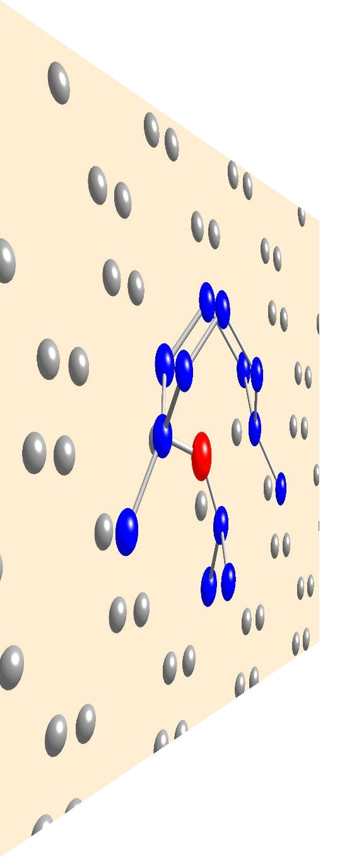
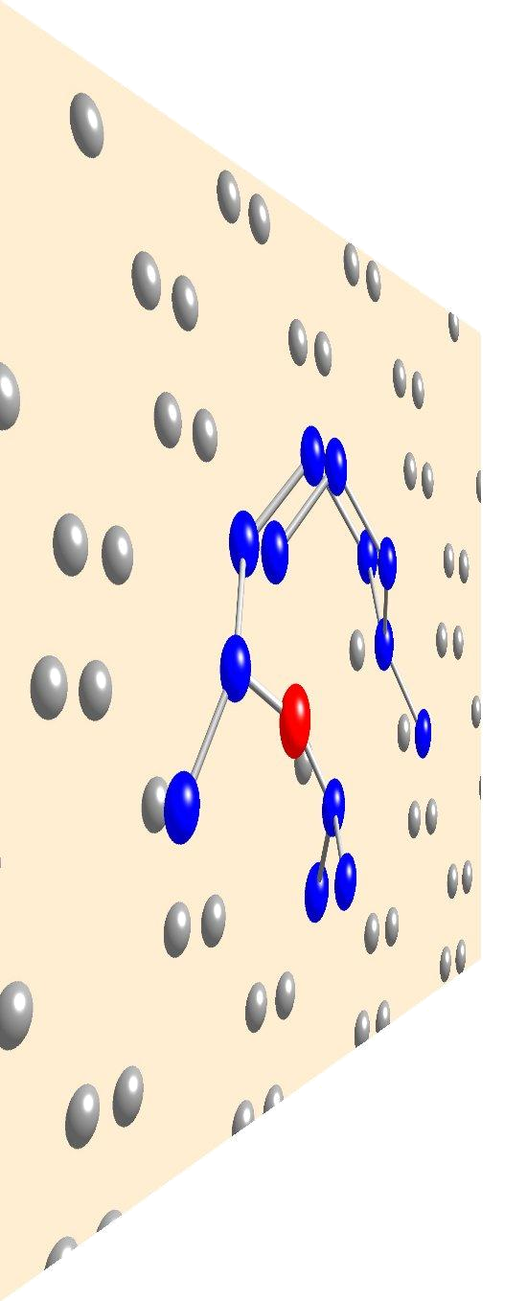
Portal Architecture
Resource Requirement
Editor on Web Browser
Result Viewer
on Web Browser
Input resource
requirements
(2) Send "reserve" req
via HTTP
(6) Return the
reservation result
(7) Launch result viewer
on Web browser and
send "run" req
(11) Draw
the results
Write/read
reservation info
Web Server
Database
Reservation Module
Application-dependent
Module
(10) Receive
simulation
results
GridARS Client API
gridmpirun
(3) Send reserve req
via GridARS
2PC WSRF
(5) Get reservation
result
(8) Submit jobs in the
reserved queues
using globusrun-ws
GridARS GRS
(4) Co-allocate distributed
resources via GridARS
2PC WSRF
NRM
NRM
NRM
CRM
WS
GRAM
CRM
WS
GRAM
CRM
WS
GRAM
PluS
+SGE
PluS
+SGE
PluS
+SGE
(9) Start QM/MD simulation
using GridMPI
GridMPI

Slide 17
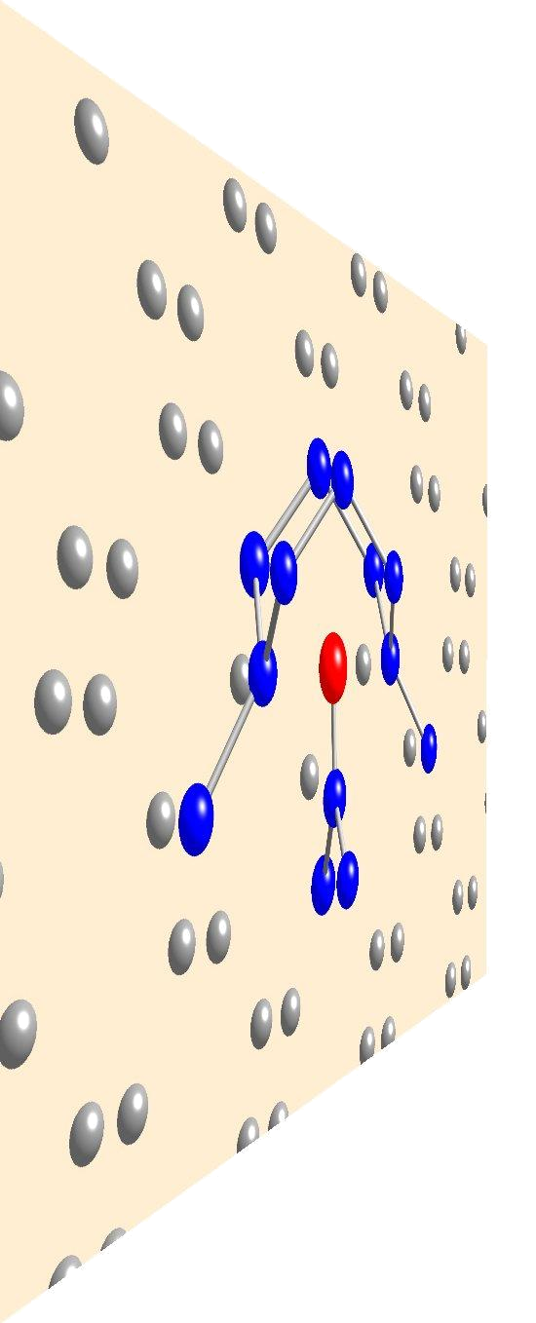
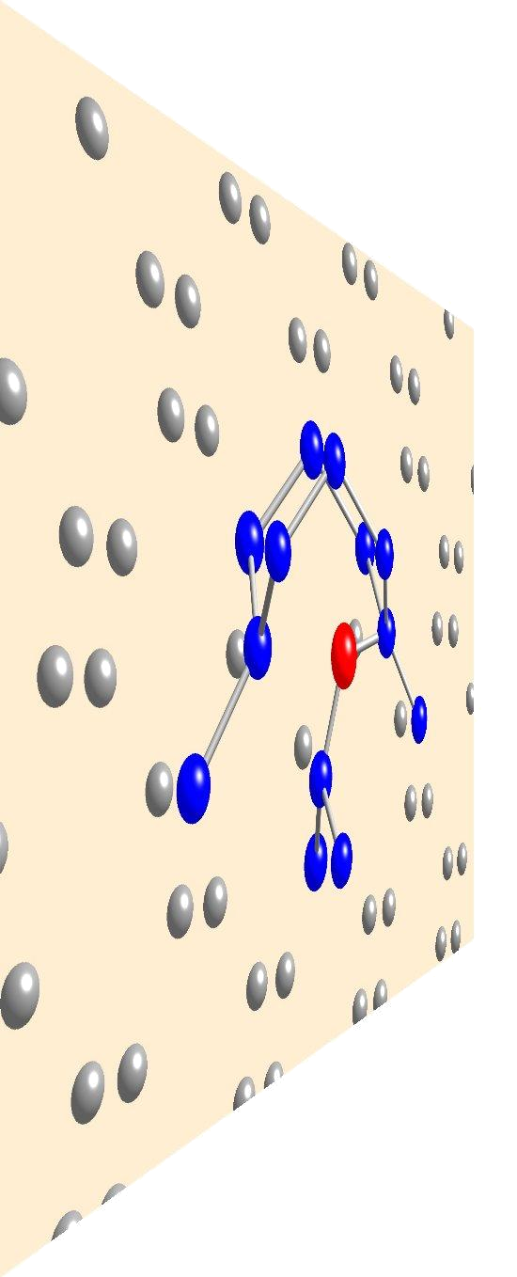
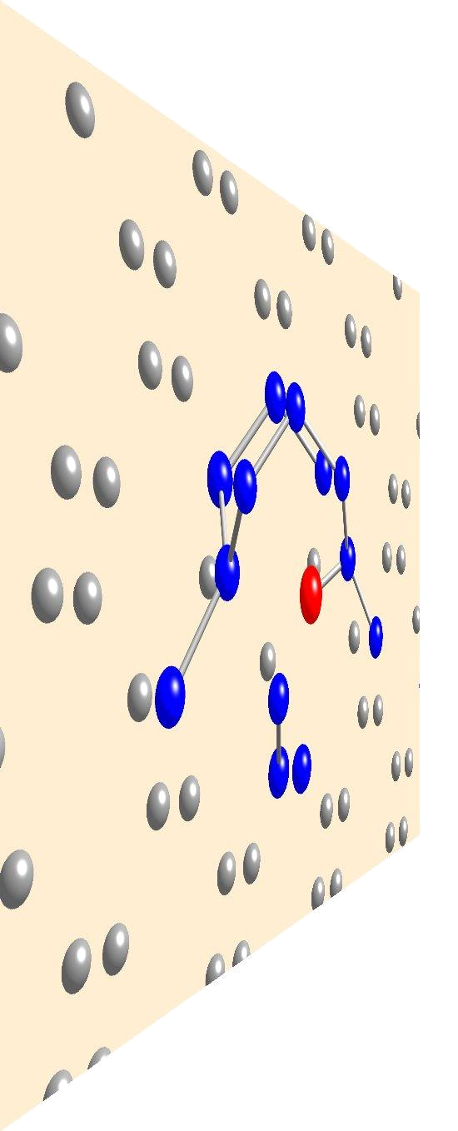
QM/MD Simulation
Simulates the chemical reaction process based on the Nudged Elastic Band (NEB) method developed by Dr. Ogata in NITECH
The energy of each image is calculated by combining classical molecular dynamic (MD) simulation with quantum mechanics (QM) simulation in parallel
MD and QM simulations on distributed clusters in Japan using GridMPI

Slide 18
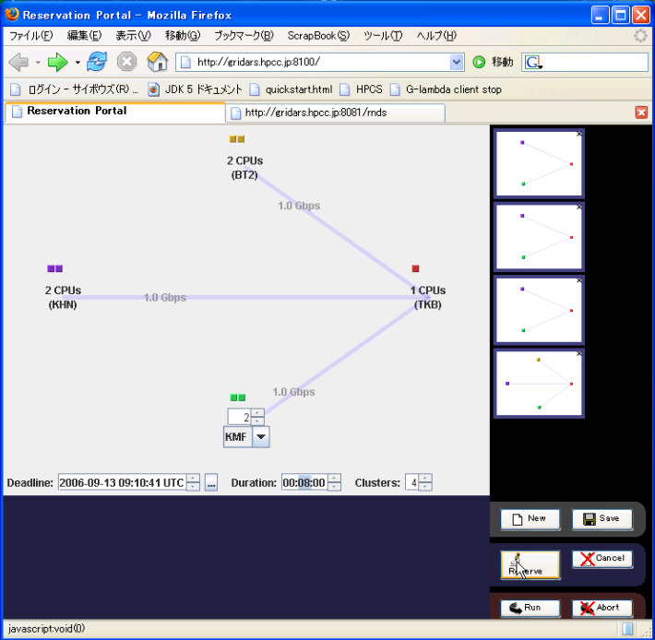
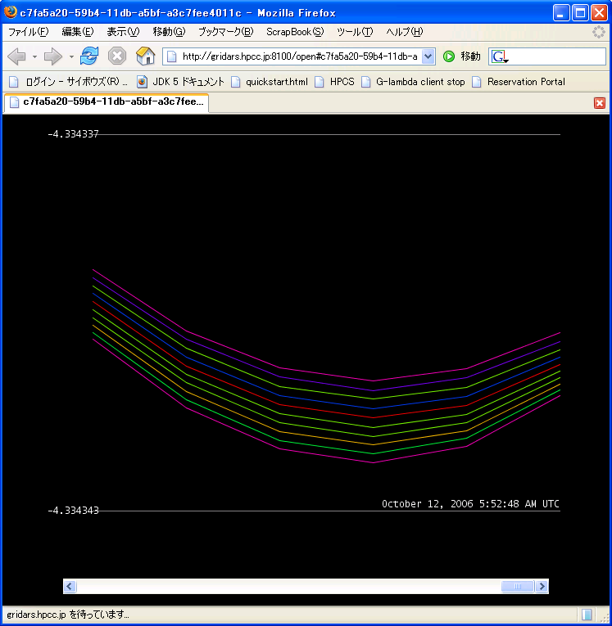
Resource Requirement Editor & Result Viewer

Slide 19
Conclusions
Developed GridARS (Grid Advance Reservation-based Scheduling framework)
  GridARS-WSRF I/F module for RMs
  GridARS-Coscheduler for co-allocation
PluS
  Works with TORQUE and SGE
  for SGE, there are no configuration change required
  now available from http://www.g-lambda.net/plus
The GridARS Demo showed that user can easily execute parallel applications over the reserved and distributed resources managed by PluS and existing queuing systems

