Slide 1
X-SIGMA
(An XML based Simple data Integration system for Gathering, Managing and Accessing scientific experimental data in grid environments)
Karpjoo Jeong(jeongk@konkuk.ac.kr)
Applied Grid Computing Center
Department of Advanced Technology Fusion
Konkuk University, Seoul, Korea

Slide 2
Motivations
Two Application Projects
  KOCED. TeleScience and Data Sharing Environments for Civil Engineering Research in Korea
  Glyco-MGrid. Collaborative Molecular Simulation Grid Environments for Glycomics
Required to support scientific data management
  Multiple data models, but not many. They may be changed and new models may be added, but not frequently
  Legacy data (just files)and analysis software (just code with input and output files), but they are kind of simple
Conventional Systems
  DBMS-based Systems. Too inflexible
  Semantic Web Systems. Too advanced and complicated
  File based Systems. Too flexible. Custom approach

Slide 3


Scientific Data Management
Scientist: John
Parameter: #$@
Data location
3D Structure
Trajectory
explain
Data Models
  Metadata
  Experimental Data
Indexing & Searching
  Metadata Management
  Data Indexing and Searching
Data Repository
  Storage for Experimental Data
  Access Management
Data Models
Search
Store
Register
Experimental
Data
Metadata
Explains
Data Repository

Slide 4

Goals: Data Models
Multiple Data Models
Data Model Evolution
Data Integration
Query
Data Model
A
Data Model
B
Experimental
Data
Metadata
Experimental
Data
Metadata
Data Repository

Slide 5
Metadata Model (Context Data)
Experimental Context
  Information about experiments (e.g. owners and parameter settings)
Logical View of Experimental Data
  Logical organization of physical experimental data
  Their location information
  Associated software information

Slide 6
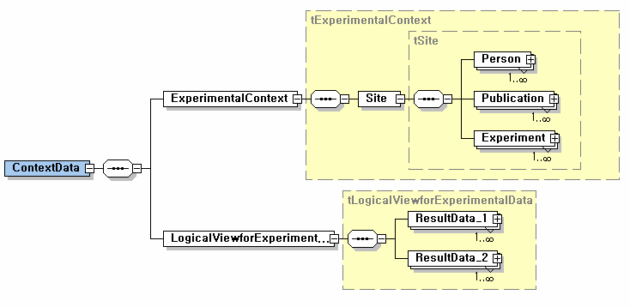
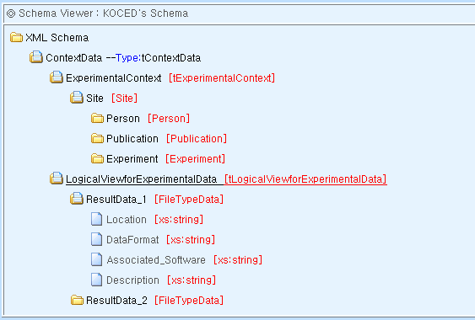
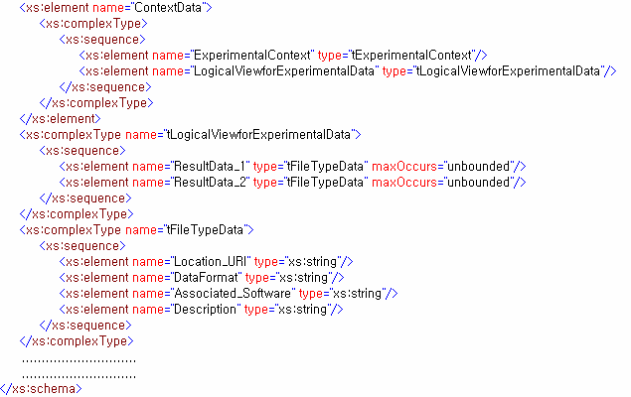
X-SIGMA Metadata Model Example
< (b) User Interface for Editor >

Slide 7
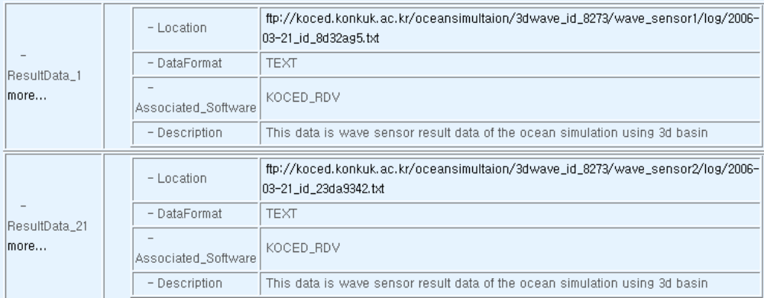
Logical View of Experimental Data
Location, Format and Associated Software

Slide 8
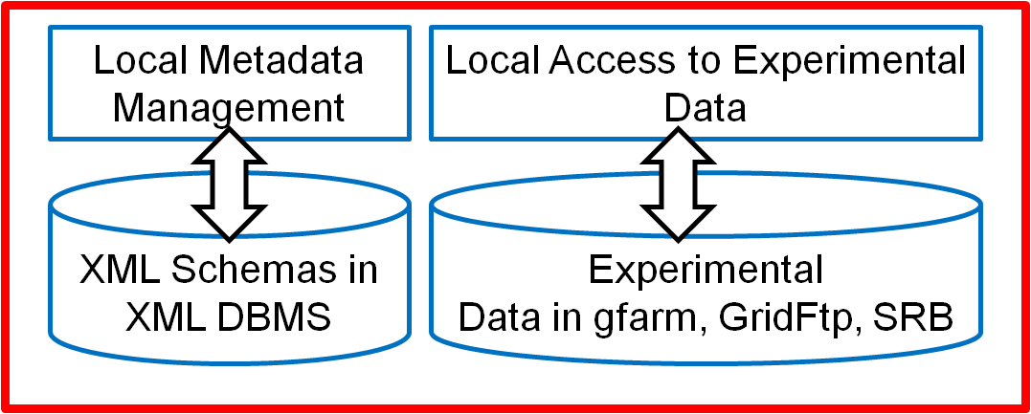
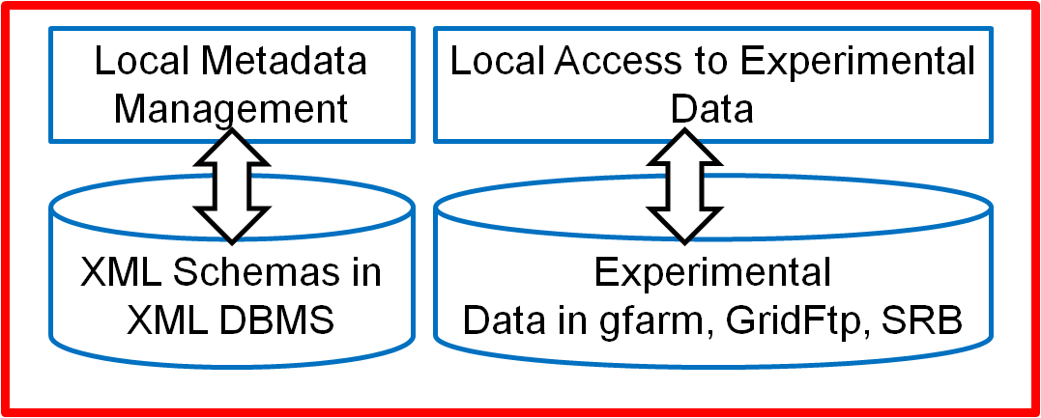
Goals: Federated Data Repository
Distributed Repository
Local Site Autonomic Management
Decoupling between Metadata and Experimental Data
Legacy Data Access Support
Global Metadata
Management
Distributed Access to Experimental Data
Site B
Site A

Slide 9
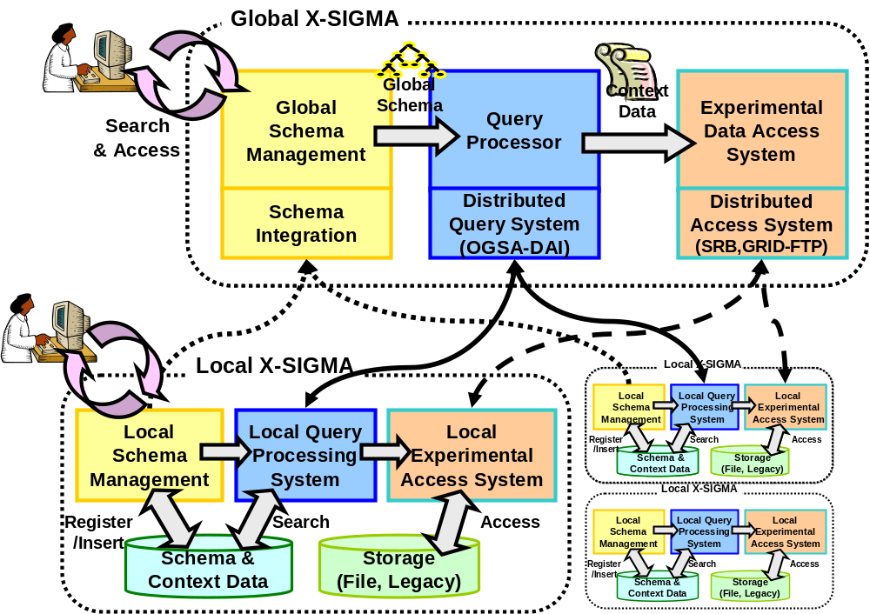
X-SIGMA System Structure

Slide 10
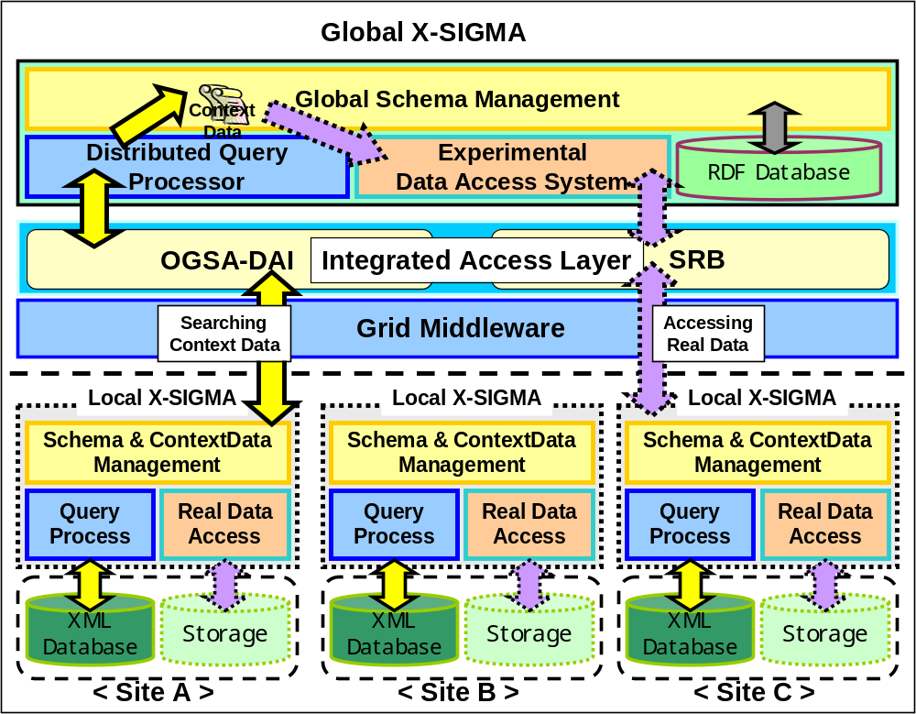
X-SIGMA System Architecture

Slide 11
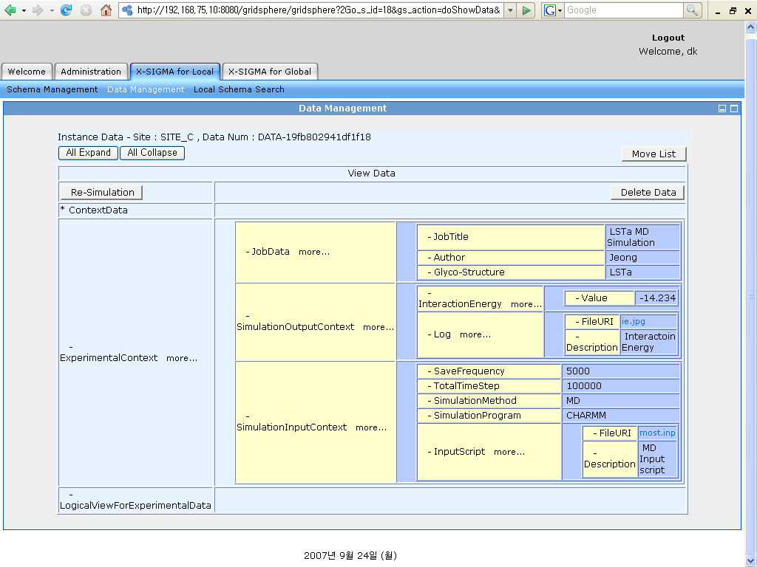
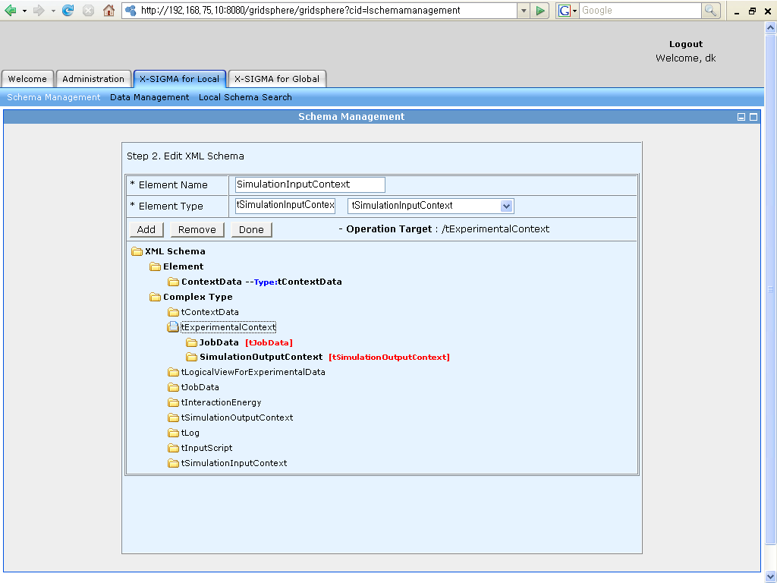
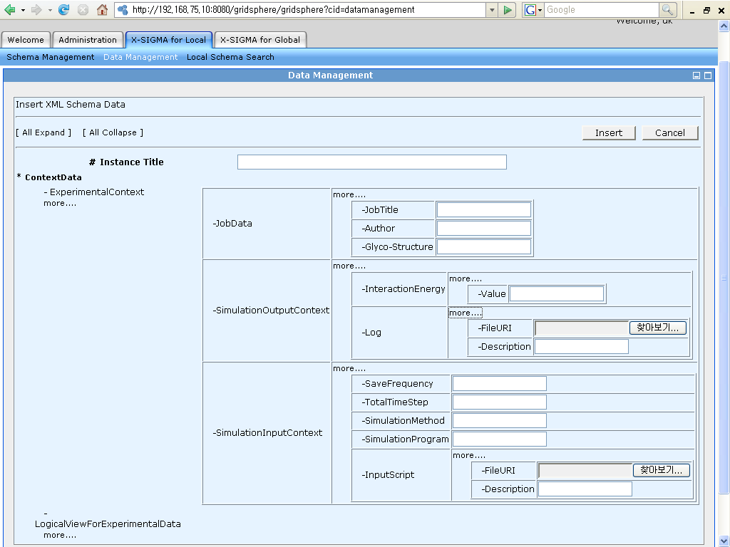
Interfaces
GUI-based Interfaces
Web Services based Interfaces

Slide 12
Glyco-MGrid
Glyco-MGrid is a molecular simulation computing and data grid portal for glycomics
It provides shared and integrated cyber-environments which support simulation, databases, and trajectory analysis in a collaborative way
Data sharing is based on X-SIGMA

Slide 13
Glyco-MGrid
Glyco-MGrid
Database
Simulation
Trajectory
Active Projects
XML
Document
MGrid-SDG
(X-SIGMA)
MGrid-CG
Analysis
Computing
PSE
Real
Data
GridFTP/RFT

Slide 14
References
“X-SIGMA: XML based Simple data Integration system for Gathering, Managing, and Accessing Scientific Experimental Data in Grid Environments”, 2nd Conference on eScience and Grid Computing, 2006
“Glyco-MGrid : A Collaborative Molecular Simulation Grid for e-Glycomics”, To appear in 3rd Conference on eScience and Grid Computing, 2007

