Slide 1
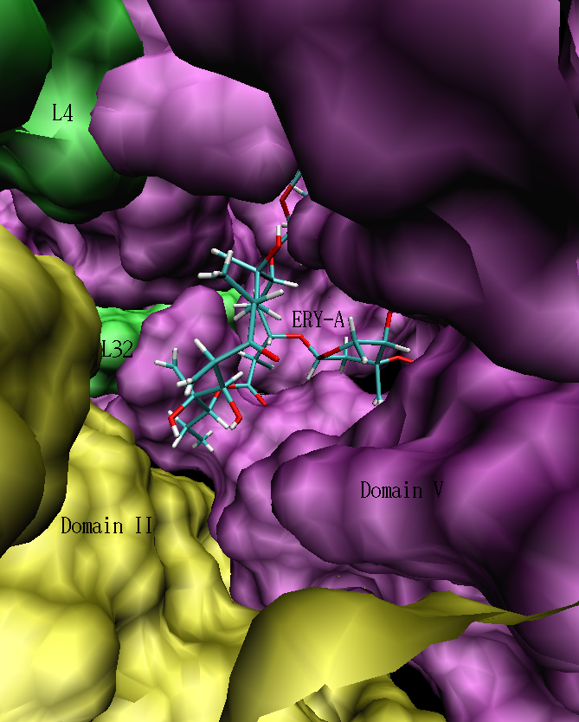
Amber 8
on
PRAGMA Gfarm-V2 Datagrid

Slide 2
Motivation
The running of AMBER in GFarm Data Grid is intended
  to provide information useful in assessing the performance of running molecular dynamics simulations on a range of computer architectures found PRAGMA testbeds with and without GFarm.

Slide 3
PRAGMA Clusters
gfml17
gfml18
  All running in Gfarm and without Gfarm.

Slide 4
AMBER 8 (Sander) Benchmark system
18056 atoms
Generalized Born model on Sander 8--thermalization
&cntrl
nstlim=10,nrespa=4,
ntx=5, irest=1,
ntpr=8,
ntf=2, ntc=2, ntb=0,
temp0 = 298.0, ntt=1, tautp=1.0,
cut=12.0, rgbmax=12.0,
igb=1, saltcon=0.2, gbsa=0,
nmropt=1
/
&wt type='END' /
DISANG=heme_tether.rst
END

Slide 5
Protocols
Identify clusters with GFARM installed
Make sure all the identified clusters have gridmpi installed
Login to each cluster and mount gfarm directory.
Recompile amber with gridmpi
Copy the compiled program to gfarm
Create rsl file for each job
Make sure globus is working from the current working cluster to the execution clusters.

Slide 6
execution time in second
System | Completion time (s)
Gfml17 (local NFS) | 63.78
gfml17-GfarmV2 | 68.02
Gfml18 (local NFS) | 63.78
gfml18-GfarmV2 | 66.82
rock32 (local NFS) | 60.60
rock32 GfarmV2 (Metaserver in Japan) | 75.15
Note:
No recompilation on the cluster – the binaries are the same
Executable binary and all input/output files are stored in Global Gfarm file system

Slide 7
Previous Benchmark GfarmV1

Slide 8
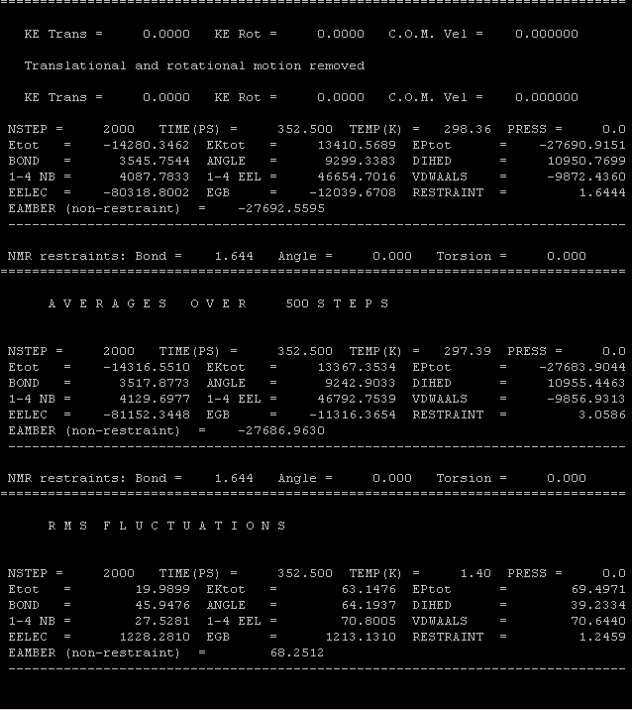
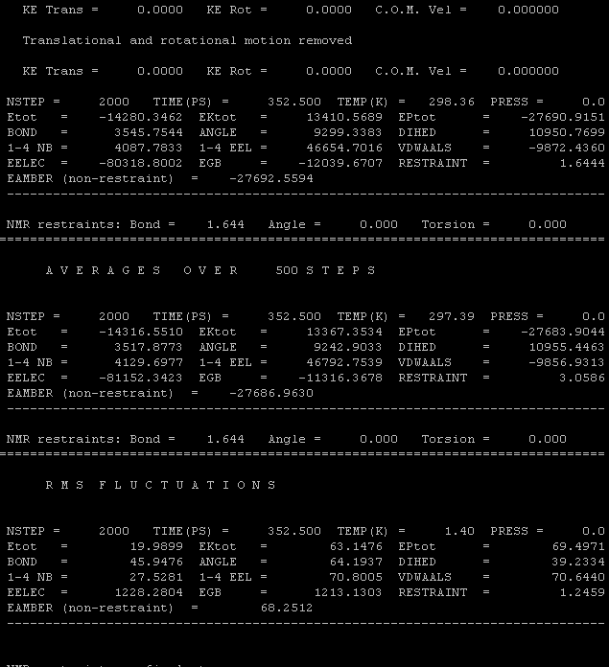
Xcluster-GFARM
Xcluster

Slide 9
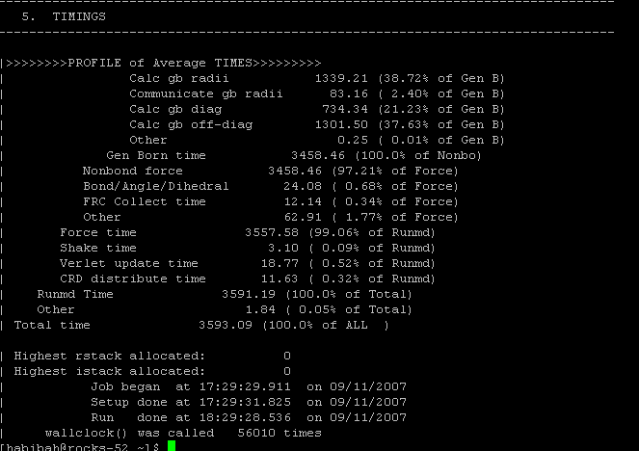
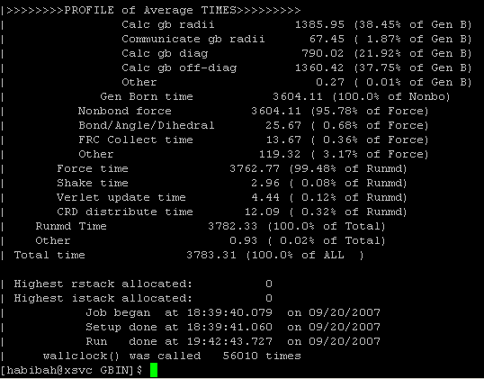
GFARM
1 hour
NOT ON GFARM
1 h 3mins

Slide 10
Advantage
All files are shared across clusters. This will save time for copying all the input files to each desired cluster.
User can save time by log in only once and not every time they change to other cluster.

