Slide 1
Demonstrations at PRAGMA 13
10 demos are nominated by WG chairs
  Did not call for demos.
We will select the best demo(s)
  Criteria is under discussion.
Notes for presenters
  Please focus on demonstration
  20 minutes including Q&A and margins
    15 minutes for the demo followed by few minutes Q&A
    Keep your time! Schedule is tight.

Slide 2
Demonstrations
Session 1 (Mon. 15:45 - 17:15)
  X-SIGMA
  CSF4 Meta-Scheduler
  Account Mgmt. using GAMA and VOMS
  Amber 8 on PRAGMA Gfarm Datagrid
Session 2 (Tue. 9:30 - 10:10)
  The Avian Flu Grid
  CSE-Online with PRAGMA and Thailand National Grid
Session 3 (Tue 10:30 - 12:00)
  3D High-Resolution GIS Taiwan Platform
  Prompt satellite image processing on GEO Grid portal
  Data Mgmt. at Kenting’s Underwater Ecological Observatory
  GEON: Networking Indian Geoscience Community through iGEON

Slide 3
Account Management using
GAMA and VOMS
Yoshio Tanaka
Grid Technology Research Center,
AIST, Japan

Slide 4
Two objectives of this demonstration
To demonstrate technologies used in GEO Grid Security infrastructure.
  Prologue of Nakamura-san’s GEO Grid demo (tomorrow morning).
To introduce VOMS for possible use on PRAGMA Grid.
  Reduce administrative work at each site.

Slide 5
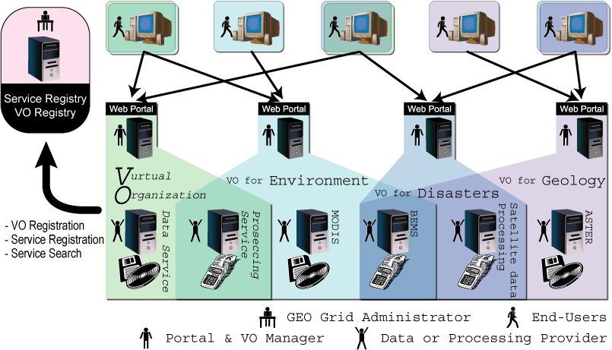
Overview and usage model of the GEO Grid system

Slide 6
Requirements for the Security Infrastructure
AuthN & AuthZ for computing services, data services, and their integrations.
Respecting data/computing service provider’s publication policies.
Ease of use
  For end users
  For service providers
  For VO admins

Slide 7
Implementation
Based on GSI
Use GAMA for
  accounts/certificates management
Use VOMS for
  Group/role-based flexible access control
  Reducing service provider’s administrative works
All services are expected to support GSI/VOMS-enabled AuthN+AuthZ
  OGSA-DAI for data
    OGSA-DAI v3.0 will support VOMS for AuthZ
  GRAM for computation
  Apache + mod_gridsite for W*S

Slide 8

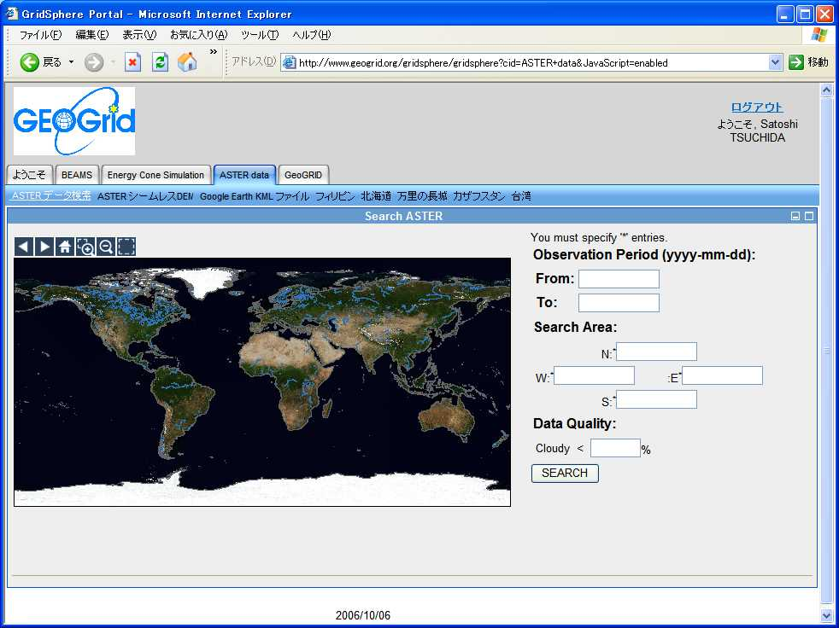


Security
account
creation
Account
DB
GAMA
User A
w/o certificate
GEO Grid Portal
login by
username /
password
GEO Grid
Admin
CA
MyProxy
X.509 long-lived
certificates
B
User B
w/ certificate
credential repository
Ａ
login by
certificate
A
X.509 proxy
certificates
B
Ａ
anonymous
login
B
X.509 proxy
certificates
w/ VOMS attributes
Anonymous User
VOMS server
GridMapAuthZ
PDP
request
Project
Admin
Decision
request
Data / Computation
Service
BlackList
PDP
PEP
WhiteList
PDP
Decision
Result
Service
Provider
Access Control by Account Mapping
  All members are mapped to a single account
  Users are mapped to local account based on groups (and role)
  Users are mapped to pool account based on groups (and role)
VOMS
PDP
Data /
Computation
PDP #n
PDPs

Slide 9
Demonstration
Prerequisites
  GAMA server + GridSphere + GridPortlet
  VOMS server
  GridFTP server + LCAS/LCMAPS
  Pre-WS GRAM + LCAS/LCMAPS
Login and submit jobs by an existing user
Create a new account (and add to VOs)
  Request an account (by an end user)
  Approve the request (by a VO admin)
  Add the user to the VO (by a VO admin)
Login and submit jobs by a new user

Slide 10
Still many issues to do
Enrich GAMA-VOMS interface
  Display credential info with VOMS attr.
  Link GAMA admin tool and VOMS admin tool
  Enable to specify roles for generation of a VOMS proxy
Improve account request procedures of GAMA
Build and package a toolkit for easy installation/configuration
Draft an Authentication Profile for Portal-based Credential Services

