Slide 1
MPICH-GX: Grid Enabled MPI Implementation to Support the Private IP and the Fault Tolerance
Oh-kyoung Kwon
Grid Computing Research Team
KISTI
First PRAGMA Institute

Slide 2
Contents
Motivation
What is MPICH-GX ?
  Private IP Support
  Fault Tolerance Support
Demos
  Job Submission Demo using Command Line Interface
  Grid Portal Demo
Experiments w/ CICESE using MM5
Conclusion

Slide 3
The Problems (1/2)
Running on a Grid presents the following problems:
    Standard MPI implementations require that all compute nodes are visible to each other, making it necessary to have them on public IP addresses
      Public IP addresses for assigning to all compute nodes aren't always readily available
      There are security issues when exposing all compute nodes with public IP addresses
      At developing countries, the majority of government and research institutions only have public IP addresses

Slide 4
The Problems (2/2)
Running on a Grid presents the following problems:
  If multiple processes run on distributed resources and a process dies, it is difficult to find one process
  What if the interruption of electric power happens on the remote site?

Slide 5
What is MPICH-GX?
MPICH-GX is a patch of MPICH-G2 to extend following functionalities required in the Grid.
  Private IP Support
  Fault Tolerant Support
MPICH-GX
Abstract Device Interface
local-job-
manager
Globus2 device
Private
IP module
Fault
tolerant module
Topology
aware
...
hole-punching-
server
Globus I/O

Slide 6
Private IP Support
MPICH-G2 does not support private IP clusters
1. Job submission
Cluster Head
(public IP)
Cluster Head
(public IP)
2. Job distribution
3. Job allocation
members
5. Report result
Compute
Nodes
(private IP)
Compute
Nodes
(private IP)
???
Public IP
Public IP
4. Computation & communication
How to do it with private IP?

Slide 7
How To Support Private IP (1/2)
User-level proxy
  Use separate application
  It is easy to implement and portable
  But it causes performance degradation due to additional user level switching
Cluster Head
(public IP)
Cluster Head
(public IP)
Relay
App.
Relay
App.
Compute
Nodes
(private IP)
Compute
Nodes
(private IP)

Slide 8
How To Support Private IP (2/2)
Kernel-level proxy
  Generally, it is neither easy to implement nor portable
  But it can minimize communication overhead due to firewall
  NAT (Network Address Translation)
    Main mechanisms of Linux masquerading
Cluster Head
(public IP)
Cluster Head
(public IP)
Out-going message
NAT
Incoming message
Compute
Nodes
(private IP)
Compute
Nodes
(public IP)

Slide 9
Hole Punching
Easily applicable kernel-level solution
  It is a way to access unreachable hosts with a minimal additional effort
  All you need is a server that coordinates the connections
  When each client registers with server, it records two endpoints for that client
Cluster Head
(public IP)
Server
Cluster Head
(public IP)
NAT
NAT
Compute
Nodes
(private IP)
Compute
Nodes
(private IP)

Slide 10
Hole Punching
Modification of Hole Punching scheme (1/3)
  At initialization step, every MPI process behind private network clusters obtains masqueraded address through the trusted entity
150.183.234.100
210.98.24.130
Cluster Head
(public IP)
192.168.1.1
Server
Cluster Head
(public IP)
10.0.5.1
NAT
NAT
150.183.234.100:3000
210.98.24.130:30000
Compute
Nodes
(private IP)
Compute
Nodes
(private IP)
192.168.1.1
10.0.5.1

Slide 11
Hole Punching
Modification of Hole Punching scheme (2/3)
  MPI processes distribute two endpoints
Cluster Head
(public IP)
Server
Cluster Head
(public IP)
NAT
NAT
Compute
Nodes
(private IP)
Compute
Nodes
(private IP)
192.168.1.1
10.0.5.1
150.183.234.100:3000
210.98.24.130:30000

Slide 12
Hole Punching
Modification of Hole Punching scheme (3/3)
  Each MPI process tries only one kind of connection
    If destination belongs to the same cluster, it connects using private endpoint
    Otherwise, it connects using public endpoint
Cluster Head
(public IP)
Server
Cluster Head
(public IP)
NAT
NAT
Compute
Nodes
(private IP)
Compute
Nodes
(private IP)
192.168.1.1
10.0.5.1
150.183.234.100:3000
210.98.24.130:30000

Slide 13
Fault Tolerant Support
We provide a checkpointing-recovery system for Grid.
Our library requires no modifications of application source codes.
  ➔ affects the MPICH communication characteristics as less as possible.
All of the implementation have been done at the low level, that is, the abstract device level

Slide 14

Recovery of Process Failure
Job
Submission
Service
resubmit
Modified
GRAM
Modified
GRAM
notify
PBS
PBS
local-job-manager
local-job-manager
notify
process
process

Slide 15
Recovery of Host Failure
Job
Submission
Service
notify
resubmit
Modified
GRAM
Modified
GRAM
PBS
PBS
Host Failure
local-job-manager
local-job-manager
process
process

Slide 16
Job Submission Demo using Command Line Interface

Slide 17
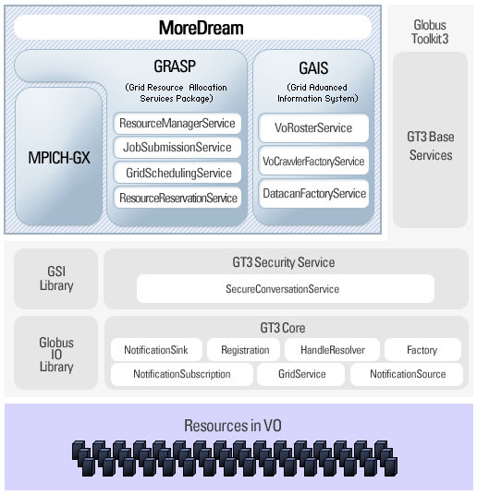
MoreDream Toolkit

Slide 18
Relation with Globus Tookit
MPICH-GX is integrated with GT
  Both GT 3.x and GT 4.x
On GT3.x, it works with both GRASP of MoreDream and gxrun & gxlrm.
At the moment, on GT4, it only works with gxrun & gxlrm, not with GRAM4
If MPICH-G4 releases, MPICH-GX will be based on MPICH-G4, which supports GRAM4

Slide 19
gxrun & gxlrm
gxrun: a client which enables users to submit a Grid job
  JRDL(Job & Resource Description Language): A Job is described as a JRDL
gxlrm: a server which accepts the Grid job on the each resource, and then allocates resources

Slide 20
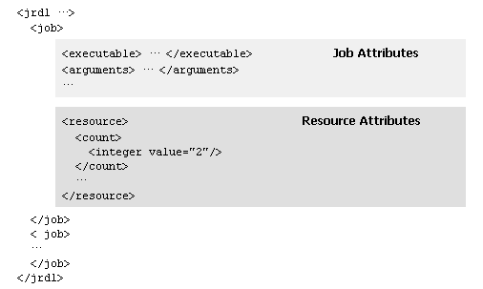
JRDL (1/2)
Job & Resource Description Language

Slide 21
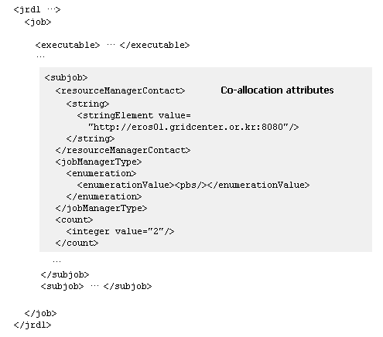
JRDL (2/2)

Slide 22
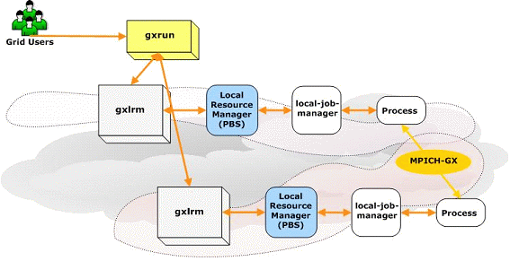
Workflow of MPICH-GX job

Slide 23
Demonstration for launching the MPICH-GX job

Slide 24
Grid Portal for the MPI job

Slide 25
Grid Portal for the MPI job
Grid Portal based on Gridsphere
  General Purpose Web Portal
  MM5 Grid Portal

Slide 26
MM5 Grid Portal
The MM5 is a limited-area terrain-following sigma coordinate model designed to simulate mesoscale atmospheric circulation
The MM5 Grid Portal is for the MM5 modeling system with which people can use it easily
The portal is consisted of 4 building blocks as follows: Terrain-, Pre-, Main-, and Post-Processing
As a testbed system, presently, the MM5 Grid Portal is targeted at the specific user group of Korea. But the portal will be gradually extended to the general purpose user services environment

Slide 27



Architecture of MM5 Grid Portal System
User
Web Portal
Get Status
Submit
MM5 Portal
Service
Pre-Processing
Main
Post-Processing
Terrain
Grid
Middleware
Grid Information
Service
Job Submission
Service
Allocate
Resources
Allocate
Resources
MPICH-GX
MPICH-GX
Compute
Resources
Seoul
Daejeon
Busan
Gwangju
Pohang

Slide 28
Demonstration
for launching the Grid job via web portal
http://150.183.249.120:8080/gridsphere/gridsphere

Slide 29
Experiences of MPICH-GX with
Atmospheric Applications
Collaboration efforts with PRAGMA people (Daniel Garcia Gradilla (CICESE), Salvador Castañeda(CICESE), and Cindy Zheng(SDSC))
Testing the functionalities of MPICH-GX with atmospheric applications of MM5/WRF models in our K*Grid Testbed
  MM5/WRF is a medium scale computer model for creating atmospheric simulations, weather forecasts.
  Applications of MM5/WRF models work well with MPICH-GX
  Functionality of the private IP could be usable practically, and the performance of the private IP is reasonable

Slide 30
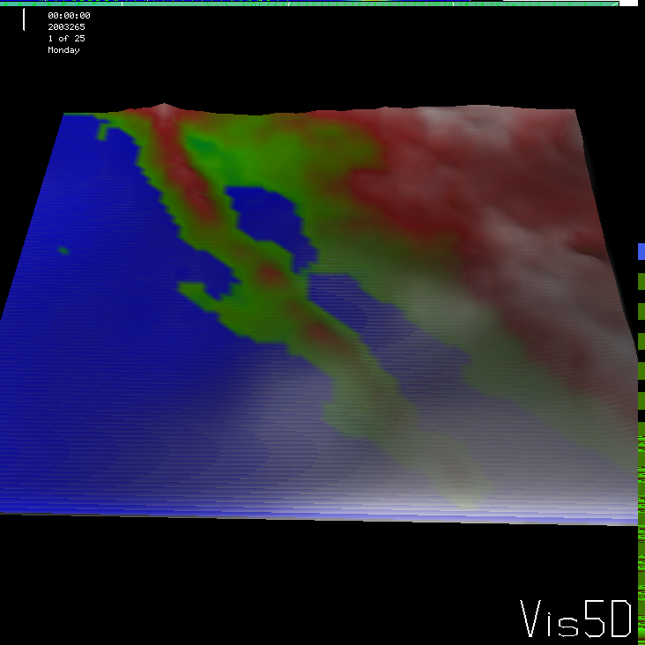


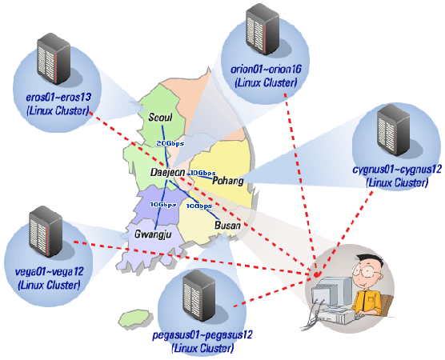

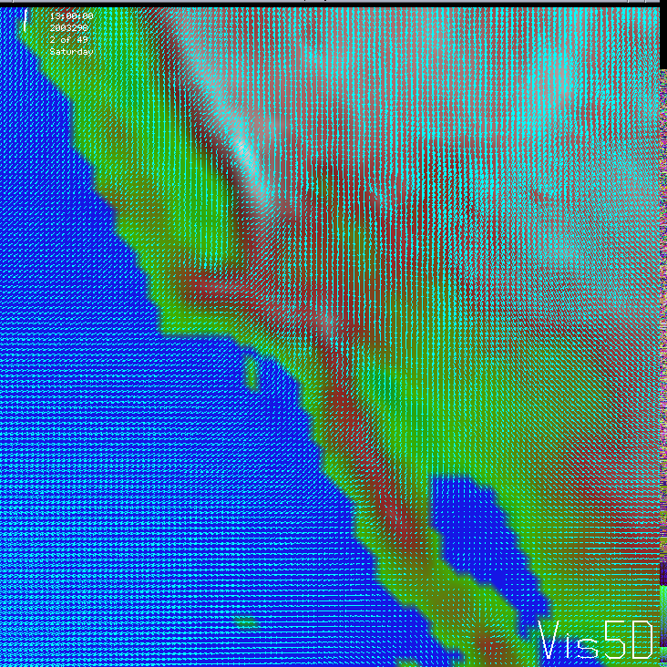
Experiments
Hurricane Marty Simulation
Santana Winds Simulation
output
eolo
pluto

Slide 31
Analyze the output
12 nodes on single cluster (orion cluster): 17.55min
12 nodes on cross-site
  6 nodes on orion + 6 nodes on eros, where all nodes have public IP: 21min
  6 nodes on orion + 6 nodes on eros, where the nodes on orion have private
  IP and the nodes on eros have public IP: 24min
16 nodes on cross-site
  8 nodes on orion + 8 nodes on eros, where all nodes have public IP: 18min
  8 nodes on orion + 8 nodes on eros, where the nodes on orion have private
  IP and the nodes on eros have public IP: 20min

Slide 32
Conclusion and Limitation
MPICH-GX is a patch of MPICH-G2 to provide useful functionalities for supporting the private IP and fault tolerance
The application of WRF model work well with MPICH-GX at Grid environments. but when using MM5 model, we have scaling problems for clusters bigger than 24 processors using MPICH-GX.
The functionality of the private IP could be usable practically, and the performance of the private IP is reasonable
MPICH-GX is compatible with Globus Toolkit 4.x. But, doesn’t work with GRAM4.
Manual installation

Slide 33
Now and Future Works
We are expecting the release of MPICH-G4
  Extension to the MPICH-G4
Continuously, we are testing with more larger input size of MM5/WRF

Slide 34
Thanks for your attention !
okkwon@kisti.re.kr

