Slide 1
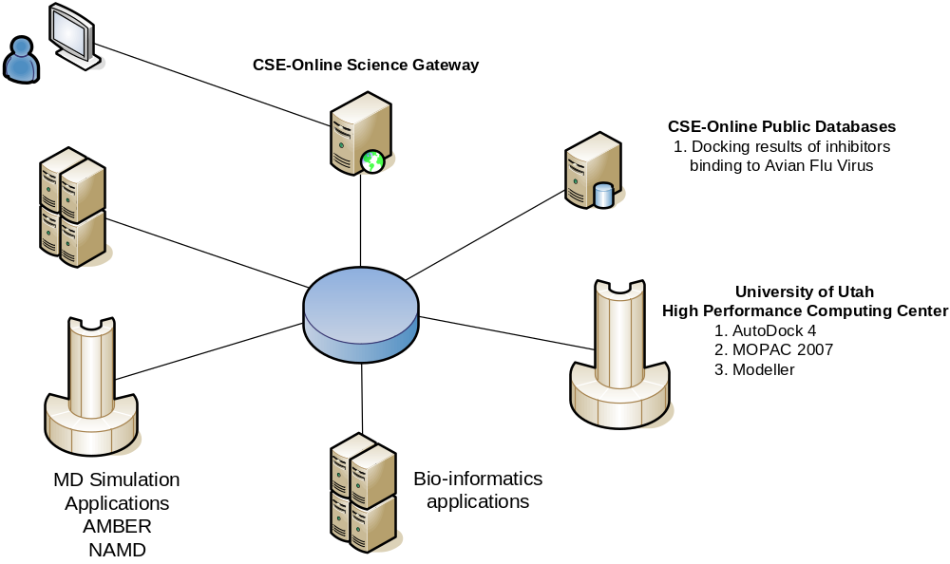
CSE-Online Science Gateway for Avian Flu Drug Design

