Slide 1





CSF4 Meta-Scheduler
PRAGMA13
Zhaohui Ding
zhaohui.ding@email.jlu.edu.cn or zhding@ucsd.edu
College of Computer Science & Technology
Jilin University

Slide 2
Agenda
CSF4 Introduction
CSF4 Functionalities
Current Deployment
Demo

Slide 3
CSF4
What is CSF Meta-Scheduler
  Full Name: Community Scheduler Framework
  CSF4 contains a group of grid services host in GT4
  CSF4 is a full WSRF compliant meta-scheduler.
  Open Source project and can be accessed at http://sourceforge.net/projects/gcsf
  Developed by Jilin University, China
  CSF4 has been added to Globus Toolkit 4 as an Execution Component

Slide 4
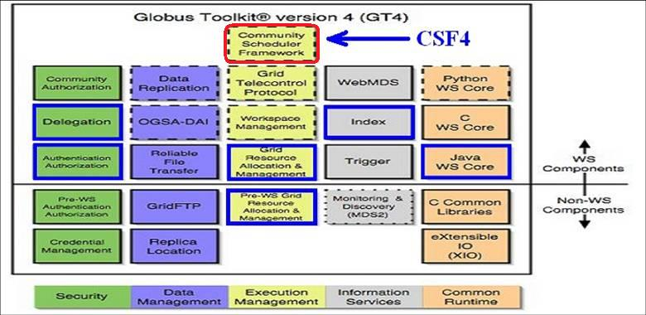
CSF4 in Globus Toolkit 4

Slide 5
What CSF4 Can Do?
Basic Functionalities
  Submit jobs to Grid without Specifying Cluster
  Monitor and Control Jobs
  Provide Queuing Service
  Schedule jobs and resource by custom-built polices
  CSF4 Portlet (A Web browser based User Interface)

Slide 6
What CSF4 Can Do? (cont.)
Advanced Functionalities
  Multiple Domains Resource Information Sharing
  Multiple scale resource scheduling policies
  Automatic user credentials delegation
  Automatic data-staging
  Extensible scheduling framework
  Supporting grid parallel jobs (MPI&MPICH-G2)

Slide 7
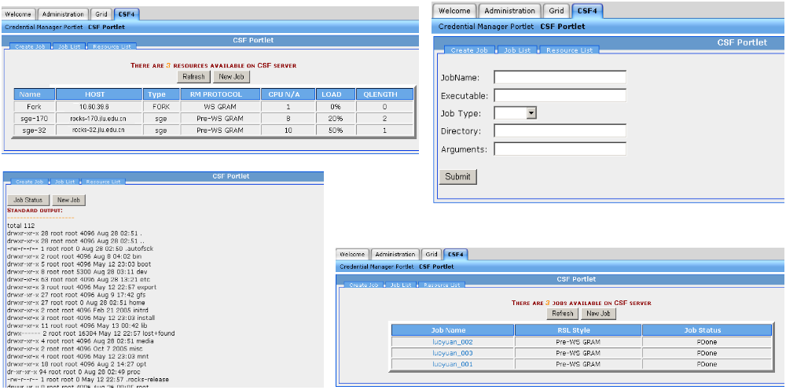
CSF4 User Interface
CSF4 Portal

Slide 8
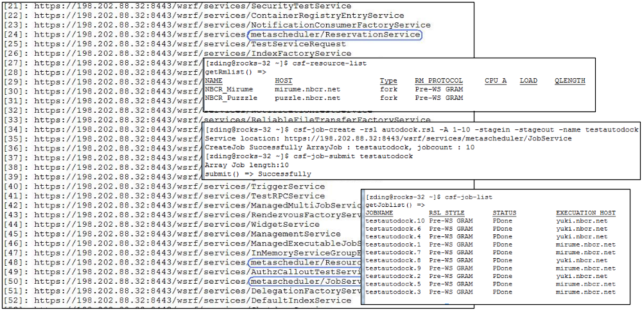
CSF4 User Interface
CSF4 Command Line

Slide 9
Current Deployment
PRAGMA CSF Server and CSF Portal
on : portal.pragma-grid.net (rocks-144.sdsc.edu)
4 available clusters (SDSC, NBCR and AIST)
From command line
Install CSF4 client on your cluster front-node
From Portal
https://portal.pragma-grid.net:9443/worksphere/start

Slide 10
Demo
Query Available Cluster, Application and Submitted Job Status
1. Simplest Job
2. Array Job (virtual screening)
3. Mpi job (linpack xhpl benchmark)

Slide 11
Thank you

