Slide 1
GEO WG update
Notes:
Update 1 or 2 slides
DEMO, for what? By what? ASTER MODIS
Working group, database federation
Chiaki/Ootsuki, IDL, HK,

Slide 2
Topics to be discussed
Federation of huge satellite data archive
Integration of diverse geology (GIS) datasets
How to design e-science infrastructure for geosciences
Discussion on possible collaboration with other WG (Telescience, Resource,Bio)
Notes:
MODIS = Bio
PEN, DCP, TWD

Slide 3



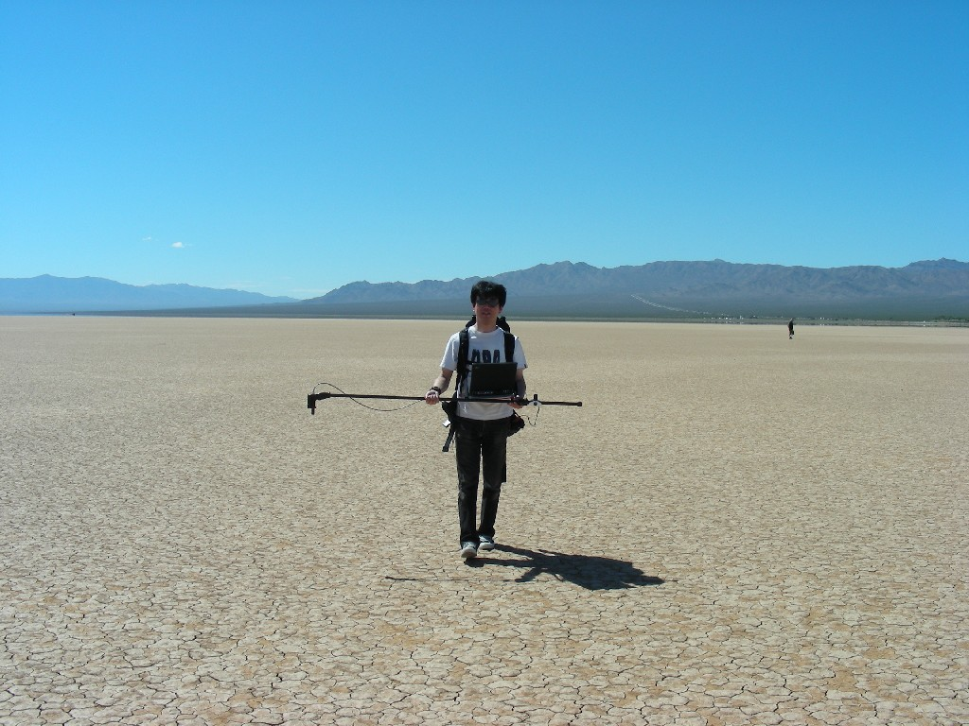
TERRA/ASTER
FORMOSAT-2
代替校正
相互校正
Vicarious calibration
Cross calibration

Slide 4
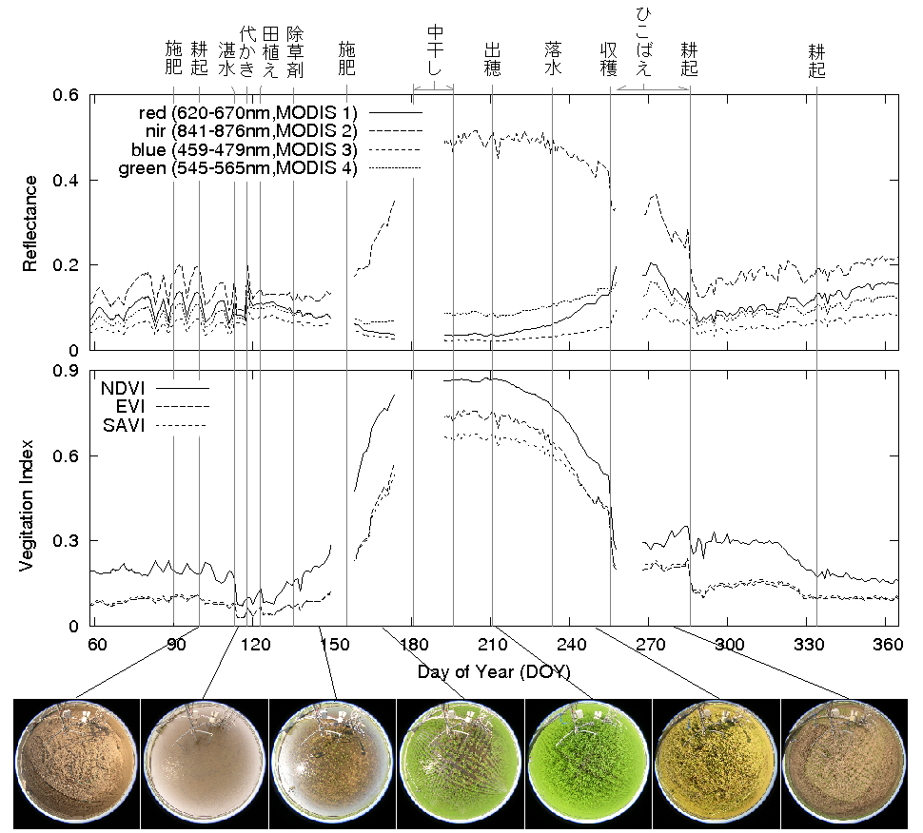
Collaboration with Telescience/Bioscience WG
MODIS
Phenological Eyes Network (AIST, U. Tsukuba, NIES)
Notes:
TWD + sensor networks,, Biosciences,,

