Slide 1

Bridging Grid Islands for Large Scale e-Science
Blair Bethwaite, David Abramson, Ashley Buckle

Slide 2



Why Interoperate?
Increasing uptake of e-Research techniques is increasing demand for Grid resources.
Infrastructure investment requires users and apps – chicken and egg.
Need it done yesterday!
Drive Grid evolution.

Slide 3

Interop is hard!
One Grid is challenging enough, try using five at once.
What’s the problem?
Grids are built with varying specifications and until recently, little regard for best practice.
Minor differences in software stacks can manifest as complex problems.
Varying levels of Grid maturity make for an inconsistent working environment.

Slide 4
Related Work
OGF Grid Interoperability Now [1].
  Helps facilitate interop work and provides a forum for development of best practice.
  Feeds into other OGF areas, e.g. standards.
  Focused areas: GIN-ops, GIN-auth, GIN-jobs, GIN-info, GIN-data.
PRAGMA – OSG Interop [2].
Many bi-lateral Grid efforts.
Middleware compatibility work, e.g. GT2 & UNICORE.
[1] http://forge.ggf.org/sf/go/projects.gin/wiki
[2] http://goc.pragma-grid.net/wiki/index.php/OSG-PRAGMA_Grid_Interoperation_Experiments

Slide 5
Our Approach
Use case: upscale computation to larger dataset. How do I use other Grids, what issues will there be?
for grid in testbed:
Resource discovery
Resource testing
Interop issues
Add to experiment
Application deployment

Slide 6
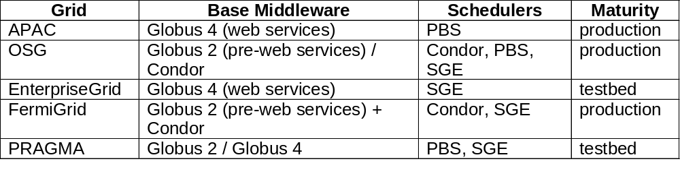
The Testbed
Five Grids of varying maturity.
Three virtual organisations: Monash, GIN, Engage.

Slide 7
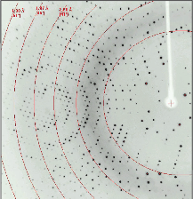
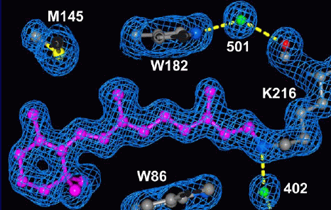
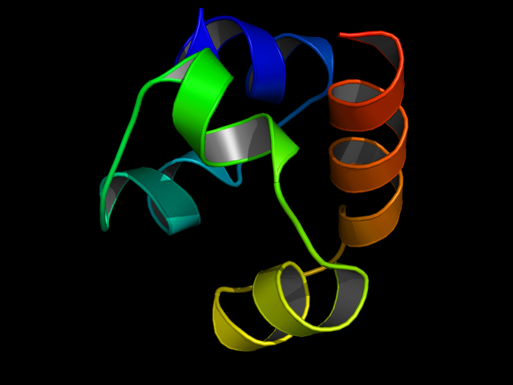
Protein Structure determination strategy
Diffraction intensities
Electron density
Fourier synthesis
Phases
+
Use known structures (molecular replacement)
Experimental methods = back to lab
3D structure

Slide 8
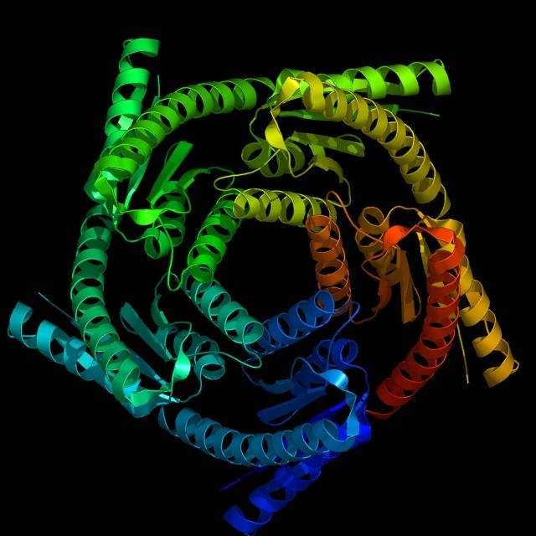
Using Nimrod/G
Nimrod/G experiment in structural biology.
  Protein crystal structure determination, using the technique of Molecular Replacement (MR).
  Parameter sweep across the entire Protein Data Bank.
  > 70,000 jobs, many terabytes of data.
Source: http://www.mdpi.org/ijms/specialissues/pc.htm

Slide 9
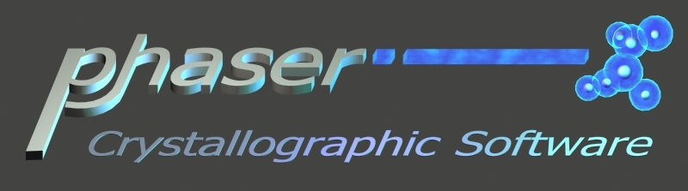
The Application
Characteristics:
  Independent tasks
  Small input/output – data locality not an issue
  Unpredictable resource requirements – few hours to few days computation, hundreds to thousands of MB of memory

Slide 10
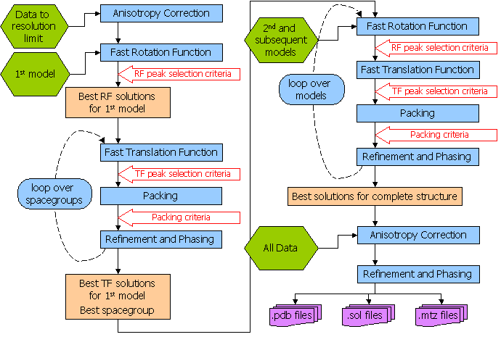
Phaser details
Source: http://www-structmed.cimr.cam.ac.uk/phaser/documentation/phaser-2.0.html

Slide 11
Interop Issues
Identified five categories where we had problems:
  Access & security:
    International Grid Trust Federation makes authn easy.
    GIN VO does not support interoperations (test only).
      Still necessary to deal with multiple Grid admins to gain access to locally trusted VO/s.
    Current VOMS implementation (users sharing a single real account) presents risk in loosely coupled VOs.
  Resource discovery:
    Big gap between production and testbed Grids in information services.
    Need to make these services easier to provide and maintain.

Slide 12
Interop Issues cont.
  Usage guidelines / AUPs
    How should I use your machines? Where do install my app?
      A standard execution environment has been a long time coming! There is a recent GIN draft [1]. Recommend GIN-ops Grids must comply.
E.g. Phaser deployment required scripts written and customised for each Grid. Too hard for a regular e-Science user!
if [ ! -z ${OSG_APP} ] ; then
echo "\$OSG_APP is $OSG_APP"
APP_DIR=${OSG_APP}/engage/phaser
elif [ -w ${HOME} ] ; then
echo "Using \$HOME:$HOME..."
APP_DIR=${HOME}/phaser
else
echo "Can't find a deployment dir!"
exit 1
fi
[1] Morris Riedel, “Execution Environment,” OGF Gridforge GIN-CG; http://forge.ogf.org/sf/go/doc15010?nav=1.

Slide 13

Interop Issues cont.
  Application compatibility:
    Some inputs caused long and large, i.e. in excess of 2GB virtual memory, searches.
    On machines with vmem_limit < 2GB this caused job termination part way through the job and wasted many CPU hours over the experiments duration.
    These memory requirements crashed some machines on PRAGMA Grid because limits were not defined.
      Not enough to just install SGE/PBS and whack Globus on top, these systems need careful config. and maintenance.
      Why doesn’t the scheduler / middleware handle this? Should be automated!

Slide 14
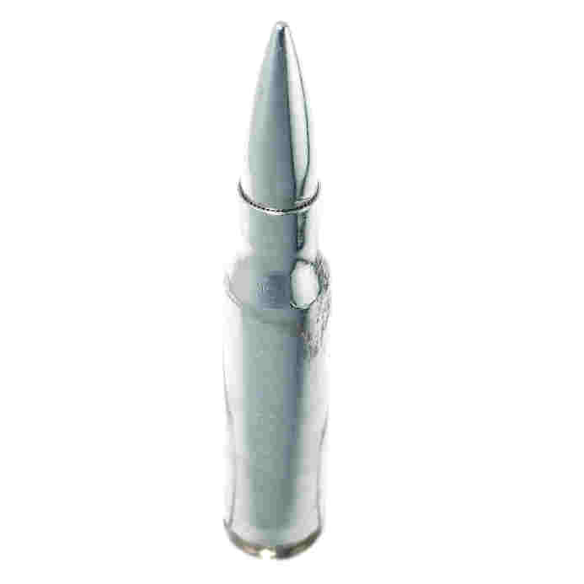
Interop Issues cont.
  Middleware compatibility:
    Yes, we need standards! But adoption is slow.
    Using GT4 on different Grids and local resource managers / queuing systems is like having a job execution standard. However we still had problems:
      E.g. GT4 PBS interface leaves automatically generated stdout & stderr behind even when they are not requested. Couple this with VOMS and get a denial of service on the shared home directory!!
    Existing standards (e.g. OGSA-BES[1]) have gaps – functionally specific, little regard for side effects. Wouldn’t stop this problem happening again.
?
[1] I. Foster et al., “GFD-R-P.108 OGSA Basic Execution Service,” Aug. 2007; http://www.ogf.org/documents/GFD.108.pdf.

Slide 15
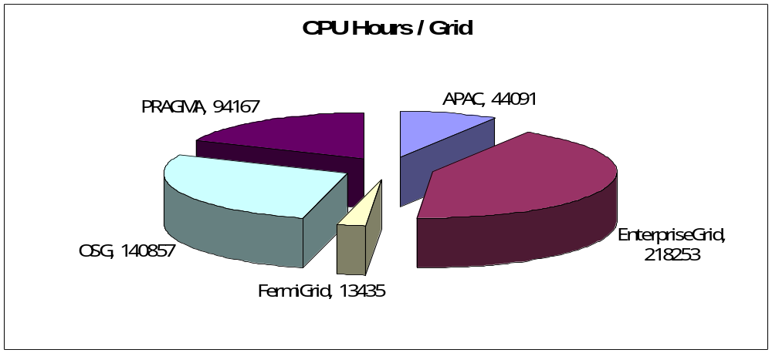
Results & Stats
Approx 71,000 jobs and half a million CPU hours completed in less than two months.
Biology in post-processing…

Slide 16
Conclusions
Authz needs work – be careful with VOMS.
Standardize execution environment, e.g. $USER_APPS, $CREDENTIAL, & tools like Nimrod could handle deployment automatically.
Maintaining a Grid is hard. Use and develop tools like the Virtual Data Toolkit.
Standards help (mostly developers) but do not guarantee interoperability.

Slide 17
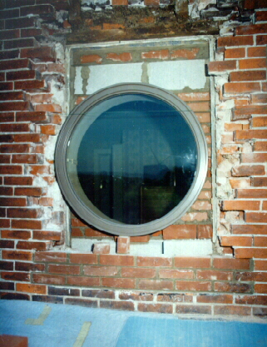
Finally
Interop is still hard… but rewarding!
  Science like this was not possible two years ago. Soon it will be routine.

Slide 18
Acknowledgments & Thanks
PRAGMA – especially Cindy Zheng and all resource providers
OSG – Neha Sharma, Mats Rynge, Ruth Pordes
GIN - Oscar Koeroo, Morris Riedel, Erwin Laure
Monash – Steve Androulakis, Colin Enticott, Slavisa Garic

