Slide 1
Interfacing SCMSWeb with Condor-G – A Joint PRAGMA-Condor Effort

Slide 2
Hello, My name is Sugree from ThaiGrid

Slide 3
I'm here to present our joint effort between Condor team and ThaiGrid team under PRAGMA

Slide 4
Somsak from ThaiGrid → Develop the code
Jaime from Condor → Condor installation & support
Jysoo from KISTI → application test
Cindy from SDSC → Coordination

Slide 5
So you can submit Condor-G job to PRAGMA resources

Slide 6
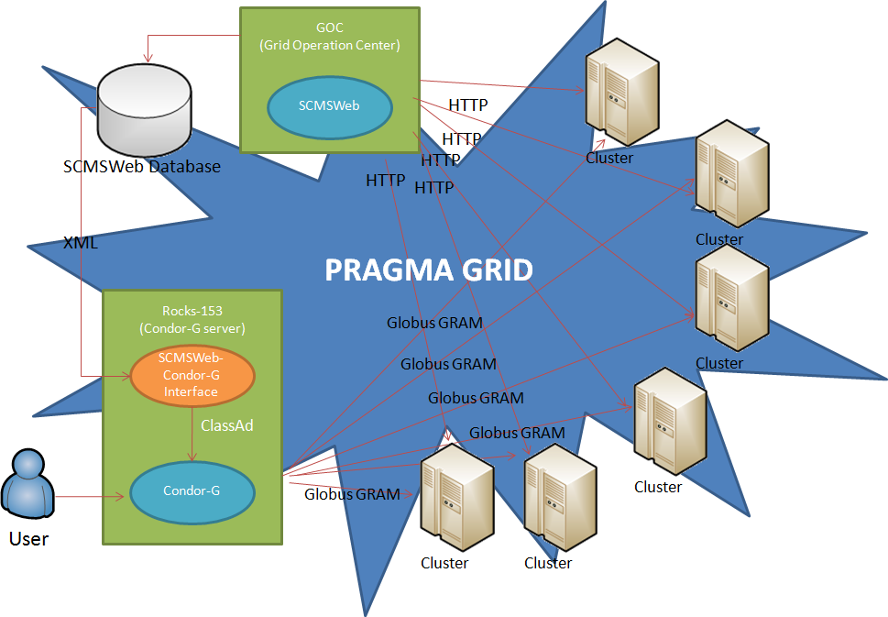

Slide 7
Job script is exactly the same as Condor-G job script

Slide 8
Condor-G will pick the (probably) best resources according to data from SCMSWeb

Slide 9
Simple job script
Executable = testcmd
Universe = grid
x509userproxy = /tmp/x509up_u533
grid_resource = $$(resource_name)
# in case you want some specific cluster
requirements = ( TARGET.name == "fsvc001.asc.hpcc.jp" )
output = test.out
error = test.err
Log = test-grid.log
Queue
# condor_submit condor_job_script

Slide 10
Get the list of managed resources condor_status -startd

Slide 11
Get the queue list condor_q

Slide 12

For more information about job submission, please ask Jysoo, he is a lot better than me

Slide 13
Now the interfacing module is working on rocks-153.sdsc.edu (same old Condor server)

Slide 14
Job scheduling is quite slow. Should be more suitable for long-running job

Slide 15
To get an account on the server, please contact Cindy (zhengc@sdsc.edu)

Slide 16
It is possible to use this on your own server, while using data from PRAGMA-GOC.

Slide 17
Future work
  Paper submitted to IEEE eScience PRAGMA workshop
  Find a better way to deal with error
  Optimize Condor scheduling

Slide 18
Any question?

