Slide 1

Resources Group Work
Since PRAGMA 14
Resources Group
Pacific Rim Application and Grid Middleware Assembly
http://www.pragma-grid.net
http://goc.pragma-grid.net

Slide 2

PRAGMA Grid
UZH
Switzerland
UZH
Switzerland
AIST
OsakaU
UTsukuba
TITech
Japan
CNIC
GUCAS
China
JLU
China
NCSA
USA
KISTI
Korea
BU
USA
UUtah
USA
LZU
China
LZU
China
SDSC
USA
ASGC
NCHC
Taiwan
CUHK
HongKong
UPRM
Puerto Rico
UoHyd
India
CICESE
Mexico
ASTI
Philippines
UNAM
Mexico
NECTEC
ThaiGrid
Thailand
HCMUT
HUT
IOIT-HCM
Vietnam
CeNAT-ITCR
Costa Rica
SKU
UI
Indonesia
MIMOS
USM
Malaysia
APAC
QUT
Australia
BII
IHPC
NGO
NTU
Singapore
MU
Australia
BESTGrid
New Zealand
UChile
Chile
27 institutions in 17 countries/regions, 24 compute sites (+ 14 in preparation)

Slide 3
PRAGMA Grid Members and Team http://goc.pragma-grid.net/wiki/index.php/Site_status_and_tasks
Sites
  19 sites from PRAGMA member institutions
  7 sites from Non-PRAGMA member institutions
  23 sites contributed compute clusters
Team members
  222 and growing
  one management contact / site
  1~3 technical support contact / site
  1~4 application drivers / application
  1~5/Middleware development teams

Slide 4
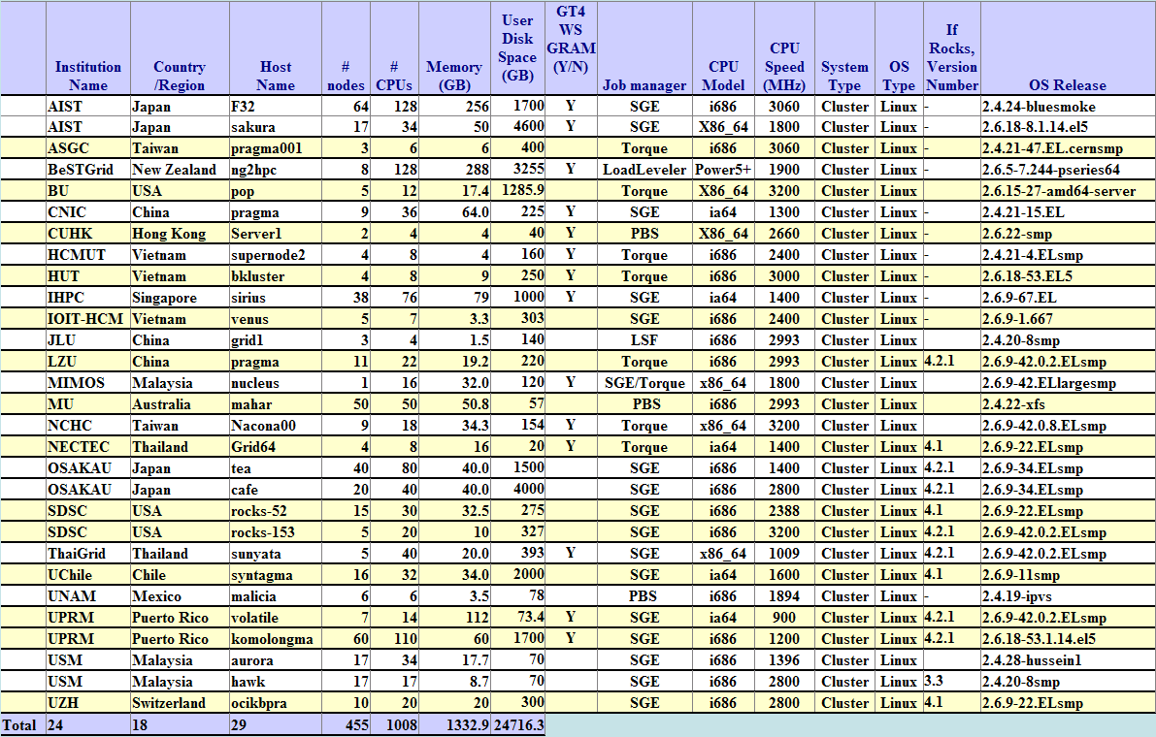
PRAGMA Grid Compute Resources http://goc.pragma-grid.net/pragma-doc/computegrid.html

Slide 5
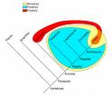
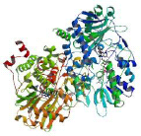
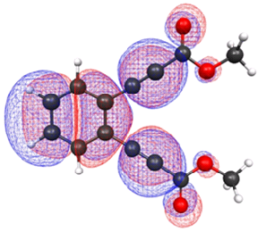
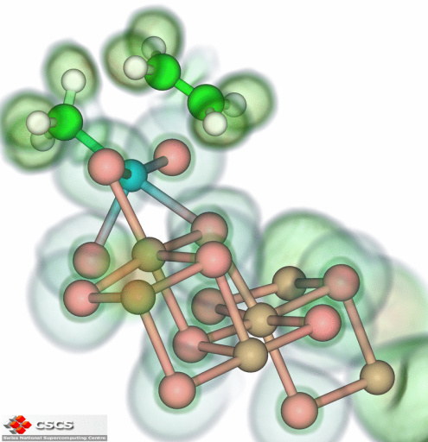

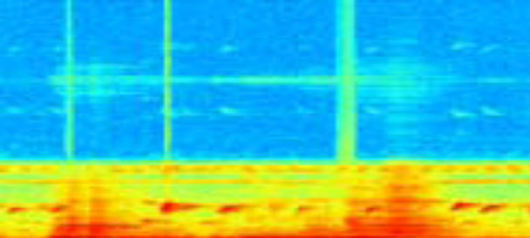
Applications http://goc.pragma-grid.net/wiki/index.php/Applications
13 applications: (8 by PRIME)
  Structure biology
    Phaser/Nimrod (MU, Australia)
  Drug analysis
    EMSAM (PRIME)
  Bio-medical research
    Cardiac output (PRIME)
    Cardial mechanics (PRIME)
    Ventricular Myocyte model (PRIME)
  Genomics and meta-genomics
    Avian Flu Grid/CSF (SDSC/CNIC/JLU/UTsukuba/…)
  Computational fluid dynamics
    e-AIRS (KISTI, Korea)
  Environmental Science
    CSTFT/Ninf-G (UPRM, Puerto Rico)
  Organic-chemistry
    Enediynes (PRIME)
    Virtual screen SHP-1 and SHP-2 (PRIME)
    Virtual screen SSH-2 (PRIME)
  Computer Science
    Image Analysis (UMelb, Australia)
  Nanotechnology
    Nanoengineering simulation (PRIME)

Slide 6



Grid Interoperation Experiments http://goc.pragma-grid.net/wiki/index.php/Run_Phaser_on_PRAGMA_grid_and_OSG
Phaser/Nimrod-G – structural biology
  Australian enterpriseGrid
  APAC Grid
  OSG
    FermilabGrid
    RENCI (VO)
Submitted a paper to an IEEE conference

Slide 7




SCMSWeb-Condor Interface http://goc.pragma-grid.net/wiki/index.php/Condor-PRAGMA_Interoperation
SCMSWeb interface Condor-G
  SCMSWeb provides system info, Condor-g dispatchs jobs accordingly
Collaboration between PRAGMA and Condor
  ThaiGrid
    Project lead
    Interface development work
  SDSC
    Coordination
    Resource support
  KISTI
    Application testing
  Condor
    Interface development support
Current Status
  Running on rocks-153.sdsc.edu
  Successfully tested with application
  Working on improving performance and fault-tolerance
Submitted a paper to an IEEE conference

Slide 8
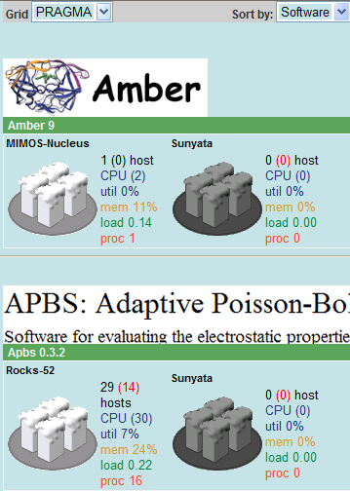
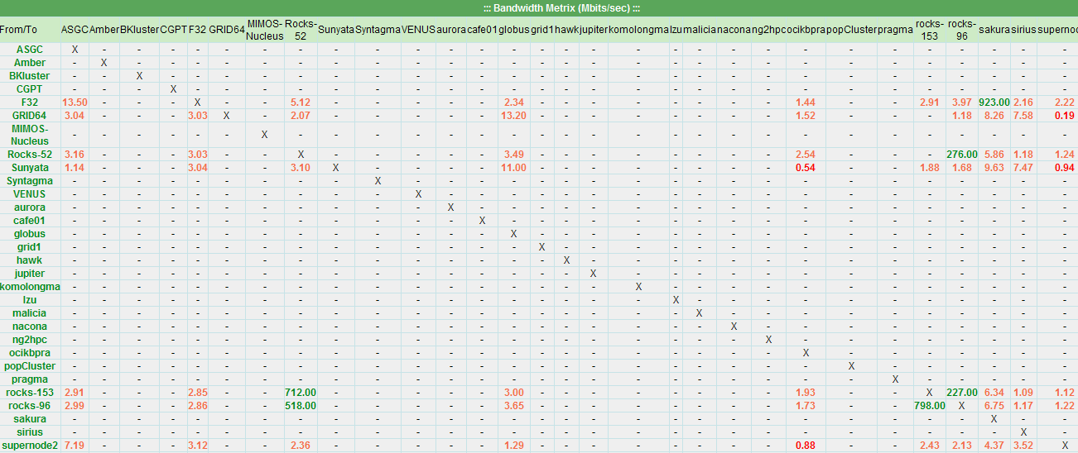
SCMSWeb New Features
Automatic email alert deployed and operational
  According to probe failure status
  3 times a week
  Email to site admins and Cindy Zheng
Bi-directional bandwidth measurements using iPerf
  Deployed on 11 systems
  Need to investigate problems with some sites in one direction
  Need to deploy to all systems
Software catalog
  Implemented for 7 software so far
    Amber, APBS, AutoDock, NAMD
    Ninf-G
    Intel-C, Intel-Fortran
  Deployed on 11 systems
  Need to deploy to all systems
  Add more software as needed

Slide 9


PRAGMA-CA and VOMS
PRAGMA-UCSD CA (https://goc.pragma-grid.net/ca)
  Lead by Yoshio Tanaka, Mason Katz and Cindy Zheng
  Built according to the most current APGrid recommendations and guidelines
  Naregi-CA developed new version
  Setup at SDSC
  Accredited by APGrid PMA in April, 2008
  Included in IGTF distribution in July, 2008
  Issued 10 host certs for PRAGMA grid services at SDSC
    Compute clusters
    GOC server
    VOMS server
    Condor server
    Portals
VOMS (http://goc.pragma-grid.net/wiki/index.php/VOMRS)
  Lead by Vladimir Mencl (BeSTGrid) and Cindy Zheng
  Setup VOMRS server at SDSC
  Focused on group mapping to local account
  Successfully tested with BeSTGrid as a client system
  Documented for users and site administrators
  Issues need to be discussed before wider deployment

Slide 10
Gfarm Grid File System http://datafarm.apgrid.org
Lead by UTsukuba, Japan
Open source development at SourceForge.net
New version V 2.1.1 is ready
Tatebe-san setup Meta-server at SDSC (rocks-45.sdsc.edu), also a file server
AIST setup a file server
Documented for users and site admins
  http://goc.pragma-grid.net/wiki/index.php/Gfarm_Data_Grid
Need more testing and with application Avian-Flu Grid

Slide 11
Tentative agenda of the breakouts
Breakout 1 14:00-15:30 (today)
VOMS in PRAGMA Grid (40 min)
PRAGMA Data Grid (20 min)
SCMSWeb (20 min)
Breakout 2 14:30-16:00 (tomorrow)
Reports from PRAGMA applications (40 min)
  e-AIRs
  Phaser
  Other application talks?
Introduction of A*STAR Digital Nervous System (iHPC) (20 min)
  FusionCloud
Open Discussions : Future direction of PRAGMA Grid (30 min)
  Theme: How make it easier for all players (esp. Cindy)
  Virtualization, VOMS, Portals, etc.
  Supporting GEO/Tele applications

