Slide 1
Geoscience breakout session
Day 1
  Wai Chi CHENG, The University of Hong Kong
  James O.P. CHEUNG, The University of Hong Kong
  Dongil Lee, Korea Meteorology Agency
  Youngkyu Yang. Kyungwon Univ.
  Ekasit Kijsipongse -- NECTEC , Thailand
  Youngseung Kim, Korea Aerospace Research Institute

Slide 2
Joint session of Tele-Geo WG
  Young-Gyu Park, "Introduction of high performance computing and visualization at Korea Ocean Research and Development Institute”
  Fang-Pang Lin “GLEON and CREON”
  Mathew Grant Allan (University of Waikato, NZ)REMOTE SENSING OF WATER QUALITY AND TEMPERATURE IN LAKES
  QinHai Lake by Baoping Yan
Notes:
Young-Kwang Yeon, Korea Geoscience and Mineral Resources

Slide 3
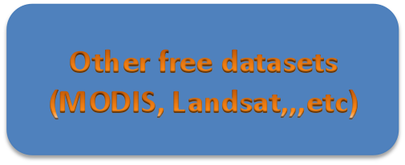
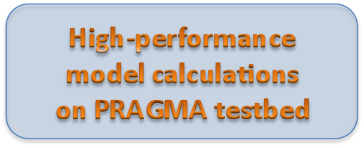




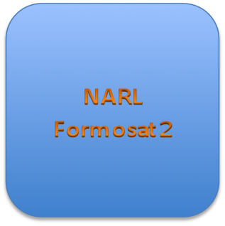

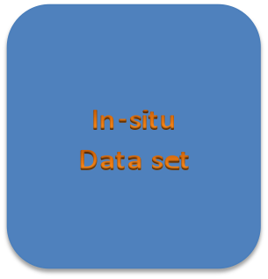
GAMA/VOMS (Resource)
OGC standard (GEO/Telesciences)

