Slide 1
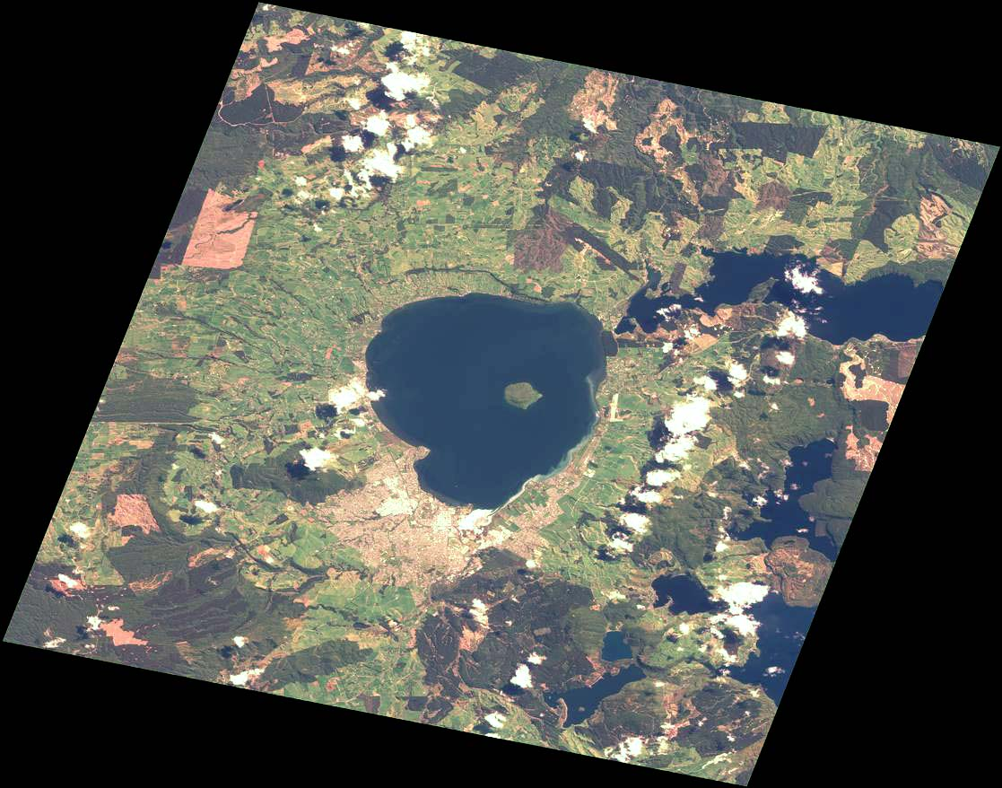
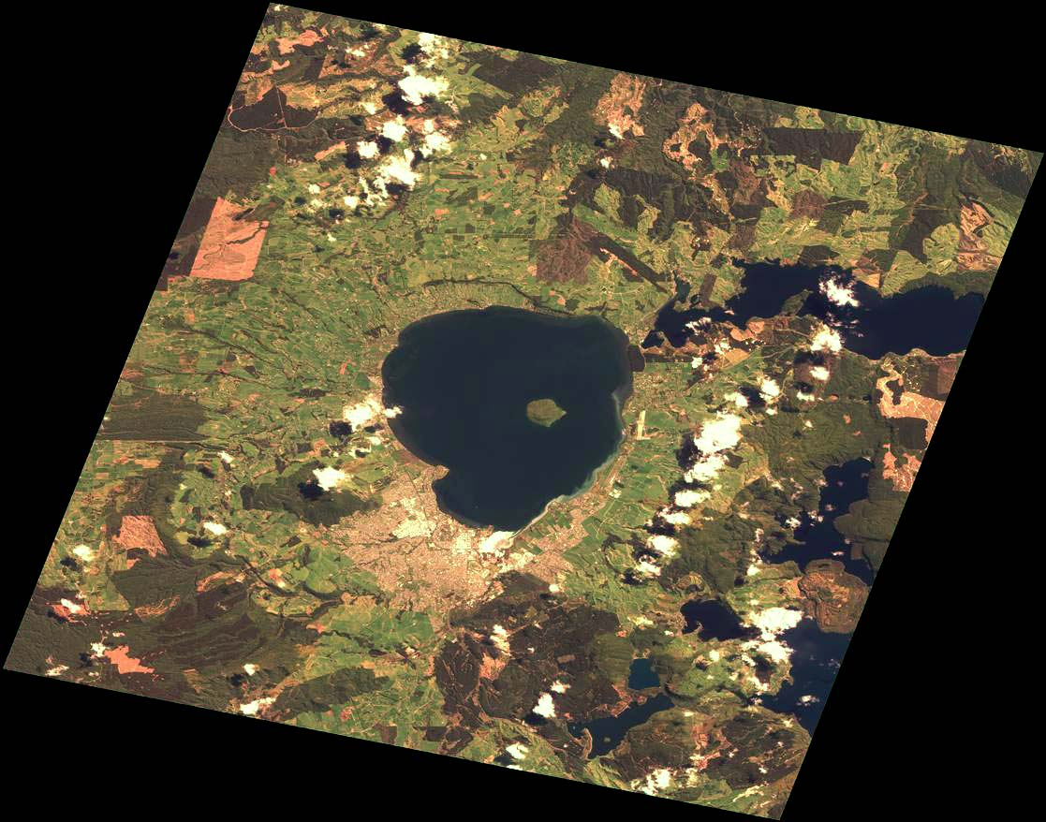
Requirement for atmospheric corrections
TOA reflectance
Rayleigh/Ozone/Water Vapor
Corrected reflectance
Linear stretch images of TOA and Rayleigh/Ozone/Water Vapor Corrected reflectance by using the same reflectance maximum and minimum

Slide 2
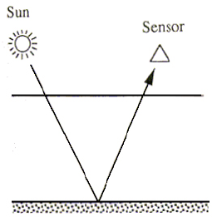
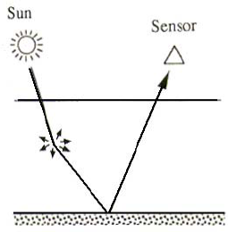
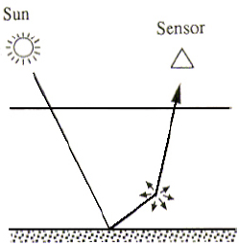
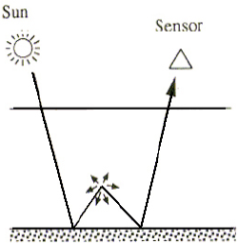
Surface reflectance and
Top of the atmosphere
Image from: http://www.profc.udec.cl/~gabriel/tutoriales/rsnote/cp9/cp9-2.htm
Notes:
A portion of the light that reaches a sensor flying overhead actually comes from the Earth's atmosphere, not the surface of the Earth.
This signal from the atmosphere, which can obscure the signal emanating from the land or water of interest, is caused by molecular scattering and absorbing of gas and particles in the atmosphere.
Particles such as dust, ash, and smoke also scatter light reflected from the Earth's surface.

Slide 3
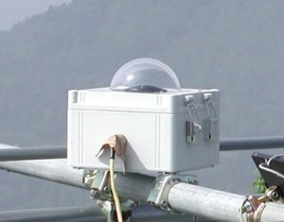
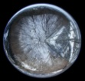
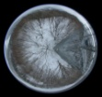
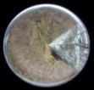
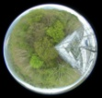
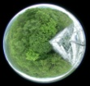

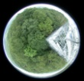
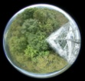
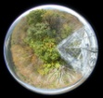
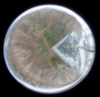
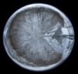
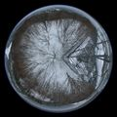
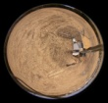
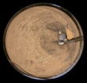
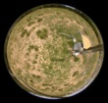
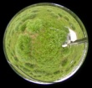
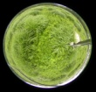
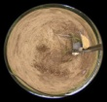
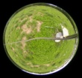
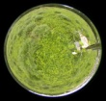
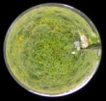
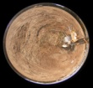
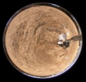
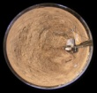
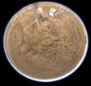
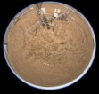
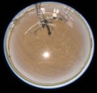
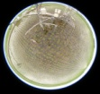
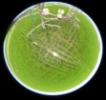
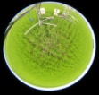
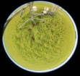
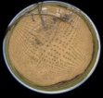
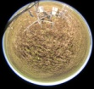
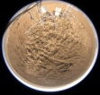
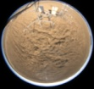
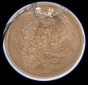
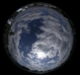
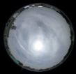
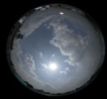
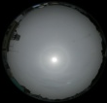
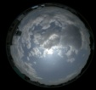
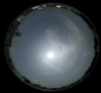
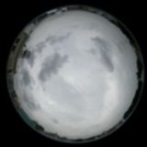
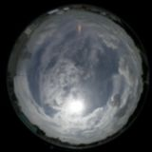



















PEN Equipments
Mar.
Apr.
May
Jun.
Jul.
Aug.
Sep.
Oct.
Nov.
Dec.
Jan.
Feb.
ADFC
TKY
TGF
MSE
RHN
SP
HSSR
http://www.pheno-eye.org

Slide 4




Validation (SP & MOD08)

Slide 5








Validation (SP & MOD04)

Slide 6










Previous System Framework
PSS
PMS
Input
Web
Page
PEN Observation System
SP
PEN DB & Backup
ADFC
HSSR
Site B
Site C
Site D
Time consuming and need high level user experience.
Lack of Robustness and scalable
Not convenience for sharing among communities
MODIS MOD08
Daily image
On developing

Slide 7





OGC System Framework
PSS
SOS
WMS,WMS-T
PEN Observation System
52NorthSOS
Mapserver
SP
ADFC
HSSR
Overpass time
scene
MODIS MOD08
Daily image
GetObservation
[During MODIS overpass time from
start to end]
JSON
GetFeatureInfo
[MODIS value
from start to end]
JSON
GetObservation
ADFC
WPS
Execute
[station,start,end,product]
PyWPS
Validation process
Least Square Fitting process
JSON
Client

Slide 8


Satellite-Field Data Integrator (SFI)
Notes:
10/22/09

Slide 9


Notes:
10/22/09

Slide 10
Conclusion
Comprehensive web-based GIS system framework enabled
  Based on various open standards of OGC specifications
  Using FOSS
    Mapserver, 52North SOS, PyWPS
    OpenLayers, jQuery,
Assimilation of sensor observation data and satellite image
  Wider area, More accuracy, Reasonable cost
Validation of aerosol properties from Satellite estimation with ground based sites
  Improve the following product which relied on satellite image “surface reflectance”

Slide 11
Future Development
Increase atmospheric observation network
  Skynet
Improving performance
  Distributing ground site data source
    More than two million records for two station and four years
  WMS-T full supported with Mapserver
  MOD03 overpass time to MOD08 Global dataset
    Possible to error 5 minutes observation
Satellite image product validation
  GLEON (Global Lake Ecological Observatory Network)
    Lake monitoring : SST, Chl. A : MODIS Ocean product
  CO Flux monitoring : Asiaflux / Japanflux
Water Column Correction
  CREON (Coral Reef Environmental Observatory Network)
Validation with higher satellite image resolution
  ASTER, FOMARSAT

