Slide 1
Extending SCMSWeb
3rd PRAGMA Institute
Hand-on Resources II
Sugree Phatanapherom
sugree_ph@thaigrid.or.th

Slide 2
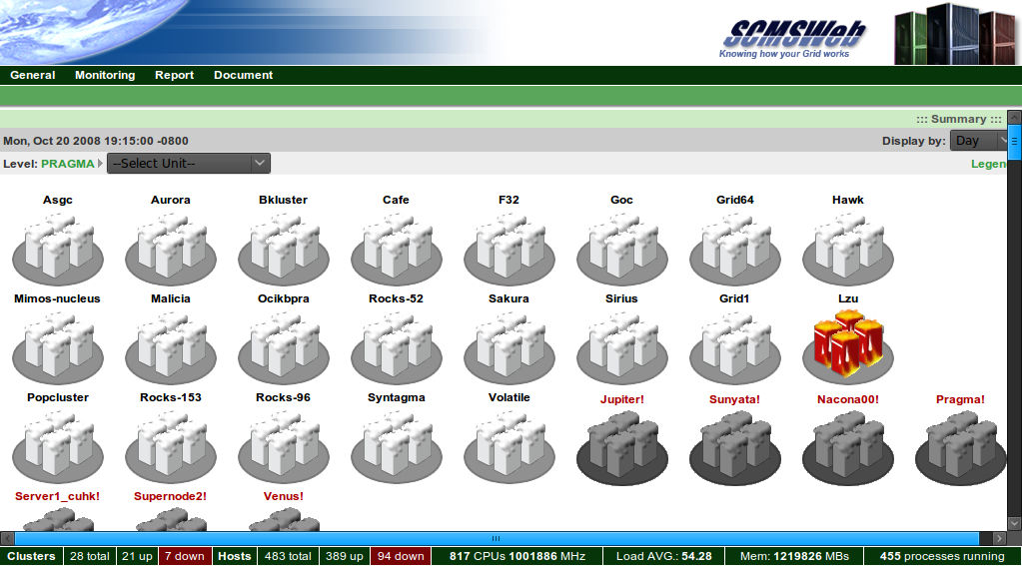
SCMSWeb in Short
Monitoring system for Cluster and Grid
Usage statistics
Service probes

Slide 3
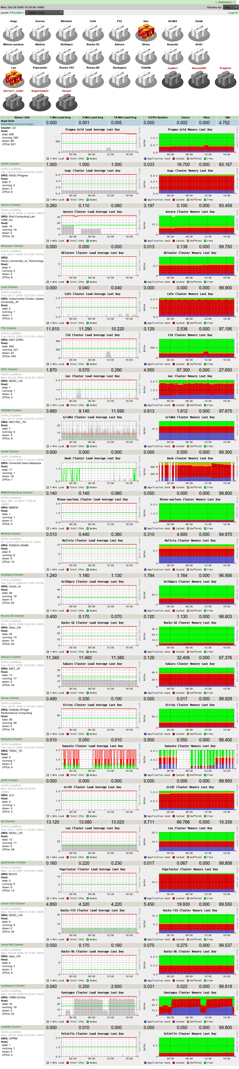
SCMSWeb in Long

Slide 4
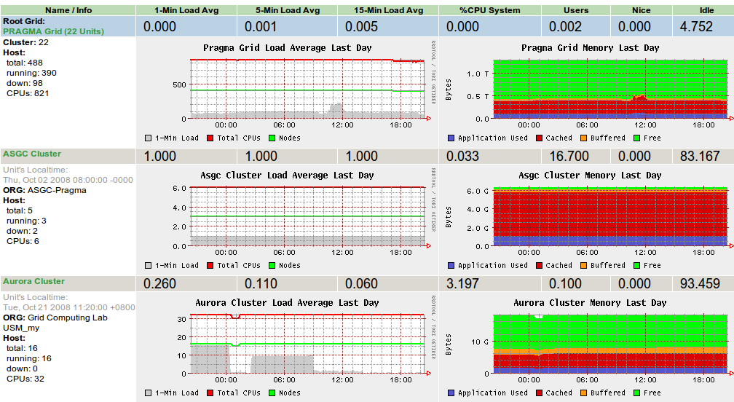
Usage statistics

Slide 5
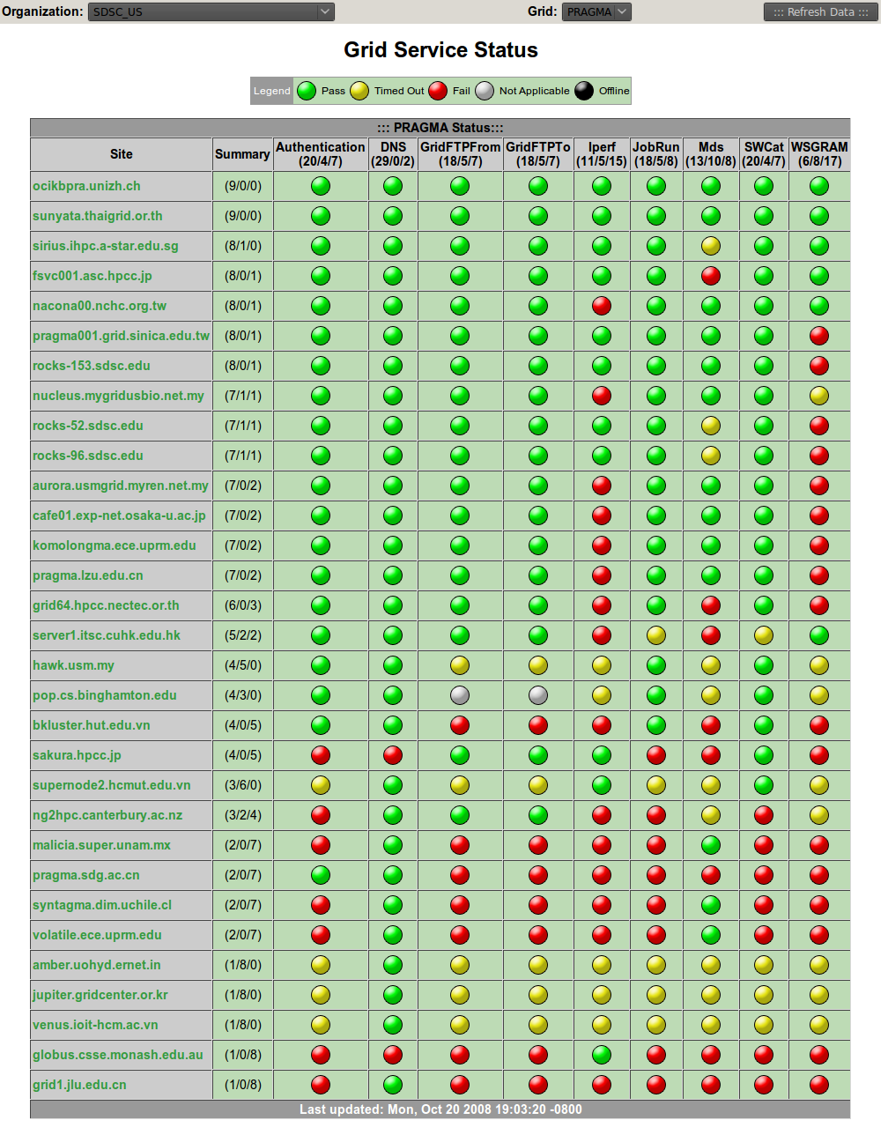
Probe

Slide 6
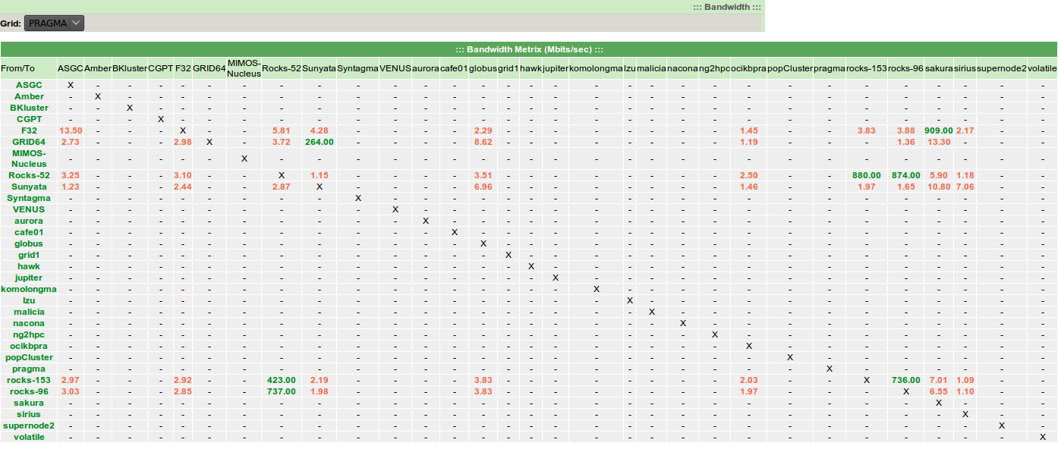
Bandwidth

Slide 7
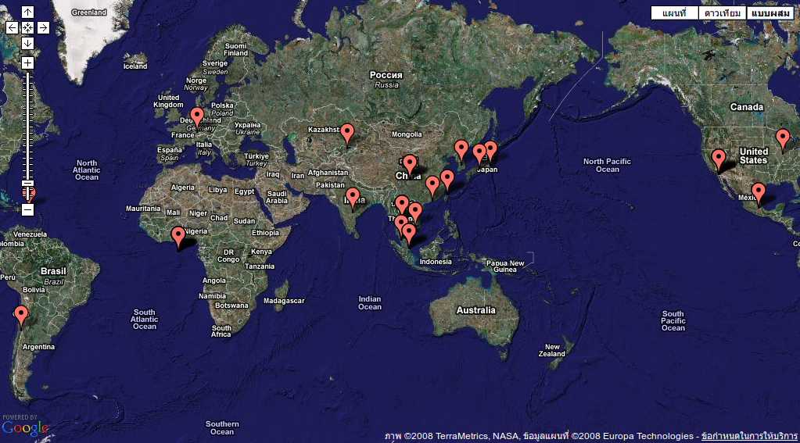
GeoMap

Slide 8
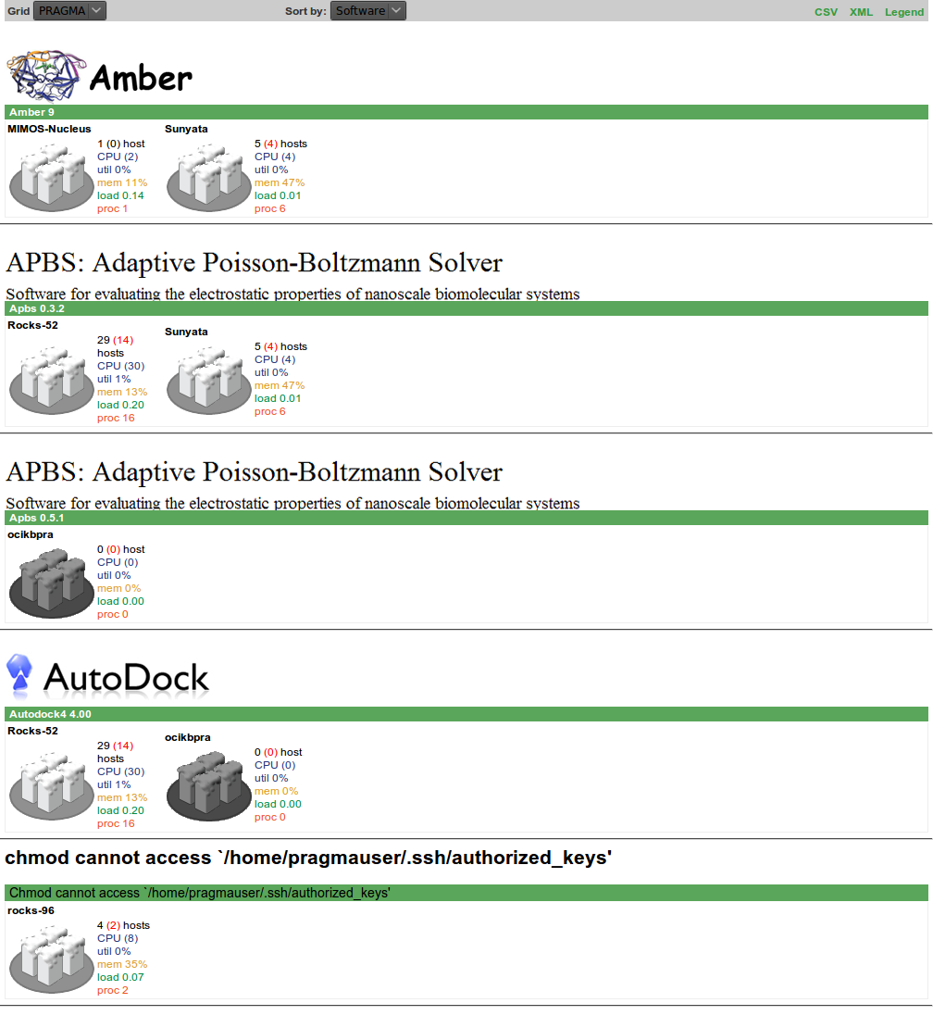
Catalog

Slide 9
Behind graphs, charts and tables
Configuration
APIs

Slide 10
Configurable
Probe
Catalog
GeoMap

Slide 11
General Configuration
/etc/sce/sce.conf
/usr/share/scmsweb/

Slide 12
Probe Configuration
/usr/share/scmsweb/grid/<name>
  probe.conf
  target.conf

Slide 13
probe.conf
[html]
xmlpath = /usr/share/scmsweb/incoming/cluster/pragma.xml
textpath = /usr/share/scmsweb/grid/PRAGMA/pragma.txt
htmlpath = /usr/share/scmsweb/grid/PRAGMA/pragma.html
[probe]
name = PRAGMA
smtp = localhost
#email = cindy.pragma@gmail.com
timestamp_path = /var/tmp/scmsweb
timeout = 40
probe0 = DNS
probe1 = Authentication
probe2 = Mds
probe3 = JobRun
probe4 = GridFTPTo
probe5 = GridFTPFrom
probe6 = WSGRAM
probe7 = Iperf
probe8 = SWCat
[globus]
basedn = mds-vo-name=npaci,o=sdsc
mdshost = rocks-67.sdsc.edu
[Gfarm]
command = /usr/share/scmsweb/gfarm/probe_gfhost %(target)s
[WSGRAM]
command = /usr/share/scmsweb/wsgram/probe_wsgram %(target)s
[time]
rerun_false = 1
SWCat = 720
Iperf = 720
Mds = 720
GridFTPTo = 360
GridFTPFrom = 360
JobRun = 120
WSGRAM = 120

Slide 14
target.conf
#[USM-CS]
[aurora]
target = aurora.usmgrid.myren.net.my
iperf_args = -p 15001
email = zhengc@sdsc.edu,keat@webmail.cs.usm.my,khuen@cs.usm.my,hychan@cs.usm.my
#[IOIT-HCM]
[VENUS]
target = venus.ioit-hcm.ac.vn
iperf_args = -p 15001
email = zhengc@sdsc.edu,han@vast-hcm.ac.vn
#[MIMOS]
[MIMOS-Nucleus]
target = nucleus.mygridusbio.net.my
iperf_args = -p 5001
email = zhengc@sdsc.edu,jyluke@mimos.my
#[SDSC_compute]
[Rocks-52]
target = rocks-52.sdsc.edu
iperf_args = -p 15001
email = zhengc@sdsc.edu
SWCat_target = rocks-52.sdsc.edu/jobmanager-fork
#[BU]
[popCluster]
target = pop.cs.binghamton.edu
GridFTPTo_probe = off
GridFTPFrom_probe = off
iperf_args = -p 15001
email = zhengc@sdsc.edu,john@jskro.org,kchiu@cs.binghamton.edu

Slide 15
Catalog Configuration
/usr/share/scmsweb/swcatalog.conf
/usr/share/scmsweb/swcatalog/

Slide 16
swcatalog.conf
[autodock4]
url=http://autodock.scripps.edu/
[namd]
url=http://www.ks.uiuc.edu/Research/namd/
[amber]
url=http://amber.scripps.edu/
[ninf-g]
url=http://ninf.apgrid.org/
[intel_c_compiler]
url=http://www.intel.com/cd/software/products/asmo-na/eng/219768.htm
[intel_fortran_compiler]
url=http://www.intel.com/cd/software/products/asmo-na/eng/219768.htm
[apbs]
url=http://apbs.sourceforge.net/

Slide 17
0-init.sh
#!/bin/sh
for file in /etc/profile.d/*.sh; do
[ -f "$file" ] && . "$file"
done

Slide 18
amber.sh
#!/bin/sh
amber_version() {
# bad guess?
VERSION=`echo "$1" | grep -q 9`
if [ X"$VERSION" = X ]; then
VERSION="9"
else
VERSION="unknown"
fi
echo -n "$VERSION"
}
SANDER_PATH=`which sander 2> /dev/null`
if [ X"$AMBERHOME" != X ]; then
# how can we decide version of amber?
VERSION=`amber_version "$AMBERHOME"/exe`
echo "amber:$VERSION:$AMBERHOME/exe"
elif [ X"$SANDER_PATH" != X ]; then
VERSION=`amber_version "$SANDER_PATH"`
echo "amber:$VERSION:$SANDER_PATH"
fi

Slide 19
ninf-g.sh
#!/bin/sh
NG_VERSION=`ng_version 2> /dev/null`
if [ X"$NG_VERSION" != X ]; then
VERSION=`echo $NG_VERSION | sed "s/.*:[[:space:]]*\(.*\)/\1/g"`
NG_PATH=`which ng_version`
NG_PATH=`dirname "$NG_PATH"`
echo "ninf-g:$VERSION:$NG_PATH"
fi

Slide 20
GeoMap Configuration
/usr/share/scmsweb/glue.d/

Slide 21
Configuration
[Site:Universiti Sains Malaysia]
parent = Grid:PRAGMA
UniqueID = USM_MY
Latitude = 5.356667
Longitude = 100.300833
Location = Malaysia
Description = USM MY
SecurityContact = mailto: noreply@noreply.com
SysAdminContact = mailto: noreply@noreply.com
UserSupportContact = mailto: noreply@noreply.com
[Grid:PRAGMA]
Name = PRAGMA
Description = PRAGMA
[Site:TNGC_TH]
parent = Grid:PRAGMA
Location = Bangkok, Thailand
Latitude = 13.84544
Longitude = 100.567802
Description = sunyata.thaigrid.or.th
SecurityContact = mailto: noreply@noreply.com
SysAdminContact = mailto: noreply@noreply.com
UserSupportContact = mailto: noreply@noreply.com
[Site:MIMOS]
parent = Grid:PRAGMA
Latitude = 5.356667
Longitude = 100.300833
Location = Malaysia
Description = MIMOS MY
SecurityContact = mailto: noreply@noreply.com
SysAdminContact = mailto: noreply@noreply.com
UserSupportContact = mailto: noreply@noreply.com

Slide 22
Extensible
Probe
Catalog
GeoMap
http://goc.pragma-grid.net/cgi-bin/scmsweb/xml_display.cgi?grid=on
http://goc.pragma-grid.net/cgi-bin/scmsweb/glue.cgi?format=xml
http://goc.pragma-grid.net/cgi-bin/scmsweb/glue.cgi?format=kml

Slide 23
Basic Usage
curl http://goc.pragma-grid.net/cgi-bin/scmsweb/xml_display.cgi?grid=on
curl http://goc.pragma-grid.net/cgi-bin/scmsweb/glue.cgi?format=xml
curl http://goc.pragma-grid.net/cgi-bin/scmsweb/glue.cgi?format=kml

Slide 24
For developers
Your codes, your rules!

Slide 25
Try it and feel it!
Host: ppkt-cluster.usm.my
User: guest<1-20>
Password: guest<1-20>

Slide 26
conf.py
scmsweb_xml = 'http://goc.pragma-grid.net/cgi-bin/scmsweb/xml_display.cgi?grid=on'
map_xml = 'http://goc.pragma-grid.net/cgi-bin/scmsweb/glue.cgi?format=xml'
map_kml = 'http://goc.pragma-grid.net/cgi-bin/scmsweb/glue.cgi?format=kml'
nano conf.py
cat conf.py
python conf.py

Slide 27
fetch.py
#!/usr/bin/python
import conf
from urllib import urlopen
fi = urlopen(conf.scmsweb_xml)
fo = open('scmsweb.xml', 'w')
fo.write(fi.read())
fo.close()
fi = urlopen(conf.map_xml)
fo = open('map.xml', 'w')
fo.write(fi.read())
fo.close()
fi = urlopen(conf.map_kml)
fo = open('map.kml', 'w')
fo.write(fi.read())
fo.close()
nano fetch.py
python fetch.py
ls -l

Slide 28
parse.py
#!/usr/bin/python
from xml.dom import minidom
fi = open('scmsweb.xml')
doc = minidom.parse(fi)
print doc
nano parse.py
python parse.py

Slide 29
traverse.py
#!/usr/bin/python
from xml.dom import minidom
fi = open('scmsweb.xml')
doc = minidom.parse(fi)
root = doc.documentElement
for node in root.childNodes:
if node.nodeType == doc.ELEMENT_NODE:
print node.tagName, node.attributes.items()

Slide 30
x.py
#!/usr/bin/python
from xml.dom import minidom
from xml import xpath
fi = open('scmsweb.xml')
doc = minidom.parse(fi)
root = doc.documentElement
nodes = xpath.Evaluate('cluster', root)
for node in nodes:
if node.nodeType == doc.ELEMENT_NODE:
print node.tagName, node.attributes.items()

Slide 31
l.py
#!/usr/bin/python
from xml.dom import minidom
from lxml import etree as ET
fi = open('scmsweb.xml')
root = ET.parse(fi)
nodes = root.xpath('cluster')
for node in nodes:
print node.tag, node.attrib

Slide 32
Congratulation!
You are python programmer now

