Slide 1

CSF4 Tutorial
The 3rd PRAGMA Institute, Penang Malaysia, 2008-10-21
Dr. Xiaohui Wei
College of Computer Science and Technology, Jilin University, China

Slide 2
Content
What is CSF
CSF4 Services
CSF4 Plugin Mechanism
Workflow and data aware scheduling
Array Job
VJM – Resource Co-allocation
How to use CSF4 in your Grid
Current Status and Future Plan

Slide 3
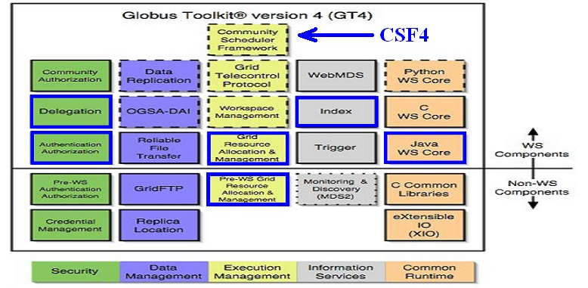
What is CSF4
CSF4 is a WSRF compliant meta-scheduler, its first version was released as an execution management service component of Globus Toolkit 4.(2004)
It is an open source project. (sourceforge.net)

Slide 4
What is CSF4
CSF4 is designed as a Meta-scheduler
  Global job scheduling, make job scheduling decisions involving resources across/span multiple administrative domains (co-allocation)
  CSF4 does not own the resources
  CSF4 need work with local schedulers (like LSF, PBS, Condor, SGE etc), which are resource owners, to fulfill job dispatch
CSF4 is WSRF compliant
  CSF4 consists of a set of WSRF based services, such as job service, queue service, resource management service etc.
CSF4 uses GRAM to work with local schedulers
  Support both of WS-GRAM(GT4) and Pre-WS GRAM(GT2)
  Support LSF, PBS and SGE
  Support job submission, job control, query
  Support automatically cluster selection for job execution

Slide 5
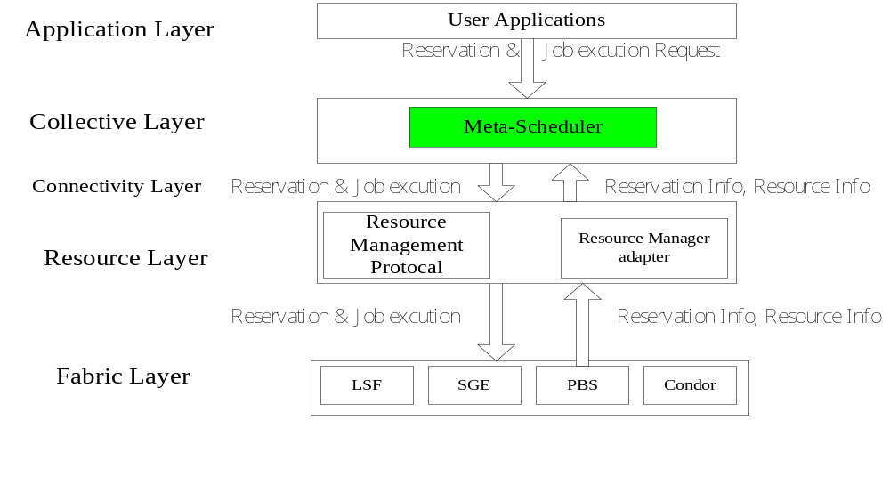
What is CSF4
Web Service interface
Gram Protocol

Slide 6
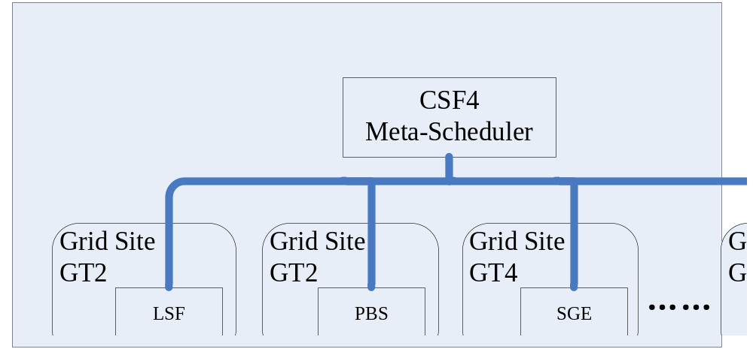
What is CSF4

Slide 7
What is CSF4
Flexible and Expendable scheduling policies
  CSF4 supports scheduling plug-in model, easy to expend new policies
  FCFS/Throttle scheduling policies were shipped with the first version of CSF4
  Workflow and Data Aware scheduling were implemented recently
  The users are able to combine multiple scheduling policies to implement more advanced job scheduling (flexible)
  The users are able to introduce new scheduling policies
Support resource co-allocation
  Support resource co-allocation across multiple administrative domains
  We implemented a resource co-allocation service, VJM, in CSF
    VJM is not rely on resource advance reservation (so it can work with SGE and GRAM)
    VJM is going to be enhanced as an independent WSRF service to provide resource co-allocation for grid applications (very soon)

Slide 8
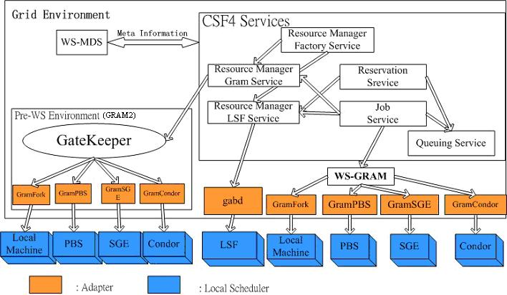
CSF4 Services

Slide 9
CSF4 Services
CSF4 consists of a bunch of web services, which are Job Service, Reservation Service, Queuing Service, and Resource Manager Factory Service etc.
Job Service
  Job Service provides the interfaces for end users to fully control a job.
    The users are able to create job instances, submit jobs to a queue, modify a job’s description and monitor job status etc. Once created, a job’s EPR will be returned to the user for further operations.
  CSF jobs are described in RSL
  Any CSF job must belong to a queue for scheduling

Slide 10
CSF4 Services
Reservation Service
  Reservation Service allows the users to reserve the resources for their jobs in advance so that the availability of the resources can be guaranteed.
  Resource reservation requests are treated as special jobs, with resource requirements but without execution binaries
  CSF extended RSL to support resource reservation (support for LSF only)
  The reservation requests will be put into a queue, and then be forwarded to the local scheduler by Queue Service like normal jobs
  Both the jobs and reservation requests are hosted in GT4 container as RPs (Resource Property), and their EPRs will be returned to the users
  In the mean time, those EPRs are saved in WS-MDS as well.
    The recovery mechanism of GT4 Index Service will make the jobs and reservations persistence after CSF4 reboot.
    GT4 Trigger Service is able to notify the end users once their jobs or reservations status changed.

Slide 11
CSF4 Services
Queuing Service
  The container holding the jobs and reservation requests
  A queue normally represents a specific scheduling policy
  Multiple queues can be configured in CSF, and different queues usually have different scheduling polices configured.
    Scheduling policies are capsulated in plug-ins
    The plug-ins are dynamic loaded for a queue according to configuration
    More scheduling plug-ins implemented means richer scheduling policies are provided (combination)
  At submission time, the user should choose a queue for their jobs so that the proper scheduling policy can be applied. (Otherwise, it will be put into the default queue. )

Slide 12
CSF4 Services
Resource Manager Services
  Resource Manger Services are not used by end users directly. They are designed to support alternative protocols other than WS GRAM.
  Resource Manager Services consist of one factory service, Resource Manager Factory Service, and two instance services, Resource Manager Lsf Service and Resource Manager Gram Service.
  Resource Manager Lsf Service is an instance service designed to support enhanced-GRAM protocol between CSF4 and LSF. Some advanced features, such as resource reservation are supported via this service.
    Following the same idea, new instance services can be designed for SGE, and PBS as well to support special features not supported by GRAM yet.
  Resource Manager Gram Service to support GRAM2(GT2) protocol

Slide 13
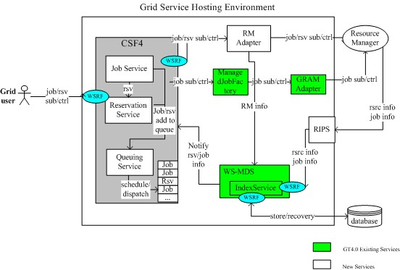
CSF4 Services

Slide 14
CSF4 Plugin Mechanism
Motivations
  In the real world, different users have different requirements. No matter how many scheduling polices are provided by a scheduler, no resource management system can meet all users’ needs.
  But for a specific user, he/she does not need many scheduling policies. For example, most of Platform LSF customers only use 5%-10% LSF features.
  It’s difficult to implement many scheduling features in a single module, it’s harder to maintain and add new features (from vendor point of view)
  It’s a hard work for users to implement tailored scheduling policy by themselves. Because it’s very complex to implement a scheduler from the scratch. (it would be useful if we enable the users to implement scheduling policies by themselves easily?)

Slide 15
CSF4 Plugin Mechanism
Overview
  The CSF4 plug-in mechanism consists of framework and plug-in modules
  Different scheduling policies are capsulated in individual scheduling plug-in modules
  Scheduling polices are defined for each queue respectively. Normally Multiple queues are defined in the scheduler, different queue have different policies (default queue’s policy is FCFS)
  The scheduler framework works as a motherboard with slots to hold scheduler plugin modules for each queue.
  Framework will do all the common and tedious work that a job scheduler has to do, such as job management, available resource collection, job dispatch and monitor, events delivery, and recovery … …
  The CSF4 framework will load the desired plug-in modules for each queue according to the configuration
  Multiple plug-in modules can be used in combination
  CSF4 provide the plug-in APIs so that the users can develop new scheduling policies easily

Slide 16
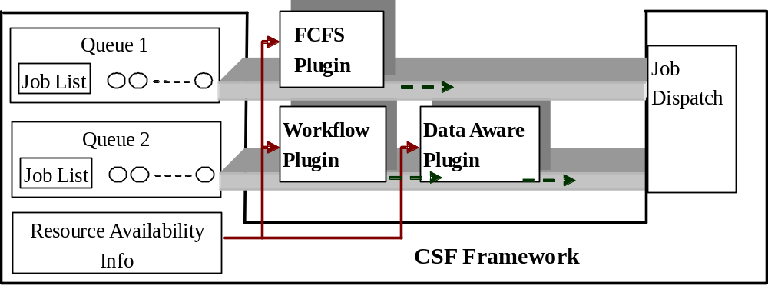
CSF4 Plugin Mechanism
CSF4 Plug-in Architecture

Slide 17
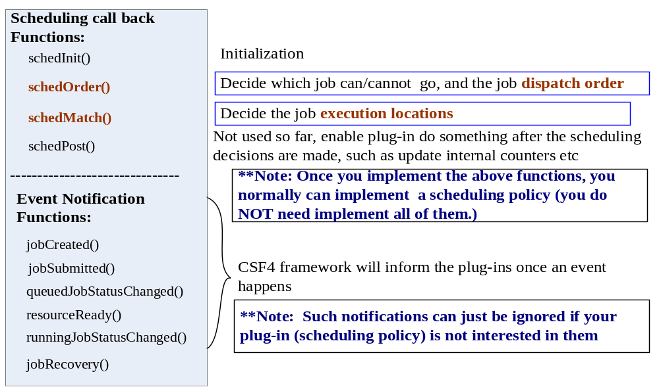
CSF4 Plugin APIs

Slide 18
Develop simple scheduling policies
1. Example one: FCFS (First Come First Serve) Policy
    As we just care about the job dispatch order, so we just need implement SchedOrder() in FCSF plug-in. All the other functions just leave empty. The p-sudo code is as below,
Vector SchedOrder (Vector Jobs)
{ // bubble sorting
while (HaveChange)
{
HaveChange = False;
for ( 1< i < n )
{ if( jobs[i].submitTime > jobs[i+1].submitTime ) {
swap (jobs[i], jobs[i+1]);
HaveChange = True;
} end if
} // end for
} // end while
} // End of SchedOrder()

Slide 19
Develop simple scheduling policies
2. Example two: Small job go first - SJFS
    Similar with FCFS, so we just need implement SchedOrder() in SJFS plug-in. The only difference is that the jobs are sorted by their required CPU numbers instead of submission time.
Vector SchedOrder (Vector Jobs)
{ // bubble sorting
while (HaveChange)
{
HaveChange = False;
for ( 1< i < n )
{ if( jobs[i].numCPU > jobs[i+1].numCPU ) {
swap (jobs[i], jobs[i+1])
HaveChange = True;
} end if
} // end for
} // end while
} // End of SchedOrder()

Slide 20
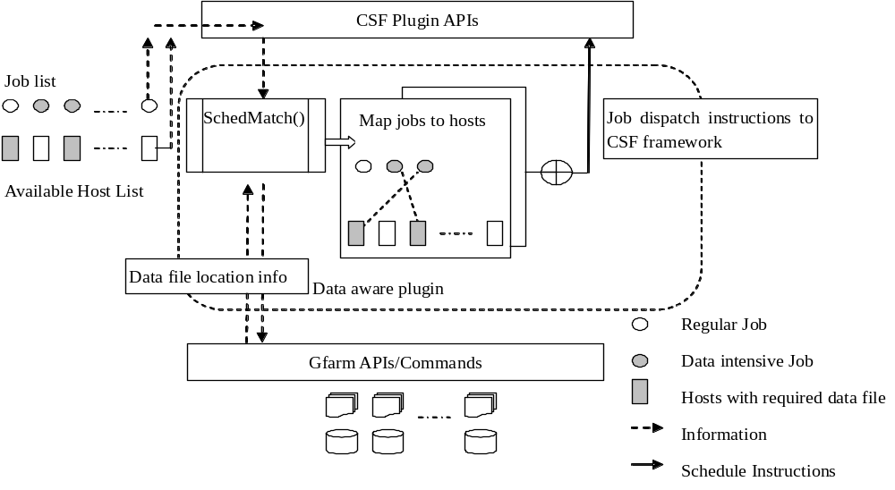
Data Aware Plugin
Data Aware Plugin is to decide the job execution location instead of dispatch order. So it need implement SchedMatch() instead of SchedOrder().
We implemented a data aware plugin to schedule data intensive applications on Gfarm file system.

Slide 21
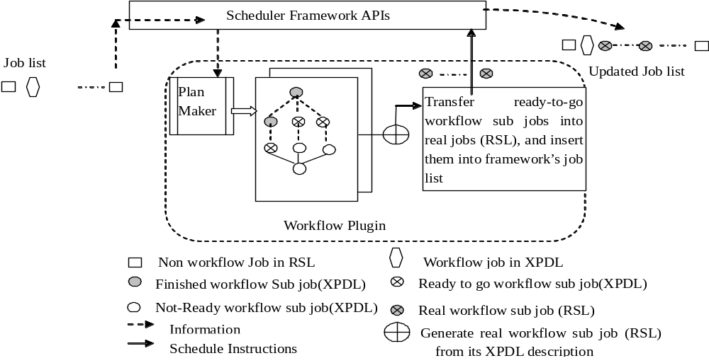
Grid Workflow Plugin
We implemented a Workflow plugin to support workflow jobs
  Using XPDL (XML Process Definition Language) describe grid workflow tasks
  Scheduling algorithm try to get the least makespan time and minimum space cost

Slide 22
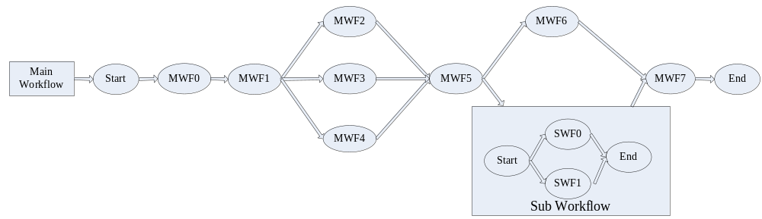
An example of Workflow

Slide 23
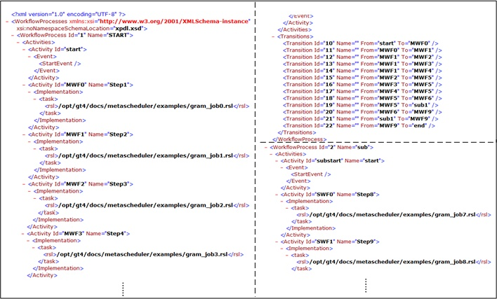
Workflow Job description in XPDL

Slide 24
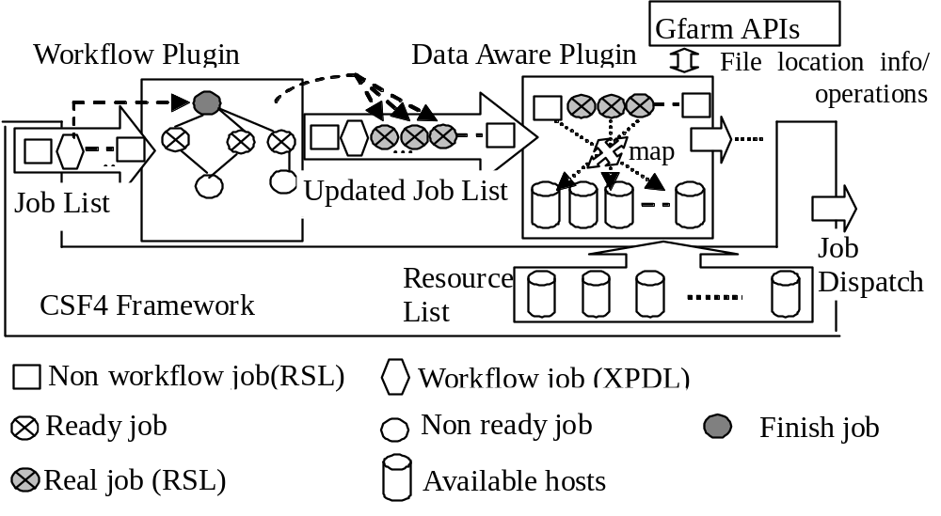
Integrate Grid Workflow Scheduling with Data Aware Scheduling
Data aware plugin and Workflow plugin can be used in combination to support data intensive workflow applications

Slide 25
Array Job
Motivations:
  In some case that the user would execute many instances (1000 for example) of same application to compete a big task, and there is no dependency and communication among jobs.
    For example, in life science, AutoDock may be used to dock different ligands to a target protein structure, or Blast may be used with different input sequences to search for potentially related sequences within a target database.
  The users have to submit a bunch of same jobs to the meta-scheduler, it is a time-consuming operation to submit a huge number of jobs one by one as below,
    Csf-job-submit sameApplication – i inputData001 –o output001
    Csf-job-submit sameApplication – i inputData002 –o output002
    …. ….
    Csf-job-submit sameApplication – i inputData1000 –o output1000

Slide 26
Array Job
CSF4 array job features
  The user just use one command to submit any number of array jobs as below (save the job submission time dramatically)
    Csf-job-submit sameApplication –A 1-1000 – i input –o output
  CSF4 will generate 1000 instances of sameApplication in the system, and
    The nth instance of the job will take “input.n” as input file name, and “output.n” as output file name.
    These 1000 instances of sameApplication are not generated immediately after the submission, but step by step when there are available resources for execution. (reduce the memory cost)
    The user can query the status of the array job as a whole, or the status of each individual instance of the array job. (good job control)

Slide 27
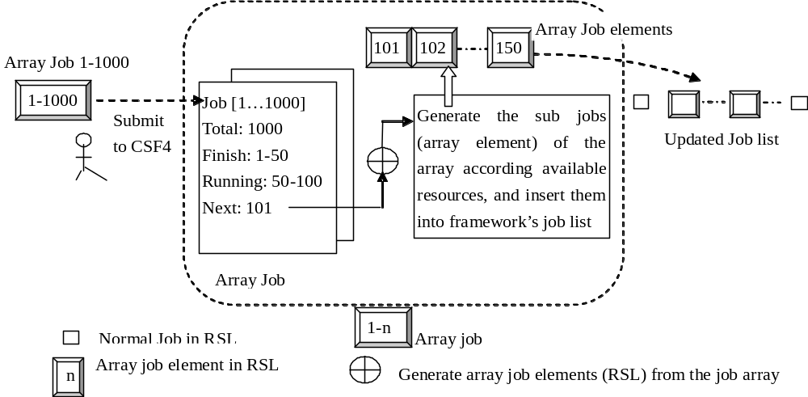
Array Job Plug-in

Slide 28
VJM – Resource Co-allocation
Co-allocation challenges
  Some applications’ resource requirements cannot meet by a single domain, so resource co-allocation is very important especially for large scale parallel jobs
  Co-allocation is time consuming and easy to fail (time out)
    The resources in a grid are actually owned by different domains, each domain has its own scheduling policy with dynamic resource availability. The resource availability is not guaranteed.
    A number of co-allocation protocols proposed like Duroc (MPICH-G2) are based on two phase commit. However, the implementation of Duroc in MPICH-G2 mixed the resource reservation stage and the job execution stage. ( MPI_INIT() )
    Resource advance reservation is proposed to guarantee the resource availability in local domains

Slide 29
VJM – Resource Co-allocation
The problems of resource advance reservation
  Not all the local schedulers support resource reservation
  The feature requires the end user to specify the duration of reservation, but in some cases it’s infeasible
    The users usually have little knowledge on the resource availability of the grid resources, it is hard for them to give out a good begin time. In [10], the begin time of a reservation was set to a random number between 0~2 hours, it is not reasonable.
    It’s also hard to give out a good end time of the reservation. When the users do not know the runtime of their applications (many cases), they have to set an upper limit value to ensure the job’s completion. This will aggravate the competing and conflict of resource allocation.

Slide 30
VJM – Resource Co-allocation
VJM model
  VJM separate the resource co-allocation phase from the job execution.
  In the resource co-allocation phase, VJM sends virtual jobs (VJobs) instead of real parallel jobs to grid sites via GRAM protocol
  A virtual job has same resource requirements with its corresponding real job but without execution binaries.
  When the virtual job startup, it will report back to VJC (virtual job center) that the resource for the sub job has been reserved.
  As all the virtual jobs registered successfully (co-allocation succeed), VJC dispatches the real jobs to their corresponding virtual jobs to start.
  With VJM, the user does not need to specify the time duration of the resource reservation. VJM will automatically reserve the earliest available resources for the real jobs in a dynamic grid environment.
    Based on queuing theory, VJM evaluates the overall capability that a local resource domain can provide through its history data, such as the average job waiting time in the local queue, and the average job execution time and so on.
    Based on the evaluation, VJM will decide which clusters should be prefered for a parallel job and how to distribute the VJobs among them.

Slide 31
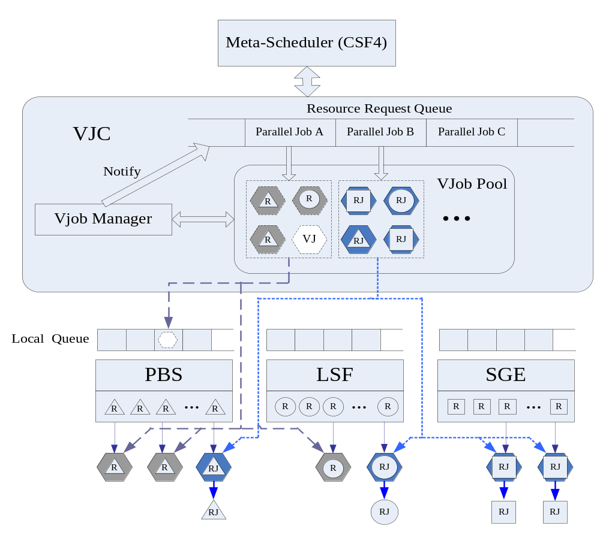
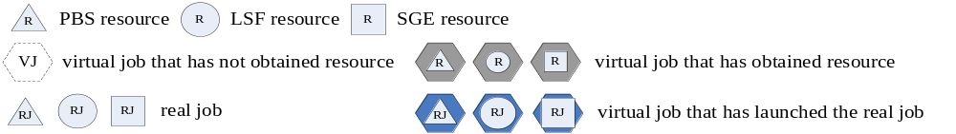

Slide 32
VJM – Resource Co-allocation
Actually the set of virtual jobs corresponding to an application dynamically construct a cross-domains virtual execution cluster dedicated for this application to run.
It is a best-efforts style resource co-allocation
It is more suitable for the case that the user does not know the resource availability and his/her application’s runtime. If the user has enough knowledge, he/she can use resource advance reservation.

Slide 33
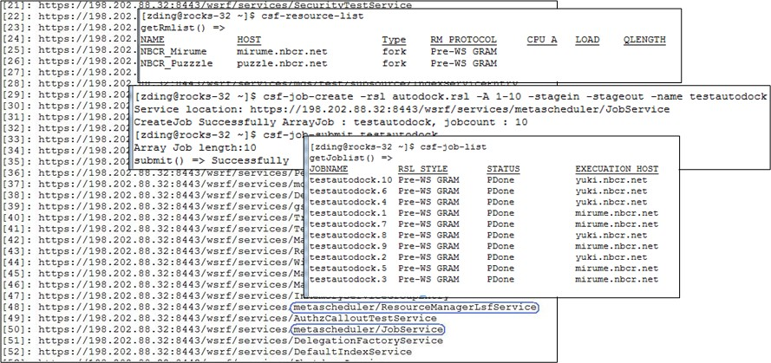
How to use CSF
Use CSF4 front end to perform global job scheduling in your grid. You can submit your jobs to CSF4 via command line or CSF4 Portal.

Slide 34
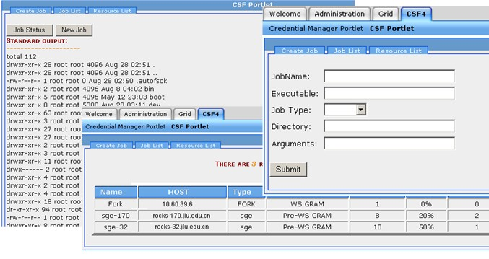
CSF4 Portal

Slide 35
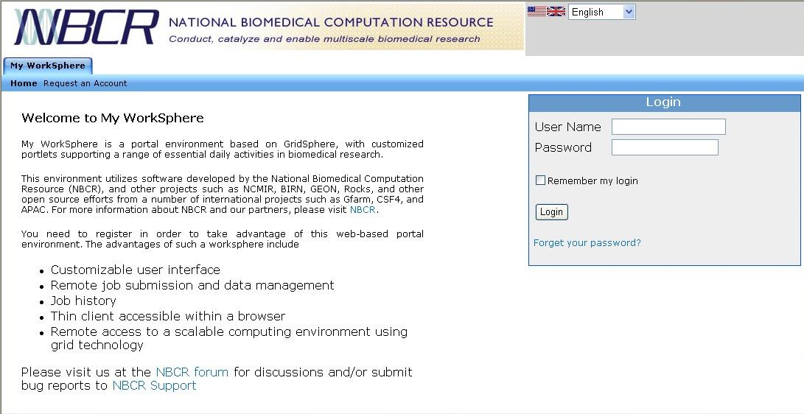
How to use CSF4
Provide backend meta-scheduling for your grid environment with your own Web Portal – like My Workshpere by NBCR)

Slide 36
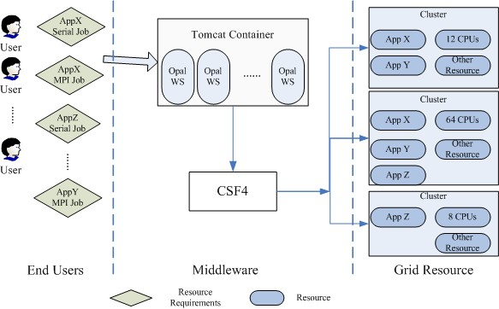
You need do some integration work in this case.
CSF4 APIs

Slide 37
How to deploy the scheduling policies
Configure multiple queues in CSF4, and each queue with different scheduling policies (plug-ins). Then submit jobs to the proper queue according to their scheduling requirements.
Combine multiple CSF4 plugins to provide more advanced meta-scheduling for a queue.
  Such as combine workflow plugin with data aware plugin
Develop your own meta scheduling policies using CSF4 plug-in APIs (For advance users)

Slide 38
Current Status and Future Plan
We are wrapping up the new features
We are going to provide complete user manual and developer guide very soon (weakness)
We hope there will be more users to use CSF4 and give us the feedback
We will continue working on the plug-in mechanism. We hope more and more users can develop their own scheduling policies via CSF4 plug-in APIs (one of our major objectives)
We will continue working on the VJM mechanism. We plan to make VJM as a separated middle ware to provide resource co-allocation service in a grid.
We are porting CSF4 to GT4.2(almost finished)

Slide 39
谢谢！
Thanks!

