Slide 1
Introduction of Grid Security
Yoshio Tanaka
AIST, Japan

Slide 2
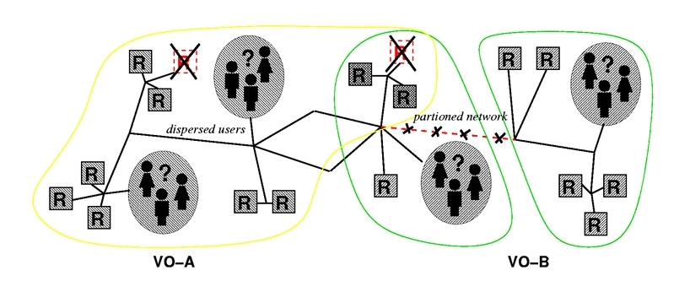
Again, what is Grid?
Resource sharing & coordinated problem solving in dynamic, multi-institutional virtual organizations
  Communities committed to common goals
    Assemble team with heterogeneous members & capabilities
    Distribute across geography and organization
This slide is by courtesy of Ian Foster @ ANL

Slide 3
Key Technologies: GSI and VOMS
Grid Security Infrastructure (GSI) is standard security technology used in the current Grid communities.
  Based on Public Key Infrastructure (PKI) and X.509 Certificates.
Virtual Organization Membership Services (VOMS) is a software for creating/managing VOs.
  Developed by European Communities
  Based on GSI

Slide 4
GSI: Grid Security Infrastructure
Authentication and authorization using standard protocols and their extensions.
  Authentication: Identify the entity
  Authorization: Establishing rights
Standards
  PKI, X.509, SSL,…
Extensions: Single sign on and delegation
  Entering pass phrase is required only once
  Implemented by proxy certificates

Slide 5
PKI and X.509 certificate
Public Key Infrastructure （a pair of asymmetric keys）
  Private key is used for data encryption
  Public key is used for data decryption
Every entity (users, computers, etc.) is required to obtain his/its certificate issued by a trusted Certificate Authority (CA)
X.509 certificates contain
  Name of Subject
  Public key of Subject
  Name of Certificate Authority (CA)
  which has signed it, to match key and identity
  Digital Signature of the signing CA
Certificate
Subject DN
Public Key
Issuer (CA)
Digital Signature

Slide 6


How a user is authenticated by a server
user
server
User Cert.
Subject DN
Public Key
Issuer (CA)
Digital Signature
User Cert.
Subject DN
Public Key
Issuer (CA)
Digital Signature
Public Key
of the CA
Send Cert.
private key
(encrypted)
QAZWSXEDC…
challenge string
QAZWSXEDC…
encrypted
challenge string
Public Key
PL<OKNIJBN…
QAZWSXEDC…

Slide 7
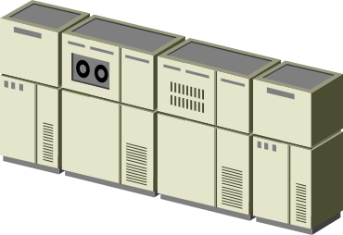

Requirements for Grid security
Single
Sign on
user
server A
server B
remote process
creation requests*
Communication*
Delegation
Remote file
access requests*
* with mutual authentication

Slide 8
PKI and X.509 certificate (cont’d)
X.509 certificates
  Similar to a driving license. Photo on the license corresponds to a public key.
  issued by a CA
  Validity of the certificate depends on the opposite entity’s policy
NAME: Taro Sanso
User Certificate
Subject DN
Public Key
Issuer (CA)
Digital Signature
Address: 1-1-1, Umezono, Tsukuba
Valid until Dec. 31, 2003
Issued by a CA
Issued by a state/prefecture
private key
(encrypted)
Identify the entity

Slide 9
X.509 Proxy Certificate
Defines how a short term, restricted credential can be created from a normal, long-term X.509 credential
  A “proxy certificate” is a special type of X.509 certificate that is signed by the normal end entity cert, or by another proxy
  Supports single sign-on & delegation through “impersonation”

Slide 10
User Proxies
Minimize exposure of user’s private key
A temporary, X.509 proxy credential for use by our computations
  We call this a user proxy certificate
  Allows process to act on behalf of user
  User-signed user proxy cert stored in local file
  Created via “grid-proxy-init” command
Proxy’s private key is not encrypted
  Rely on file system security, proxy certificate file must be readable only by the owner

Slide 11
User Proxies (cont’d)
Identity of the user
Proxy Certificate
Subject DN/Proxy
(new) public key
(new) private key
(not encrypted)
Issuer (user)
Digital Signature (user)
User Certificate
Subject DN
Public Key
Issuer (CA)
Digital Signature
grid-proxy-init
User Certificate
Subject DN
Public Key
Issuer (CA)
Digital Signature
private key
(encrypted)
sign

Slide 12
Delegation
Remote creation of a user proxy
Results in a new private key and X.509 proxy certificate, signed by the original key
Allows remote process to act on behalf of the user
Avoids sending passwords or private keys across the network
Proxy-1
Public
Key
Proxy-1
Private
key
Proxy-2
public
Proxy-2
private
User
Private
Proxy-2
public
Proxy-1
Private
grid-proxy-init
Client
Server
Proxy-2
Public
User
Public
Key
User
Private
key
Proxy-1
private
CA
Private

Slide 13

Traverse Certificate Chain to verify identity
User Identity
CA
User
Certificate
User Identity
CA
User
Certificate
Proxy
Certificate
User Identity
CA
User
Certificate
Proxy
Certificate
Proxy
Certificate

Slide 14
Requirements for users
Obtain a certificate issued by a trusted CA
  You can launch your CA for tests
  The certificate and the signing policy file of the CA should be put on an appropriate directory (/etc/grid-security/certificates).
  International Grid Trust Federation (IGTF) is a community for building trust.
Create a Proxy Certificate in advance
  Need to enter pass phrase for the decryption of a private key.
    Only once!
  A proxy certificate will be used for further authentication.

Slide 15
Summary of GSI
Every entity has to obtain a certificate.
Treat your private key carefully!!
  Private key is stored only in well-guarded places, and only in encrypted form
Create a user proxy in advance
  Run grid-proxy-init command
  virtual login to Grid environment
  A proxy certificate will be generated on user’s machine.
Single sign on and delegation enable easy and secure access to remote resources.

Slide 16
What’s the role of VOMS?
GSI provides basic technology for authentication (who is the user).
  The other framework is necessary for authorization (what the user can do).
The most naive approach is to map each user to each local account on each server.
  What happens if there are thousands to millions of users?
“/C=JP/O=AIST/O=GRID/CN=Yoshio Tanaka” yoshio
“/C=JP/O=AIST/O=GRID/CN=Ryosuke Nakamura” ryosuke
…..

Slide 17
What’s the role of VOMS? (cont’d)
VOMS provides a mechanism for VO-based authorization.
  Users are registered to VO(s)
  Users can belong to Group(s) in the VO
  Users can be assigned role(s)
  Service providers can configure the system to control access based on
    VO-base
      All users in a VO can access to the service
    Group-base
      Users in a specific group can access to the services
    Group&Role-base
      Users in a specific group with specific role can access to the services
It is implemented by embedding “VOMS attributes” in user’s proxy certificate.

Slide 18

Introduction of Grid and its technology
Yoshio Tanaka
National Institute of Advanced Industrial Science and Technology
(AIST), Japan

Slide 19

What is the GEO Grid ?
The GEO (Global Earth Observation) Grid is aiming at providing an E-Science Infrastructure for worldwide Earth Sciences communities to accelerate GEO sciences based on the concept that relevant data and computation are virtually integrated with a certain access control and ease-of-use interface those are enabled by a set of Grid and Web service technologies.
AIST: OGF Gold sponsor (a founding member)
AIST: OGC Associate member (since 2007)
Satellite Data
Grid
Technologies
Geology
Map
Geo* Contents
Applications
GIS data
Resources
Environment
Field data
Disaster
mitigation

Slide 20
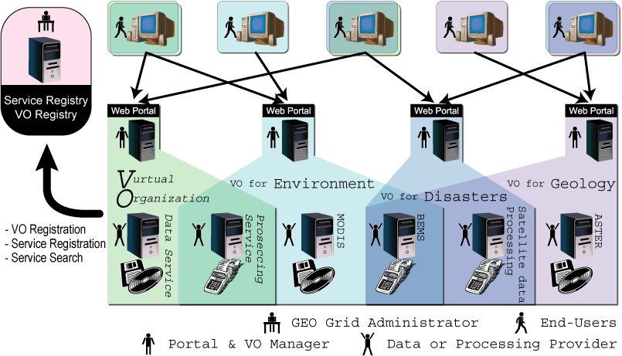
Overview and usage model of the GEO Grid system
User-level Authentication and VO-level Authorization
  User’s right is managed (assigned) by an administrator of his belonging VO.
  Access control to a service is configured by the service provider according to the publication policy. There are some options of the access control
    VO-level, Group/Role-based, User-level, etc.
  Scalable architecture for the number of users.

Slide 21


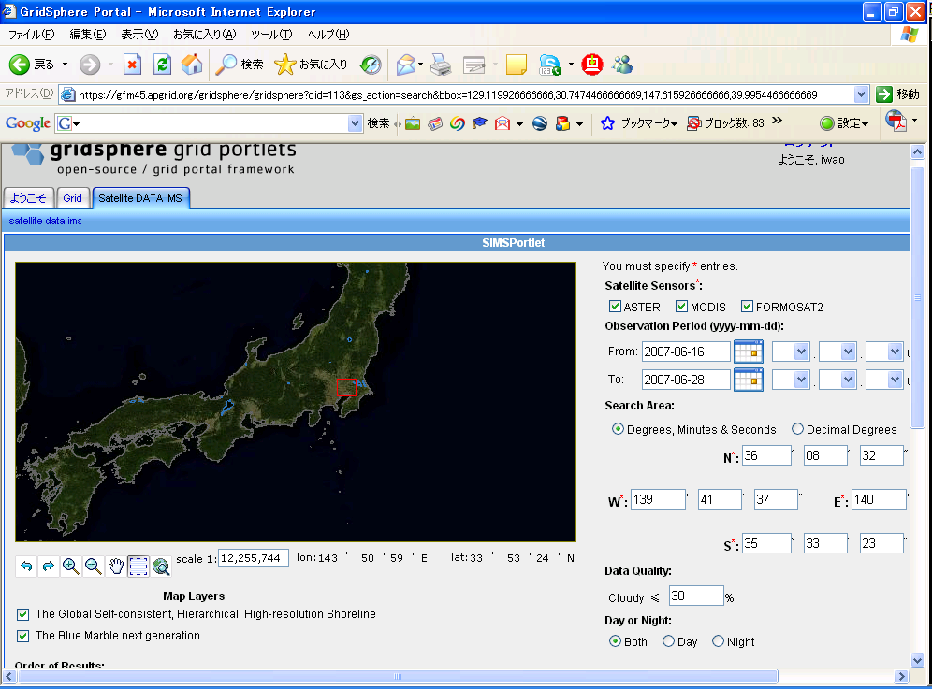



login
Account
DB
user
Terra/ASTER
account (GAMA)
server
VO DB
TDRS
credential
VO (VOMS)
server
APAN/TransPAC
portal server
GET
exec
query
GSI +
VOMS
ERSDIS/NASA
GSI + VOMS
GSI + VOMS
CSW
OGSA
DAI
WFS
WCS
WMS
GRAM
GridFTP
GIS
server
map
server
catalogue/
metadata
server
gateway
server
GEO Grid Cluster
L0
L0
L0
L0
L0
L0
L0
L0
Data
Maps
Meta data
Storage
(DEM)
L0
L0
L0
L0

