Slide 1
A Lightweight Scheduler for PRAGMA Testbed
Shava Smallen Montoya,
Nadya Williams, Phil Papadopoulos,
Mauricio Tsugawa, Jose Fortes

Slide 2
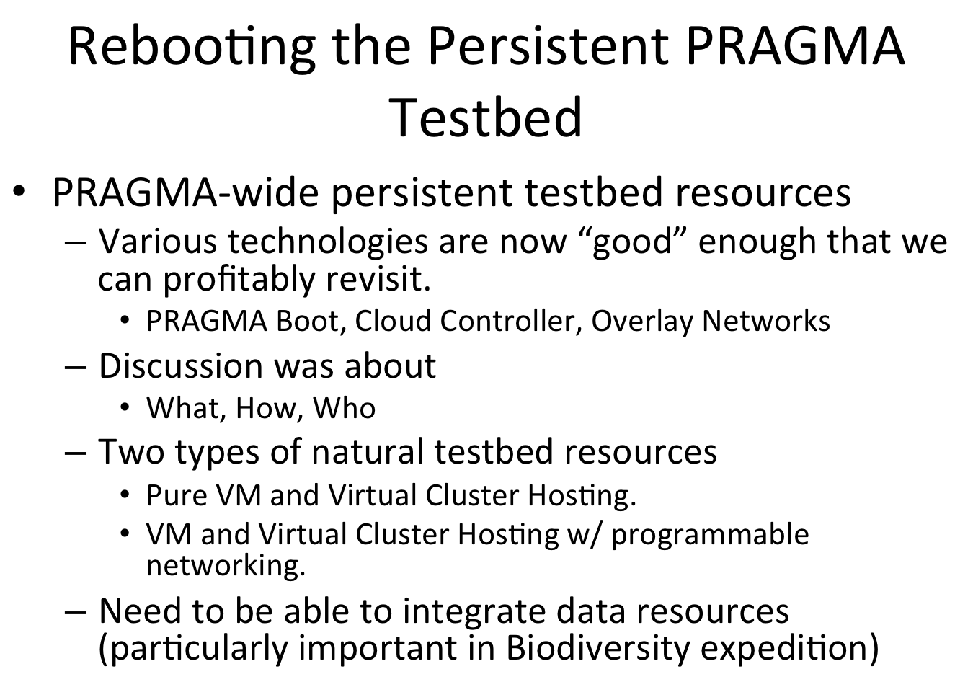
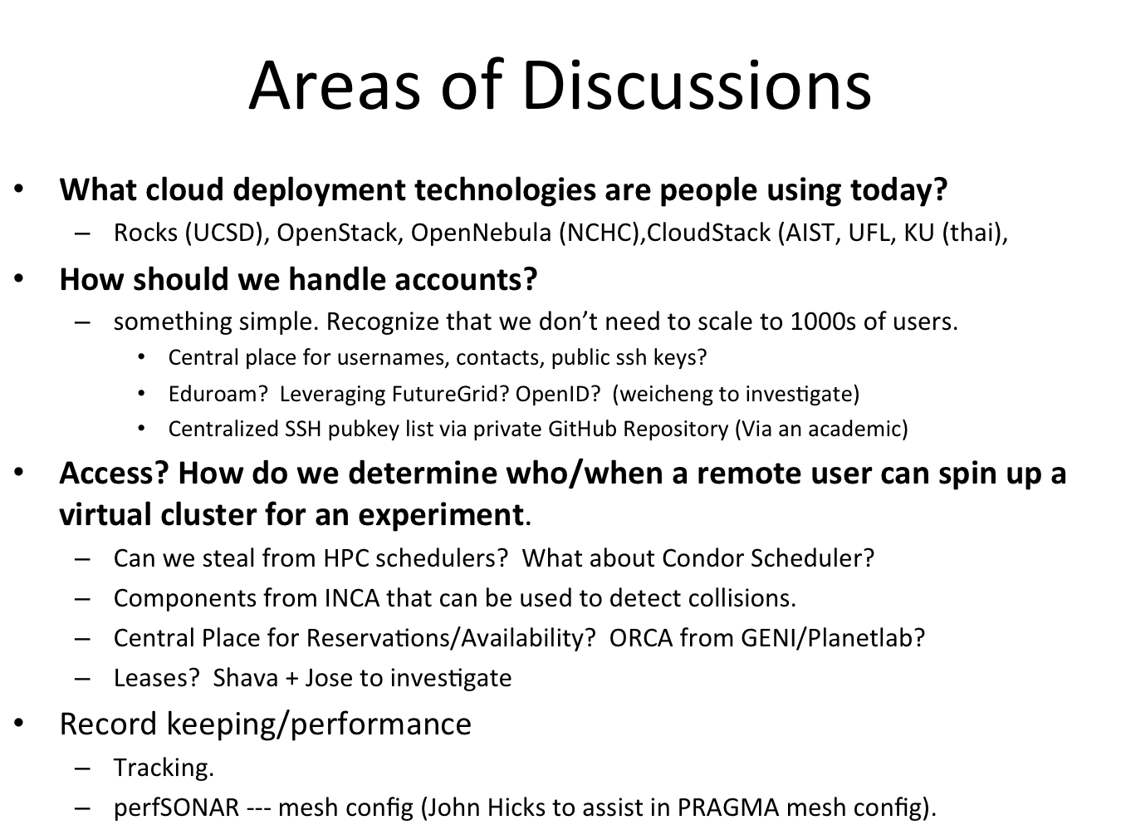
Last PRAGMA meeting…
Notes from Resources WG discussion meeting at PRAGMA27

Slide 3
Requirements for Testbed
Scale to tens of users (not necessarily to hundreds or thousands)
Leverage existing tools such as PRAGMA Boot, Personal Cloud Controller, and overlay networks to deploy virtual clusters/machines.
Needs to work with multiple cloud deployment tools (e.g., Rocks, Openstack, OpenNebula, and CloudStack).
Participating sites should only need to install a small amount of software

Slide 4

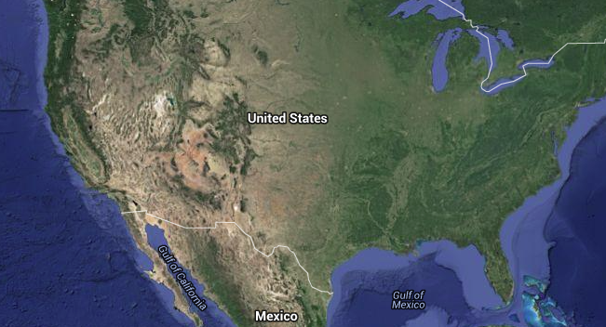
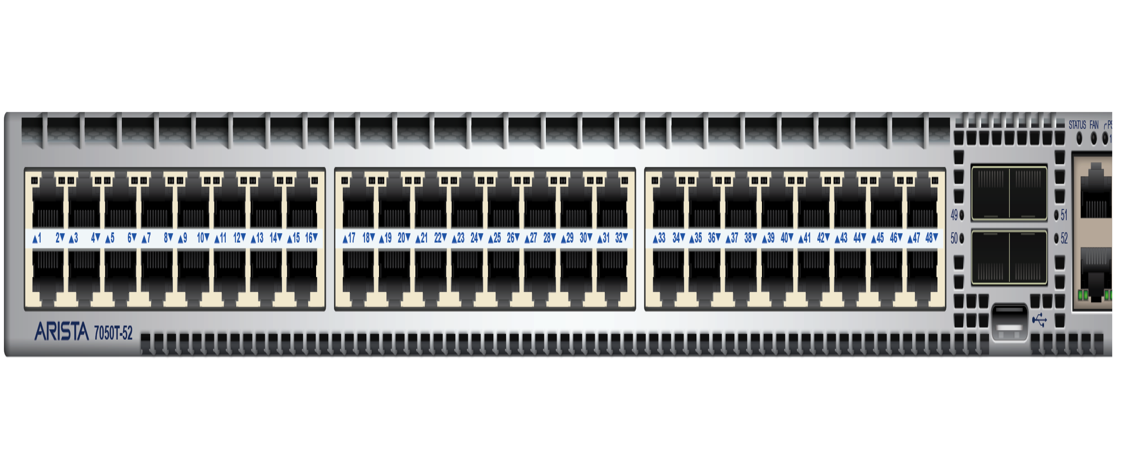







PRAGMA scheduler architecture
SDSC
SDSC
UF
VC
VC
VC
VC
VC
LC
San Diego, CA
Gainesville, FL
site
Central site
site
PRAGMA package
ssh *
pragma_boot *
pragma_agent
PRAGMA
Booking *
Planned VM/VC provisioners
PCC
(per user)
6.2
* Components integrated into prototype

Slide 5
PRAGMA Booking
Can we leverage an existing room reservation scheduler?
http://www.bookedscheduler.com
Pros:
Open source
Easy to setup
Nice GUI interface
Report features
REST API
Customizable-ish
LDAP and Active Directory support.
Fine tuned roles and permissions.
User and group quotas.
Cons:
Can only handle one reservation per resource at a time
PHP changes can be painful (heavy OO makes it hard to find right files)
Doc is sparse

Slide 6
Demo: Login/Register
http://calit2-119-121.ucsd.edu/cloud-scheduler

Slide 7
Demo: Resources

Slide 8
Demo: Reservations

Slide 9
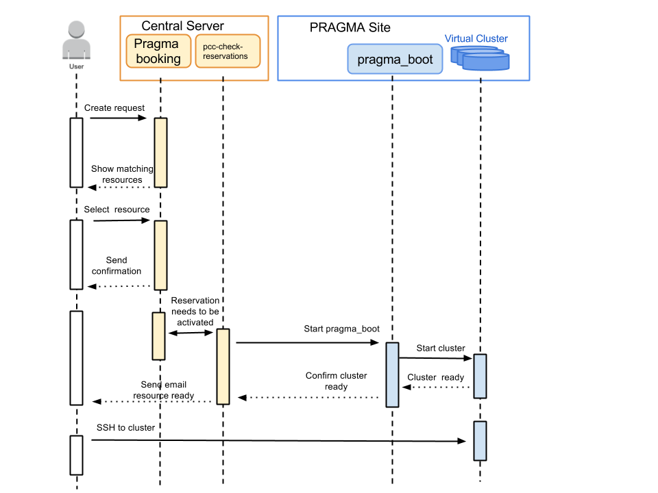
Activating reservations

Slide 10
Demo: Common Reports

Slide 11
Demo: Custom Report

Slide 12
Implementation status
Prototype code available at:
https://github.com/pragmagrid/cloud-scheduler
https://github.com/pragmagrid/pcc
Several Missing Pieces
GUI: Ability to reserve more than one virtual cluster per resource
PCC: Enable Condor Glide-in, automatic shutdown of reservations, enabling extension of reservations, network overlay/ENT integration
pragma_boot: Efficient VM/VC startup, port to other provisioners (OpenNebula, Openstack, Cloudstack)
Images: storage and management, library of base images
Documentation: How to guides (site, user)
User management: Integration with OpenID?
Component | Features
Booking (GUI) | Ability to reserve more than one virtual cluster per resource, integration with OpenID?
PCC | Enable Condor Glide-in, automatic shutdown of reservations, enabling extension of reservations, network overlay/ENT integration
pragma_boot | Efficient VM/VC startup, port to other provisioners (OpenNebula, Openstack, Cloudstack)
pragma_agent | Needs to be written and ported to other provisioners too
Images | storage and management, library of base images
Doc | How to guides for sites and users

Slide 13
Feedback? Questions?
What applications would you like to run?
Would you be willing to volunteer to test/run your application across the PRAGMA Testbed?
What additional features would you like?
Contact Info
Shava Smallen: ssmallen@sdsc.edu
Nadya Williams: nadya@sdsc.edu

