Slide 1

Deployment of Virtual Clusters in a Multi-Cloud Environment for Molecular Docking
Anthony Nguyen, Jason H. Haga, Mauricio Tsugawa, Kohei Ichikawa
October 17, 2014
Software Design and Analysis Lab, NAIST
Infraware Research Group, AIST
Advanced Computing and Information Systems Laboratory, University of Florida

Slide 2

Background
Multi-cloud computing is both cost efficient and offers a high degree of versatility and flexibility.
  No hardware cost (pay for time used)
  Essentially limitless resources
  Can easily scale and alter computational environment
  Adds a degree of fault tolerance (If one cloud has high traffic or goes down for maintenance others still run)

Slide 3
Objective
The goal is….
  Develop a multi-cloud environment to run virtual screenings
    Virtual screenings of molecular dockings performed via DOCK program
Anticipating that the multi-cloud environment will…
  Simplify process to scale the number of screenings
  Maintain same performance level as grid computing

Slide 4

Run DOCK Test

Slide 5
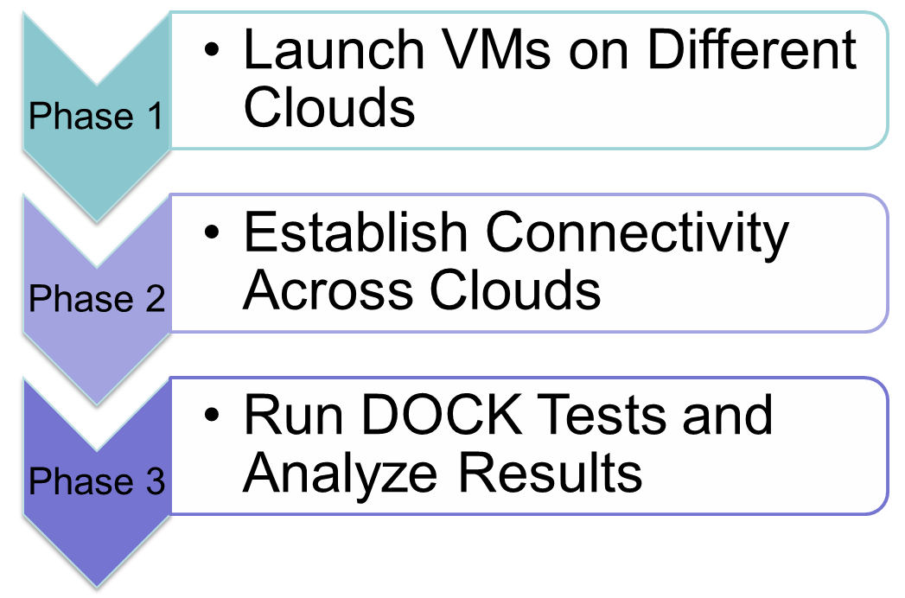
Project Approach

Slide 6
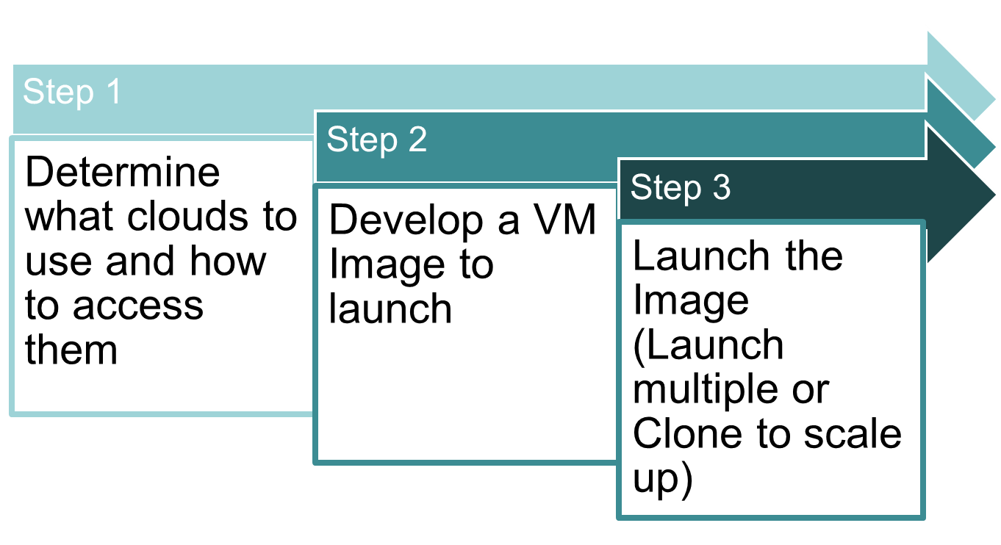
Phase 1: Launch VMs on Different Clouds

Slide 7
Step 1: Cloud Selection
Factor
  Low Cost or Free
Clouds Selected
  NAIST Private Cluster Environment
  AIST Private Cluster Environment
  FutureGrid Alamo Cloud Computing Resource
    Proposal Submitted to attain access to FutureGrid resources.

Slide 8
Step 2: Developing VM Image
Used a KVM Virtual Image designed by UCSD PRIME 2013 Interns
  This Virtual Image was set up to optimize DOCK program performance with regards to consistency in results.
  Some modification were necessary to match specific requirements of cloud (network configuration)

Slide 9
Step 3: Launch the Image
Each Cluster uses a different Cloud Middleware System so image launch method varied from cloud to cloud
  NAIST: Libvirt (KVM)
  AIST: OpenNebula
  FutureGrid Alamo: Nimbus

Slide 10
Project Approach

Slide 11
Phase 2: Establish Connectivity
ViNe
  Can be used to establish a virtual network supporting symmetric communication beyond boundaries like firewalls
  Requires no change to physical network
  Requires no change to machines operating system

Slide 12
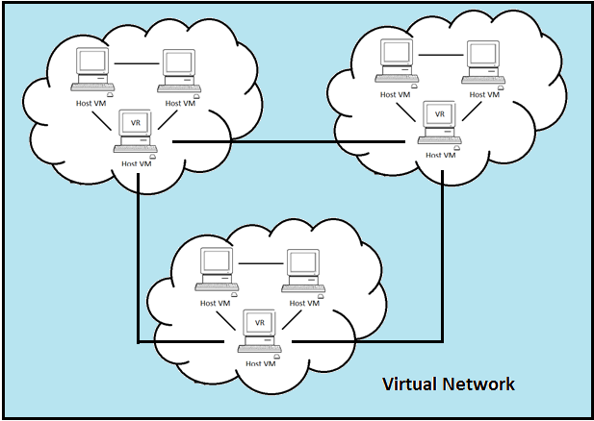
How ViNe Works
Notes:
Diagram depicts clusters on 3 clouds. (1 cluster per cloud)
Each Consists of 3 VM hosts
On each cloud, One host becomes a virtual Router.
Virtual Router has its own VRID and a list of Virtual IP addresses.
All 3 hosts, including the one that is the router, needs to be given a VirtIP from this list.
The VR and hosts must then all be specified to be a part of some virtual network.
This is done to all 3 clouds.
All VirtIP and VR on the VN are connected and can communicate with eachother using their VirtIP opposed to the standard public IP

Slide 13
Project Approach

Slide 14
Phase 3: DOCK Tests and Results
With full connectivity in Multi-Cloud Environment, DOCK jobs were run using mpi (message passing interface)
The tests that were run were used to assess effectiveness and flexibility of a multi-cloud environment.
Notes:
Test factors such as increased the business of the cloud (more work on the processors)
What if set up an unbalanced environment
Factors of this nature
(also compare to grid computing)

Slide 15
Our Environment
Three VMs on NAIST
  One is master, two run DOCK
Three VMs on AIST
  All three run DOCK
Three VMs on FutureGrid
  All three run DOCK

Slide 16
Results
  Processing times for DOCK tests in same order of magnitude for Grid Computing and Multi-Cloud Environment
  Grid Computing DOCK Test
    82s per compound per processor
  Multi-Cloud DOCK Test
    30s per compound per processor
Notes:
Difference between Test 1 and Test 2 is that test 1 was run when not other tasks were running on servers (that I had control over)

Slide 17
Results
  Processing times longer with increased workloads
  Anticipate that this will no longer be the case when using larger clouds with more resources
  Jobs evenly distributed across clouds and VMs when scaling environment
  Jobs distributed on a per VM basis, not a per cloud basis

Slide 18
Our Demo Environment
Two VMs on NAIST
  One is master, one run DOCK
One VM on Osaka U
One VM on UF
One VM on UCSD
*Connectivity through PRAGMA-ENT

Slide 19

PRAGMA-ENT
Application using multisite resources
  Pragma-ENT allows to provide a single L2 flat network for applications. This makes it easy for application users to use multisite resources simultaneously.
Logical View
VM
VM
VM
VM
VM
Internet2
JGN-X@Osaka
JGN-X@Tokyo
FLR
NAIST
OsakaU
AIST
UCSD
UF
VM
VM
VM
VM
VM

Slide 20
DOCK Demo Output

Slide 21
Conclusions and Future Work
Scaling up of the number of virtual screenings and VMs on the environment was simple and quick
Performance on the Multi-Cloud environment was equivalent to that on a grid computing environment
Incorporate Hadoop for job distribution and fault tolerance
Incorporate larger commercial clouds (Azure) for larger scale tests
Notes:
Tests
compare to grid and regular cloud computing
Scale up number of molecules and number of VMs
Hadoop
mpi does not account for job failures
Azure, EC2, Google Cloud. Etc

Slide 22
Acknowledgements
Previous PRIME students
  Kevin Lam
  Karen Rodriguez
UCSD Pacific Rim Experiences for Undergraduates (PRIME)
  Dr. Gabriele Wienhausen
  Teri Simas
  Jim Galvin
  Madhvi Acharya
Funding Sources
  URS Ledell
  PRIME Alumna Haley Hunter-Zinck
  National Science Foundation

Slide 24
Rigid Test with Flexible Parameter Off
Molecules Processed per Host (100 total) Test 1 (Small Workload)
Cloud | Host 1 | Host 2 | Host 3
NAIST | MASTER | 10 | 10
AIST | 13 | 11 | 14
FG | 16 | 14 | 12
Molecules Processed per Host (100 total) Test 2 (Large Workload)
Cloud | Host 1 | Host 2 | Host 3
NAIST | MASTER | 14 | 13
AIST | 10 | 12 | 12
FG | 13 | 11 | 15
Notes:
Difference between Test 1 and Test 2 is that test 1 was run when not other tasks were running on servers (that I had control over)

Slide 25
Rigid Test with Flexible Parameter Off
Average Processing Time per Molecule on each Host (sec) Test 1 (Small Workload) Total Time: 1066 sec
Cloud | Host 1 | Host 2 | Host 3
NAIST | MASTER | 96 | 140
AIST | 79 | 90 | 70
FG | 66 | 71 | 81
Average Processing Time per Molecule on each Host (sec) Test 2 (Large Workload) Total Time: 3015 sec
Cloud | Host 1 | Host 2 | Host 3
NAIST | MASTER | 197 | 222
AIST | 280 | 237 | 233
FG | 232 | 241 | 189
Notes:
Difference between Test 1 and Test 2 is that test 1 was run when not other tasks were running on servers (that I had control over). Test two was run while many processor intensive tests were being run resulting in slower rate.
Notice the drastic difference in total time when increased the amount of processes being run. Had more control over NAIST.
Because Naist only processing on 2 VMs, might explain why the CHANGE in rates were smaller here compared to the rest. Less processes means less lag.

Slide 26
Rigid Comparison Test
(100 Compounds)
Average Processing Time per Molecule on each Host (Multi-Cloud) (sec) Total Time: 24380
Cloud | Host 1 | Host 2 | Host 3
NAIST | MASTER | 1290 | 1561
AIST | 3104 | 1184 | 1649
FG | 1907 | 2603 | 1850
Published Rate for Grid Computing DOCK Test
  82 seconds per compound per processor
Multi-Cloud DOCK Test
  30 seconds per compound per processor
Notes:
Clear that the rate per compound per processor is significantly faster (total time / # of compounds / # of processors)
May be an incorrect assessment but it is all it shows but all publication shows is (seconds per compound per processor)

Slide 27
Unbalanced Rigid Test
Molecules Processed per Host (Balanced) (100 total) Test 1
Cloud | Host 1 | Host 2 | Host 3
NAIST | MASTER | 10 | 10
AIST | 13 | 11 | 14
FG | 16 | 14 | 12
Molecules Processed per Host (Unbalanced) (100 total)
Cloud | Host 1 | Host 2 | Host 3 | Host 4 | Host 5 | Host 6
NAIST | MASTER | 8 | 9 | - | - | -
AIST | 9 | 8 | 7 | - | - | -
FG | 9 | 11 | 10 | 9 | 11 | 9
Notes:
Ran this test with no other processes.
Can see that when scaling up in an unbalanced manner, distribution still relatively even with regards to Number of Molecules processed.
Appears scaling up on Multi-cloud will function just like grid computing.
Wanted to see if one cloud would get “preferential treatment” based on number of VMs

Slide 28
Unbalanced Rigid Test
Average Processing Time per Molecule on Each Host (Balanced) (sec) Total Time: 1066 sec
Cloud | Host 1 | Host 2 | Host 3
NAIST | MASTER | 96 | 140
AIST | 79 | 90 | 70
FG | 66 | 71 | 81
Average Processing Time per molecule on each Host (Unbalanced) (sec) Total Time: 766 sec
Cloud | Host 1 | Host 2 | Host 3 | Host 4 | Host 5 | Host 6
NAIST | MASTER | 91 | 82 | - | - | -
AIST | 73 | 89 | 97 | - | - | -
FG | 78 | 60 | 65 | 80 | 64 | 85
Notes:
Looks to confirm what we saw based on molecule distribution. Rate does not seem to have altered much by the small scaling up. Overall Environment runs just like grid computing with an even distribution to all tasks.

