Slide 1
An Information Interface for Disaster Management Professionals - DADm
Jason H. Haga, Richard Hsiao, Hironori Shigeta, Yoshiyuki Kido, Susumu Date, Shinji Shimojo
Cyber-physical Cloud Research Group
National Institute for Advanced Industrial Science and Technology (AIST)
Cybermedia Center, Osaka University

Slide 2




Disaster Management Cycle
Mitigation – Preemptive actions to reduce severity, consequences, and risks to people
Preparedness – range of critical tasks and activities necessary to build, sustain and to improve operational capability to prevent, protect against, respond to, and recover from disaster
Response – immediate/ongoing activities and systems to manage the effects of an incident and help reach a stable status for the entity
Recovery – programs designed to return conditions to a level that is acceptable to the entity. Assisting victims and restore institutions. Rebuilding.
Notes:
Many major communities utilize a disaster management cycle to plan against disasters. Disaster management cycle is the creation of plans through which communities reduce vulnerability to hazards and cope with disasters.
The purpose of the application is to assist in the response phase of the cycle, during which the disaster is occurring. The purpose of the app is that geographic-specific data can be processed and pushed to users at multiple-sites.
This is key in decision-making because decision-makers may not necessarily be able to meet up in one location to discuss their response plans.
The users can then simultaneously interact and discuss their plan of action while presenting their case with real-time data being displayed on the application through SAGE2.
Prior methods of screen-sharing have limited capabilities with regards to interaction. For example, screen-sharing is a collaborative medium that limits the control to only one user, which would make it difficult for other users to communicate their ideas.
A disaster management cycle focuses on creating plans to decrease the impact of disasters which would otherwise lead to damage to assets, human mortality, and lost revenue. This application can assist during real-time crises where crucial decisions need to be made.

Slide 3
Shonan Meeting 2014 - User Card Stories
A method to help define what end users will/want to do with interface
What do they look like?
As a [user] I want to [action] in order to [goal].
Prioritize – MoSCoW method
Must = Minimum features for product to be useful
Should = Not critical but high value and important
Could = Nice to have without incurring too much cost
Won’t = Outside of scope, possible for the future

Slide 4
Key Points of User Card Stories
Data/information is critical
Real-time
Updatable
Filtered
Sharable
Continuous
Accessible

Slide 5
User Interface Requirements
Data-centric
Collect different data types, but basic information
Data is updated and always presents current status
Temporal and spatial referenced data
Simple, easy to access and interpret
User has limited IT experience
Workspace application
Present different types of data (simulation/sensor/crowd)
Aggregate/filter data
Shareable data
Ability to view data individually or overlayed

Slide 6

Multisite Visualization Interface
Map view/overlay
workspace
SD
infrastructure
Map view/overlay
workspace
User moves map up
User adds new data here
Decision Makers at Site D
Decision Makers at Site E
Laptops
Mobile devices

Slide 7
Key Data Requirements Spatial/temporal or Where/when
Infrastructure
Transportation
Roads/bridges intact, congested
Power
On or off, power station locations
Water
On or off
Gas
On or off, fires?
Communication
Landline and cellular
Hazards
Structural
Buildings destroyed
Combustible
Ongoing fires
Water
Areas that are flooded and inaccessible
Health/safety
Fire department
Police
Medical
Military

Slide 8
Workspace Concept
Area selection:
lat, long
name
Overlay:
☑Infra
☐Hazards
☐H/S
Map View
(Google maps based)
workspace
Infrastructure data
☑ Traffic
☐ Power
☐ Water
☐ Gas
☐ Comm
Hazards data
☑ Structural
☐ Fire
☐ Water
☐ Wind
Health/safety data
☑ Fire dept
☐ Police
☐ Medical
☐ Military

Slide 9
DADm - Research Objective
Deployment of a multi-site visualization tool for disaster management
Design Objectives
Being able to geographically visualize regions of interest
Being able to access multiple unique datasets to gauge disaster action choices
Selectively view and toggle relevant datasets
The application needs to be streamlined, straightforward, and transparent to the user
Notes:
Objectives:
-selectively view – we want the program to streamlined, straightforward, and transparent to the user. We’re giving them a set of information that they can look at to help them gauge/estimate their choices/judgement. It’ll remove clutter. Corroboration is key.

Slide 10

Methods
Development on a Shared Collaborative Environment (SAGE2)
JavaScript
Leaflet Map, D3, and Heatmap Libraries
Data Broker (JSON datasets)
HTML Document Object Model (DOM)
Notes:
Methods to develop the Application
SAGE2 – Scalable Amplified Group Environment 2.
Scalable solution for viewing and interacting with arbitrary content. Develop and tested various methods of synchronizing data across multiple sites.
middleware to display and interact intensive information from multiple sources of display of arbitrary size.
Generally, commercial software has enabled groups to collaborate over distance but only when display environment is cloned in all locations (desktop mirroring and video conferencing).
Why do we choose SAGE2?
Disaster response decision-makers need to be able to make strategic and critical choices during the onset of disasters.
SAGE2 is an answer for the limitations of cloned environment. It enables groups to work in front of large shared displays in order to solve problems that require juxtaposing large volumes of synchronized information
SAGE2 is a proper platform for this because it allows users to examine and manipulate data. Users can explain their thought processes both visually from their own interface at the same time as other players. It is a collaborative environment that extends beyond a show-and-tell through desktop mirroring and video conferencing.
Teams at different locations are able to corroborate with one another, which can be key during a disaster when travel might not be practical. There really is not time for everyone to get into the same room to collaborate.
The team needs to be both be able to examine relevant data and work in collaboration.
SAGE2 is a middleware that displays and allows users to interact with data-intensive information from multiple sources. It is a scalable environment that can be accessible over multiple sources of display.
JavaScript
SAGE2 applications run off of JavaScript files.
To create the UI, the Document Object Model (DOM/tree of objects to create dynamic HTML) was accessed in JavaScript to create/interact with elements in an HTML document.
SAGE2 applications are able to use libraries and cascading style-sheets (CSS).
The Leaflet library was used to initialize a tile layered map.
The d3 (data-driven document) library was used to overlay and manipulate data on the map.
The heatmap library was used to layer a heatmap for three-dimensional data.
The user interface was a combination of CSS and HTML elements.
Note: I initially tried Google Maps. There exists a google maps application for SAGE2, but it was not recommended by one of the developers as it required special attention to produce in SAGE2. Google maps doesn’t really like sharing space on a web page with other d3 charts and graphs and the updates were odd when data was overlaid map. Leaflet was the alternative with layer capabilities and libraries that were relevant in the data application.

Slide 11
Application Demo
Created a working prototype SAGE2 application with a simple user interface
Allows user to link JSON datasets and tag them with keywords through the data broker
Users can see both static 2D data and 3D data with the heat map layers
Show the feasibility of creating a data-intensive application on SAGE2
Notes:
How to Showcase
1. Boot up SAGE2 and load the DADm Application
We should be centered over Chicago, overlooking most of the city.
2. Showcase the Leaflet Map.
Using the SAGE2 pointer, we can “zoom-in” and “zoom-out” using the Widget buttons (Right-click with the SAGE2 Pointer)
Using deep-mouse interaction (Shift+click), we can click and drag to move around the map.
3. Showcase the UI for data.
Using the regular mouse, we can just click on the Toolbar Button on the right.
Or Using the SAGE2 pointer, we can click on it with deep-mouse or through the Widget buttons
Continuing the interaction with regular mouse or deep-mouse, we can click each individual item on the list to show the legend
By clicking “Police Stations” or “Fire Stations”, we can visualize the coordinate-specific JSON data available in Chicago
Hover over the markers with the regular mouse or deep-mouse pointer to display a tooltip
Continue showcasing by zooming out and showing Hospital locations sprawled across the US
4. Showcase disaster/heatmap data
Zoom-out and drag the map to the right across toward the eastern coast of Japan.
Note: The Heatmap should already be loaded
Click the “Earthquakes” to display the coordinate-specific geographic data
We should see markers on the map at the epicenters of the earthquake/heatmap
Note: The heatmap scales with the magnitude of the Earthquake
5. Optional: Showcase the multiple layers and heatmap boolean using the buttons on the top right of the Leaflet map.
Note: This is a little buggy with the deep mouse interaction. It is much better for it to be used with the regular mouse.
We can also showcase scalability by scrolling up and down with the SAGE2 pointer

Slide 12
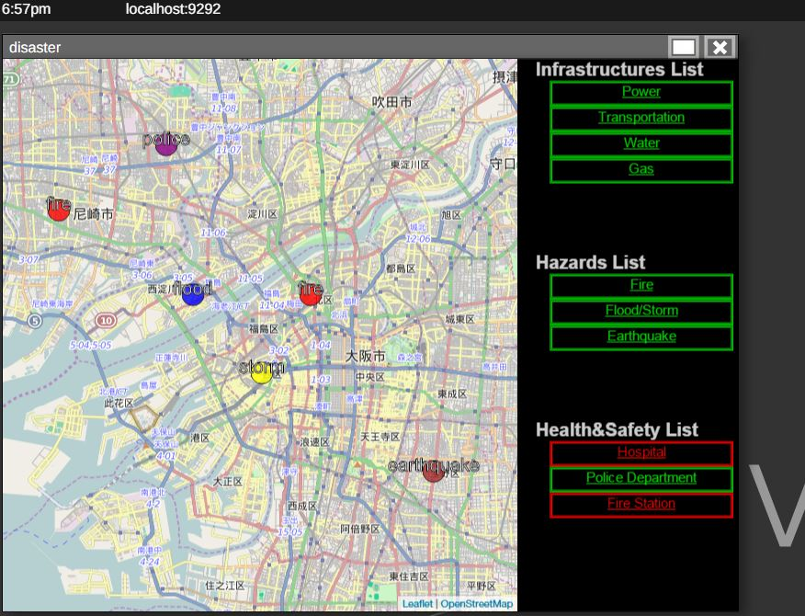
Figure 1: Early renditions of the application with a static UI and sample data

Slide 13
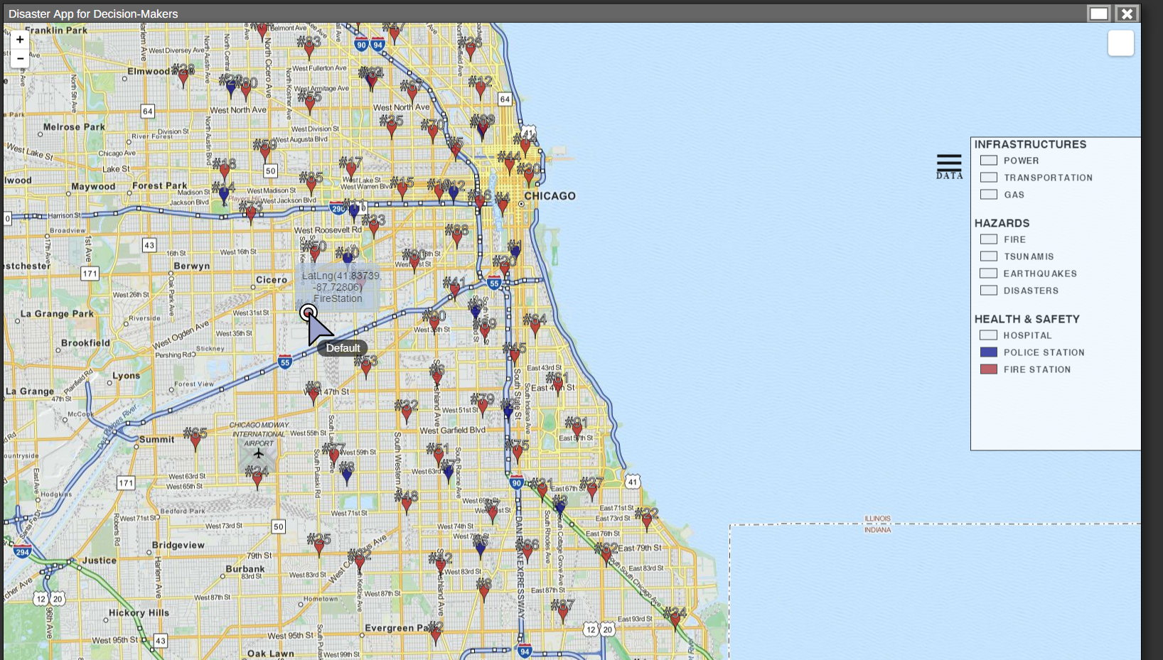
Figure 2: Current rendition of the application overlooking Chicago with Police & Fire Station Data

Slide 14
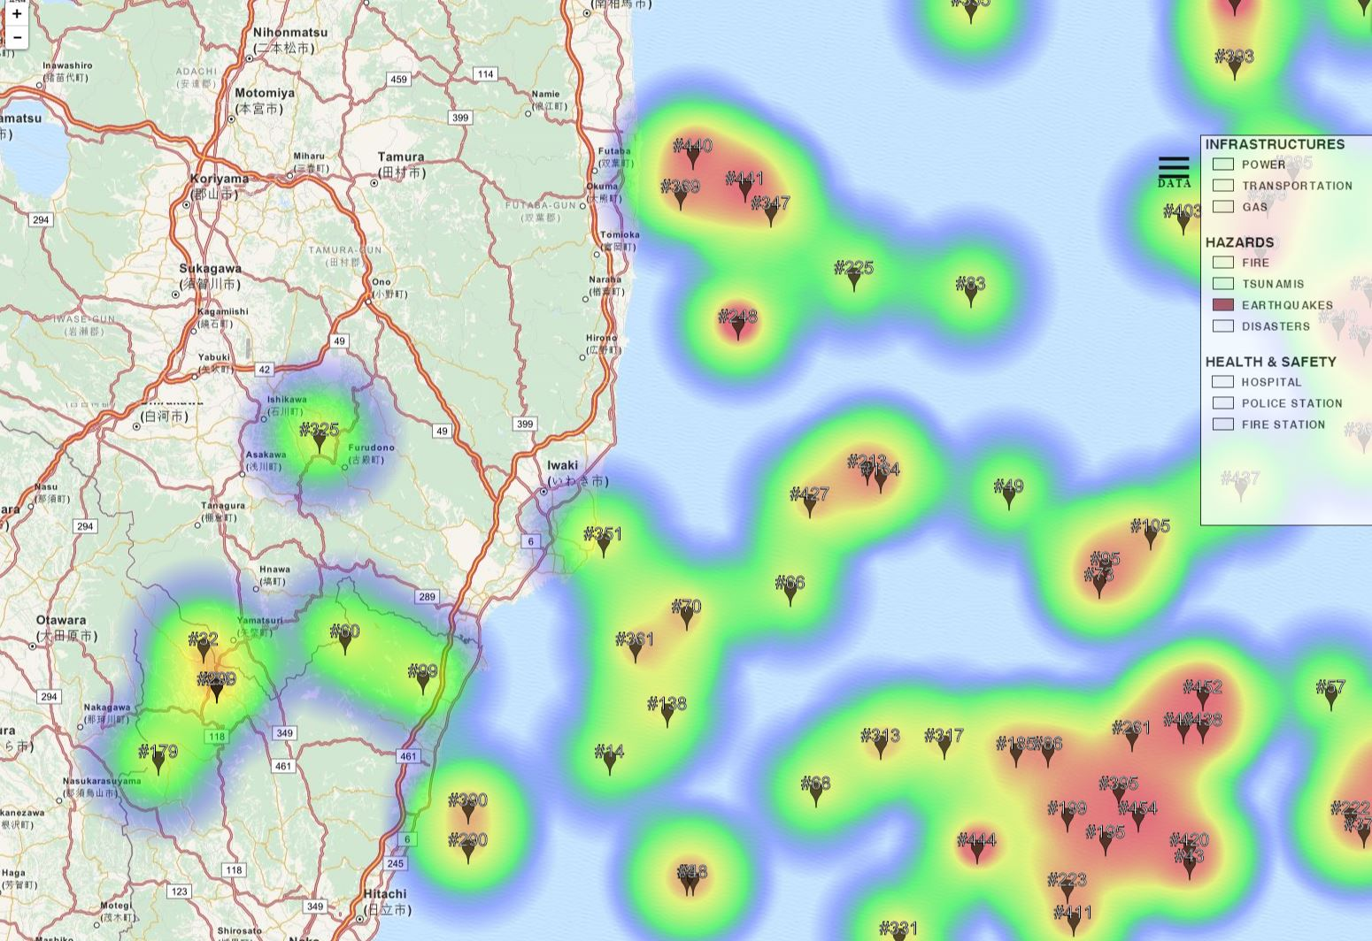
Figure 3: Current rendition overlooking the East Coast of Japan with earthquake disaster data

Slide 15
Conclusion
SAGE2 is meant to be used as a shared multi-site collaborative environment for viewing and interacting with content.
DADm is one application of SAGE2 that displays coordinate-specific JSON data based on the user’s specifications
Further development will display disaster-management data in both a more streamlined and effective manner
No conclusive real-time application due to lack of an available dataset, but as a whole it is a step toward app development in the SAGE2 platform
Notes:
Overall, the application, named DADm (Disaster Application for Decision-makers) was able to fulfill the design objectives, being a multi-site application that could display coordinate-specific JSON data based on the users’ specifications. There is no conclusive real-time application, which is crucial for disaster management tools, because of the lack of a database; however, this application is an insightful step for application development on SAGE2. Future work will include improving DADm to display real-time data in a more streamlined manner and with a more universal data broker.

Slide 16
Future Work
Tuning the heat map feature and UI improvement
Working within SAGE2
Integration of different types of datasets
Open vs. usable
More advanced data broker
More detail each data point
Further testing with real-time data to mimic intended application
Notes:
Integration of Different Types of Dataset – Currently, it only incorporates and reads JSON filetypes
Advanced Data Broker – The current way it parses JSON datasets is through recursive functions. Perhaps, there is a more robust way to parse.
More Detail on Each Data Point – Currently, it can only display the Geographical Coordinate and arbitrary numbering on the data point given by the parser
Tuning the Heat Map Features – Currently, the heatmap is show-case only. Preferably, it should options that allow for easier manipulation by the user in the SAGE2 interface and have a much more streamlined way of implementing onto the Leaflet map
Real-time Data – Currently, no real-time data is easily accessible for me to test the application with so I have been using static datasets.
Further UI improvements – Just to make it look better

Slide 17





Acknowledgements
University of California, San Diego
Prime Alumna Haley Hunter-Zinck
The Ledell Family URS
National Institute of Information and Technology (NICT)
Dr. Masanori Goto
Osaka University
Dr. S. Matsumoto
SAGE2 Development Group and SAGE2 Google Groups
Dr. Andy Johnson
Dr. Luc Renambot

