Slide 1

Bandwidth and Latency Aware Routing using OpenFlow
Pongsakorn U-chupala, Kohei Ichikawa, Putchong Uthayopas, Susumu Date, Hirotake Abe

Slide 2


Application-aware Routing
Controller
SSH
FTP
HTTP

Slide 3
Architecture
App
App
App
Controller
OpenFlow Network

Slide 4
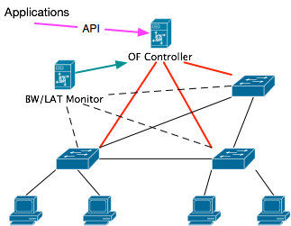
Mechanism

Slide 5
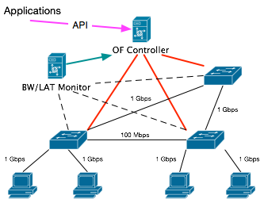
Mechanism

Slide 6

Mechanism

Slide 7
Path Preference Table
Path Identifier (src_ip, src_port, dst_ip, dst_port) | Preference (DEFAULT / MAX_BW / MIN_LAT)
(10.0.0.1, 1234, 10.0.0.2, 80) | DEFAULT
(10.0.0.1, *, 10.0.0.2, 80) | MAX_BW
(10.0.0.2, 80, 10.0.0.1, *) | MAX_BW
(10.0.0.1, *, 10.0.0.2, *) | MIN_LAT
(*, *, *, *) | DEFAULT

Slide 8
