Slide 1
Linking collections to related resources: Multi-scale, multi-dimensional, multi-disciplinary collaborative research in biodiversity. Is this a “Big Data” paradigm?
Reed Beaman, , University of Florida, Gainesville, FL, USA PRAGMA 26: 10 April 2014

Slide 2
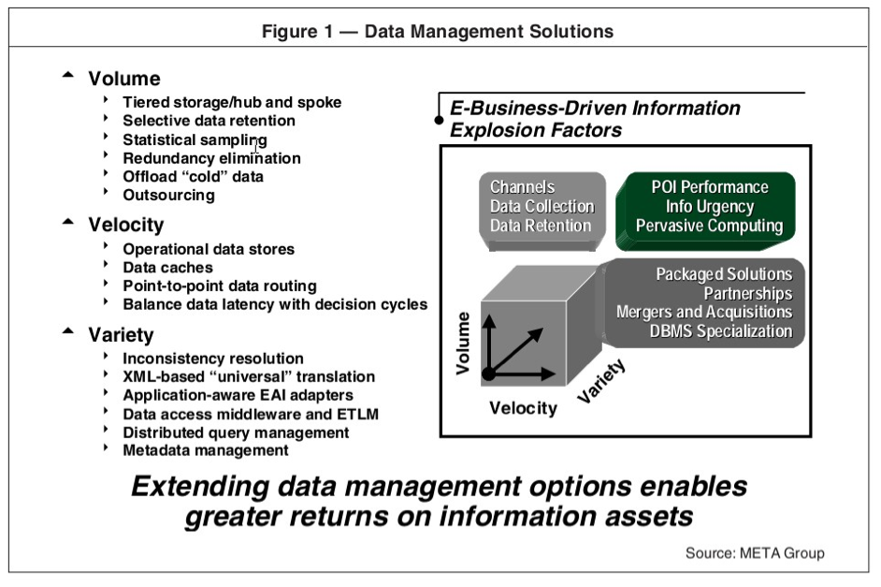
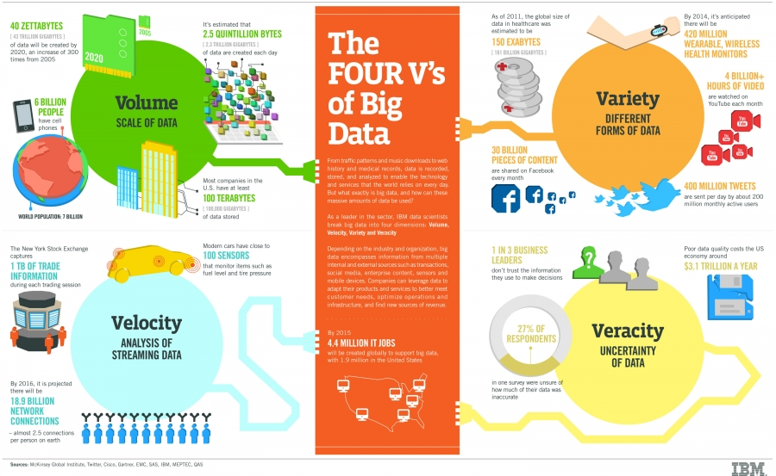
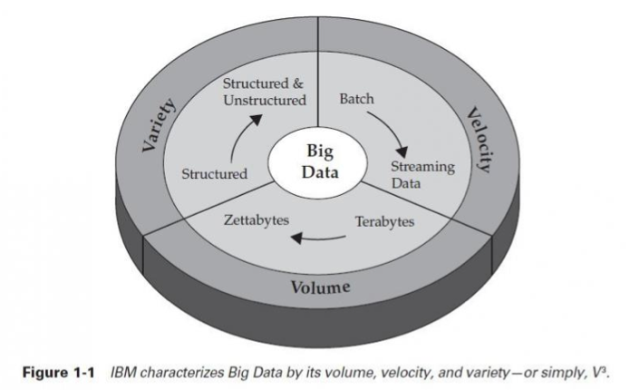
The 3 or 4 Vs of Big Data
“Big data is data that’s an order of magnitude bigger than you’re accustomed to, Grasshopper.” Doug Laney, Gartner

Slide 3
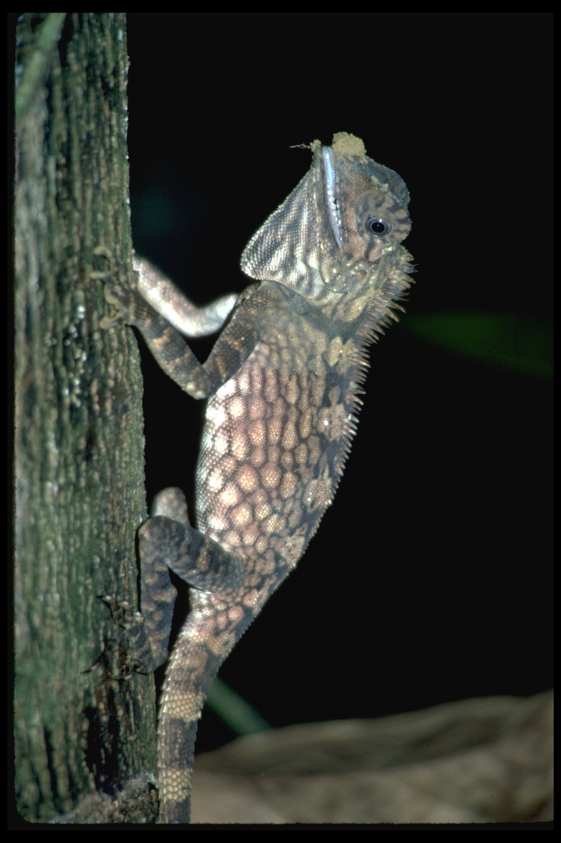

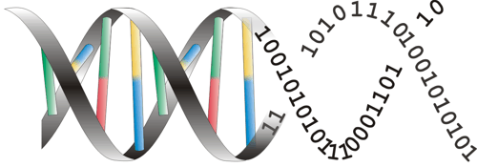
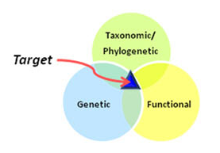
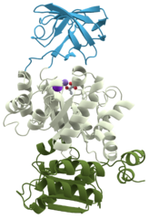
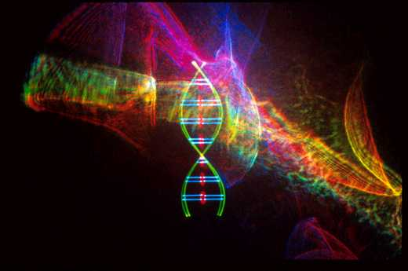
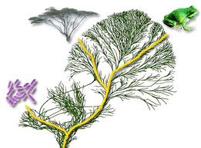

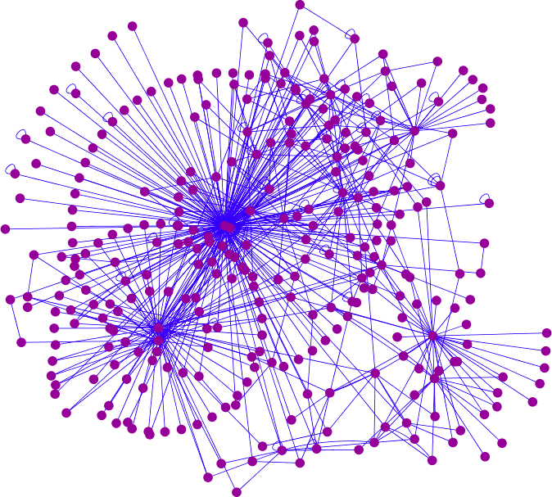
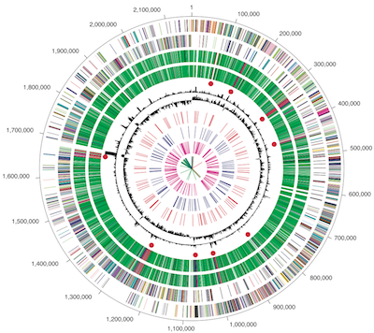
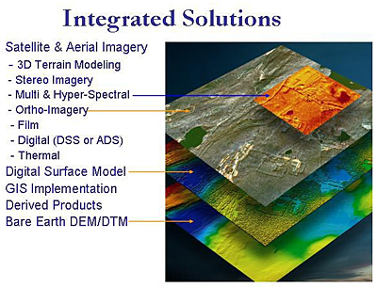
Integrative Biodiversity: Multiscale, Multi-disciplinary
US NSF Dimensions of Biodiversity program)
Interaction at the intersection of taxonomic, genetic, functional domains
Organisms -> species
Phenotypic expression
Trophic interations
Tree of Life, phylogenomics
Bioactive compounds/chemistry
Molecular -> Ecosystem

Slide 4
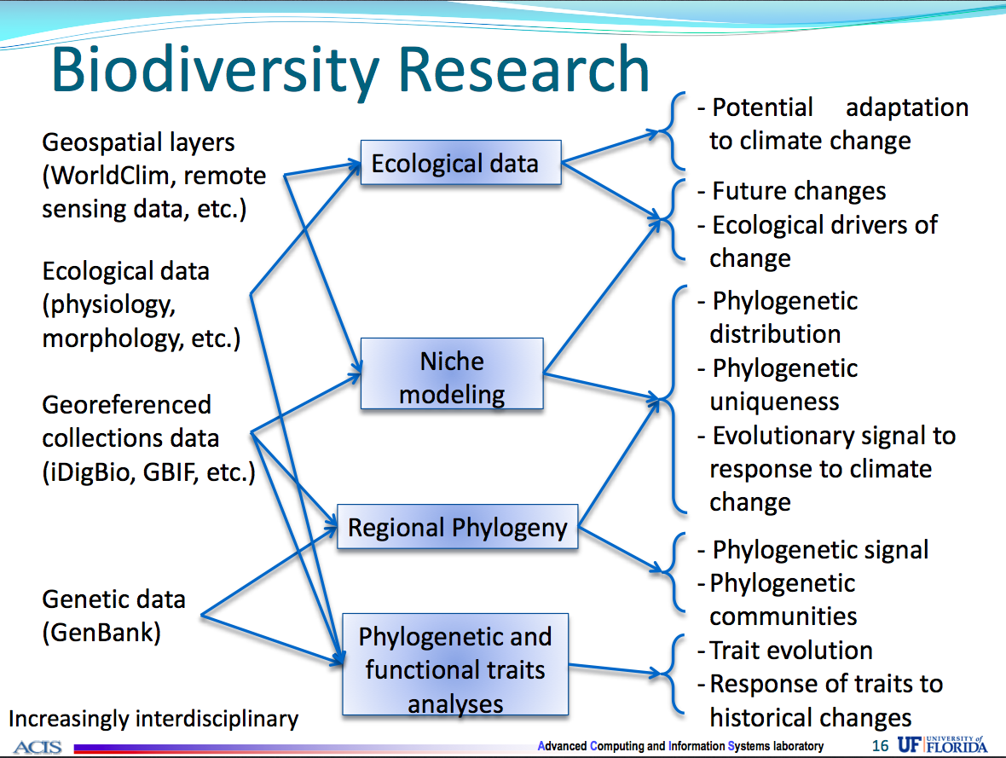
Source: Andrea Matsunaga

Slide 5
Big data is a given for genomics, high throughput sequencing, analysis, and visualization
What about all the other data that relates to genetic and genomic data?

Slide 6
4Vs for Biodiversity Big data
Volume: billion or more specimens, 2-10 million species (excluding microbial), 10 billion plus related edges
Velocity: Snail’s pace? 250 year long-tail legacy of taxonomic data -> rapid digitization <-> large scale genomic sequencing
Variety: Occurrences, sequences, morphological, geospatial; structured and unstructured
Veracity: Very challenging to validate?

Slide 7
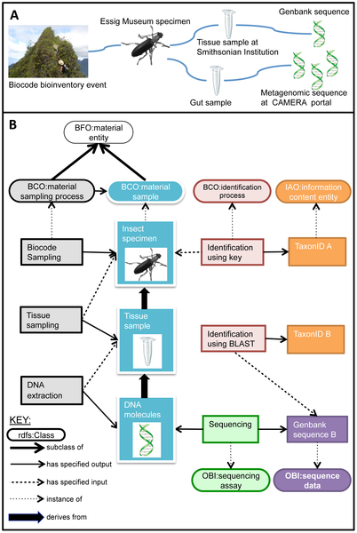
Figure 3. Linking samples and derivatives from the Moorea Biocode project.
BiSciCol (Biological Science Collections Tracker) use case:
Every specimen links to a multitude of parent and derivative data. Users of biodiversity data need to be able to easily and quickly see these relationships
Citation: Walls RL, Deck J, Guralnick R, Baskauf S, Beaman R, et al. (2014) Semantics in Support of Biodiversity Knowledge Discovery: An Introduction to the Biological Collections Ontology and Related Ontologies. PLoS ONE 9(3): e89606. doi:10.1371/journal.pone.0089606http://www.plosone.org/article/info:doi/10.1371/journal.pone.0089606

Slide 8
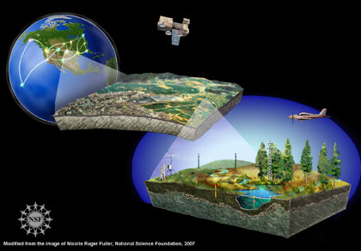
The "Big" in Ecological Big Data
The defining aspect of ecological Big Data is not raw size but another dimension: complexity.
Dave Schimel, (former) NEON Chief Scientist

Slide 9
4Cs of Biodiversity Big Data
Complexity: scale, interactions (e.g., food webs) between individuals, populations, species, environments (cf. story lines)
Collaboration: International and multidisciplinary
Citizen Science: Increasing as a solution to digitization
Completeness: Will we always be 10% complete, and can we validate and create the linkages?

Slide 10
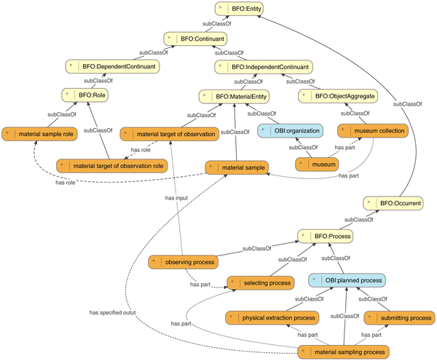
Figure 2. Core terms of the Biological Collections Ontology (BCO) and their relations to upper ontologies.
Citation: Walls RL, Deck J, Guralnick R, Baskauf S, Beaman R, et al. (2014) Semantics in Support of Biodiversity Knowledge Discovery: An Introduction to the Biological Collections Ontology and Related Ontologies. PLoS ONE 9(3): e89606. doi:10.1371/journal.pone.0089606 httphttp://www.plosone.org/article/info:doi/10.1371/journal.pone.0089606

Slide 11
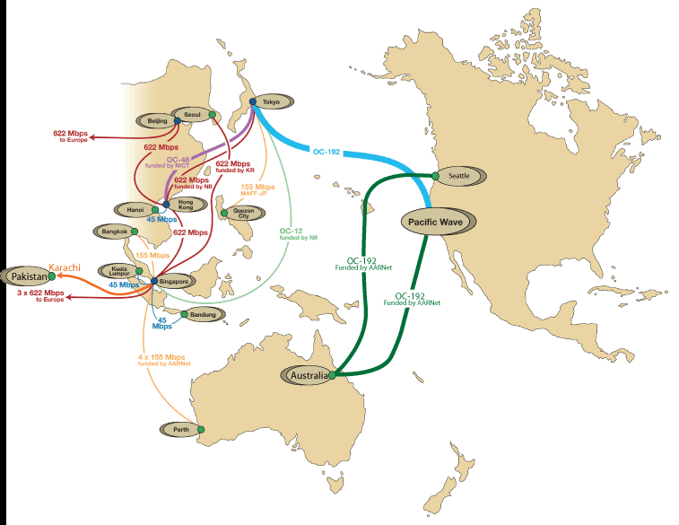


Trust Envelope
Software Defined System
From Virtual Machines to Virtual Clusters
Adjusts to changing needs and environments
Application
VM
Virtual Cluster
Overlay Network
Data sharing over multiple networks
Data Server
Other Networks
Move the software to the data

Slide 12
Trust Envelope
Trust Envelope
AIST Japan may have more compute resources
LifeMapper AIST
LifeMapper Virtual Cluster
Satellite imagery
Sensitive biodiversity data and UAV (Drone) imagery
Overlay Network
iDigBio, GBIF
Sensitive or licensed data may not be portable

Slide 13
Integrative Biodiversity
Grand challenge science: Big data is about asking big questions
Organisms -> species
Phenotypic expression
Trophic interations
Tree of Life, phylogenomics
Bioactive compounds/chemistry
Molecular -> Ecosystem

