Slide 1

Global Virtual Cluster Deployment Through a Content Delivery Network
Pongsakorn U-chupala, Kohei Ichikawa (NAIST) Luca Clementi, Philip Papadopoulos (UCSD)

Slide 2

Some History
PRAGMA 21
Easily share computational infrastructure components between PRAGMA members
PRAGMA Virtual Cluster Sharing

Slide 3
Virtual Cluster Sharing
Virtual Cluster Image
Virtual Cluster Images Standard
KVM
Single disk image RAW format
The first partition is the root / partition
No LVM or RAID!!
Frontend 2 network interfaces
First private
Second public
Compute 1 network interface
/root/vc-out.xml for all network configuration
Frontend
Image.gz
Compute
Image.gz
vc-in.xml

Slide 4

Virtual Cluster Sharing
Deployment mechanism
Pragma Bootstrap: a software tool to help with deployment of PRAGMA compliant virtual cluster.
Available at: https://github.com/pragmagrid/pragma_boot
Plugins architecture (to support more platforms)
DynIP: To enable Rocks cluster to work inside PRAGMA Bootstrap
https://github.com/rocksclusters/dynip
VC-out-parser: generic driver for RedHat system
https://github.com/pragmagrid/vc-out-parser
Notes:
Deploy VC to supported infrastructure using PRAGMA Bootstrap

Slide 5


Virtual Cluster Sharing
Where is the sharing?
Amazon Simple Storage Service (S3): an online file storage web service
Amazon CloudFront: is a content delivery network
Notes:
Gfarm have it’s fair share of a problem
Outsource the burden

Slide 6
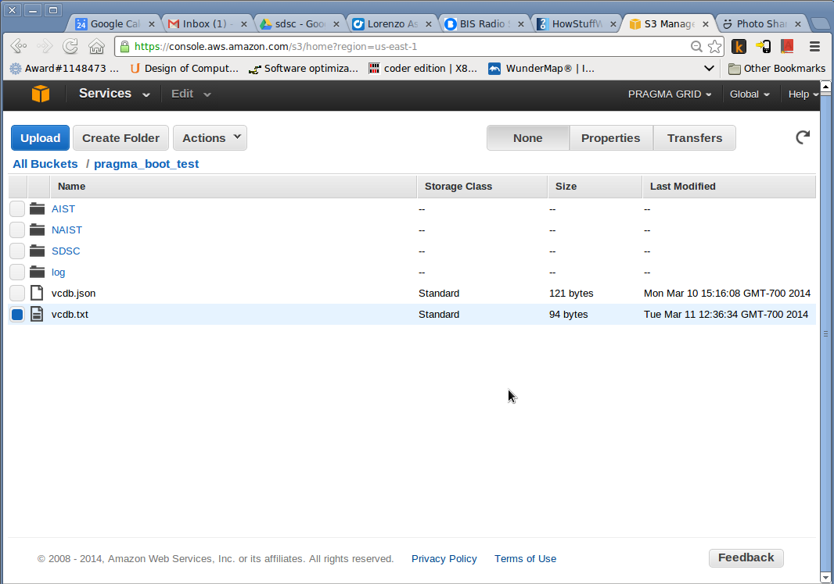
Amazon S3
Amazon Simple Storage Service: online file storage web service
Web based GUI
Multiple user accounts
Fine-grained access control
Pay per use

Slide 7
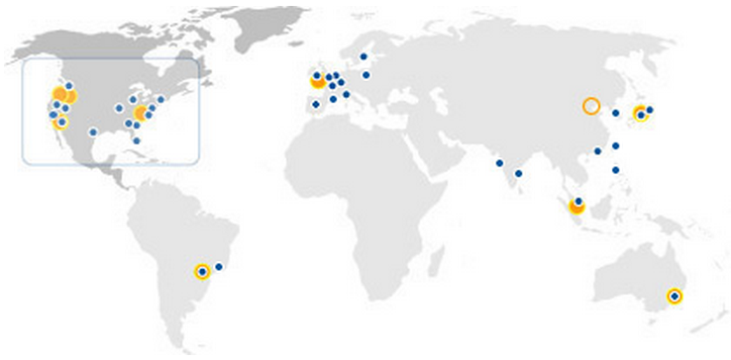
Amazon CloudFront
Global Content Delivery Network:
Multiple edge locations in Asia
Work with Amazon S3
Pay as you use
Access control for protected content

Slide 8
Amazon CloudFront
Our images are stored in the US Standard S3 bucket

Slide 9
Amazon CloudFront
Delivered by all edge locations

Slide 10
Performance
Caching
No clue!!
Object was already cached
Network issue due to Pragma ENT
No clues!!
On average:
S3: ~20-25 MB/s
CloudFront hit: 50 MB/s
CloudFront miss: 2 MB/s
Notes:
Benchmark
Benefit from CloudFront may be more significant in other countries

Slide 11



Pragma Bootstrap
S3 bucket
Disk images are delivered by local CloudFront Edge servers
GET /abs/disk1.vda
GET /abs/disk1.vda
GET /abs/disk1.vda
pragma_boot
pragma_boot
Notes:
Run exactly the same command anywhere and CloudFront will deliver the file from the nearest edge location

Slide 12
Pragma Bootstrap
Pluggable download architecture
Local: use local file
Http: use plain http or https to download file
CloudFront: support Cloud Front security mechanism (signed URL)
Supported file format:
raw: plain file
gzip: compressed with gzip
splited: split file in multiple sub-files
splited_gzip: split file in multiple sub-files and compress them
Notes:
To make PRAGMA Bootstrap works with cloud storage, we also implement…

Slide 13
Thank you!
Questions?
Source code available at:
pragma_boot: https://github.com/pragmagrid/pragma_boot
Contacts:
lclementi@ucsd.edu
pongsakorn.uchupala.pm7@is.naist.jp

