Slide 1
Day1
Update and discussion about charges
NCHC, NECTEC, UCSD, Osaka, AIST.
Disaster Management
Future Project

Slide 2
Presentation
Kyoung-Sook Kim
Peter Lee: “Disaster Management Information Platform & i-Fly-Over Demo”
Jason Haga “JFG Haiku Hunt”
Kun Won Cho “ERGO and GLOVE”
Yoshiyuki Kido “VizCloud”
FangPang Lin “Big Data and Water Disaster”

Slide 3




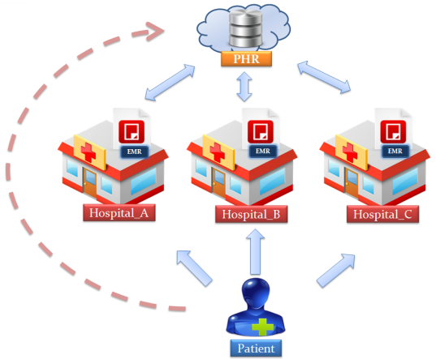

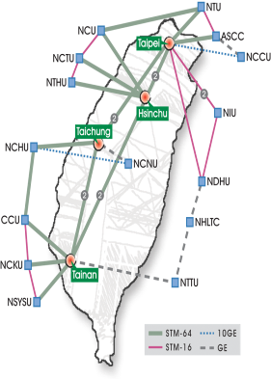

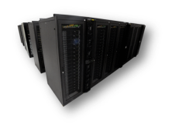

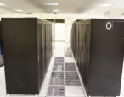
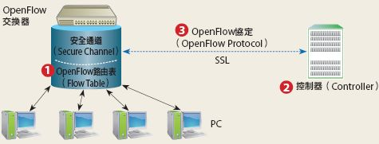

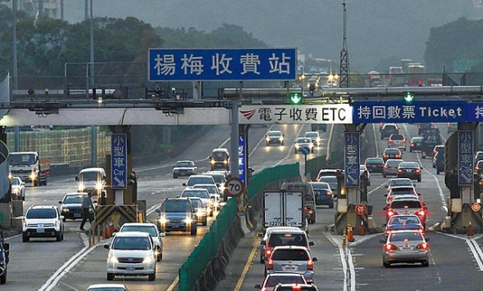


Government Big Data
NCHC/NARLabs provides Big Data Platform,
Bridging Excellent Research Societal Impact
Culture: Animation
Finance: e-invoice
Health: Electronic Medical Record
Network: Openflow
Food Security: Food Traceability
Transportation: etag system

Slide 4
Discussion on Tele/Sensor
MAEViz (ERGO) KUN WON CHO
International Collaborative Project of Disaster Management
GLOVE system

Slide 5
Discussion on Tele/Sensor
VizCloud (Kido)
SensorCloud (Phil)
DMCloud (WheyFone)
Life Mapper
Realtime on demand system deployment with workflow
Disater Management
Visualization System
in situ analysis
Big Data
Parallel is a Key
Virtual Cluster
ON Pragma ENT

Slide 6

“Water management and Big Data”
7-10 July 2014, Shonan, Japan
Fang-Pang Lin, Satoshi Sekiguchi, Phil Papadopoulos

