Slide 1




HathiTrust Data Capsules : Text Mining 4.6 Billion Pages
Beth Plale
Professor of Informatics and Computing
Director, Data To Insight Center, Indiana University
@bplale

Slide 2
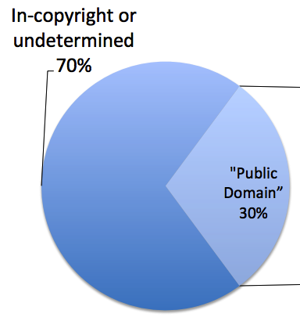
4.6 Billion Pages
HathiTrust digital repository
13.3 million books and growing
Digitization sources
Google (96.8%)
Internet Archive (2.9%)
Local (0.3%)

Slide 3
HathiTrust Research Center
Purpose: Enable researchers world-wide to carry out text mining analysis of the HathiTrust repository
Since 70% of the digitized content under copyright, compute has to be co-located at the data. Data are “pinned” to location.
Software services called: Secure HathiTrust Analysis Research Commons (SHARC)

Slide 4
Starting principles
Digital nature of content and restrictions of copyright precludes a model of checking out a set of (digital) volumes/books, taking them home, and promising to return them, or destroy them, later so
computation moves to the data (not vice versa)
How support access and computational analysis a way that doesn’t constrain the research (in a non-work-limiting way)?

Slide 5
Research Questions
Non-consumptive use*: can framework provide safe handling of large amounts of protected data?
Openness: can framework support user-contributed analysis without resorting to code walkthroughs prior to acceptance?
Large-scale and low cost: can protections be extended to utilization of large-scale national (public) computational resources?
*Non-consumptive use is defined as computational analysis of the copyrighted content that is carried out in such a way that human consumption of texts is prohibited.
Notes:
???

Slide 6
HathiTrust Data Capsule
User “checks out” a virtual machine (VM)
VM runs in, and only in, the HTRC Services Environment*
User owns their VM through weeks/months of analysis
Getting stuff into VM is easy, but there is a controlled and audited process for getting results out of the VM
* A “local cloud”

Slide 7
Assumptions
Phase I (current phase) assumptions
User is trusted to not be malicious (trust users)
User’s programs are malicious (don’t trust programs)
A user cannot share their VM with someone else
A user can bring any alternate data into the VM to enrich analysis on the HT corpus, but the focus is the HT corpus (HT corpus as center of universe assumption)
Notes:
Trusts researchers to not deliberately leak copyrighted data.
Prevents malware acting on researcher’s behalf from leaking data.

Slide 8
HathiTrust Data Capsule Details
Maintenance Mode
arbitrary input
Data Capsule
Data Capsule
user
arbitrary output
Computation is carried
out inside Data Capsule.
Foundations of HT Data Capsule:
K. Borders, E. V. Weele, B. Lau, and A. Prakash. Protecting confidential data on personal computers with storage capsules. 18th USENIX Security Symposium, pp 367–382. USENIX Association, 2009.

Slide 9
HathiTrust Data Capsule Details
Secure Mode
sensitive data
Data Capsule
user
output constraint
Computation is carried
out inside Data Capsule.

Slide 10
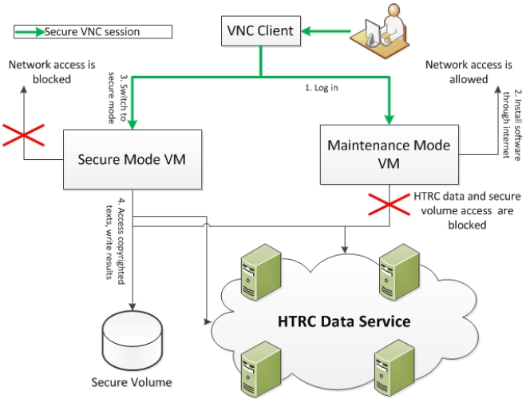
HTRC Data Capsule Access

Slide 11
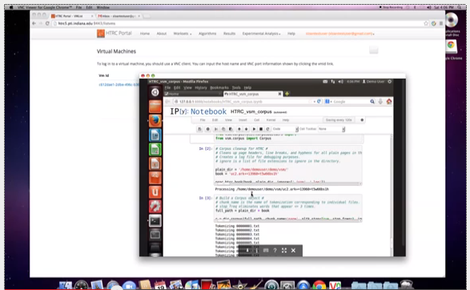
HT Data Capsule: view from researcher’s couch

Slide 12
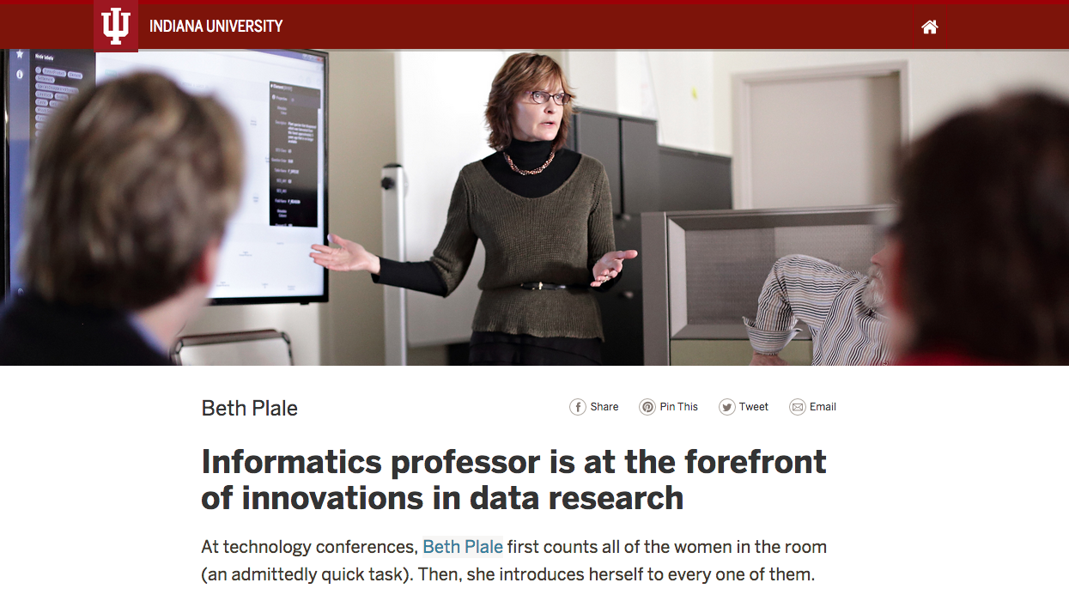
https://herstory.iu.edu/plale-beth.html

Slide 13
Why tell this story and why now?
Full professor at Indiana University, major research university in US
Be inspiration to students who may be facing hurdles of their own to achieving their dreams

