Slide 1
A Multipath Controller for Accelerating GridFTP Transfer over SDN
Che Huang, Chawanat Nakasan, Kohei Ichikawa, Hajimu Iida
Nara Institute of Science and Technology, JAPAN
Notes:
Good morning,everyone.My name is huangche from NAIST.Today i'll talk about A Multipath Controller for Accelerating GridFTP Transfer over SDN.

Slide 2




Background
The large scaleness of data utilisation in scientific research
A platform service for the high-speed large-scale data transfer between sites is necessary
GridFTP
Notes:
scientific research process and store a lot of data.In addition, in international collaborative research today, large-scale data isn’t stored in one site; so,high-speed data transfer between sites is very important.
GridFTP is a popular tool that can transfer a lot of data between sites quickly.

Slide 3
Problem
GridFTP's high-speed transfer
GridFTP supports parallel data transfer scheme by using multiple TCP streams to realize high speed transfer
There are unused paths
GridFTP only use a single shortest
path as per IP Routing
GridFTP
Traffic engineering would allow GridFTP to use multiple paths improving its performance.
Notes:
GridFTP supports parallel data transfer scheme by using multiple TCP streams to realize high speed transfer.
But,GridFTP only use a single shortest path as per IP Routing and it causes limited bandwidth.
And actually there are many unused paths.If we can use traffic engineering to assign the traffic to multiple paths, we could get a better bandwidth in total.

Slide 4
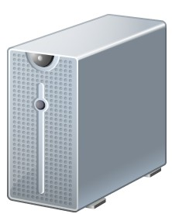
Approach
Parallel GridFTP transfer using SDN
Multipath
OpenFlow
controller
Route request
Route Control
GridFTP
client
GridFTP
server
OpenFlow Switches
Notes:
In our work, we created a multipath OpenFlow controller.
First, when GridFTP client wants to send data, a route request is made to the controller.
The controller would assign the appropriate routes.
The GridFTP's TCP streams would go along different routes.

Slide 5




Test on PRAGMA-ENT
Osaka
Tokyo
OFS(NEC PF5240)
OFS
(NEC PF5240)
NICT
OFS(Pica8
P-3290)
OFS(Pica8
P-3290)
OVS
OFS(Pica8
P-3290)
GridFTP
server
GridFTP
client
OVS
NAIST
OVS
UF
UCSD
OVS
OU
Path 1
Path 2
Path 3
: GRE link; OFS: OpenFlow Switch; OVS: Open vSwitch
Path 4
Notes:
We tested our controller on the PRAGMA-ENT network testbed. When we used the conventional method, only path one in red is used. When we use our controller, all four paths would be used.

Slide 6
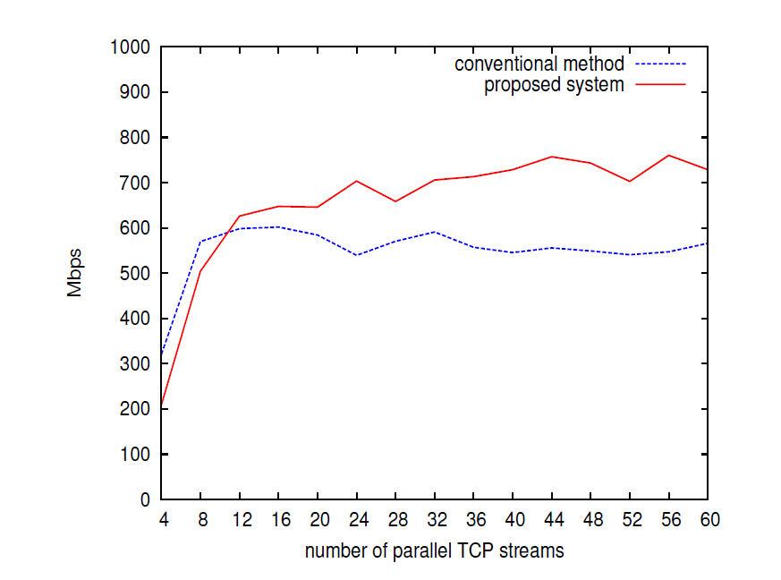
Average Speed of Data Transfer
Notes:
Here is the results of our work.
This graph shows the comparison between our works and conventional method in term of average speed of data transfer.
As we can see, when we increase the number of parallel TCP streams, our proposed method perform better than the traditional one by achieving more available bandwidth.

Slide 7
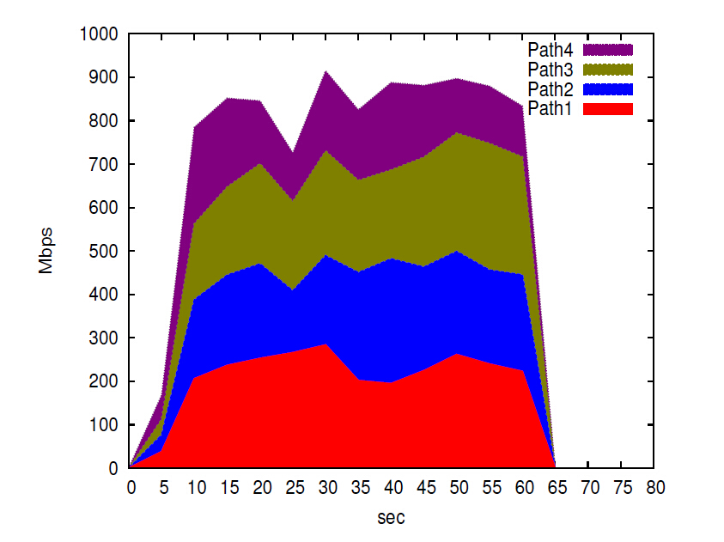
Used Bandwidth of Each Path
Notes:
This graph shows the used bandwith of our work when using 24 parallel TCP streams.
The results show that the bandwidth ketp at around 880Mbps upto 900Mbps.
In addition, traffic is considered to be stable as well.
Our virtual machine host is equipped with a 1Gpbs NIC, so our achieved performance is almost equal to the physical limitation.

Slide 8
Future Work
Implement algorithms to search optimal routes considering bandwidth and latency of each path
Consider a method that calculates the optimal number of parallel TCP streams for each path
Notes:
In future work, we plan to consider bandwidth and latency of the network.
We also plan to assign an optimal number of TCP streams to each path to improve performance.
Thank you very much.

Slide 9
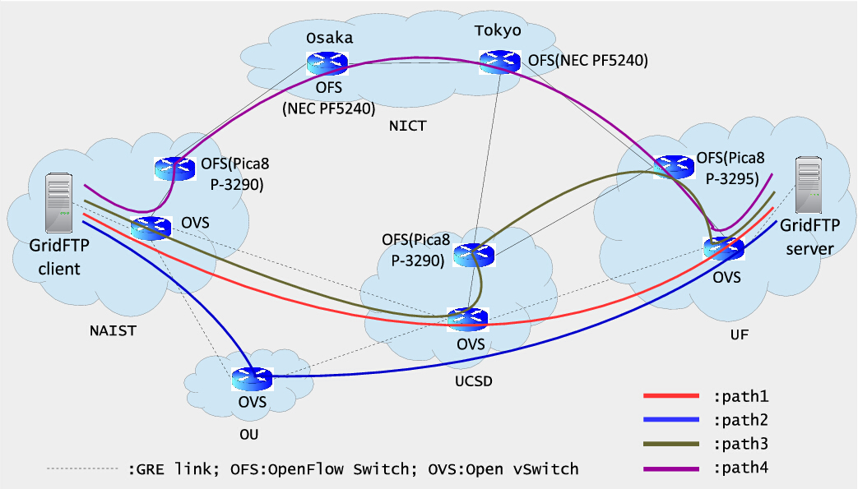
Test on PRAGMA-ENT
Notes:
We tested our controller on the PRAGMA-ENT network testbed. When we used the conventional method, only path one in red is used. When we use our controller, all four paths would be used.

Slide 10



Approach
Parallel GridFTP transfer using SDN
OpenFlow
controller
Assign
Multipath
API
(1) request
available paths
Make Path
API
(4) set flow entries
(3) request different
path for each
TCP stream
(2) search and
secure paths
User
assign_mpath
GridFTP
client
GridFTP
server
XIO
Host A
OpenFlow Switches
Host B
Notes:
In our work, we created a multipath OpenFlow controller.
First, when GridFTP client wants to send data, a route request is made to the controller.
The controller would assign the appropriate routes.
The GridFTP's TCP streams would go along different routes.

Slide 11
Future Work
Osaka
Tokyo
OFS(NEC PF5240)
OFS
(NEC PF5240)
NICT
OFS(Pica8
P-3290)
OFS(Pica8
P-3290)
OVS
OFS(Pica8
P-3290)
GridFTP
server
GridFTP
client
OVS
NAIST
OVS
UF
UCSD
OVS
Path 1 : ~60.7 Mbps 188 ms
OU
Path 2 : ~55.97Mbps 190.8ms
Path 3 : ~60.7Mbps 200ms
Path 4 : ~53.76Mbps 159ms
Notes:
In future work, we plan to consider bandwidth and latency of the network.
We also plan to assign an optimal number of TCP streams to each path to improve performance.
Thank you very much.

Slide 12
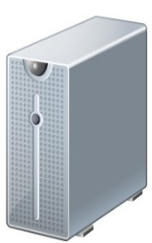
研究目的
SDN技術を用いたトラフィックエンジニアリング
GridFTPが用いる複数TCPストリームによる
並列転送を複数のネットワーク経路に分散
OpenFlow
Controller
GridFTP
経路制御
OpenFlow
Switch
データ転送高速化システムを実現

