Slide 1


Cross-Institute Virtual Cluster Management in PRAGMA
Yuan Luo¹, Shava Smallen ², Nadya Williams², Beth Plale¹, Philip Papadopoulos²
¹School of Informatics and Computing, Indiana University Bloomington
²San Diego Supercomputer Center, University of California San Diego

Slide 2
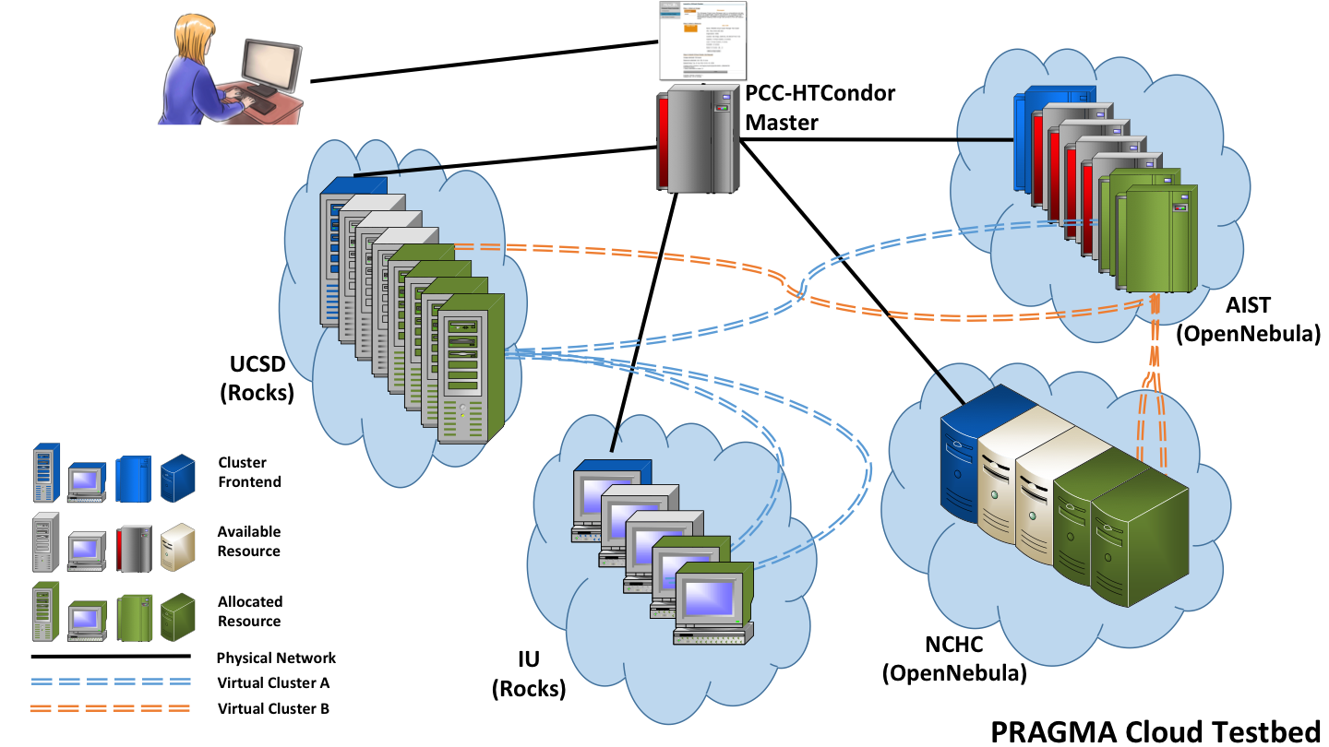


Goals of Personal Cloud Controller (PCC)
Enable lab/group to easily manage application virtual clusters on available resources
Leverage PRAGMA Cloud tools: PRAGMA Bootstrap, IPOP, ViNE, Rocks.
Lightweight, extends HTCondor from U Wisc.
Provide command-line and Web interfaces
Working Group: Resources
Notes:
Diagram – what is a cross-site vc
Why is this useful – LM

Slide 3
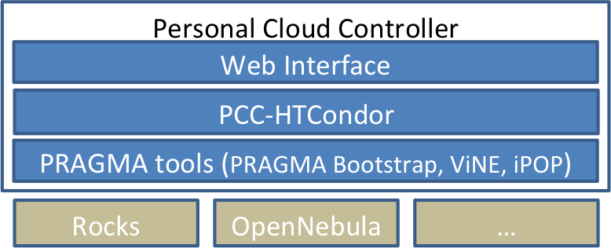
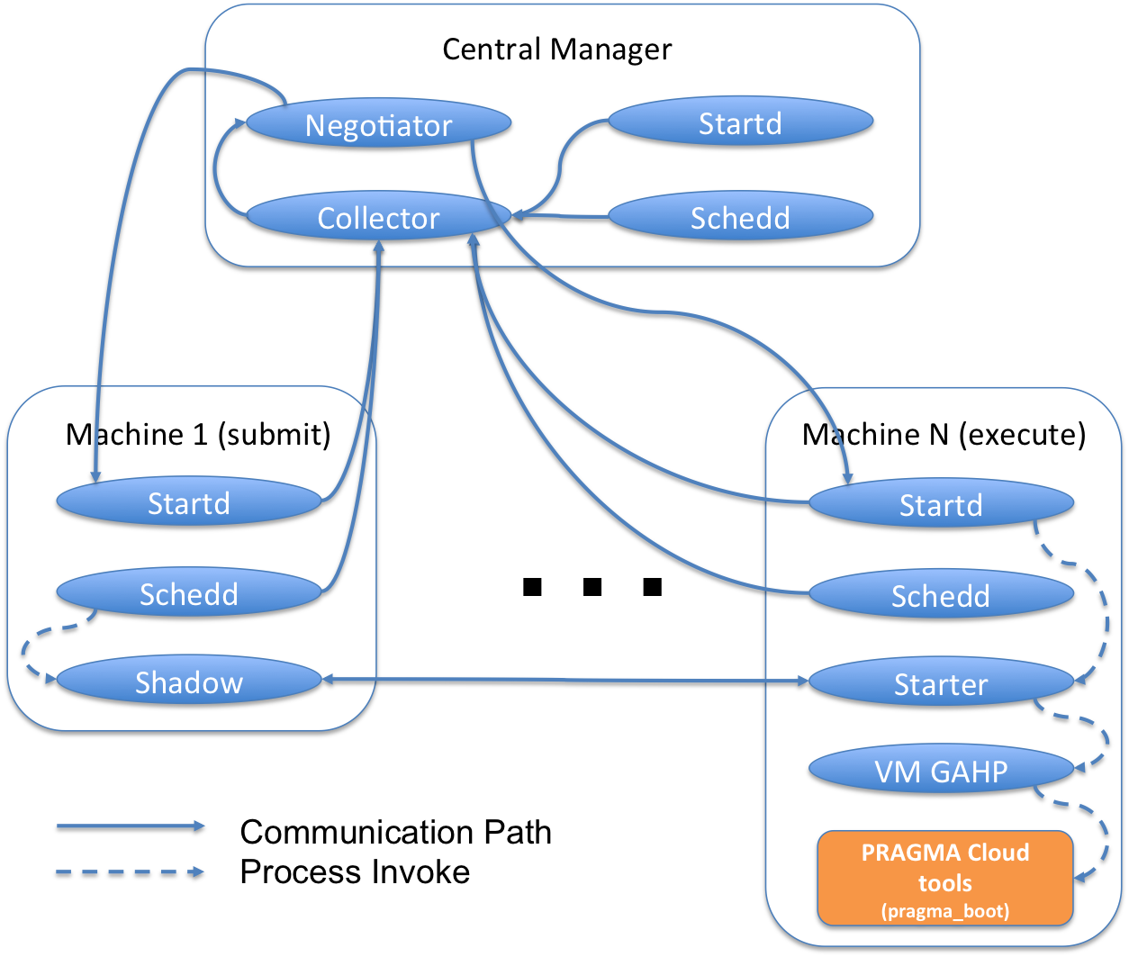
Previous work Demoed single site virtual cluster prototype at PRAGMA 26
High level architecture diagram of PCC
Web interface to launch and view status of virtual cluster
Architecture diagram of PCC-HTCondor

Slide 4
Progress for PRAGMA 27 Cross-institute virtual cluster using IPOP
Accomplished
TODO
Setup Rocks with KVM roll on 3-node cluster at IU
Experimented with IPOP and measured initialization and bandwidth performance between IU and SDSC
Drafted a paper “A Personal Cloud Controller Framework” for submission
Developed new IPOP Rocks roll for easy installation of IPOP to any Rocks virtual cluster
Added automated IPOP server/client initialization to PRAGMA Bootstrap
Enabled multi-site virtual cluster creation via enhanced PCC-HTCondor (VM GAHP) and Condor DAG capabilities
Part-way thru setup of OpenNebula/PRAGMA Bootstrap on 4-node cluster at AIST
Automated reconfiguration of Rocks DB
Debug OneNebula/PRAGMA Bootstrap issues
Integrate changes into Web interface
Rocks rolls for PCC-HTCondor and enhanced PRAGMA Bootstrap
Live application demo with Lifemapper

Slide 5

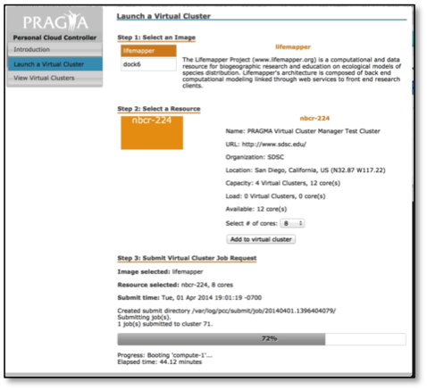

163.220.56.77 (AIST)
(4) Dell PowerEdge M610
(2) Quad-Core 2.4 GHz Intel Xeon
24 GB Memory)
PCC-HTCondor Master
nbcr-224.ucsd.edu
(4) Dell PowerEdge SC1435
v4.8.0
(2) Dual-Core 2.4 GHz AMD Opteron
8 GB Memory)
.5 TB
v6.1
1.25 TB
pragma8.cs.indiana.edu
(3) Dell PowerEdge 6950
(4) Dual-Core 1 GHz AMD Opteron
16 GB Memory)
Cluster Frontend
Allocated Resource
1 TB
v6.1.1
PCC Software
Physical Network
v8.0.6
Virtual Cluster
nbcr-227.ucsd.edu
PRAGMA Bootstrap

Slide 6
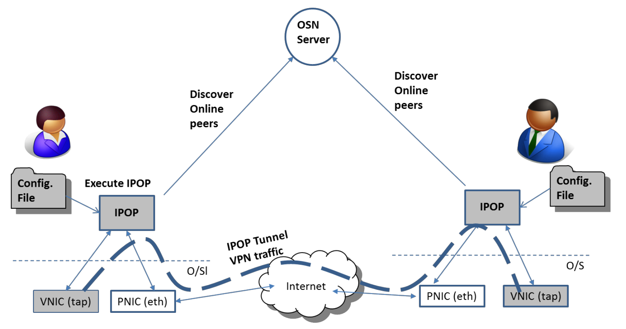
IPOP
Ejabberd Server
Virtual Machine 1
Virtual Machine 2
Image from IPOP White Paper, http://ipop-project.org/wp-content/uploads/2014/07/IPOP-WhitePaper-1407.pdf

Slide 7
PCC Evaluation
We measure overhead of PCC as captured by overhead during the resource provisioning phase and overhead of application running over VPN.
Testbed. Two clusters were selected: one at Indiana University(IU) and the other at the San Diego Supercomputer Center (SDSC).
Table 1. Testbed Specifications
Cluster | Nodes | CPU | Cores | Mem | Ethernet | OS | VMM | Cloud Platform
SDSC | 4 | 2.4GHZ | 4 | 8GB | 1000Base-T | CentOS 6 | KVM | Rocks 6.1
IU | 3 | 2.4GHZ | 8 | 16GB | 1000Base-T | CentOS 6 | KVM | Rocks 6.1

Slide 8
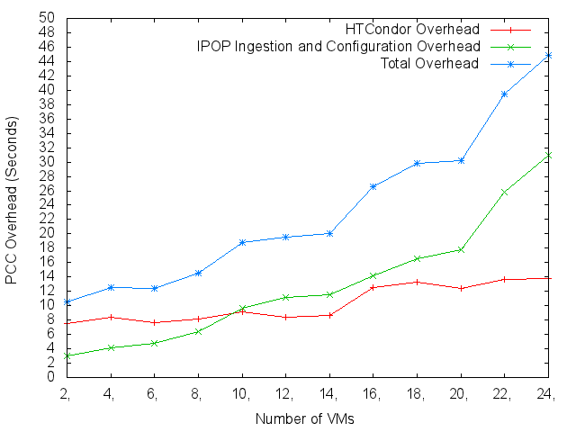
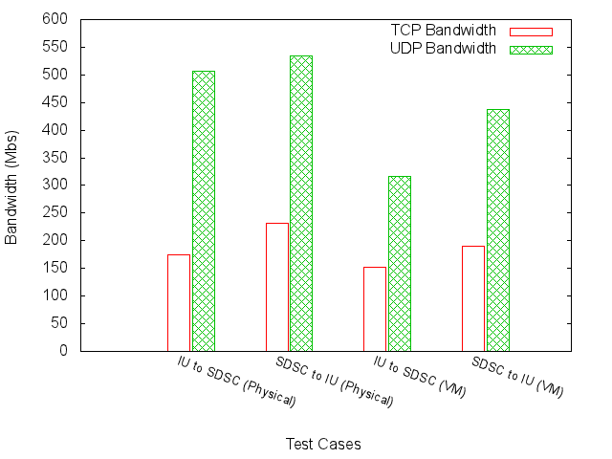
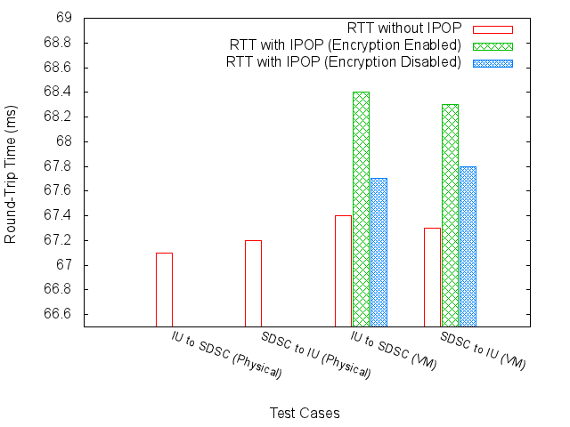
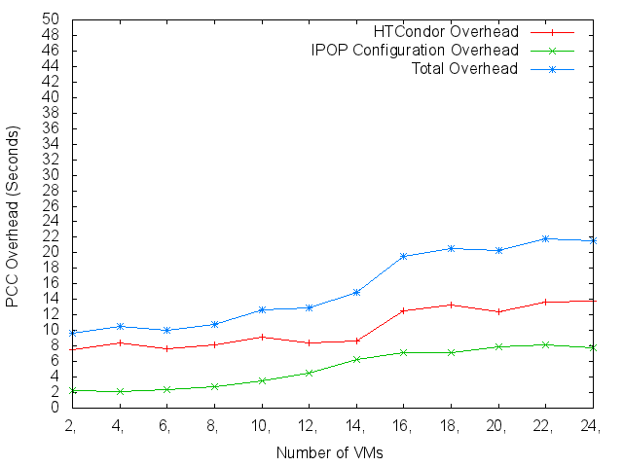
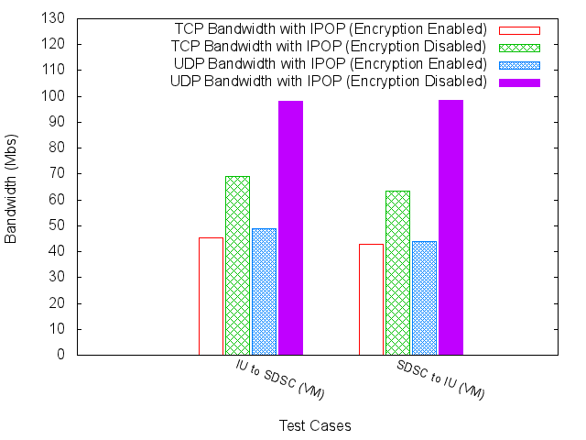
PCC Evaluation – cont’d
PCC Overhead Evaluation
Network Overhead Evaluation

Slide 9



IPOP Rocks Roll
https://github.com/pragmagrid/ipop
v17.0
v14.07
v14.07
File | IPOP Server | IPOP Client | Purpose
/opt/ipop/ejabberd/bin/initEjabberd | X |  | (Re-)initializes Ejabberd for IPOP usage and produces ipopserver.info file.
/etc/init.d/ejabberd | X |  | Optionally initializes (via initEjabberd) and then starts Ejabberd
/var/www/html/ipop/ip.php | X |  | Distributes unique IP addresses to IPOP clients
/opt/ipop/bin/updateConfJson | X | X | Populates IPOP config.json file with ipopserver.info contents
/etc/init.d/ipop | X | X | Optionally initializes then starts IPOP
Many thanks to Nadya Williams!!

Slide 10
IPOP-enabled PRAGMA Bootstrap
PRAGMA Bootstrap
IPOP Enhancements
Instantiates dynip-enabled virtual clusters within a single cluster
Utilizes “drivers” to support multiple cloud platforms (current support for Rocks and OpenNebula)
Allocates IP addresses, installs vc-out.xml (for dynip), and boots VMs
--enable-ipop-server=<URL>
Starts up IPOP-enabled virtual cluster with the frontend serving as the IPOP server; fetches IPOP server info once initialization is complete
--enable-ipop-client=<URL>
Start up the IPOP-enabled virtual cluster as an IPOP client (to another virtual cluster).

Slide 11
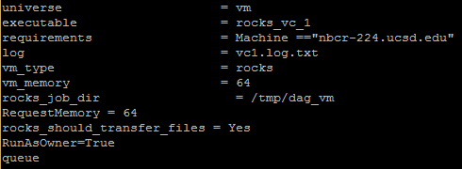
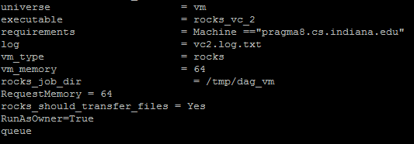

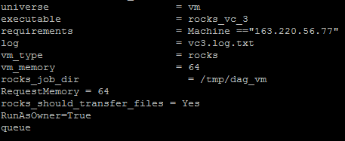
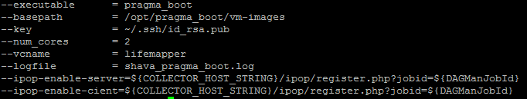

Enhanced PCC-HTCondor (Leveraged HTCondor DAG capabilities to create multi-site virtual cluster)
HTCondor DAG
VC configuration file
Parallel pragma_boot jobs

Slide 12
Instantiated virtual cluster
asccmp077
.hpcc.jp
nbcr-225
ucsd.edu
pragma-f0
cs.indiana.edu
pragma-f0
cs.indiana.edu
public
172.228.41.6
172.228.41.254
ipop
172.228.41.2
172.228.41.3
172.228.41.5
172.228.41.1
172.228.41.4
Compute-0
Compute-1
Compute-2
Compute-0
Compute-1
private

Slide 13
Demo: View Ejabberd interface

Slide 15

Future Work
Near-term goals
Longer-term goals
Oct-Dec
Automated reconfiguration of Rocks DB
Integrate changes into Web interface
Rocks rolls for PCC-HTCondor and enhanced PRAGMA Bootstrap
Live application demo with Lifemapper
Jan – April
Work with Aimee to develop load model for LM
Develop PCC auto-sizing capabilities
Improve resource allocation algorithms.
Enable resource to application information sharing.
Extend the Hierarchical MapReduce model to support distributed sensitive data processing.
Schedule application jobs based on VC topologies, and VM provenance.

