Slide 1


Wide-Area Distributed Storage Acceleration using MPTCP
Chawanat Nakasan, NAIST Lightning Talk @ PRAGMA 26 Tainan, Taiwan

Slide 2
Distributed Storage doesn’t function well when distributed over wide area.
Storage node
Intermediate network
(routers, switches, etc)
Only one route is used at a time
(per high-level connection)*
Storage node
Perfectly fine but unused route
* Of course it depends on other configuration as well

Slide 3
Unequal links in WAN prevents use of low-layer load balancing …
Packet 2
fast route
Packet 1
slow route

Slide 4
… due to problems like packet ordering.
fast route
Packet 2
Packet 1
slow route
There are other problems too.

Slide 5
We plan to use SDN to create an overlay network.
Overlay Network
Physical Network

Slide 6
Then, use MPTCP to span the data transfer to multiple routes.
Packet 2
Packet 1
Packet 2
Packet 1

Slide 7
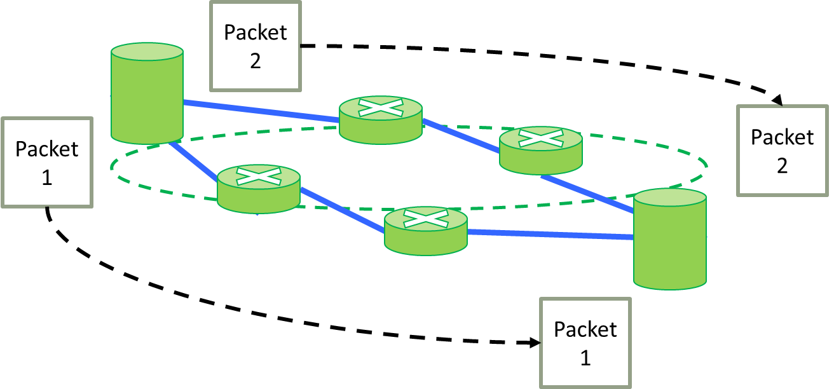
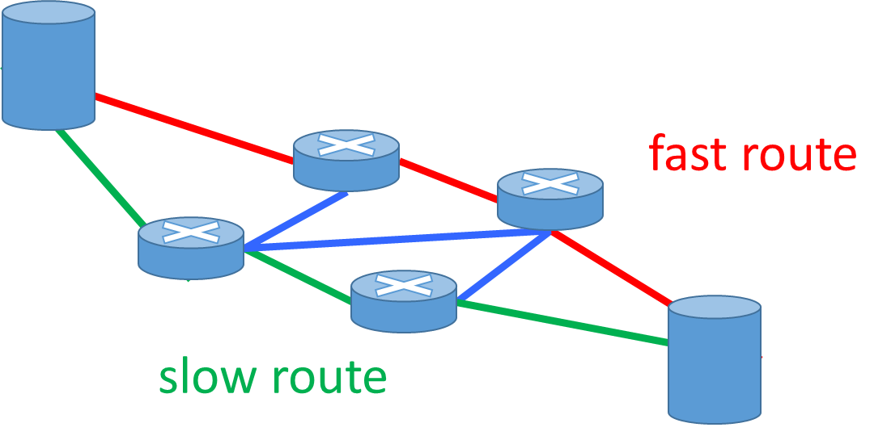
We expect:
that in the end, MPTCP can increase data rate
that we can use more routes thanks to SDN

Slide 8
and:
that we shouldn’t have to modify anything else too much.
Especially the Application.
Application
MPTCP
Transport
TCP Subflow
TCP Subflow
TCP Subflow
SDN
Network
Data Link

Slide 9
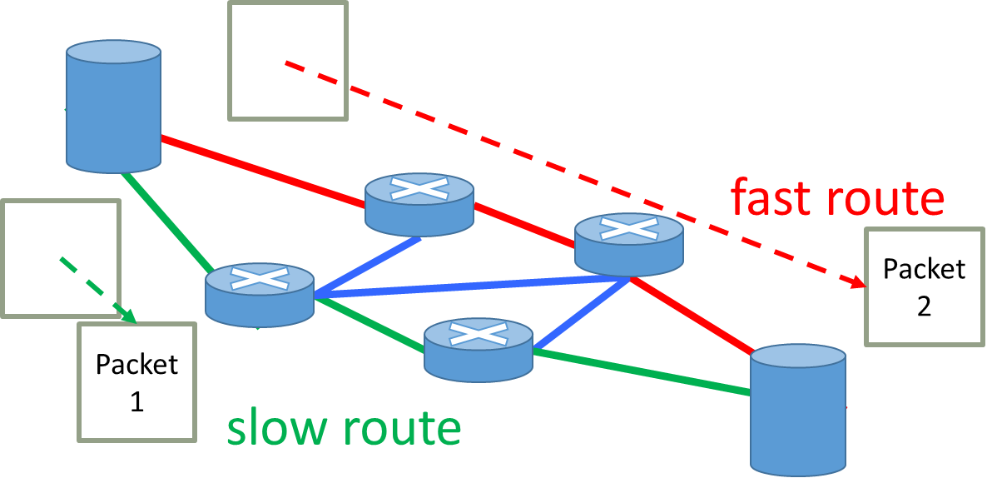
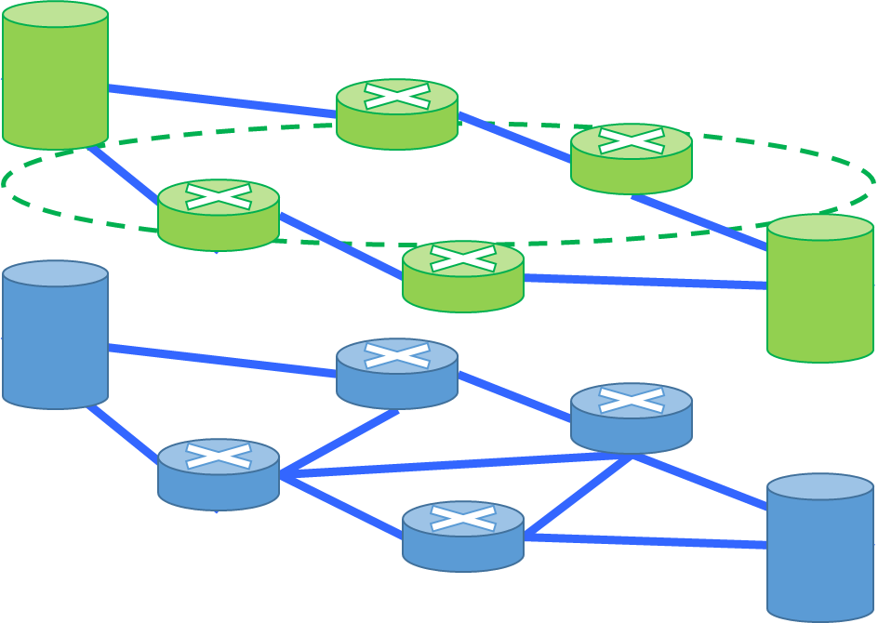
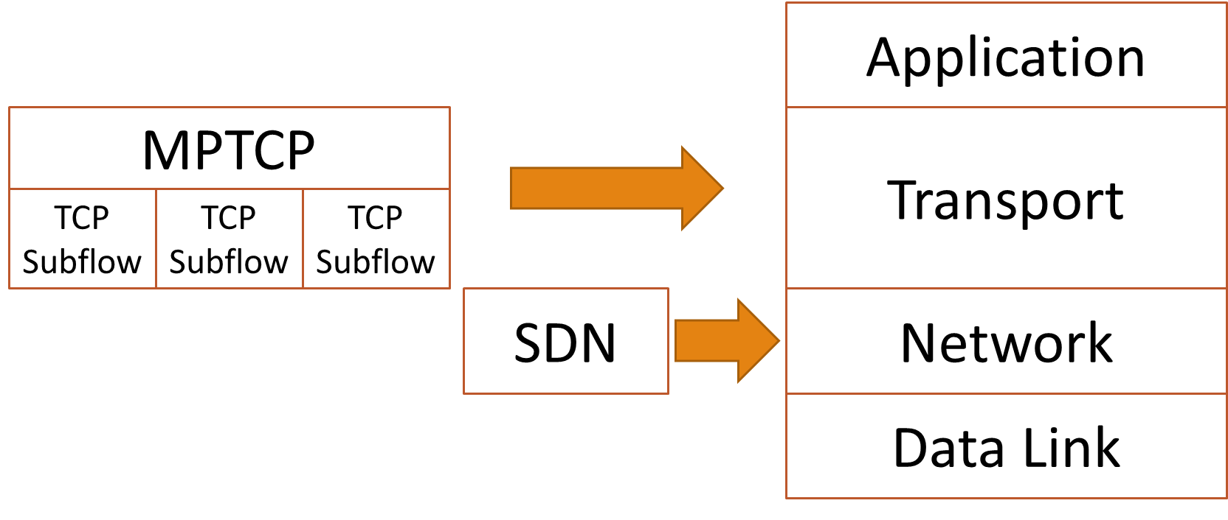

Slide 10
Some challenges for MPTCP
* Availability
Very new, and few public implementations (iOS7)
MPTCP is not in Mainline Linux yet.
* Memory constraints
TCP requires memory to maintain connection state and transfer window
* Application-layer fine-tuning
Can applications get better performance if they manage MPTCP directly?(even if Transport is a layer separate from Application)

Slide 11
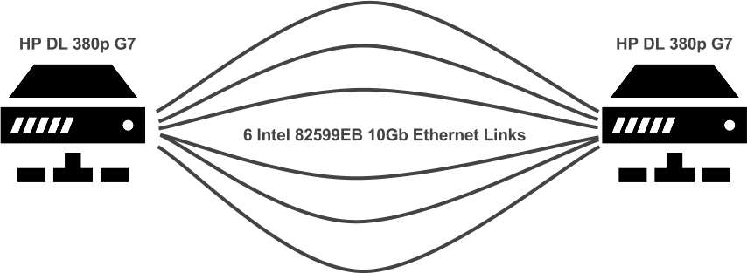
Insanely fast data rate (not my work, link here)
http://multipath-tcp.org/pmwiki.php?n=Main.50Gbps
10Gbps Ethernet x 6 links => 51 Gbps

