Slide 1
Ceph Distributed File System: Simulating a Site Failure
Mohd Bazli Ab Karim, Ming-Tat Wong, Jing-Yuan Luke
Advanced Computing Lab
MIMOS Berhad, Malaysia
emails: {bazli.abkarim, mt.wong, jyluke} @mimos.my
In PRAGMA 26, Tainan, Taiwan
9-11 April 2014

Slide 2
Outline
Motivation
Problems
Solution
Demo
Moving forward

Slide 3
Motivations
Explosion of both structured and unstructured data in cloud computing as well as in traditional datacenters presents a challenge for existing storage solution from cost, redundancy, availability, scalability, performance, policy, etc.
Our motivation thus focus leveraging on commodity hardware/storage and networking to create a highly available storage infrastructure to support future cloud computing deployment in a Wide Area Network, multi-sites/multi-datacenters environment.

Slide 4
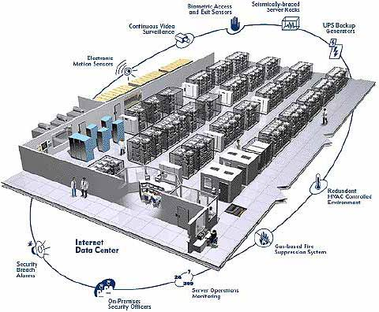

Problems
Restore
R/W
SAN/NAS
Replication/De-duplication
R/W
Disaster Recovery Site(s)
Backup
☞ Performance
SAN/NAS
☞ Redundancy
☞ Availability/Reliability
Data Center

Slide 5
Solution
R/W
SAN/NAS
One/Multiple Virtual Volume(s)
Disaster Recovery Site(s)
Data Striping and Parallel R/W
SAN/NAS
Local/DAS
Local/DAS
...
Local/DAS
Data Center
Data Center 1
Data Center 2
Data Center n
Replications

Slide 6
Challenging the CRUSH algorithm
CRUSH – Controlled, Scalable, Decentralized Placement of Replicated Data
It is an algorithm to determine how to store and retrieve data by computing data storage locations.
Why?
To use the algorithm to organize and distribute the data to different datacenters.
Notes:
What we needed to do in order to fulfill the Solutions...

Slide 7
CRUSH Map
IF LARGE SCALE, WE NEED A CUSTOM CRUSH MAP
root
Bucket
datacenter
Bucket
datacenter
Bucket
datacenter
Bucket
ENSURE DATA SAFETY
host
Bucket
host
Bucket
host
Bucket
host
Bucket
host
Bucket
host
Bucket
OBJECT A
Replica B
host
Bucket
host
Bucket
osd.0
Bucket
Replica D
Replica A
osd.7
Bucket
OBJECT B
Replica C
osd.1
Bucket
osd.6
Bucket
osd.2
Bucket
osd.5
Bucket
osd.3
Bucket
osd.4
Bucket
DEFAULT SANDBOX ENVIRONMENT
host
Bucket
host
Bucket
host
Bucket
host
Bucket
Replica C
OBJECT D
Replica A
OBJECT C
Replica B
Replica D
osd.8
Bucket
osd.9
Bucket
osd.10
Bucket
osd.11
Bucket
Replications

Slide 8
CRUSH Map - default
root@poc-tpm1-mon1:~/ceph-deploy# ceph osd tree # id weight type name up/down reweight -1 2.12 root default -2 0.23 host poc-tpm1-osd1 0 0.23 osd.0 up 1 -3 0.23 host poc-tpm1-osd2 1 0.23 osd.1 up 1 -4 0.23 host poc-tpm1-osd3 2 0.23 osd.2 up 1 -5 0.23 host poc-tpm1-osd4 3 0.23 osd.3 up 1 -6 0.06999 host poc-tpm2-osd1 4 0.06999 osd.4 up 1 -7 0.06999 host poc-tpm2-osd2 5 0.06999 osd.5 up 1 -8 0.06999 host poc-tpm2-osd3 6 0.06999 osd.6 up 1 -9 0.06999 host poc-tpm2-osd4 7 0.06999 osd.7 up 1 -10 0.23 host poc-khtp-osd1 8 0.23 osd.8 up 1 -11 0.23 host poc-khtp-osd2 9 0.23 osd.9 up 1 -12 0.23 host poc-khtp-osd3 10 0.23 osd.10 up 1 -13 0.23 host poc-khtp-osd4 11 0.23 osd.11 up 1

Slide 9
CRUSH Map Rules - default
# rules
rule data {
ruleset 0
type replicated
min_size 1
max_size 10
step take default
step chooseleaf firstn 0 type host
step emit
}
rule metadata {
ruleset 1
type replicated
min_size 1
max_size 10
step take default
step chooseleaf firstn 0 type host
step emit
}
Pick one leaf node
of type host

Slide 10
CRUSH Map - New
root@poc-tpm1-mon1:~/ceph-deploy# ceph osd tree # id weight type name up/down reweight -1 2.12 root default -23 0.92 datacenter tpm1 -2 0.23 host poc-tpm1-osd1 0 0.23 osd.0 up 1 -3 0.23 host poc-tpm1-osd2 1 0.23 osd.1 up 1 -4 0.23 host poc-tpm1-osd3 2 0.23 osd.2 up 1 -5 0.23 host poc-tpm1-osd4 3 0.23 osd.3 up 1 -24 0.28 datacenter tpm2 -6 0.06999 host poc-tpm2-osd1 4 0.06999 osd.4 up 1 -7 0.06999 host poc-tpm2-osd2 5 0.06999 osd.5 up 1 -8 0.06999 host poc-tpm2-osd3 6 0.06999 osd.6 up 1 -9 0.06999 host poc-tpm2-osd4 7 0.06999 osd.7 up 1 -25 0.92 datacenter khtp1 -10 0.23 host poc-khtp-osd1 8 0.23 osd.8 up 1 -11 0.23 host poc-khtp-osd2 9 0.23 osd.9 up 1 -12 0.23 host poc-khtp-osd3 10 0.23 osd.10 up 1 -13 0.23 host poc-khtp-osd4 11 0.23 osd.11 up 1

Slide 11
CRUSH Map Rules – New
# rules
rule data {
ruleset 0
type replicated
min_size 2
max_size 10
step take default
step chooseleaf firstn 0 type datacenter
step emit
}
rule metadata {
ruleset 1
type replicated
min_size 2
max_size 10
step take default
step chooseleaf firstn 0 type datacenter
step emit
}
Pick one leaf node
of type datacenter

Slide 12
DEMO

Slide 13
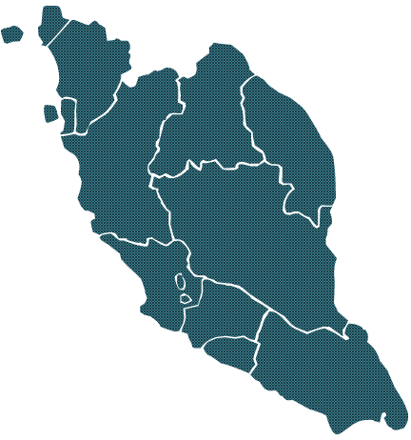




Demo Background
It was first started as a proof of concept for Ceph as a DFS over wide area network.
Two sites had been identified to host the storage servers – MIMOS HQ and MIMOS Kulim
Collaboration work between MIMOS and SGI.
In PRAGMA 26, we will use this Ceph POC setup to demonstrate a site failure of a geo-replication distributed file system over wide area network.
DC3
Mimos Berhad
Kulim Hi-Tech Park
350 KM
WAN
DC1
DC2
Mimos Berhad
Technology Park Malaysia, Kuala Lumpur
Notes:
Baz/MT/Jo to ssh to 172.16.1.2 (Zone 1 Switch) from 10.4.112.1
Commands:
oper
port 21
dis
cur
...wait...
ena
cur

Slide 14
This Demo…
DC3
Mimos Berhad
Kulim Hi-Tech Park
Demo:
Simulate node/site failure while doing read write ops.
Test Plan:
From DC1, continuously ping servers in Kulim.
Upload 500Mb file to the file system.
While uploading, take down nodes in Kulim. From (a), check if nodes are down.
Upload completed, download the same file.
While downloading, bring up the nodes in Kulim.
Checksum both files. Both should be same.
350 KM
WAN
DC1
DC2
Mimos Berhad
Technology Park Malaysia, Kuala Lumpur
Notes:
Baz/MT/Jo to ssh to 172.16.1.2 (Zone 1 Switch) from 10.4.112.1
Commands:
oper
port 21
dis
cur
...wait...
ena
cur

Slide 15
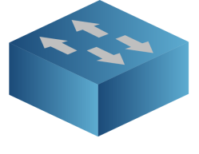




Demo in progress…
Datacenter 3 @ MIMOS KULIM
mon-03
osd03-1
osd03-2
Edge switch
osd03-3
Core switch
osd03-4
We will go HERE to disconnect the ports
WAN
Core switch
Datacenter 2 @ MIMOS HQ
Client
10.11.21.16
Edge switch
Edge switch
mon-01
osd01-1
mon-02
osd01-2
We will ping Kulim hosts HERE!
osd02-1
osd01-3
Owncloud sits HERE!
osd02-2
osd01-4
osd02-3
osd02-4
client
Client
10.4.133.20
Datacenter 1 @ MIMOS HQ

Slide 16
Moving forward…
Challenges during POC which running on top of our production network infrastructure.
Next, can we set up the distributed storage system with virtual machines plus SDN?
Simulate DFS performance over WAN in a virtualized environment.
Fine-tuning and run experiments: Client’s file-layout, TCP parameters for the network, routing, bandwidth size/throughput, multiple VLANs etc.
Notes:
Using CRUSH map to organize data placement is not enough. We need to consider many other factors like, the file layout, tcp buffer, best route path, bandwidth size and throughput and others.

