Slide 1
PRAGMA Resources Group Updates
Philip Papadopoulos (Interim Working Group Lead)
Reporting on SIGNIFICANT WORK by a LARGE Cast of Researchers

Slide 2
Personnel Changes
Cindy Zheng Retired ~1 year ago → Philip Papadopoulos “promoted” to working group co-chair
Yoshio Tanaka has taken a new position at AIST that makes travel to PRAGMA meetings nearly impossible for the next 2 years → Yoshio “promoted” to ex-officio chair. Phil “promoted again” to working group chair
So, We’re looking for a some able, hardworking people to take on significant leadership roles in the Resources working group.

Slide 3
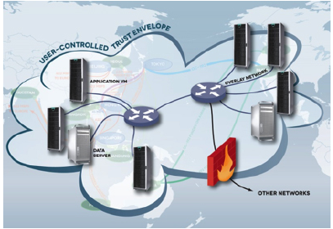
Distributed Clouds with Trusted Envelopes enabled by Overlay Networks
Virtualization to enable complex software deployment at multiple physical sites
Overlay networks to create a trusted environment to share resources
Controlled access to data to support data sharing

Slide 4
PRAGMA ENT (Experimental Networking Testbed)
Formulated at PRAGMA 25
Co-Leads: Mauricio Tsugawa, University of Florida, Kohei Ichikawa, Nara Institute of Science and Technology
Part of 1st working group session dedicated to moving this forward to the next step.

Slide 5
Significant Activities in Resources Working group (one-line summaries)
Improvements to PRAGMA bootstrap: distribute images via Amazon Cloud Front to port virtual clusters to different sites (Pong* (NAIST) and Luca (UCSD))
Revision 0 of a personal cloud controller (PCC) using pragma_bootstrap and HTC condor. Web interface to simplify use (Yuan* (Indiana) and Shava (UCSD)
First heartbeats of PRAGMA-ENT Openflow Testbed (Kohei (NAIST), Mauricio (U Florida), Pong (NAIST), Luca (UCSD), Many others actively participating
Virtualization of Lifemapper Server, Database, Web Interface (Aimee (Kansas) and Nadya (UCSD) (Biodiversity Expedition)
IPOP overlay networking with Windows (Renato (U Florida), Paul (Wisc) (Lake Ecology Expedition)
* Graduate students

Slide 6

Pragma Bootstrap
Virtual Cluster Images Standard
Deployment mechanism
Virtual Cluster Image
Frontend
Image.gz
Compute
Image.gz
vc-in.xml
Automatically deploy and bootstrap PRAGMA compliant virtual clusters
Available at: https://github.com/pragmagrid/pragma_boot
Plugins architecture (to support more platforms)

Slide 7
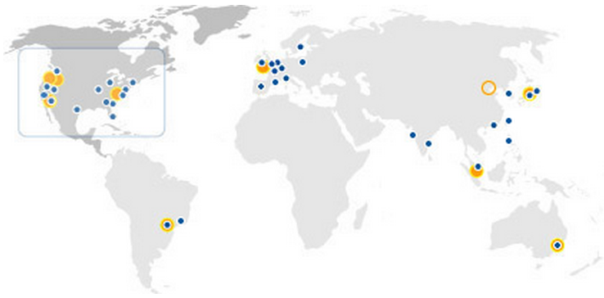

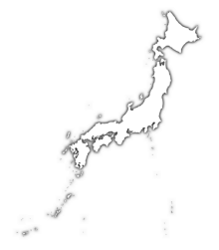
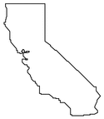


Pragma Bootstrap
S3 bucket
GET /abs/disk1.vda
GET /abs/disk1.vda
GET /abs/disk1.vda
pragma_boot
pragma_boot
Disk images are delivered by local Cloud Front Edge servers

Slide 8


Personal Cloud Controller (PCC) (Yuan Luo, Shava Smallen, Beth Plale, Philip Papadopoulos)
Goals:
Enable lab/group to easily manage application virtual clusters on available resources
Leverage PRAGMA Cloud tools: pragma_bootstrap, IPOP, ViNE.
Lightweight, extends HTCondor from U Wisc.
Provide command-line and Web interfaces
Working Group: Resources

Slide 9
Personal Cloud Controller (PCC) - cont.
Current status
Start and monitor virtual cluster using pragma_bootstrap via HTCondor (VM GAHP)
Web interface prototype (PHP)
Near-term goals
Add increased controllability and robustness (April – June)
Multi-site clusters (July – Sept)
Personal Cloud Controller
Web Interface
HTCondor+PCC
PRAGMA tools (pragma_boot, ViNE, iPOP)
Rocks
OpenNebula
…
Longer-term goals
Data-aware scheduling
Fault tolerance
Provenance

Slide 10
Central Manager
HTCondor-PCC Architecture
Negotiator
Startd
Collector
Schedd
Machine 1 (submit)
…
Machine N (execute)
Startd
Startd
Schedd
Schedd
Shadow
Starter
VM GAHP
Communication Path
Process Invoke
PRAGMA Cloud tools
(pragma_boot)

Slide 11
PRAGMA-ENT Goals
Build a breakable international SDN testbed for use by PRAGMA researchers
Provide access to SDN hardware/software to PRAGMA researchers
Integrate with overlay networks (e.g., ViNe)

Slide 12
PRAGMA-ENT Progress
Established in PRAGMA-25 (Oct-2013)
Collaboration using pragma-ent@googlegroups.com
If interested, please send join requests to tsugawa@acis.ufl.edu
20 members
10 Institutions
Support from Internet2, KDDI, NICT, FLR
First group meeting: SC’13 (Nov-2013)
Monthly conference calls ever since
Presence at Internet2 2014 Global Summit (Denver, Apr 06-11)
Jim Williams (IU/Internet2)
Chris Griffin (UF/FLR)
Jin Tanaka (KDDI)

Slide 13
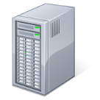
Connecting US and NCHC into the RISE Switch in LA + Multipath between JP and US
NCHC
LA
Internet2/Pwave
UF
RISE
Internet2
TP3
Pwave
AIST
UCSD
NAIST
OsakaU
RISE’s OFS
Local OFS
L2 Switch
Native OF
OF over L2VPN

Slide 14

Data Challenges
Scalability
meet tomorrow’s needs as oppose to only today’s
Data transfer
Need centralized/unified file transfer
Allow multiple users and sites to setup simple or complex file transfers
Have tools for file transfer jobs
Data storage
Administration
Data management operations: snapshots, replication, cloning
Sharing
Performance tuning
Availability
build &customize
manage & monitor
audit
Data quality & new data integration
Local storage
Notes:
To address the scalability need to deal with Data storage and Data transfers areas

Slide 15
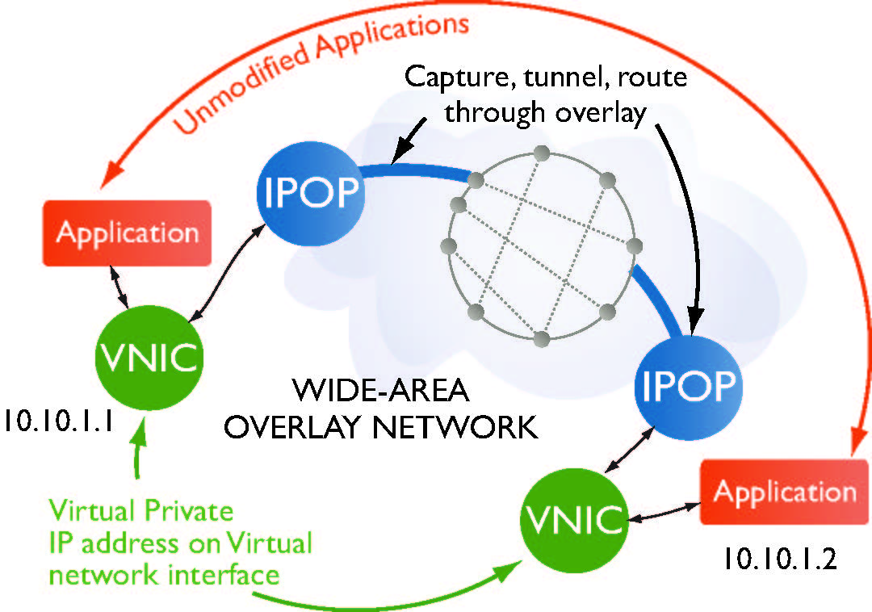
Goals
Enhancements to the IPOP codebase
Improved functionality
Use of standards (XMPP, ICE, STUN, TURN)
Support for additional devices (Android; OpenWRT)
IPv6 support
Demonstrate applicability of overlay
Support of collaborative computing environments (HTCondor) for lake ecology modeling

Slide 16
Architecture
Unmodified applications
Connect(10.10.1.2,80)
Capture, encapsulate,
tunnel over P2P links; NAT
traversal
Application
IPOP
IPOP
TinCan
Links
VNIC
10.10.1.1
Discover,
notify
peers
IPOP
Application
Isolated,
private virtual
address space
Online
Social
Network
(XMPP)
VNIC
10.10.1.2
Notes:
This illustrates the points made in the previous slide. The virtual router is where IPOP resides; applications are unmodified, and we reuse existing VNICs.

Slide 17
Progress – IPOP overlay
Major code redesign
Decoupled architecture:
TinCan links - datapath
End-to-end private tunnel links with NAT traversal
C/C++; reuses libjingle, XMPP, STUN, TURN
VPN controllers – GroupVPN and SocialVPN
Setup TinCan links (on-demand, proactively)
Configure virtual IP addresses
JSON/RPC API ; Python, or other languages

Slide 18
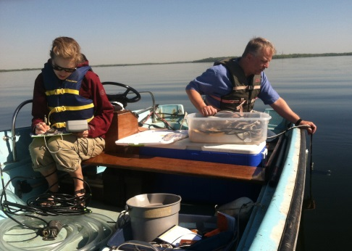
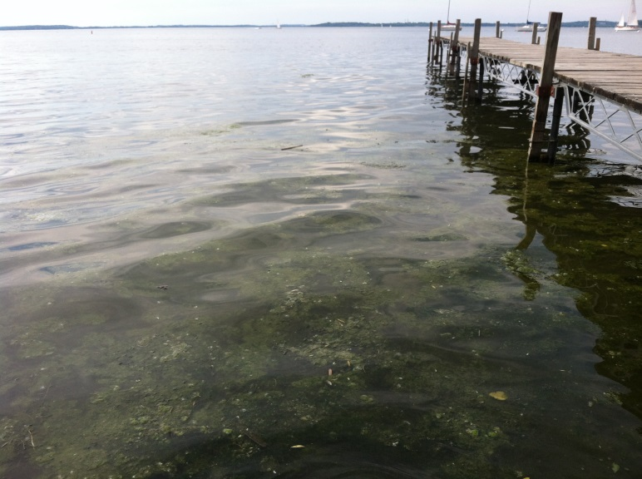
Accomplishments
Deployment of IPOP overlay network – PRAGMA lake expedition
Cross-institution HTCondor pools
U. Florida, U. Wisconsin, Virginia Tech
Desktops, servers; virtual and physical
Ability to grow to tap additional resources
VMs at these (and other institutions)
Including commercial clouds

Slide 19
Relevance
IPOP is a low-barrier overlay technology that can be used to create “trust envelopes” for PRAGMA collaborations
Open-source software available for all PRAGMA partners

