Slide 1
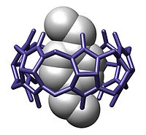
A Linked Data based Approach to Carbohydrate Complexation
Yinling An,
Karpjoo Jeong
Department of Advanced Technology Fusion
Daham Jeong,
Seunho Jung
Department of Bioscience and Biotechnology
Konkuk University

Slide 2
Contents
Background
Our Goal
Existing Carbohydrate & Chemical Databases
System Design
System Implementation

Slide 3
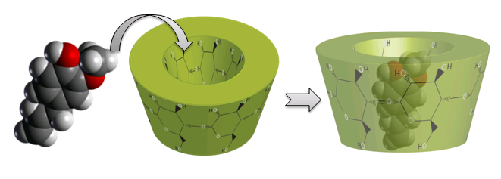
Carbohydrate Complexation
Complexation
A chemical process where a host molecule and a guest molecule recognize each other, interact with each other, and form a complex by non-covalent bonding
Guest
(drug,harmful molecule)
Host
(carbohydrate)
Host-Guest Complexation
Notes:
정의: 교수님께서 정의한것

Slide 4
Major Applications
Improve solubility of substances
Remove hazardous molecules
Stabilize of light or oxygen-sensitive substances
Modify of the chemical reactivity of guest molecules
Modify of liquid substances
Mask of ill smell and taste
Notes:
Application -> 동사 시작

Slide 5
Challenging Issues
Guest: a large number of molecules
Ex: PubChem (https://pubchem.ncbi.nlm.nih.gov/). Contains 54 million compound entries
Host(carbohydrate): complicated, dynamic and modifiable structures
Potentially, a number of new variants
A single complexation experiment takes a few days, but finding effective hosts requires the comparative evaluation of many complexation experiments

Slide 6
Our Goal
Build carbohydrate based host-guest complexation database
Recommend candidate hosts for a specific guest
Study common patterns in previous complexation results
Structure based
Property based
Notes:
위에건: cabohydrate based complexation data for the user
Help - >
결과 / 행위

Slide 7
Current Carbohydrate & Chemical Databases
Carbohydrate Databases
Chemical Databases
BCSDB
ChemSpider
MonosaccharideDB
GlycomeDB
KEGG Compound
CFG
ChEBI
KEGG Glycan
ChEMBL
JCGGDB
PubChem
UniCarbKB
Transfer
Transfer
RDF
Developed standard
ontology: GlycoRDF
RDF
Notes:
위에건: cabohydrate based complexation data for the user
Help - >
결과 / 행위

Slide 8
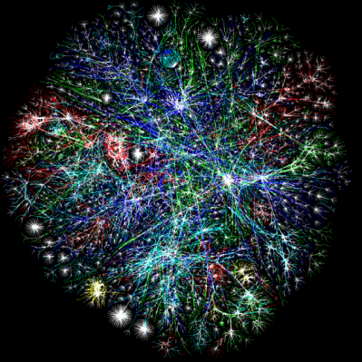
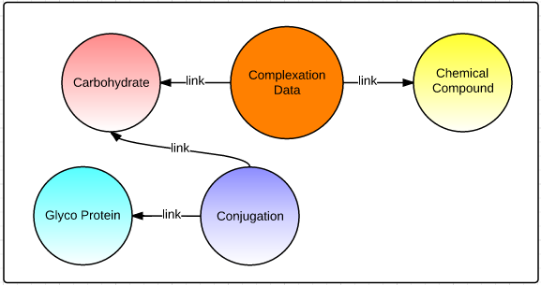
Approach – Linked Data
Linked Data
Connect distributed data across the web
Machine readable data
Notes:
Linked data: 데이터들을 연결
Carbohydrate in protein 점검 받다
- Bio RDF.

Slide 9
Carbohydrate Complexation Database
Host DB
Data from PubChem - Property info - Structure info
Links to Monosaccharide DB
GlycoRDF Data Model
Guest DB
Data from PubChem - Property info - Structure info
Monosaccharide DB
Structure info - GlycoRDF Monosaccharide Data Model
Complexation DB
Data from experiments and publication - Experimental info - Binding result info

Slide 10
Host Recommendation
Guest structure-based similarity search
Steps
1. Compare the structure between the guests and the specific molecule
2. Get hosts complex with all similar structure guests
Structure comparation using Tanimoto Coefficient
The most popular similarity measure for comparing chemical structures represented by means of fingerprints
Notes:
알고리즘

Slide 11
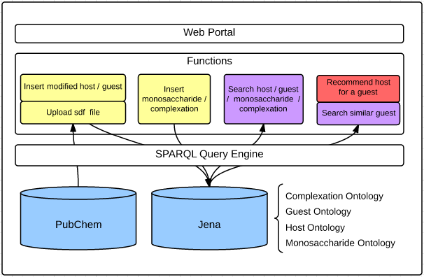
System Design
Notes:
Similar guest spelling correct
Create host / guest
Modify host / guest
Query engine - > Sparql query engine
Function - > service
Web & application - > web portal

Slide 12
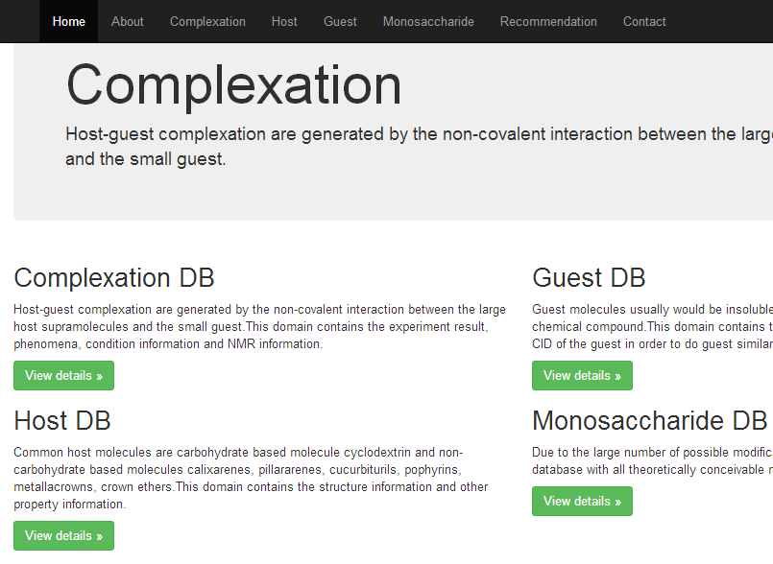
Implementation: Web Portal

Slide 13
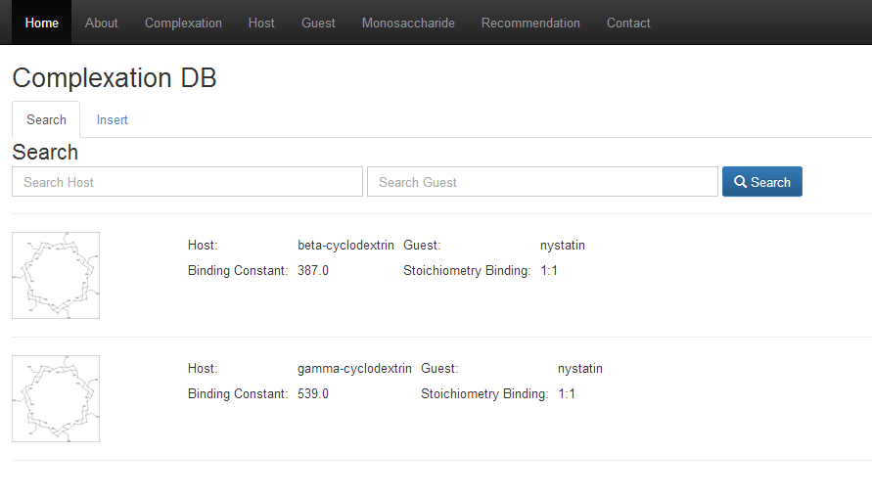
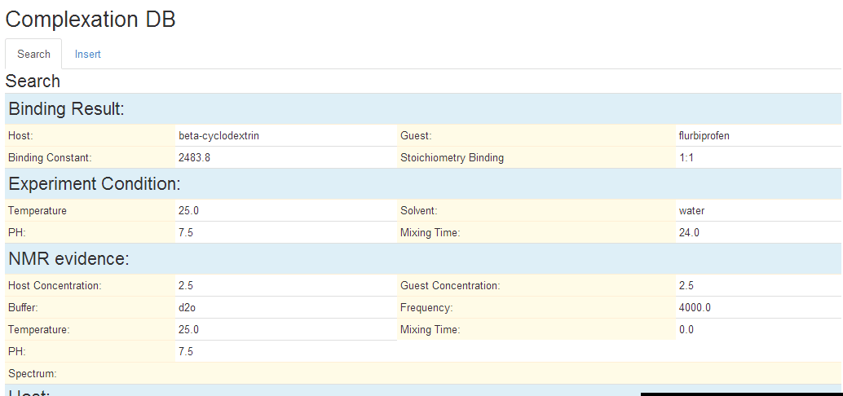

Search Complexation

Slide 14
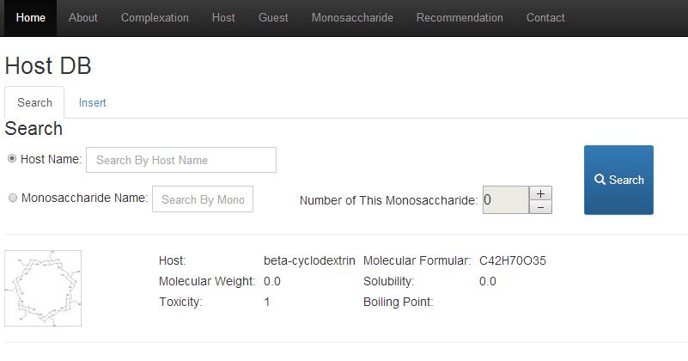
Search Host

Slide 15
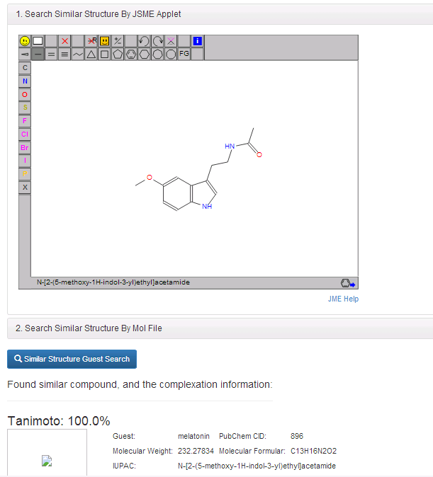
Recommendation By Guest Structure-based Similarity Search

Slide 16
Development Environment
Database
Jena Triple Storage
Required Tool
Checkmol/Matchmol
Mol2ps
JSME
Development Language
JSP
Development Tool
Eclipse
OS
Windows

Slide 17
Conclusion
Carbohydrate complexation
Applicable for industrial applications
Challenges
Finding effective hosts by experiments requires lots of time and efforts
Carbohydrate complexation database
Informatics based approach to finding effective hosts
Use the linked data technology

Slide 18
Current & Future Work
Collect data from previous experiments and publications
Study data mining techniques for common patterns in complexation data

